Slide 1
DFDL WG Session 2
WG Meeting
WG Co-Chairs:
  Mike Beckerle, IBM (was Ascential, but is now part of IBM)
  Alan Chappell, PNNL
  Martin Westhead
Two note takers please
Sign the attendance sheet
Note: GGF Intellectual Property Rules apply
Thursday, 2005-06-30 11:00 am

Slide 2
Intellectual Property Policy
I acknowledge that participation in GGF meetings is subject to the GGF Intellectual Property Policy.
Intellectual Property Notices Note Well: All statements related to the activities of the GGF and addressed to the GGF are subject to all provisions of Section 17 of GFD-C.1 (.pdf), which grants to the GGF and its participants certain licenses and rights in such statements. Such statements include verbal statements in GGF meetings, as well as written and electronic communications made at any time or place, which are addressed to: the GGF plenary session,
any GGF working group or portion thereof,
the GFSG, or any member thereof on behalf of the GFSG,
the GFAC, or any member thereof on behalf of the GFAC,
any GGF mailing list, including any working group or research group list, or any other list functioning under GGF auspices,
the GFD Editor or the GWD process
Statements made outside of a GGF meeting, mailing list or other function, that are clearly not intended to be input to an GGF activity, group or function, are not subject to these provisions.
Excerpt from Section 17 of GFD-C.1 Where the GFSG knows of rights, or claimed rights, the GGF secretariat shall attempt to obtain from the claimant of such rights, a written assurance that upon approval by the GFSG of the relevant GGF document(s), any party will be able to obtain the right to implement, use and distribute the technology or works when implementing, using or distributing technology based upon the specific specification(s) under openly specified, reasonable, non-discriminatory terms. The working group or research group proposing the use of the technology with respect to which the proprietary rights are claimed may assist the GGF secretariat in this effort. The results of this procedure shall not affect advancement of document, except that the GFSG may defer approval where a delay may facilitate the obtaining of such assurances. The results will, however, be recorded by the GGF Secretariat, and made available. The GFSG may also direct that a summary of the results be included in any GFD published containing the specification.
GGF Intellectual Property Policies are adapted from the IETF Intellectual Property Policies that support the Internet Standards Process.

Slide 3
Abstract
Work on
  Annotation Syntax/Model
  Layering
    Esp: Data Source Indirection
Mostly not a slide show!

Slide 4
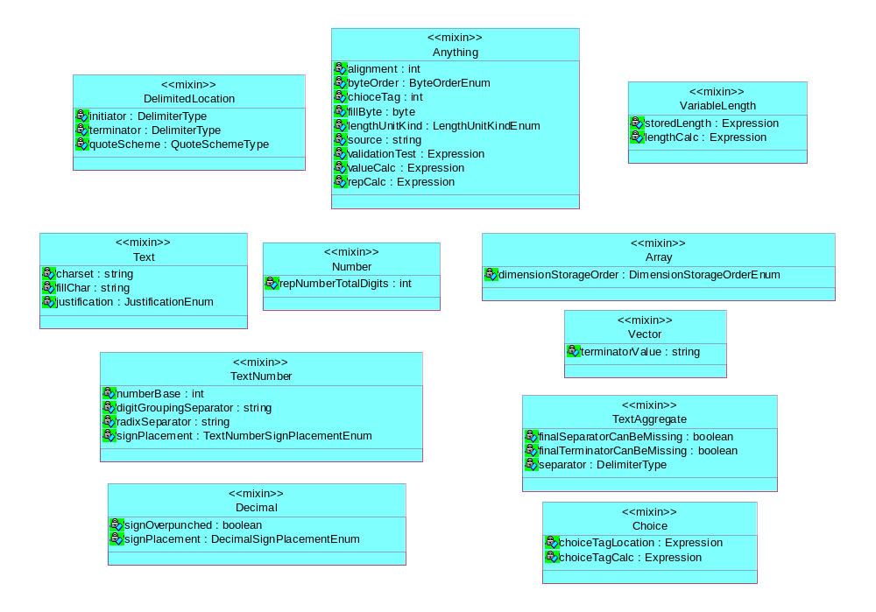
Mixins

Slide 5
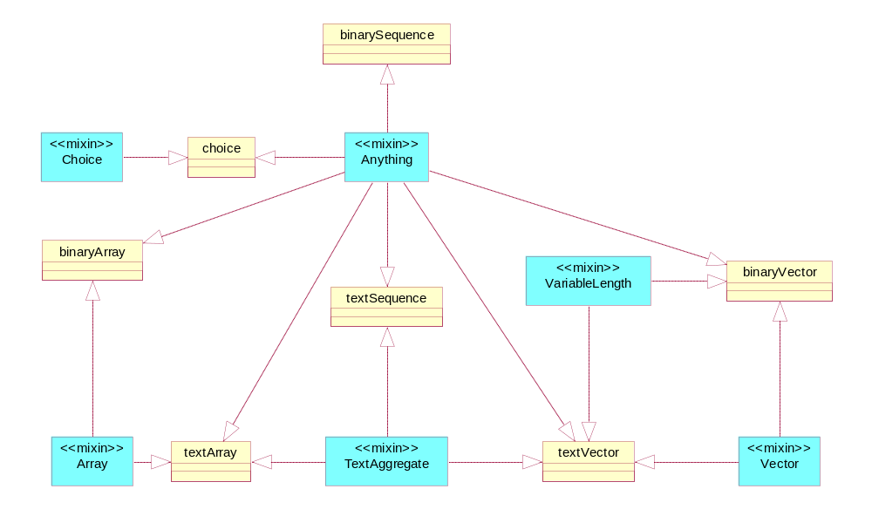
Aggregate Types

Slide 6
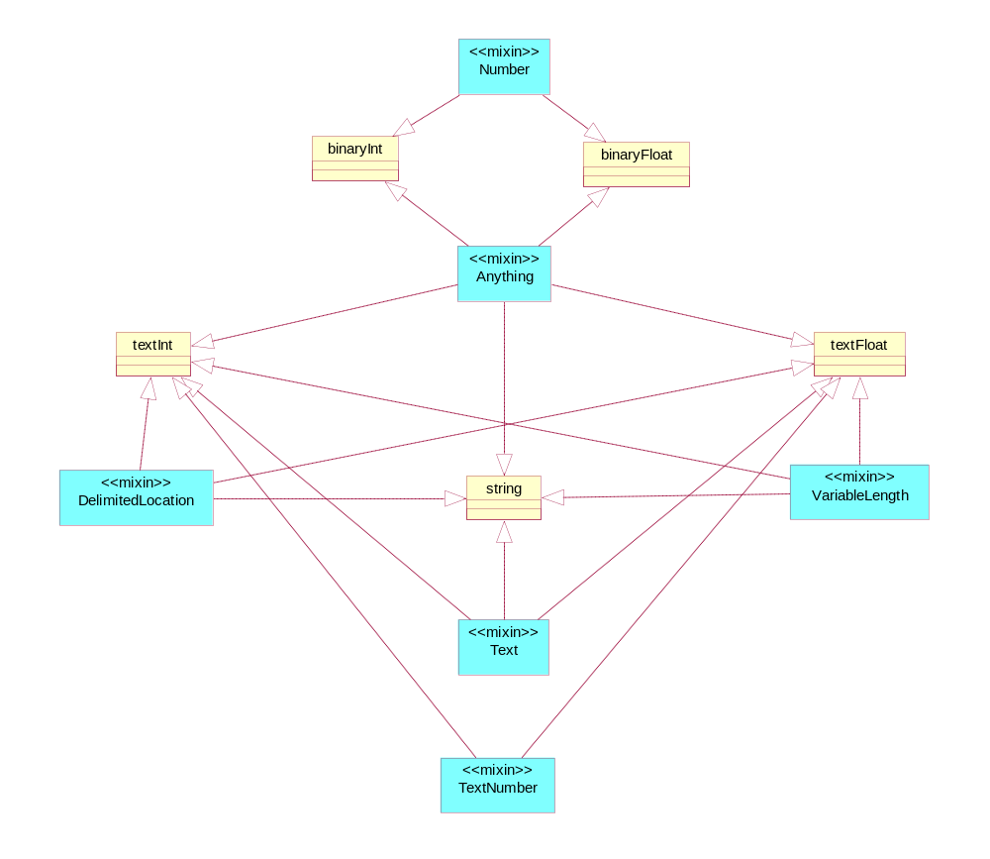
Simple Types

