Slide 1
DFDL
Data Format Description Language
Overview & Summary of Status
WG Co-Chairs:
  Mike Beckerle, IBM
  Martin Westhead, Avaya
Two note takers please
Sign the attendance sheet
Note: GGF Intellectual Property Rules apply

Slide 2
Intellectual Property Policy
I acknowledge that participation in GGF meetings is subject to the GGF Intellectual Property Policy.
Intellectual Property Notices. Note Well: All statements related to the activities of the GGF and addressed to the GGF are subject to all provisions of Section 17 of GFD-C.1 (.pdf), which grants to the GGF and its participants certain licenses and rights in such statements. Such statements include verbal statements in GGF meetings, as well as written and electronic communications made at any time or place, which are addressed to: the GGF plenary session,
any GGF working group or portion thereof,
the GFSG, or any member thereof on behalf of the GFSG,
the GFAC, or any member thereof on behalf of the GFAC,
any GGF mailing list, including any working group or research group list, or any other list functioning under GGF auspices,
the GFD Editor or the GWD process
Statements made outside of a GGF meeting, mailing list or other function, that are clearly not intended to be input to an GGF activity, group or function, are not subject to these provisions.
Excerpt from Section 17 of GFD-C.1 Where the GFSG knows of rights, or claimed rights, the GGF secretariat shall attempt to obtain from the claimant of such rights, a written assurance that upon approval by the GFSG of the relevant GGF document(s), any party will be able to obtain the right to implement, use and distribute the technology or works when implementing, using or distributing technology based upon the specific specification(s) under openly specified, reasonable, non-discriminatory terms. The working group or research group proposing the use of the technology with respect to which the proprietary rights are claimed may assist the GGF secretariat in this effort. The results of this procedure shall not affect advancement of document, except that the GFSG may defer approval where a delay may facilitate the obtaining of such assurances. The results will, however, be recorded by the GGF Secretariat, and made available. The GFSG may also direct that a summary of the results be included in any GFD published containing the specification.
GGF Intellectual Property Policies are adapted from the IETF Intellectual Property Policies that support the Internet Standards Process.

Slide 3
Abstract
Orientation: What is DFDL?
Progress and Status Review
Provide enough context for those interested in getting involved who haven't been following along.
Discuss some of the requirements, solicit comments on some of the trade-offs we've made

Slide 4
Data Interchange Formats
There are two kinds:
Prescriptive: Put your data in this format!
  XML – textual
  Binary – ASN.1, XDR, NetCDF, HDF, EBML,…
Descriptive: What format is your data in?
  Commercial products
  ASN1 Encoding Control Notation
    ITU-T X.692
  DFDL

Slide 5
Why Descriptive?
Allows us to achieve two goals simultaneously:
Interoperability
  Modern and Legacy data formats
Performance!
  Density
    Fewest bytes to represent data without resorting to compression
  Optimized I/O
    Seekable random access
    Memory mapped, aligned
      Without sacrificing general access

Slide 6
Why Grids and DFDL?
Grids are about big-data and big-computation problems
  Simplistic solutions like “use XML” won’t cut it!
  Performance and space usage
Grids are about universal data interchange

Slide 7
General Features
Basic Text/Binary data capabilities
Validated input (from XML Schema)
Defaulted input for missing values
Reference – use of a previously read value in subsequent expressions
Choice – use of a previously read value to select among format variations
Basic Math – in DFDL expressions
Very general parsing/writing capability
Multi-layer – description of an intermediate representation not exposed in the final result
Future:
Extensibility – New type/transform specification

Slide 8
Desires
Leverage XML technology and concepts
Support very efficient parsers/formatters
  Allow extensions for new data formats
Support round-tripping
  i.e., read and write data in described format from same description
Keep simple cases simple
  Simple descriptions should be "human readable"
    to the same degree that XSD is.
Generality
  Can describe any format at all.

Slide 9
Related Standards Efforts
Prescriptive systems:
  W3C binary XML (http://www.w3.org/XML/Binary/)
Descriptive systems:
  ASN1 Encoding Control Notation
    ITU-T X.692

Slide 10
XML Synergy
Use XSD subset to describe logical data
Use annotations within the XSD to describe the representation of it.
This approach already used by commercial systems from
  IBM WebSphere Business Integrator Message Broker
  Microsoft (BizTalk flat file)
  Others

Slide 11
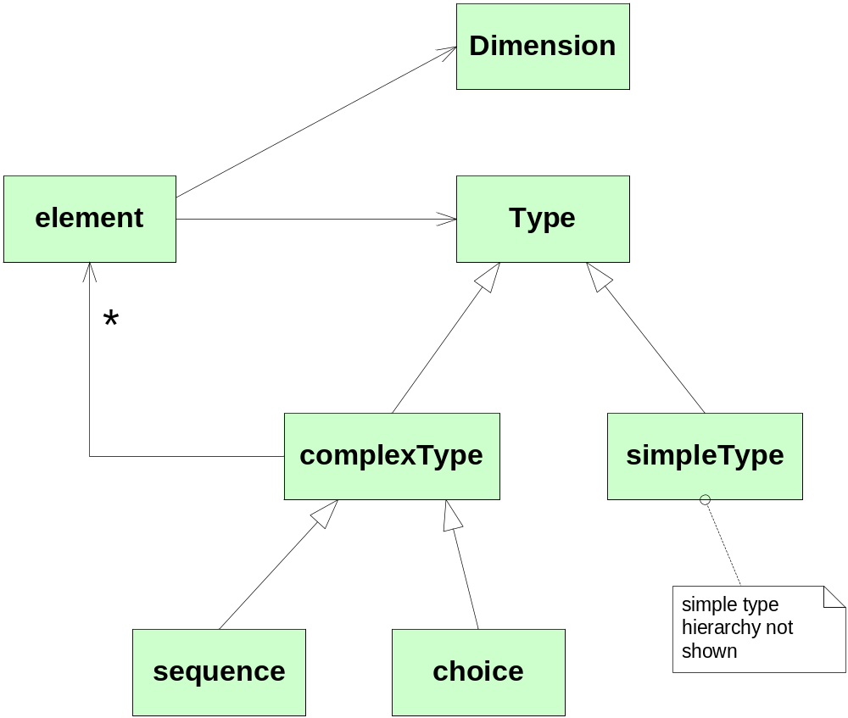
DFDL Information Model

Slide 12
XML Schema Subset
Elements
  A.k.a. fields. These are named.
Sequence groups, All groups
  All = unordered group
Choice
  A.k.a. union, redefine,
Vectors
  Use element with minOccurs, maxOccurs.
Nillability
  A.k.a. Nullable values
Missing – multi-dimensional arrays. We have to add a way to do this.

Slide 13
DFDL Information Model – basic types
anySimpleType
string
QName
NOTATION
float
double
decimal
boolean
base64Binary
hexBinary
anyURI
normalizedString
integer
token
long
nonPositiveInteger
nonNegativeInteger
language
Name
NMTOKEN
int
negativeInteger
positiveInteger
unsignedLong
NCName
NMTOKENS
short
unsignedInt
ID
IDREF
ENTITY
byte
unsignedShort
IDREFS
ENTITIES
unsignedByte
date
time
dateTime
gYear
gYearMonth
gMonth
gMonthDay
gDay
duration

Slide 14
Example 1: XML
<w>5</w>
<x>7839372</x>
<y>8.6E-200</y>
<z>-7.1E8</z>

Slide 15
Example 1: XSD
<xs:sequence>
<xs:element name="w" type=“int"/>
<xs:element name="x" type=“int"/>
<xs:element name="y" type=“double"/>
<xs:element name="z" type=“float"/>
</xs:sequence>

Slide 16
Example 1 DFDL - binary
0000 0005 0077 9e8c
169a 54dd 0a1b 4a3f
ce29 46f6

Slide 17
Example 1 DFDL - binary
<xs:complexType name="example1">
<xs:annotation>
<xs:appinfo source="http://dataformat.org/">
<dfdl:format applies="toScope"
repType="binary"
byteOrder="bigEndian"/>
</xs:appinfo>
</xs:annotation>
<xs:sequence>
<xs:element name="w" type="int"/>
<xs:element name="x" type="int "/>
<xs:element name="y" type="double "/>
<xs:element name="z" type="float "/>
</xs:sequence>
</xs:complexType>

Slide 18
Example 1 DFDL - textual
“5, 7839372, irl1=-7.1E8, baseQ=8.6E-200”

Slide 19
Example 1 DFDL - textual
<xs:complexType name="example1">
<xs:annotation>
<xs:appinfo source="http://dataformat.org/">
<dfdl:format appliesTo="scope"
repType=“text”
encoding=“UTF-8”
decimalSeparator=“.” />
</xs:appinfo>
</xs:annotation>
<xs:sequence dfdl:separator="," >
<xs:element name="w" type="int"/>
<xs:element name="x" type="int"/>
<xs:sequence dfdl:separator="," >
<xs:element name="y" type="double"
dfdl:initiator="baseQ"
dfdl:tagSeparator="=" />
<xs:element name="z" type="float"
dfdl:initiator="irl1"
dfdl:tagSeparator="=" />
</xs:sequence>
</xs:sequence>
</xs:complexType>

Slide 20
Short Form DFDL Annotations
<xs:sequence dfdl:separator=",">
…
<xs:element name="y" type="double"
dfdl:initiator="baseQ"
dfdl:tagSeparator="="/>
…
</xs:sequence>
Non-native attribute syntax
Easy for users to write.

Slide 21
Construct-specific Annotations:
<xs:sequence>
<xs:annotation>
<xs:appinfo source="http://dataformat.org/">
<dfdl:sequence separator=","/>
</xs:appinfo>
</xs:annotation>
…
<xs:element name="y" type="double">
<xs:annotation>
<xs:appinfo source="http://dataformat.org/">
<dfdl:element initiator="baseQ" tagSeparator="="/>
</xs:appinfo>
</xs:annotation>
</xs:element>
…
</xs:sequence>
Annotation on Sequence can be dfdl:sequence.
Restricts properties to those sensible for sequences
Annotation on double can be dfdl:element. Restricts properties to only those sensible for elements.

Slide 22
Status
Recent Activity
Language/Specification
Prototype Implementations
  IBM
  NCSA/PNL - SourceForge 'Defuddle' project

Slide 23
Status of Specification
Aug 2006: Created consolidated "internal WG" spec
Consensus: Still too big, too hard to comprehend because of size and huge number of details
  Decided to split into
    core
    supplements
    parking lot
Currently in process of splitting out "advanced" topics

Slide 24
Resolved issues
Scoping rules
Expression language - will be consistent with XPath 2.0
How much XSD to cover?
  DFDL will use a small subset of XSD

Slide 25
Open Issues
Multi-dimensional arrays
How to describe group handling in a general way that can consistently cover all known cases
  basic delimiters not too hard: separators, terminators
  but what about interactions with:
    initiators, null values, default values, optional values, missing delimiters, regular expressions for termination, etc. etc.
    input parsing, and output writing
Layered Schemas
Extensibility

Slide 26
Summary: Where are we on this spec?
Just starting? Done yet?
Start Over
We're Done
Why?
We've not adequately addressed
  Output direction
  Exposition issues/Extensibility
Complexity still considered too high
  Splitting into core + extensions

Slide 27
Simplifications
We've had to simplify DFDL to make faster progress toward a Version 1.0 specification
E.g.,
  very small subset of XML Schema
  ....?

Slide 28
What DFDL is Not: FAQ
I have a pre-defined XML Schema.
Q: Can I use DFDL to populate it from a non-XML data file?
A: Only Partly
  DFDL is focused on data format
  DFDL does not provide general data transformation
  Populating a pre-defined XML Schema involves two separate problems:
    using DFDL to describe the data file format
    use a transformation system to transform that to conform to the pre-defined schema (not DFDL's job)

Slide 29
DFDL is only about Format
The structure of the DFDL schema is dictated by the logical structure of the data
You must work bottom up.
Start from the data format, not from what you want to turn it into.

Slide 30
DFDL subset of XML Schema
Includes
standard XSD namespace management
standard XSD import/include file mgmt.
local element declarations
  optional dimensionality via maxOccurs and minOccurs.
global element declarations
complexType definitions
maxOccurs, minOccurs attributes
  only on local element declarations and element references
DFDL appinfo annotations describing the data format
These simple types:
  string, float, double, decimal, integer, long, int, short, byte, unsignedLong, unsignedInt, unsignedShort, unsignedByte, boolean, date, time, dateTime, duration
'sequence' groups (no dimensionality)
'choice' groups (no dimensionality)
simple type derivations
Reusable Groups: named model groups
Element references
  optional dimensionality via maxOccurs and minOccurs.
Group references without dimensionality
xs:any element wildcards

Slide 31
DFDL subset of XML Schema
Excludes
Attribute declarations (local or global)
Attribute references
Attribute groups
complexType derivations
Union and list simple types
These atomic simple types: normalizedString, token, Name, NCName, QName, language, positiveInteger, nonPositiveInteger, negativeInteger, nonNegativeInteger, gYear, gYearMonth, gMonth, gMonthDay, gDay, ID, IDREF, IDREFS, ENTITIES, NMTOKEN, NMTOKENS, NOTATION, anyURI
maxOccurs and minOccurs on non-elements (that is, model groups)
Identity Constraints
Substitution Groups
'all' groups
Redefine

Slide 32
TBD: Requirements Discussion
Start with controvercial assertions/questions
Hierarchical data
Q: How many people were planning to use DFDL to convert data into XML?
  get out of legacy formats into standard XML?
Q: How many people were not?

Slide 33
TBD: Other requirements
Layering related
  (e.g., data source indirection)
Extensibility?

Slide 34
END

Slide 35
Old/Extra slides follow this slide

Slide 36
Scoping
<xs:simpleType name="xType">
<xs:restriction base="xs:int">
…
</xs:simpleType>
<xs:sequence dfdl:separator=","
dfdl:charset="ebcdic-cp-us">
<xs:element name="w" type="int"/>
<xs:element name="x" type="xType"/>
</xs:sequence>
Are the elements of the sequence in EBCDIC, or just the separators? (lexical scoping?)
Are the contents of type 'xType' affected by the rep-properties or not? (dynamic inclusion?)

Slide 37
Scoping
Issues: a use case:
Definition says "comma separated", but is silent about what charset
Goal is to reuse in contexts with different character sets
<xs:complexType name="xyType">
<xs:sequence dfdl:separator=",">
<xs:element name="x" type="xs:int"/>
<xs:element name="y" type="xs:int"/>
</xs:sequence>
</xs:complexType>
E.g., I want to re-use the above type definition
  In a charset EBCDIC context
  In a charset ASCII context
One possibility:
<xs:sequence dfdl:separator=",">
<xs:element name="a" type="xyType" dfdl:charset="US-ASCII"/>
<xs:element name="b" type="xs:int" dfdl:charset="ebcdic-cp-us"/>
</xs:sequence>
Complexity of this kind of contextual parameterization is of concern to some

Slide 38
Scoping
Issues:
Simple proposals don't cover needed use cases
General desire for a simple approach
Status: design team will put forward a new proposal to replace the one in the latest draft.

Slide 39
Expression Language
DFDL contains expressions
  Some are simple: '../rephdr/count'
  Some are more complex
Idea: adhere to an XML-standard
  XPath ?
  XQuery ?
Difficulties:
  Need 'let' variables for more complex expressions
  So, we need more than just XPath
  but don't really need all of XQuery
  Define subset?
Draft doc defines "DPath", variant of XPath
  Needs change. Neither functional enough, nor standard enough

Slide 40
Extensibility
Too many rep-properties
  Meanings and interactions are subtle
  Need formal definition to be precise
Never enough rep-properties
  There will always be need for new rep-properties to handle unanticipated formats
    …cust:16John L. Customerid:09123456789 ….
    <cust>John L. Customer</cust><id>123456789</id>
Extensibility is key
Idea:
  Define "Core" DFDL with very few rep properties (bootstrap set)
  Define the libraries of properties as extensions from the core
    This is really a reference implementation for the extensions
    Acceptable as it is self-defined in terms of the standard
  Same extension mechanisms can be used to add new properties by end users
Status
  Idea only. No proposal yet.
Concern
  How does this interact with the carefully set up hierarchy of annotation classes?

Slide 41
Multi-Layer Descriptions
Issue: language complexity
Layering features include
  Hidden elements
  repDef
    use of a complex type to represent a simple type
  Data source indirection
Need layers to handle some representations

Slide 42
Multi-Layer Descriptions
String vector with all lengths first
How many strings
L0
L1
Ln
n-1
L0
L1
…
Ln
S0
S1
…
Sn
Lengths of the strings
Contents of the strings

Slide 43
Multi-Layer Descriptions
String vector with all lengths first
<xs:element name="data"
type="xs:string"
maxOccurs="unbounded">

Slide 44
Multi-Layer Descriptions
String vector with all lengths first
<xs:complexType name="SVArrayHeader">
<xs:sequence>
<xs:element name="count" type="xs:int"/>
<xs:element name="stringLengths" type="xs:int"
maxOccurs="unbounded">
<xs:annotation>
<xs:appinfo source="http://dataformat.org/">
<dfdl:occurs
repLengthUnitKind="elements"
storedLength="../count"/>
</xs:appinfo>
</xs:annotation>
</xs:element>
</xs:sequence>
</xs:complexType>

Slide 45
Multi-Layer Descriptions
String vector with all lengths first
<xs:complexType name=“stringWithHeaderType”>
<xs:sequence>
<!-- Will create a hidden Instance named "rephdr". Hidden Instances-->
<!-- are called "layers" and are defined by nesting a <dfdl:layer> -->
<!-- tag in an empty sequence. -->
<xs:sequence>
<xs:annotation>
<xs:appinfo source="http://dataformat.org/">
<dfdl:layer name="rephdr"
type="SVArrayHeader"/>
</xs:appinfo>
</xs:annotation>
</xs:sequence>

Slide 46
Multi-Layer Descriptions
String vector with all lengths first
<xs:element name="data" type="xs:string" maxOccurs="unbounded">
<xs:annotation><xs:appinfo source="http://dataformat.org/">
<dfdl:occurs
repLengthUnitKind="elements“
storedLength=“../rephdr/count”/>
<dfdl:string repType="text" charset="US-ASCII"
repLengthUnitKind="characters"
storedLength=
“../../rephdr/stringLengths[@dfdl:index]”/>
</xs:appinfo></xs:annotation>
</xs:element>
</xs:sequence>
</xs:complexType>

Slide 47
Multi-Layer Descriptions
Issue: slippery slope to general transformation
  Once you have field[@dfdl:index], you can do very extensive transformations right in DFDL
  Logical model vs. representational model can be quite different and this is beyond the scope we intended
  On the other hand. Examples like this would be good to handle
Status
  We have general agreement in the WG about
    Hidden elements
    repDef – for simple types - related to hidden elements
  We are actively formulating a proposal for
    Data source indirection
    (No status change since GGF14 - though work has been done)

Slide 48
Implementations
IBM
PNL and NCSA Open-Source

Slide 49
IBM Status
DFDL is part of Virtual XML overarching project
Developed at IBM Research
Alphaworks release

Slide 50
PNL and NCSA Prototype
SourceForge 'Defuddle' Project
Open source w/Apache 2 license

Slide 51
PNNL-initiated
DFDL Implementation
Extension of JaxMe XML- Java Binding compiler
Layered approach to optimize conversions of the data within a translation and provide additional capabilities

Slide 52
Basic Mechanism: JaxMe
Vanilla
  Parses schema,
  creates Java classes to represent instances
  Unmarshal data from sax events
DFDL
  Alter class generator so that classes retrieve values from data stream rather than merely storing them.
  Unmarshal from ByteBuffer data stream
  Make annotations accessible for controlling parsing
  Add readers to control parsing of incoming data

Slide 53
Current capabilities
Simple binary and text translations into XML.
Translate text based numbers to various numeric types.
Input from multiple data sources.
Determine length of sequence based on value obtained from data.
Use of regular expressions for separators and terminators.
‘Zipper’ transform
Format resulting data using XSLT translations.

Slide 54
Performance Thoughts
DFDL
  Designed to support skipping through data
JaxMe
  Compiled code
Java NIO Features
  Slice() – buffers from other buffers
  View Buffers as different types:
    FloatBuffer fb = bb.asFloatBuffer();
  Memory mapping
  Bulk transfers

Slide 55
Status Summary
We have:
  Some major challenges still
  Lots of finer details
  Good progress on prototypes to help drive the standard
  A set of “unit-test” examples to help in finalizing the syntax and semantics
    Common framework for unit tests usable across groups

Slide 56
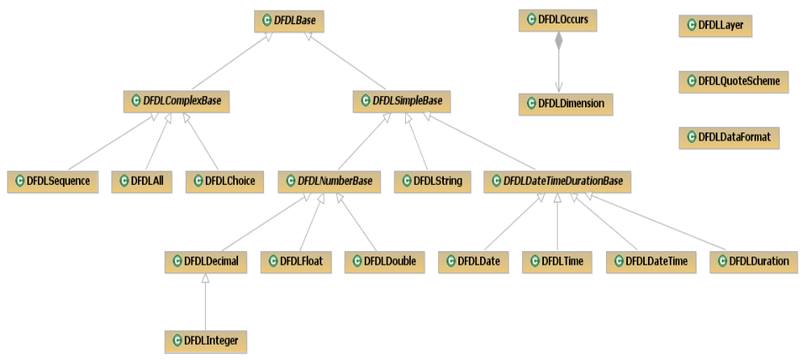
DFDL Format Properties Conceptual Model

Slide 57
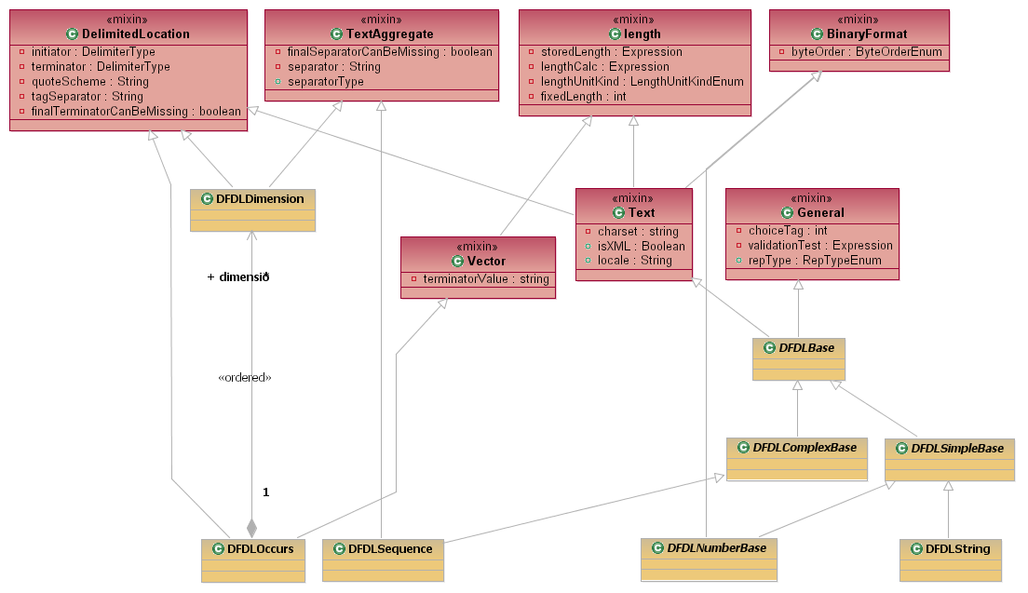
DFDL Properties Conceptual Model
Fragment with Attribute Detail Shown

