Slide 1

Grid Schedulers’ Interaction
Washington, 13 September 2006

Slide 2

Outline
GRMS interface & interoperability
Grid schedulers job submission interface
Grid schedulers interaction issues

Slide 3
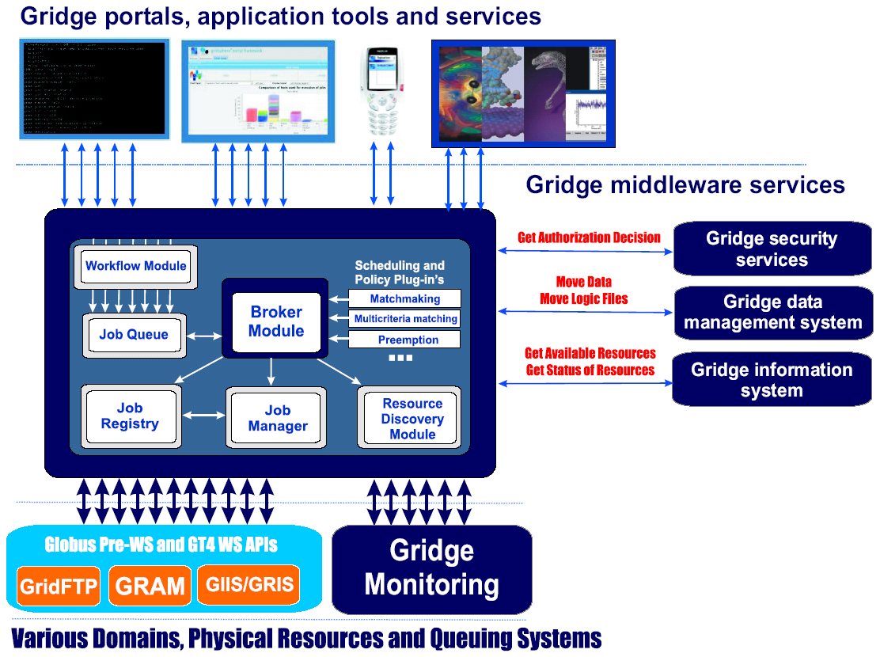
GRMS
Open source meta-scheduling system
Implemented as GSI-enabled Web Service
Notes:
- initially developed within the GridLab EU project
- developed by several subsequent projects
- part of the Gridge toolkit developed by PSNC
- intended for different underlying Grid middleware but using currently Globus Toolkit (anyway it may use also other middleware e.g. DSP)
- integrated with various useful grid tools & services
- metascheduler with modular architecture
- it consists of several modules…
- submitted jobs decomposed by workflow module and put the queue…

Slide 4
GRMS - Features
Job submission
Job control (suspending, resuming, canceling)
Ability to chose “the best” resource for the job execution using multicriteria matching algorithm
Support for the job checkpointing and migration
Dynamic resource discovery
Support for file staging
Storing all information about the job execution
User notifications support
Workflow jobs support

Slide 5
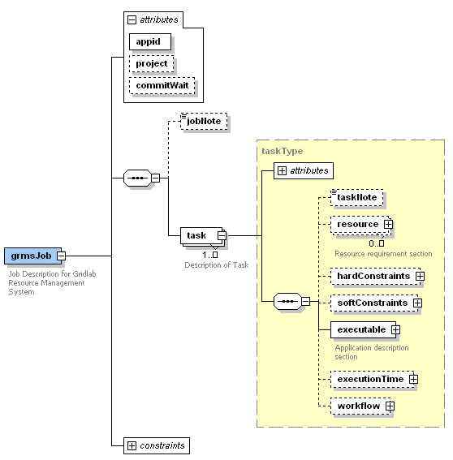
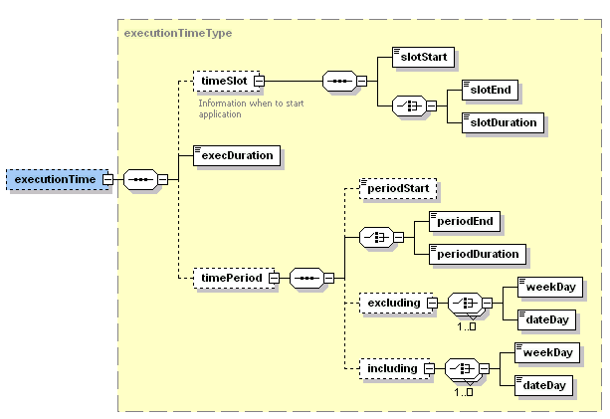
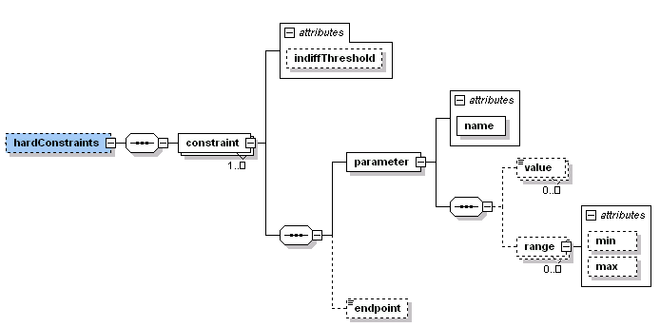
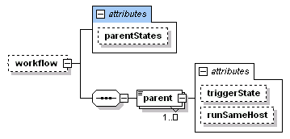
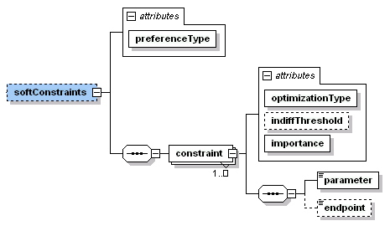
GRMS Interface
Functionality
  Job submission and control
  Providing information about jobs
  Providing a list of resources that meet user’s requirements
Job Description
  Executables
  Resource requirements
  Workflow
  Constraints & preferences
  Scheduling requirements

Slide 6
GRMS Interface Interoperability
Ongoing work on hierarchical structure of GRMS schedulers
JSDL support
  Developed within the HPC-Europa project
  Translation of JSDL into GRMS Job Description (using XSLT sheet)
  Support for JSDL1.0 + minor extensions (parallel jobs, software requirements, objectives)
SLA support
  Plans towards it within 1-2 EU projects
Currently GRMS used in several projects
  Clusterix, inteliGrid, HPC-Europa, ACGT, QoSCos

Slide 7
Grid schedulers job submission interface
Functionality Group | Function | Middleware
 |  | GRMS | JOSH | UNICORE | GRIA
Job Submission | Submit job | submitJob | submit_ge | SubmitJob | SubmitJob
 | Submit job to the best resource | submitJob | findsite_ge + submit_ge | - | SetJob
Finding Resources | Find all sites meeting resource requirements | findResources | - | ResourceCheck | Tender
 | Find the best site for a job | ⁻ | findsite_ge | - | Compare

Slide 8
Grid schedulers job submission interface – States
Job State | GRMS | JOSH | UNICORE | GRIA
Job finished successfully | FINISHED | FINISHED | SUCCESSFUL | FINISHED
Job failed | FAILED | ERROR | FAILED | DATA_STAGER_CHECK_FAILURE INPUT_RETRIEVAL_FAILURE OUTPUT _STAGING_FAILURE EXITING
Job is pending in the system | QUEUED | WAITING_IN_PENDING_LIST HELD_IN PENDING_LIST | PENDING | QUEUED
Job is pending in the local queue | PENDING | WAITING_IN_PENDING_LIST HELD_IN PENDING_LIST | QUEUED | SUBMITTED
Job is running | RUNNING | RUNNING | EXECUTING | RUNNING
Job is cancelled | CANCELLED | DELETING? | ? | KILLED
Job is suspended | SUSPENDED | SUSPENDED_BY_USER, SUSPENDED_BECAUSE _QUEUE_SUSPENDED, THRESHOLD_CAUSED _SUSPENSION | ? | PAUSE
Job preprocessing | PREPROCESSING | TRANSFERRING? | PENDING? | INPUT RETRIEVAL IN PROGRESS
Job postprocessing | POSTPROCESSING | TRANSFERRING? | EXECUTING? | OUTPUT STAGING IN PROGRESS
Job is stopped | STOPPED | ? | EXECUTING? | TERMINATED

Slide 9
Grid schedulers job submission interface – Job Description
Groups | Element | Middleware
 |  | GRMS | JOSH | UNICORE | GRIA
Job Description | Executable | + file:// gsiftp:// | + file:// http:// ftp:// gsiftp:// | + local and remote | + SOAP with attachments over https://
 | Arguments | + | + | + | +
 | Stdin | + | - | + | -
 | Stdout | + | + | + | -
 | Stderr | + | + | + | -
 | Environmental variables | + | + | + | +
 | Local system options | - | + | - | +
Data specification | Input files | + file:// gsiftp:// or using Data Mngmt System | + file:// http:// ftp:// gsiftp:// | + From USite to USite using logical names | +
 | Output files | + file:// gsiftp:// or using Data Mngmt System | + file:// http:// ftp:// gsiftp:// | + From USite to USite using logical names | SOAP with attachments over https://

Slide 10
Grid schedulers job submission interface
– Resource Requirements
Groups | Element | Middleware
 |  | GRMS | JOSH | UNICORE | GRIA
Resource Requirements | Memory | + | - | + | +
 | Nodes | - | - | + | SOAP with attachments over https://
 | processors | + | - | + | +
 | CPU speed | + | - | - | +
 | Storage | - | - | + | +
 | Performance | - | - | + in megaflops | +
 | CPU type | + | - | - | +
 | OS name & version | + | - | + | +
 | Software | + | - | + | +
 | Destination resource |  |  |  | +

Slide 11


Interaction between Scheduling Instances
VO_{A}
VO_{B}
Data Management System
Data Management System
Grid Scheduler A
Protocol + Interface
Grid Scheduler B
Information System
Information System
Local Resource Manager
Local Resource Manager
Local Resource Manager
Local Resource Manager
Local Resource Manager
Local Resource Manager
Notes:
Another goal of the GSA-RG is to propose the way how Grid schedulers can interact with each other.
To this end a protocol and interface will be proposed. Of course, existing GGF recommendations and specifications will be taken into consideration where possible.
Other components of the architecture are not the comprehensive set and of course the remaining elements can be included to a VO.

Slide 12
Necessary Communication Stages
Information gathering
about available remote Grid Scheduler. This may optionally already include information about available resources at the remote sites. This information may be dynamic from an information service or static by scheduler configuration.
Non-binding Negotiation may end up with several possible agreement alternatives. The initiating Grid scheduler may start parallel negotiation with several remote grid Schedulers. Economic schedulers may apply auctioning strategies in this step.
The foreseen WS-Negotiation in GRAAP-WG might be suitable for this step.
Agreement Creation and Commitment; may fail an require return to previous stages.
WS-Agreement may be a suitable protocol for this step.
Handing over job control to remote Grid scheduler; however, responsibility remains at initiator as the remote site may fail and re-scheduling is required.
1. Information
Gathering
2. Non-binding Negotiation/
Requesting for Offers
3. Reservation/Commitment
4. Job Control/Job Monitoring

Slide 13
Grid Schedulers’ Interoperability Issues
Between which entities should agreements be established:
  between consumer and provider (scheduler only finds a provider)
  between consumer and a Grid scheduler (scheduler takes responsibility for the whole communication between consumer and provider)
How to handle different syntax and semantics of parameters?
How to handle different models of constraints and preferences?
How to handle different scheduling procedures, e.g. scheduler provides a list of offers or the best one (from its point of view)?
Which subset of resource and scheduling parameters shall we use? What evaluation criteria (service level objectives) should be used?

Slide 14
Interaction between Scheduling Instances
VO_{A}
VO_{B}
SLA
Data Management System
SLA
Data Management System
Grid Scheduler A
Grid Scheduler B
Information System
SLA
Information System
SLA
SLA
Local Resource Manager
Local Resource Manager
Local Resource Manager
Local Resource Manager
Local Resource Manager
Local Resource Manager
SLA request
SLA offer
SLA commitment

Slide 15
Grid Schedulers’ Interoperability Issues
Between which entities should agreements be established:
  between consumer and provider (scheduler only finds a provider)
  between consumer and a Grid scheduler (scheduler takes responsibility for the whole communication between consumer and provider)
How to handle different syntax and semantics of parameters?
How to handle different models of constraints and preferences?
How to handle different scheduling procedures, e.g. scheduler provides a list of offers or the best one (from its point of view)?
Which subset of resource and scheduling parameters shall we use? What evaluation criteria (service level objectives) should be used?

