Slide 1

Grid Scheduling Architecture RG
Ramin Yahyapour, Oliver Wäldrich, Philipp Wieder
OGF 19, January 29, 2007

Slide 2

OGF IPR Policies Apply
“I acknowledge that participation in this meeting is subject to the OGF Intellectual Property Policy.”
Intellectual Property Notices Note Well: All statements related to the activities of the OGF and addressed to the OGF are subject to all provisions of Appendix B of GFD-C.1, which grants to the OGF and its participants certain licenses and rights in such statements. Such statements include verbal statements in OGF meetings, as well as written and electronic communications made at any time or place, which are addressed to:
    the OGF plenary session,
    any OGF working group or portion thereof,
    the OGF Board of Directors, the GFSG, or any member thereof on behalf of the OGF,
    the ADCOM, or any member thereof on behalf of the ADCOM,
    any OGF mailing list, including any group list, or any other list functioning under OGF auspices,
    the OGF Editor or the document authoring and review process
Statements made outside of a OGF meeting, mailing list or other function, that are clearly not intended to be input to an OGF activity, group or function, are not subject to these provisions.
Excerpt from Appendix B of GFD-C.1: ”Where the OGF knows of rights, or claimed rights, the OGF secretariat shall attempt to obtain from the claimant of such rights, a written assurance that upon approval by the GFSG of the relevant OGF document(s), any party will be able to obtain the right to implement, use and distribute the technology or works when implementing, using or distributing technology based upon the specific specification(s) under openly specified, reasonable, non-discriminatory terms. The working group or research group proposing the use of the technology with respect to which the proprietary rights are claimed may assist the OGF secretariat in this effort. The results of this procedure shall not affect advancement of document, except that the GFSG may defer approval where a delay may facilitate the obtaining of such assurances. The results will, however, be recorded by the OGF Secretariat, and made available. The GFSG may also direct that a summary of the results be included in any GFD published containing the specification.”
OGF Intellectual Property Policies are adapted from the IETF Intellectual Property Policies that support the Internet Standards Process.
Notes:
IPR Notices Note Well for OGF meetings

Slide 3
Agenda
Session #1 and #2
  Progress of the research group
  Scheduler interoperation
    Scenario
    Required services & protocols
    Basic set of JSDL parameters
    Negotiation & agreement management
    Execution management
  Scheduling description language
  Open issues & discussion

Slide 4
Milestones
Short term
  Scheduler interoperation feasibility study
  Practical show-case
  Within 12 months from now
Long term
  Definition of a generic Grid scheduling architecture

Slide 5
Progress of the Research Group
Between OGF 18 and OGF 19
  F2F discussion about scheduling interop in October
  First outline of process at GSA-RG Wiki
  First version of JSDL parameter document
  First version of scheduler attributes document
Grid Scheduling Architecture – Requirements document
  Ongoing discussions about function and form
  Status: still immature

Slide 6
Scheduler interoperation

Slide 7
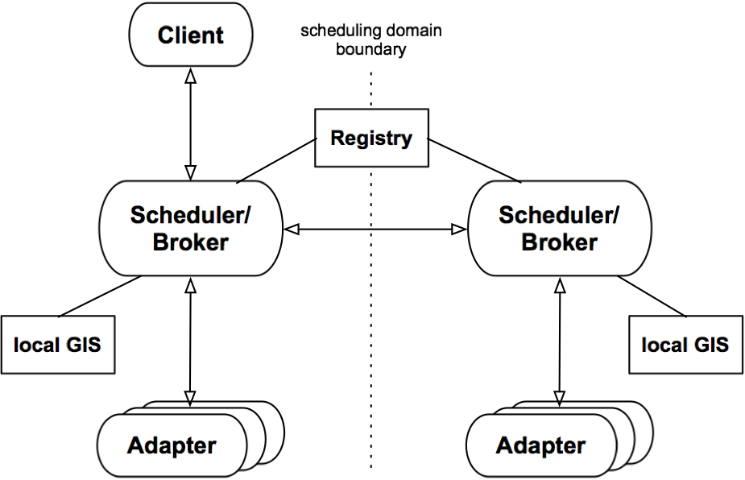
Scenario – picture it!

Slide 8
Scenario – picture it!
Resource
Discovery
EPS
(OGSA-RSS)
CSG
(OGSA-RSS)
WS-Agreement
Negotiation
OGSA
Info-DG
OGSA-BES
proprietrary
WS-Agreement
Negotiation
Sub-
Scheduler
Adapter
Adapter

Slide 9
Entities involved
Main entities
  Client
  Scheduler
  Adapter
Utility entities
  Registry
  Local GIS (Grid Information Service)

Slide 10
Communication Stages
1. Information
gathering
Information gathering about available remote Grid schedulers
Non-binding negotiation may end up with several possible agreement alternatives (possibly in parallel)
Agreement creation and commitment; may fail and require return to previous stages
Handing over job control to remote Grid scheduler (responsibility remains at initiator)
2. Non-binding negotiation/
request for offers
3. Reservation/commitment
4. Job control/job monitoring

Slide 11
Feasibility study

Slide 12
Goal & Interactions
Simple use case: Two schedulers interoperate with each other
Goal: Show feasibility through implementation
Concrete interactions to reach agreement on delegation of scheduling decision:
  Scheduler A cannot fulfil a scheduling request
  Request is passed to Scheduler B
  Scheduler B checks its capabilities
  Scheduler A & B agree/disagree on conditions to fulfil the request
  [Potentially it is possible to re-negotiate the conditions]
  Scheduler B fulfils the scheduling request

Slide 13
Candidate “standards”
“Standard” descriptions:
Common job description: JSDL
Common resource model: OGSA Info model?
  OR semantic translation services between different models
Add. scheduling parameters: JSDL extensions?
“Standard” protocols
Agreement creation: WS-Agreement
Negotiation: WS-Negotiation?

Slide 14
Participating projects
Confirmed
Grid Resource Management System (GRMS)
MetaScheduling Service (MSS)
D-Grid
Interested
GridWay
… your project?

Slide 15
JSDL Profile

Slide 16
Goal
Agree on a basic set of attributes to be referenced in an SLAs during negotiation between Grid schedulers
JSDL profile attributes …
  … needed for scheduling (e.g. info about data, required number of CPUs, bandwidth etc.),
  … referenced in service description terms in SLA negotiations (e.g. amount of memory etc.),
  … essential for proper job execution by LRMS (e.g. job arguments, environmental variables etc.)
  … are defined in GFD.56
Question: What is the minimal set of attributes a scheduler MUST support?

Slide 17
Minimal attribute set
Intersection of attributes supported by different systems is small
  Comparison of GRMS and MSS resulted in only a hand of common attributes
Full JSDL support not in focus
Start with traditional resources: compute & files
… Discussion needed

Slide 18
JSDL Profile Candidate Attributes
JobIdentification
  JobName
  JobProject
Resources
  CandidateHosts (HostName)
  FileSystem (name)
  OperatingSystem
  CPUArchitecture
  IndividualCPUSpeed
  IndividualCPUTime
  IndividualCPUCount
  IndividualNetworkBandwidth
  IndividualPhysicalMemory
  IndividualVirtualMemory
  IndividualDiskSpace
DataStaging
  FileName
  Source (URI)
  Target (URI)
  Executable
Application
  ApplicationName
  ApplicationVersion
POSIX Application
  Executable
  Argument
  Input
  Output
  Error
  Environment

Slide 19
Attributes Supported
JobIdentification
  JobName
  JobProject
Resources
  CandidateHosts (HostName)
  FileSystem (name)
  OperatingSystem
  CPUArchitecture
  IndividualCPUSpeed
  IndividualCPUTime
  IndividualCPUCount
  IndividualNetworkBandwidth
  IndividualPhysicalMemory
  IndividualVirtualMemory
  IndividualDiskSpace
DataStaging
  FileName
  Source (URI)
  Target (URI)
  Executable
Application
  ApplicationName
  ApplicationVersion
POSIX Application
  Executable
  Argument
  Input
  Output
  Error
  Environment

Slide 20
Summary of JSDL Profile
So far only GRMS and VIOLA examined
  Other schedulers should be included to have a broader view
Only 4 attributes common for Grid schedulers!
However some of attributes needed only by LRMS so they can be just passed if LRMS supports JSDL
Some of attributes are essential but not available in VIOLA. Will they be implemented?

Slide 21
Scheduling Description language

Slide 22
Scheduling Attributes
The goal: information needed by Grid schedulers to schedule a job(s) according to user’s requirements and preferences
In general these requirements and preferences may concern time constraints, job dependencies, job priorities, scheduling objectives, data-dependent scheduling information, and other
An initial set of attributes proposed
From this wide set of attributes those supported by available Grid schedulers selected

Slide 23
Argumentation
Attributes exist which are
  … out of scope of JSDL (sic!), but …
  … within the scheduling scope
Approach
  a) Extend JSDL
  b) Create a Grid Scheduling Language
  c) Steel something out there
Note: b) could be a showstopper aiming for fast progress

Slide 24
Attributes Supported
Duration (required)
  Maximal job execution time
EarliestStartTime
  Specifies the earliest start time of a job (e.g. 31st January 2007 10:00AM)
LatestStartTime
  Specifies the latest start time of job (e.g. 12th February 2007 16:00PM)
NoCoallocation
  Defines whether resources required for a given job can be allocated at more that one site

Slide 25
Scheduling Description Language (SDL)
In general, specification of scheduling attributes is missing
Not available even for local resource management systems (e.g. to specify requirements concerning advance reservation)
Categories of scheduling attributes considered
  time constraints,
  job dependencies,
  job priorities,
  scheduling objectives/preferences,
  data-dependent scheduling information,
  queue-based scheduling information,
  miscellaneous.

Slide 26
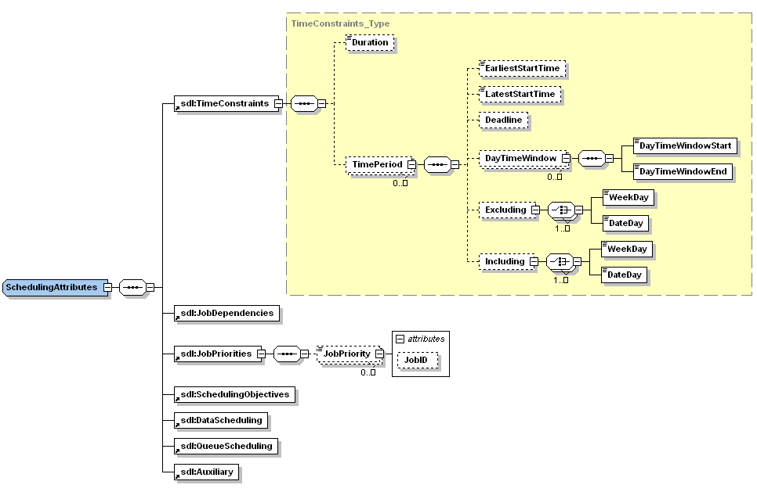
Preliminary Proposal of SDL

Slide 27
SDL Open Issues
How to define SDL?
  JSDL extension ?
    But in the JSDL spec is said that SDL is out of scope
  WS-Agreement ?
    But concrete terms are needed
  Separate specification?
    Design group within GSA?
    Another group ?
Should be the same for LRMS?
Which attributes should be selected?
What else is out there?

Slide 28
Argumentation
Attributes exist which are
  … out of scope of JSDL (sic!), but …
  … within the scheduling scope
Approach
  a) Extend JSDL
  b) Create a Grid Scheduling Language
  c) Steel something out there
Note: b) could be a showstopper aiming for fast progress

Slide 29
More information
JSDL profile draft document
  https://forge.gridforum.org/sf/go/doc14009?nav=1
Scheduling attributes (SDL) draft document
  https://forge.gridforum.org/sf/go/doc14026?nav=1

Slide 30
Negotiation Protocol

Slide 31
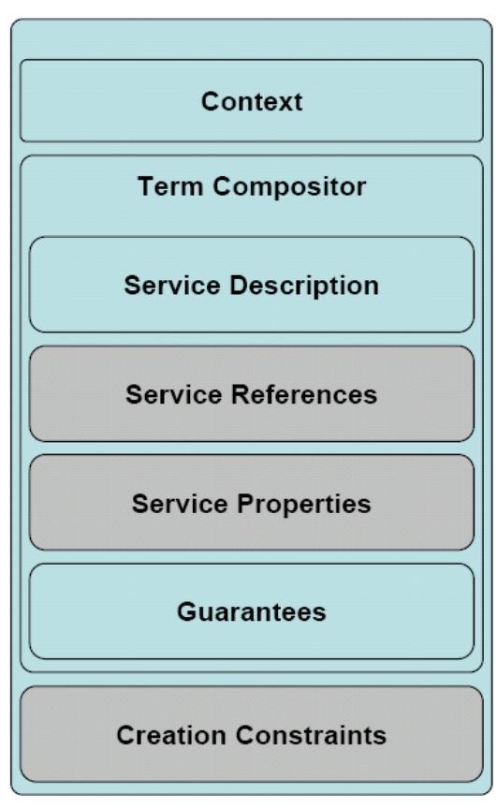
“Extend” WS-Agreement
New method refineAgreement()
Input is a normal agreement offer
No agreement created / no EPR sent back
Response is (possibly refined) counter offer
Content may change
  e.g. ranges (CPU, memory, …) may be refined
refineAgreement() can be called multiple times in the negotiation phase
  Negotiating start times, resources, …
Only valid counter offers are returned
  Counter offer can be created in principle
Counter offer is only a hint (no guarantee)
  No pre-reservation implied here
Grey terms may be skipped in a first step (needed?)

Slide 32
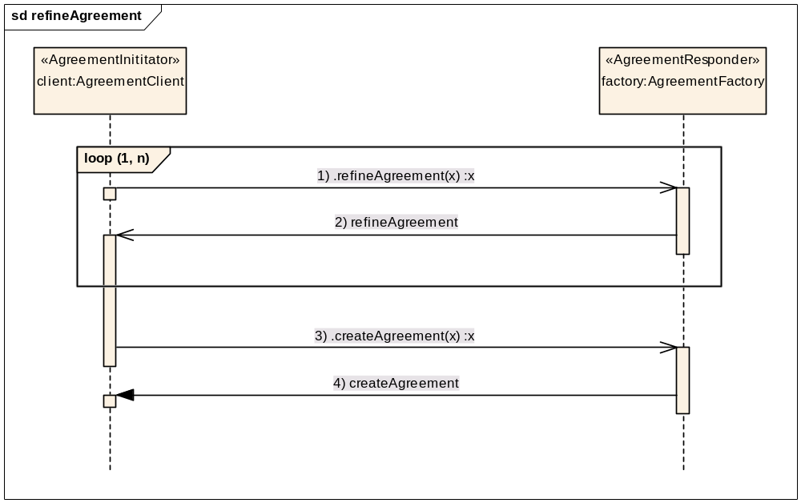
Refine & create agreement

Slide 33
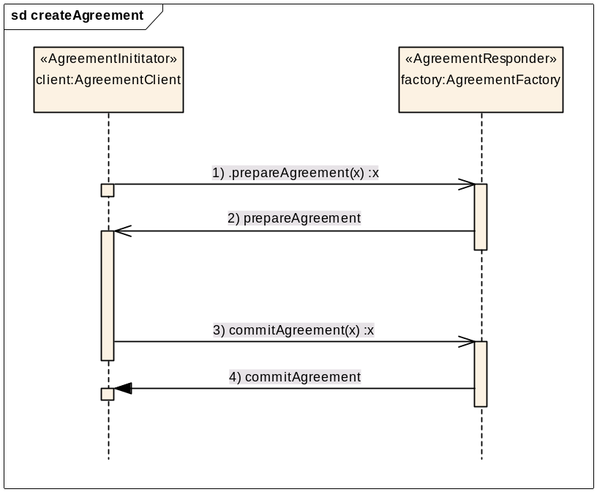
createAgreement (2PCP)
EPR prepareAgreement(offer)
  Same signature as createAgreement()
  Creates a new Agreement with new state prepared
  Short lifetime (e.g. one minute)
  Includes resource pre-reservation
  No or reduced Penalties?
void commitAgreement(EPR)
  Commits the prepared agreement referenced by the EPR
  Changes the state to observed
  Regular lifetime
  Agreement costs/rewards/penalties become active
  No errors are thrown, since resources are pre-reserved

Slide 34
Grid scheduling process
Resource
Requestor
Resource Discovery
  Authorization Filtering
  Minimal requirement filtering
System Selection
  Information gathering (caching)
Reservation
  Advance reservation
  Task Submission
Monitoring
Cleanup
Grid level
Scheduler
Resource
Auth
Filtering
Resource
Req.
Filtering
Resource
Resource

Slide 35
Multi domain negotiation
Resource
Requestor
Grid level
Scheduler
Grid level
Scheduler
Resource
Resource
Auth
Filtering
Auth
Filtering
Resource
Resource
Req.
Filtering
Resource
Req.
Filtering
Resource
Resource
Resource

Slide 36
Execution Management

Slide 37
Execution Management after the
Agreement Commitment
Job-Transfer
Data-Transfer
Provisioning
Prior to job execution
Monitoring/Reporting
Failure-Detection/Management
During execution
Access to results
Clean-Up
After execution

Slide 38
Execution Management –
Prior to Job Execution
How is the job description transferred by whom?
What about additional data?
Long-term:
Data management as separate activity that is scheduled managed by initiating scheduling instance.
Short-term:
JSDL job description is attached to agreement.
Data management is not supported

Slide 39
Execution Management –
Job Control
Who initiates the job execution?
Does it need to be triggered?
  How is the agreement referenced to be considered?
Or is it done automatically based on the agreement?
Long-term:
OGSA-BES?
OGSA-HPC-P?
Short-term:
The job execution is initiated automatically by the agreement provider based on the JSDL description.

Slide 40
Execution Management –
During Job Execution
How is the job monitored?
Who recognizes failures?
Who manages failures?
Long-term:
If possible, failures should be handled at the resource provider;
if not possible to recover locally, it is reported to and handled by the initiator.
Short-term:
Failures are automatically handled.
Monitoring?

Slide 41
Execution Management –
After Job Execution
How are results accessed?
How long are job information available?
Long-term:
Short-term:

Slide 42
Security Context –
Authentication
How do we manage access control and authentication?
Long-term:
VOMS?
Short-term:
?

Slide 43
Issues, questions, …

Slide 44
Issues to discuss
Is the current extension to WS-Agreement feasible?
Schedulers remain automonous. All information needed has to be passed via one scheduler interoperation interface. Do we cover all aspects
There is no common information model shared between the schedulers. Solution?
….

Slide 45
Full Copyright Notice
Copyright (C) Open Grid Forum (2007). All Rights Reserved.
This document and translations of it may be copied and furnished to others, and derivative works that comment on or otherwise explain it or assist in its implementation may be prepared, copied, published and distributed, in whole or in part, without restriction of any kind, provided that the above copyright notice and this paragraph are included on all such copies and derivative works.
The limited permissions granted above are perpetual and will not be revoked by the OGF or its successors or assignees.
Notes:
OGF Full Copyright Notice if necessary

