Slide 1

Grid Scheduling Architecture RG
Ramin Yahyapour, Philipp Wieder
OGF 21, October 16, 2007

Slide 2

OGF IPR Policies Apply
“I acknowledge that participation in this meeting is subject to the OGF Intellectual Property Policy.”
Intellectual Property Notices Note Well: All statements related to the activities of the OGF and addressed to the OGF are subject to all provisions of Appendix B of GFD-C.1, which grants to the OGF and its participants certain licenses and rights in such statements. Such statements include verbal statements in OGF meetings, as well as written and electronic communications made at any time or place, which are addressed to:
    the OGF plenary session,
    any OGF working group or portion thereof,
    the OGF Board of Directors, the GFSG, or any member thereof on behalf of the OGF,
    the ADCOM, or any member thereof on behalf of the ADCOM,
    any OGF mailing list, including any group list, or any other list functioning under OGF auspices,
    the OGF Editor or the document authoring and review process
Statements made outside of a OGF meeting, mailing list or other function, that are clearly not intended to be input to an OGF activity, group or function, are not subject to these provisions.
Excerpt from Appendix B of GFD-C.1: ”Where the OGF knows of rights, or claimed rights, the OGF secretariat shall attempt to obtain from the claimant of such rights, a written assurance that upon approval by the GFSG of the relevant OGF document(s), any party will be able to obtain the right to implement, use and distribute the technology or works when implementing, using or distributing technology based upon the specific specification(s) under openly specified, reasonable, non-discriminatory terms. The working group or research group proposing the use of the technology with respect to which the proprietary rights are claimed may assist the OGF secretariat in this effort. The results of this procedure shall not affect advancement of document, except that the GFSG may defer approval where a delay may facilitate the obtaining of such assurances. The results will, however, be recorded by the OGF Secretariat, and made available. The GFSG may also direct that a summary of the results be included in any GFD published containing the specification.”
OGF Intellectual Property Policies are adapted from the IETF Intellectual Property Policies that support the Internet Standards Process.
Notes:
IPR Notices Note Well for OGF meetings

Slide 3
Agenda
Scope of GSA-RG
Scheduler interoperation
teikoku Grid Scheduling Framework Standards Compliance - Lessons Learned, Alexander Papaspyrou (University Dortmund)
JSDL Profile
Scheduling description language
Progress of the research group Discussion & actions

Slide 4
Scope of the GSA-RG
In general: Grid Scheduling Architecture
Current focus
  Interoperation of Grid Schedulers
    JSDL Profile
    Scheduling Description Language
Documents
  Grid Scheduling Requirements
  Grid Scheduler Interoperation
  Scheduling Description Language
More during the presentation ....

Slide 5
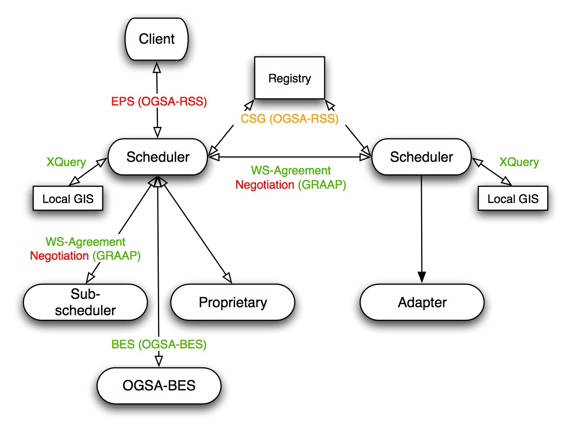
Scheduler interoperation

Slide 6
Questions to be answered
How to specify client requirements?
  Just the job, workflow, activity, ... or ...
  ... specific scheduling parameters?
Communication between schedulers
  Message content
  Agreement/re-negotiation protocol
And: communication with other entities like registry, information service, ...
But let us see one approach ...

Slide 7

Presentation
Alexander, the floor is yours ...

Slide 8
Interop.: Participating projects
Confirmed
  Grid Resource Management System (GRMS)
  MetaScheduling
  Service (MSS)
  D-Grid
Interested
  GridWay
  … your project?

Slide 9
Interop.: Goal & Interactions
Simple use case: Two schedulers interoperate with each other
Goal: Show feasibility through implementation
Concrete interactions to reach agreement on delegation of scheduling decision:
  Scheduler A cannot fulfil a scheduling request
  Request is passed to Scheduler B
  Scheduler B checks its capabilities
  Scheduler A & B agree/disagree on conditions to fulfil the request
  [Potentially it is possible to re-negotiate the conditions]
  Scheduler B fulfils the scheduling request

Slide 10
Candidate “standards”
“Standard” descriptions:
  Common job description: JSDL Profile (√)
  Add. scheduling parameters: SDL (√)
  Common resource model: CIM, ... (?)
“Standard” protocols
  Agreement creation: WS-Agreement (√)
  Negotiation: WS-Negotiation (?)
  Resource selection: CGS (?)

Slide 11
JSDL Profile: Goal
Agree on a basic set of attributes to be referenced in an SLAs during negotiation between Grid schedulers
JSDL profile attributes …
  … needed for scheduling (e.g. info about data, required number of CPUs, bandwidth etc.),
  … referenced in service description terms in SLA negotiations (e.g. amount of memory etc.),
  … essential for proper job execution by LRMS (e.g. job arguments, environmental variables etc.)
  … are defined in GFD.56
Question: What is the minimal set of attributes a scheduler MUST support?

Slide 12
JSDL Profile: Minimal attribute set
Intersection of attributes supported by different systems is small
  Comparison of GRMS and MSS resulted in only a hand of common attributes
Full JSDL support not in focus
However some of attributes needed only by LRMS so they can be just passed Start with traditional resources: compute & files
Proposal: GRMS and MSS people decide on JSDL profile

Slide 13
JSDL Profile: Candidate attributes
JobIdentification
  JobName
  JobProject
Resources
  CandidateHosts (HostName)
  FileSystem (name)
  OperatingSystem
  CPUArchitecture
  IndividualCPUSpeed
  IndividualCPUTime
  IndividualCPUCount
  IndividualNetworkBandwidth
  IndividualPhysicalMemory
  IndividualVirtualMemory
  IndividualDiskSpace
DataStaging
  FileName
  Source (URI)
  Target (URI)
  Executable
Application
  ApplicationName
  ApplicationVersion
POSIX Application
  Executable
  Argument
  Input
  Output
  Error
  Environment

Slide 14
JSDL Profile: Attributes supported
JobIdentification
  JobName
  JobProject
Resources
  CandidateHosts (HostName)
  FileSystem (name)
  OperatingSystem
  CPUArchitecture
  IndividualCPUSpeed
  IndividualCPUTime
  IndividualCPUCount
  IndividualNetworkBandwidth
  IndividualPhysicalMemory
  IndividualVirtualMemory
  IndividualDiskSpace
DataStaging
  FileName
  Source (URI)
  Target (URI)
  Executable
Application
  ApplicationName
  ApplicationVersion
POSIX Application
  Executable
  Argument
  Input
  Output
  Error
  Environment

Slide 15
Scheduling Attributes: Goal
The goal: information needed by Grid schedulers to schedule a job(s) according to user’s requirements and preferences
In general these requirements and preferences may concern time constraints, job dependencies, job priorities, scheduling objectives, data-dependent scheduling information, and other
An initial set of attributes proposed
From this wide set of attributes those supported by available Grid schedulers have to be selected

Slide 16
Scheduling Attributes: Argumentation
Attributes exist which are
  … out of scope of JSDL (sic!), but …
  … within the scheduling scope
Approach
  a) Extend JSDL
  b) Create a Grid Scheduling Language
  c) Steel something out there
Note: b) could be a showstopper aiming for fast progress, but ...
GSA-RG has decided to define a Scheduling Description Language

Slide 17
Scheduling Description Language
Scheduling Description Language (SDL) draft exists
  Attribute list plus description
  Schema is also specified
Broker Property Description Language
  Proposal by Kertész et al.
  Comparison has been done, intersection exists
Proposal
  Agree on common set
  Discuss with community at large

Slide 18
SDL: Attributes supported
Duration (required)
  Maximal job execution time
EarliestStartTime
  Specifies the earliest start time of a job (e.g. 31st January 2007 10:00AM)
LatestStartTime
  Specifies the latest start time of job (e.g. 12th February 2007 16:00PM)
NoCoallocation
  Defines whether resources required for a given job can be allocated at more that one site
...

Slide 19
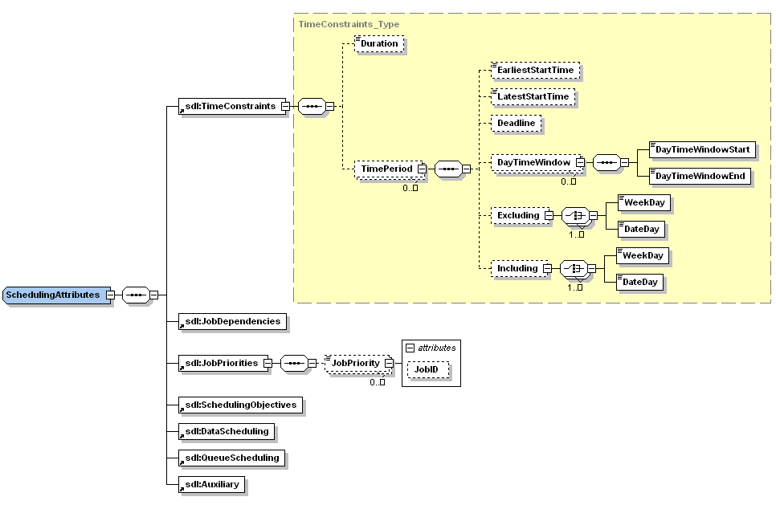
Preliminary Proposal of SDL

Slide 20
Agreement/Negotiation protocol
WS-Agreement is there and can be used at low cost
WS-Agreement Negotiation may take some time
Proposal: Use WS-Agreement as specified in GFD.107
  Simple 2PC protocol, but ...
  ... should be enough for a simple interop. Test
Alternative
  Implement proposal made at OGF 20
  More sophisticated, but more effort and maybe not standard

Slide 21
More information
JSDL profile draft document
  https://forge.gridforum.org/sf/go/doc14009?nav=1
Scheduling attributes (SDL) draft document
  https://forge.gridforum.org/sf/go/doc14026?nav=1

Slide 22
Process I
Grid Scheduling Requirements
  Legacy
  Best Practices document
  No progress, why? (benefit questionable, no time, ...)
  Proposal: either final draft at OGF 22 or closing
  Action: discuss at OGF 21, vote via mailing list on continuation

Slide 23
Process II
Grid Scheduling Interoperation
  Best Practices document
  Contains
    JSDL Profile
    Scheduling Description Language (SDL)
    Negotiation & agreement
  Substantial progress, but
    should SDL become its own spec.? (Yes)
    If so, how to proceed (design team, ...)
    Anyway, take existing SDL document and create GFD
    Co-ordination of SDL with JSDL, EMS, ...
    Co-ordination of neg./agreement with GRAAP

Slide 24
Full Copyright Notice
Copyright (C) Open Grid Forum (2007). All Rights Reserved.
This document and translations of it may be copied and furnished to others, and derivative works that comment on or otherwise explain it or assist in its implementation may be prepared, copied, published and distributed, in whole or in part, without restriction of any kind, provided that the above copyright notice and this paragraph are included on all such copies and derivative works.
The limited permissions granted above are perpetual and will not be revoked by the OGF or its successors or assignees.
Notes:
OGF Full Copyright Notice if necessary

