Slide 1
Heads in the cloud? GSM-WG at OGF31, Taipei
Jens Jensen, RAL

Slide 2
Agenda for Today
Introduction to the Storage Resource Manager
Alan Sill (TTU) Interoperating SRM and S3
WeiLong Ueng (ASGC): iRODS and SRM: ASGC’s interoperation layer
Jens Jensen (RAL): SRM and CDMI: How griddy is CDMI? How cloudy is SRM?
Storage – SRM and EMI roadmap

Slide 3
SRM and CDMI – A Potentially Possibly Practical Perspective
The challenges:
Manage large data sets
Make data available to computing resources
This presentation is about:
Comparing SRM and CDMI functionality
Not about:
Deploying SRM in the Cloud
Deploying the Cloud on the Grid

Slide 4
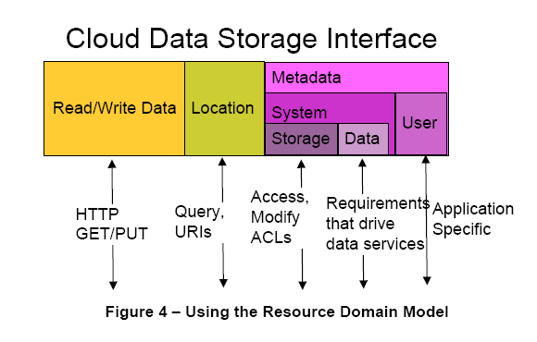
CDMI overview

Slide 5
SRM overview
User metadata is in AMGA, Hydra, etc.
Replica service in LFC (or similar)
Data
Transfer
Information
System
Control
Interface
(SRM)‏
GridFTP
HTTP(S)
LDAP

Slide 6
Comparing
CDMI
ReST + JSON
Pseudodirectory
Containers
Queue objects
Capabilities objects
Accounting objects
SRM
SOAP + SOAP
Full directory support
Space token descrs.
N/A
Capabilities in infosys.
Accounting in infosys.

Slide 7
Common Features
Data integrity: available in both
Data confidentiality:
CDMI supports in-flight and at-rest
SRM is transfer protocol agnostic
But always supports GridFTP
Copy and move files/objects:
SRMCopy()
Supported in CDMI

Slide 8
Front end for big storage
Creating files/objects:
SRM is (potentially) wholly asynchronous
CDMI : delayed object creation
Accessing files/objects:
SRM access usually asynchronous (access nearline data)
CDMI can do this, too.

Slide 9
Mounting
CDMI “legacy clients”
NFS4
WebDAV
CIFS
SRM
NFS4 local protocol support (dCache)

Slide 10
Other Potential Issues
File object addressing
CDMI: all is URI, includes container address
Magic paths for “meta-objects” – capabilities, accounting
SRM: reserve “mount point” (VOInfoPath)
Total capacity
Irrelevant for elastic DaaS?
Previously considered irrelevant for tape (note)
Authentication, Permissions
Unimplemented features in SRM

Slide 11
Bottom Line
Layering CDMI on top of SRM:
Needs additional stuff, like queues
Or could be a partial implementation
Issue: layering synchronous API if impl. async.
Layering SRM on top of CDMI:
Thin-layer SRM (like StoRM), make use of richness of CDMI
Publish information as objects, not LDAP

Slide 12
Conclusion
Superficially, SRM and CDMI are very similar
CDMI more or less superset of SRM
Potential easy wins:
Lightweight SRM in the cloud
Complexity is SEP
Grid moves data between cloud and grid
Make use of OSD and XAM?

