Slide 1
R-GMA Revisited
23/7/2002
Werner Nutt / Heriot-Watt University
<w.nutt@hw.ac.uk>

Slide 2
Contributors
Brian Coghlan TCD
Andy Cooke Heriot-Watt
Ari Datta QMUL
Abdeslem Djaoui RAL
Laurence Field PPARC
Steve Fisher RAL
James Magowan IBM-UK
Werner Nutt Heriot-Watt
Manfred Oevers IBM-UK
John Ryan TCD
Manish Soni PPARC
Norbert Podhorszki SZTAKI
Antony Wilson PPARC
Xiaomei Zhu PPARC

Slide 3
Grid Monitoring
In a Grid we have
  Computers
  Storage elements
  Network nodes and connections
  Application programmes, …
Monitoring:
  What is the current state of the system?
  How did the system behave in the past ?

Slide 4
Monitoring Queries
  “For every node N, how many computers
  connected to N have currently
  a cpu-load of no more than 30%?”
  “Yesterday, between which nodes was
  the average transportation time for 1 MB packets
  higher than than 0.… seconds?”
  “Show me the (average) cpu-load
  of computers at Heriot-Watt!”

Slide 5
Approach 1: The Monitoring
Data Warehouse
Idea:
  store all data about the Grid status into a huge database
  and query it
Not realistic:
  Loading takes time
  Data occupy space
  Connections to the warehouse may fail
  Often monitoring data flow as data streams, and queries ask for data streams as output

Slide 6
Approach 2: Monitoring with a
“Multi-agent System”
The Grid Monitoring Architecture (GMA) of the Global Grid Forum
distinguishes between:
Consumers of information
Producers of information
Directory Service
  Producers register their supply
  Consumers register their demand
Consumer
find/
register
Directory
Service
Producer
Sensor
Data Base
Monitoring-
Application

Slide 7
Questions
Which kinds of producers and consumers are there?
In which language do producers register their supply
and consumers their demand?
What is the meaning of a registration?
How does a consumer find suitable producers?
And how does a producer find suitable consumers?
Producers have different capabilities to answer queries
(e.g. selections, joins, …).
Which of them should they register?

Slide 8
R-GMA: A Virtual Monitoring
Data Warehouse
Language of producers and consumers:
relational queries (SQL)
Vocabulary: Relations in a global schema
Consumer
Query
Consumer: poses queries over
global schema
Producer:
Global Schema S
has a type
(stream p., database p.)
publishes relations
R1, … ,Rk
for every R, registers a simple view V on the global schema
Views
on S
Registry
V1
V2
.
.
.
Vn
V
Stream Producer
DB-Producer
DB
Sensor

Slide 9
Primary Producers
Database producer
supports queries over fixed set of tuples (static queries)
Stream producer
supports queries over changing set of tuples
(continuous queries)
supports “snapshot queries”
  offers up-to-date values for each primary key

Slide 10
Communication Modes
Stream Producers offer two communication modes for continuous queries:
  lossless (… but tuples could become stale) to do!
  lossy (… but tuples are fresh) done!
Producer
Servlet
Consumer
Servlet
Producer
Consumer
IIIIIIII...
IIIIIIII...
Queue
Queue

Slide 11
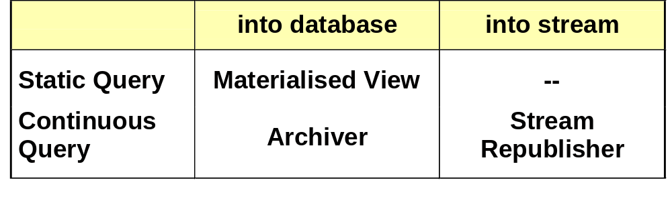
Republishers: Publish Query Answers
Archiver: shows the history of a stream done!
Stream Republisher: enables
  merging,
  thinning,
  summarising of streams … to do!

Slide 12
Temporal Query Types
Query over global relation “Transport Time”:
tt(src, dest, pcktSize, method, timestamp, value)
SELECT * FROM tt
WHERE src = ral AND dest = bologna
What is meant? Measurements
  from now ? (Continuous Query)
  up until now ? (History Query)
  right now ? (Snapshot Query)
How will R-GMA distinguish between these? API? Extension to SQL?

Slide 13
Global and Local Consumers
P1, P2 produce for tt (Transport Time)
P1: … WHERE src = hw
P2: … WHERE src = ral AND pcktSize > 20
Global consumers pose queries over global relations
SELECT * FROM tt WHERE pcktSize > 10 ,
which are translated into queries over local relations
SELECT * FROM P1.tt WHERE pcktSize > 10
UNION
SELECT * FROM P2.tt
Local consumers pose queries over local relations directly

Slide 14
Finding Suitable Producers
P1, P2, P3 produce for tt (Transport Time)
P1: … src = hw
P2: … src = ral AND pcktSize > 20
P3: … src = ral AND method = ping
Q: SELECT * FROM tt WHERE src = ral AND method = ping
We see: P1 is not suitable for Q, but P2 and P3 are. Why?
src = hw AND src = ral AND method = ping is never true
src = ral AND pcktSize > 20 AND … is sometimes true
Satisfiability Test! done!

Slide 15
… so which producers should
R-GMA ask?
P2: … src = ral AND pcktSize > 20
P3: … src = ral AND method = ping
Q: SELECT * FROM tt WHERE
src = ral AND method = ping
All answers to Q returned by P2 are also returned by P3 :
whenever
src = ral AND pcktSize > 20 AND src = ral AND method = ping
is true, then
src = ral AND method = ping AND src = ral AND method = ping
is true.
Hence, R-GMA only needs to ask P3
Entailment Test! to do!

Slide 16
… but what did the producers promise?
P registers view V
Does P promise
  some of V ? (sound description)
  all of V? (sound and complete description)
The Entailment Test only makes sense when the registered views are sound and complete descriptions
Producers should register completeness flags to do!

Slide 17
… why may a producer not be complete?
The language of views is more restricted than the language of queries
Hence: republishers may be unable to say exactly
what they publish
Archivers may archive in lossy mode, or clean-up mode
Producers may lose tuples
A producer may not know everything
about the real world
(Open to debate)

Slide 18
Keys in the Global Schema
tt(src, dest, method, pcktSize, timestamp, value)
Intuitively, tt has the primary key
(src, dest, method, pcktSize, timestamp).
We need to know the primary keys
to understand the global schema
to answer snapshot queries
But can we enforce them?
Sometimes, they hold globally if they hold locally !

Slide 19
Summary (1)
Producers
primary producers vs. republishers
DB producers: support static queries
stream producers: lossless vs.
lossy communication modes
republishers: materialised views vs. archivers
vs. stream republishers
Consumers
global vs. local consumers

Slide 20
Summary (2)
Query Types
continuous vs. history vs. snapshot
Suitable Producers
Satisfiability Test
Query Planning
Entailment Test
sound vs. sound and complete producers
Global Schema
primary keys

