Slide 1


R2AD, LLC
&
Northrop Grumman
P.O. Box 10872
McLean, VA 22012
(703) 714-0442
http://www.r2ad.com
info@r2ad.com
OGSA Interest
Michael Behrens
R2AD, LLC
behrens@r2ad.com
Peter Ziu
Northrop Grumman
peter.ziu@ngc.com

Slide 2
Command and Control System Overview
DoD Command and Control Information Model
  Person, Place, and Thing Tracking system
    near real time
    thousands of entities being tracked (state, location)
    0-100 events per second
  Database for non-realtime data (formatted, images, other)
  Distributed - worldwide
  Multiple organizations, multiple jurisdictions (politics)
Unique Opportunity
  Government has some control over internal organizations
  Motivated to provide open networks data services - transforming
  Moving toward Net-Centric model, away from stovepipes

Slide 3
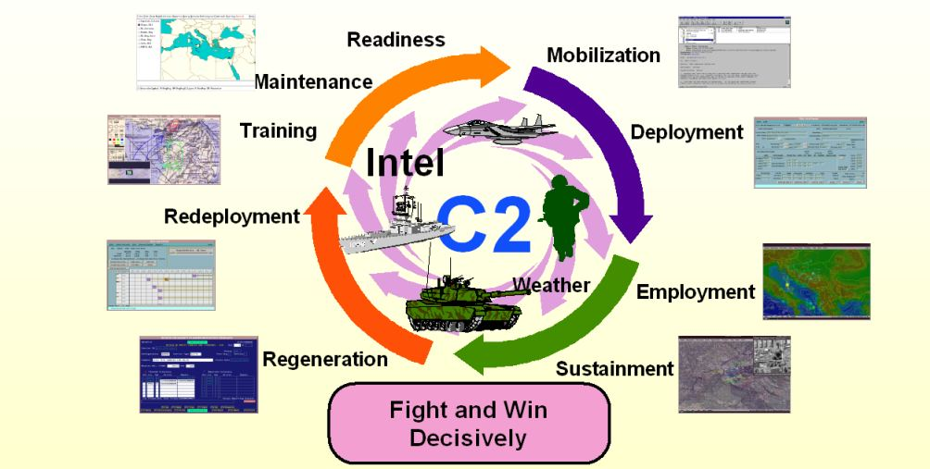
Current Joint C2 Capability is GCCS-J
GCCS-J is DOD’s Joint C2 System that provides interoperable, secure
information to the decision maker at the Unified Commands

Slide 4
Grid Technology - Meets the Need
Unique Opportunity cont.
  Motivated to provide open networks data services - standards based
  Government moving toward SOA - Web Services, etc. (NCES)
R2AD and Northrop Grumman Goals
  Understand OGSA specifications and process
    what are the relationships with GT3, GridPort, Sun, IBM, HP, Oracle, etc.
    Provide feedback on specification and possibly contribute to them
      Documentation
      Coding
      Ideas
  Be a bridge between OGSA and DISA (DoD)
    grid.geden.org
    Be an OGSA advocate to DoD, DARPA, IC world, others

Slide 5
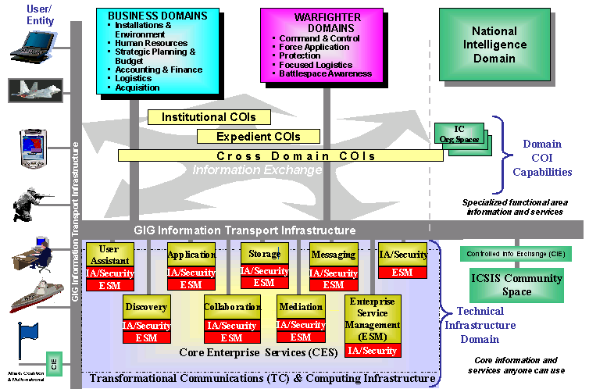
Network Centric Enterprise Services (NCES)

Slide 6
Areas of Interest
Automation (Autonomic Behaviors)
  Portability/Mobility of Grid Services
  Spanning domains (inter-grid communication)
  Sensors
Packaging (Segmentation) and Installation - (ACS)
  Initiated during installation and/or registration
  Availability or readiness of a service
  Development environment from test labs to field
Misc
  Security
  External interfaces & Internal Behavior specification
  Standards Process - time frame
    Mutually beneficial to establish standard

Slide 7
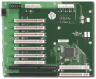
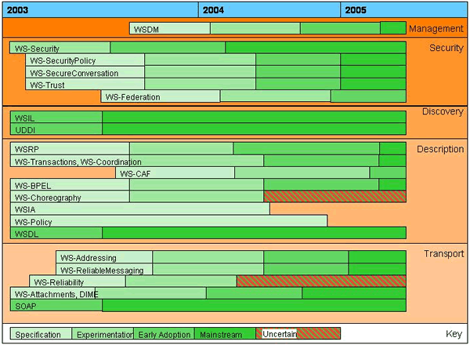
Evolving SOA Backplane Standards
OGSA

Slide 8
NCES Backplane :Recommended Standards
Standard Category
Present/Future NCES Standards
Security
PKI, SSL, SAML, XACML
Discovery
UDDI 2.0+ compliant, UDDI 3.0
Application Server
J2EE-compliant
Description
WSDL (Doc Literal)
Transport
SOAP (Doc Literal), WS-Attachments, DIME, HTTP, FTP
Portlet
JSR-168 Java Specific, WSRP
Data
XML (XML Registry), LDAP, ODBC, JDBC, ANSI-SQL
Management
SNMP, WSDM
Notes:
NCES Backplane Description
This list is the April target
E.g. (Mostly) Web Service Standards Stack – current

Slide 9


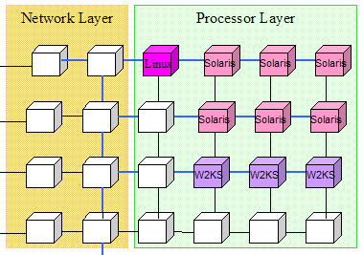
Thank you
R2AD
Defense Information Systems Agency
Sponsor:
Mark Kuzma

