Slide 1
Group Dinner Plan
Hiro Kishimoto
13 August, 2007

Slide 2
Restaurant list
Mexican
  Pedro's Restaurant & Cantina, $$, 4 min, 
Chinese
  Chef Chu, $$, 14 min, 
Brewer
  Faultline, $$, walking distance, 
American
  Hungry Hunter, $$, 16 min, 
Italian
  Piatti - Santa Clara, $$$, 7min, 
Mediterranean
  Zibibbo, $$, 19 min, 
See food
  Fish Market, $$, 5 min, 
Rating by Yahoo Local

Slide 3
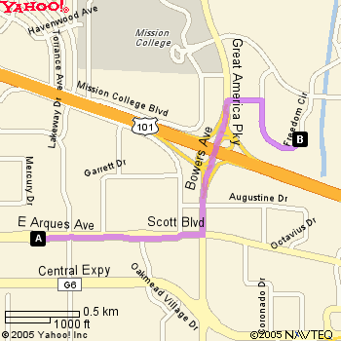
Mexican: Pedro's Restaurant & Cantina
3935 Freedom Cir, Santa Clara
Phone: (408) 496-6777
$$, 4min


Slide 4
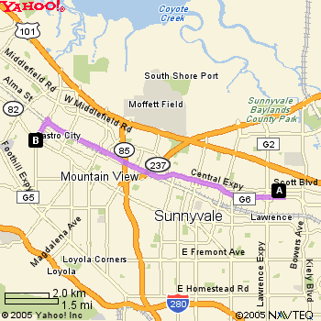
Chinese: Chef Chu
1067 N San Antonio Rd, Los Altos
Ph: 650-948-2696
$$, 14 min


Slide 5
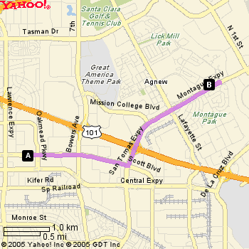
Italian: Piatti
3905 Rivermark Plz, Santa Clara
(408) 330-9212
$$$, 7 min


Slide 6
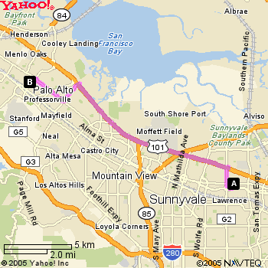
Mediterranean: Zibibbo
430 Kipling St.
Palo Alto, CA 94301
(650) 328-6722
$$, 19 min


Slide 7
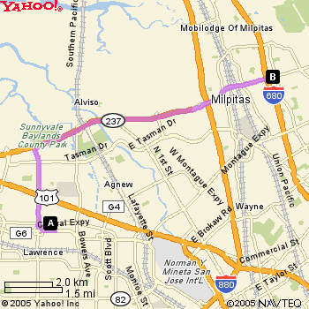
American: Hungry Hunter
1181 E Calaveras Blvd, Milpitas
(408) 946-4667
$$, 16 min


Slide 8
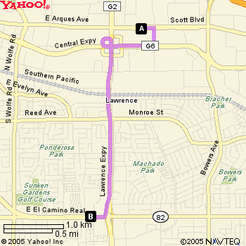
See food: Fish Market
3775 El Camino Real, Santa Clara
(408) 244-3907
$$, 5min


