Slide 1

Remote Instrumentation (not only) for fun
LEGO Mindstorm Exploration Demo
Authors: Andrea Del Linz, Roberto Pugliese
(Sincrotrone Trieste S.C.p.A.)
Mails:
andrea.dellinz@elettra.trieste.it
roberto.pugliese@elettra.trieste.it

Slide 2

LEGO Mindstorm Exploration Demo
Summary
  We will see a set of small robots equipped with on board sensors and a camera. The robots are integrated in the eInfrastructure though a middleware extensions called Instrument Element
  The user can interact with the robots, control and monitor missions via a Virtual Control Room.

Slide 3
Deployment of Remote
Instrumentation Infrastructure
(DORII) Architecture
Legenda:
IE - instrument element
CE - computing element
SE - storage element
WMS - workload management system
(CE broker)
LFC - location file catalog (SE broker)
DB - database element
IS - information system
VOMS - VO management system
OtherS - other services (e.g. OGC)
VCR - virtual control room
G-Eclipse - developer workbenck
Wf-Editor - workflow editor
Wf-Monitor - workflow monitor
Wf-Man System - workflow management system
Script Man - script manager
Apps Man - application manager
Wf-Editor
User
Apps
Man
VCR
Client
(browser)
Wf-Monitor
Tunnel
Non-Grid
Interactive
Script
Man
Native App
Launcher
Application
Developer
Wf-Man
System
VCR
Server
G-Eclipse
common java lib
common java lib
common java lib
IE
CE
SE
DB
IS
VOMS
WMS
LFC
OtherS
Grid / eInfrastructure

Slide 4
LEGO Mindstorm Robots: the real instruments

Slide 5
Hardware
NTX brick comes with four input ports (one doubles as an expansion slot for a still-hypothetical sensor hub) and three output ports. The nice-but-small LCD can display black and white text and graphics, while the brick's loudspeaker plays a variety of NXT sound files.
You connect your computer to the brick using either a USB cable or a Bluetooth wireless connection
The iCommand java library allows you to build and run Java programs on your computer
These programs send low-level commands to the NXT brick over a Bluetooth connection
A wireless camera is connected to the computer via USB acquisition board connected to the wireless receiver

Slide 6
The Instrument Element: virtualisation of sets of instruments and sensors
Data & Info Publishing
Alarms & Events
JMS
WS-I Compliant
Instrument Control
gLite Security Model
Kerberos Security
Instrument
Element
BDII
GlueSchema
extension
Web Services
GridFTP
WS-I Compliant
Instrument
Reservation Service
Access
to the
Grid
IM
IM
IM
Plugins Custom
Instruments
Access

Slide 7
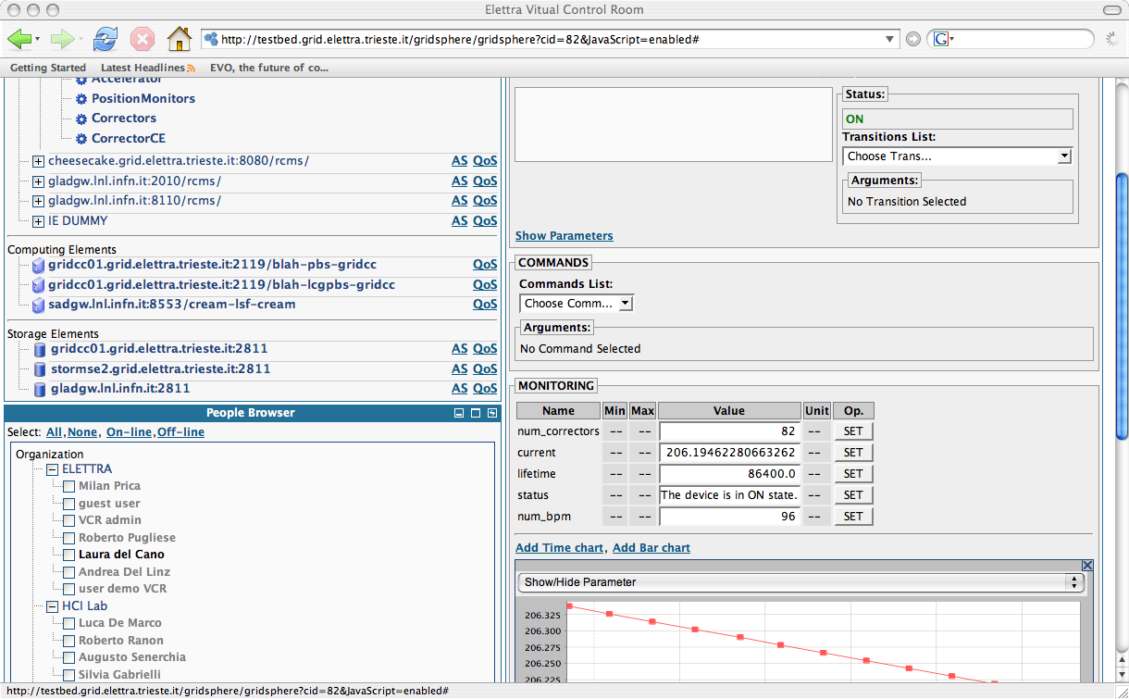
The Virtual Control Room: simplified access to the e-Infrasructure

Slide 8
LEGO robot exploration demo
Define workflows
Collective behavior
Controls robots
Deploys software
Acquire robot data
(camera, …)
developer
scientist
collaborate
Defines exploration
strategy
Performs off-line
Processing of acquired
exploration data
Start/stop
exploration
Monitors
exploration
Runs workflows,
scripts
Monitors workflows,
scripts
Access and visualizes
Exploration data
user
user

Slide 9
LEGO robot exploration demo
Workflow description
The user controls the robots and
starts the exploration
Each acquired data is stored
and streamed to the VCR
The exploration data processing
occurs
The processed data is stored
and streamed to the VCR
The user visualizes the
processed data results
VCR
2
1
6
IE
IE
SE
4
CE
SE
CE
2
3

Slide 10
Demo setup
PC a: Linux, runs the VCR and IE (LegoFifth ntx)
  Using the VCR we can control the IM state machine transition to the exploration state where the robot explores the environment and sends data via JMS
PC b: windows, runs IE (Camera, CameraRobot ntx)
  Using the VCR we can control interactively the robot VCR and receive images from the camera (go straight, stop, turn, move single motor, say bye)

