Slide 1
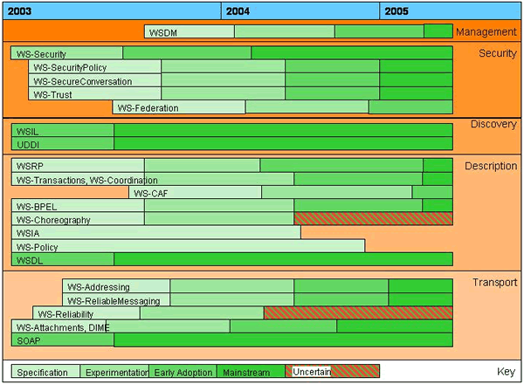
2004.08.20
v2…vN
Coarser granularity
Architecture Roadmap
(Ian, Hiro, Jay)
OGSA-WG
v1…vN-1
EMS
(Ravi)
Data
(DaveB)
Security
(Frank)
…
Design Team
Normative specs
Capability
We are
here
EPS
CSG
…
External standards (e.g., WS specs) that
satisfy our requirements
Or identify what we’d like to see happen
Finer granularity
And a detailed chart with stages of individual specs and when
we expect they would be available, e.g.,

