Slide 1
Securing Grid Services
Thijs Metsch
German Aerospace Center – DLR e.V.
Simulation and Software Technology (SISTEC)
Thijs.Metsch@DLR.de
GGF-Meeting, March 14, 2005

Slide 2


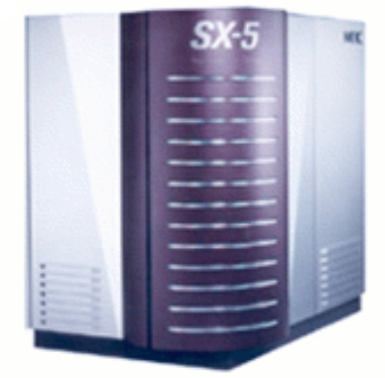
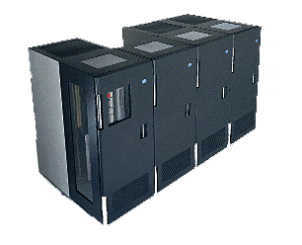
Problem Description
Virtual Organization
Firewall
Internet
Firewall
Grid A
Grid B

Slide 3
Basic Solution
Suggested by the German Federal Office for Information Security (BSI)
Firewall
ALG
Firewall
ALG
Internet
Intranet
Intranet
DMZ

Slide 4
Introduction of the Application Level Gateway (ALG)
“A system which represents the Grid to the outside and acts as a client
to the inside”
Node (1)
Request
Firewall
“Grid”
“Client”
Node (2)
ALG
Firewall
To Node (4)
Node (4)
DMZ
Node (3)

Slide 5
Functional description
Firewall
Traffic management
Load sharing
preliminary filter
(IP Packet Signing)
Application Level Gateway
Two-way Proxy
User level control of the Grid
Validation of SOAP messages
Logging
Accounting
Non Blocking Buffered I/O
  GridFTP
  GASS

Slide 6
Solution of security problems
Potential risks:
Spoofing
Data manipulation
Uncontrolled use of resources
Denial of Service attacks
Wiretapping of data
Privilege manipulation
Countermeasures:
Proxy authenticates the user.
Proxy validates traffic.
Mapping to internal user.
Detection of DoS attacks.
Data encryption
Data is located in the intranet.

Slide 7
Software Architecture
Validation
&
Mapping Unit
GRAM
Support
WS-Container
Sender
Consumer
RFT
Support
Supplier
User authentication
Own
Service
Fetcher
Cache
…
Framework

Slide 8
Further Ideas
Use of standards
  e.g. Java with Axis (http://ws.apache.org/axis/)
  OGSA/WSRF compliant
GUI for configuration
Easy expansion by the use of plugins
Increase security level by
  The use of community authorization service (CAS)
  The use of VPN-Tunnels
  Integration of virus scanners and intrusion detection systems
First implementation expected by end of 2005

