Slide 1

TC-RG Milestone 1 Progress Report
GSI+TPM Prototyping
(GSI augmentation with TPM)
Wenbo Mao
Principal Engineer
HP Labs China
Joint work with ChinaGrid
Wuhan University
Huazhong University of Science and Technology

Slide 2
Outline
Review of Grid Security Problems and Current Solutions
What Trusted Computing can help
Progress Report
Q&A + Discussions

Slide 3
Grid Security: Problems and Solutions
Grid Security Problems:
  1 Authentication (basics)
  2 Authorization (policy)
  3 Single-sign-on (one credential with ubiquitous usability)
  4 Security for dynamic virtual organization
  5 Secure multi-party computation (science collaborations)
  6 WS Security (WS: Game played by everybody in town)
Current Solutions in Globus Toolkit (respective to above):
  1 Grid Security Infrastructure: conventional PKI, proxy cert
  2 GridMap: mapping between VO policy to local policy
  3 MyProxy (online credential service, good idea)
  4 None
  5 None
  6 SAML from OASIS

Slide 4
What we do: Trusted Computing for Grid Security
To establish trust in proper uses of resources in a cross organization environment
Ways for establishing trust
1) Trust can be based on reputation and introduction
this is what GSI does currently by applying PKI
2) Trust can also be established by forcing
(even remote) system to behave as expected
This is the so-called system behaviour conformance
Trusted Computing is about trust establishment in (2)
This is achieved via system integrity measurement and attestation

Slide 5
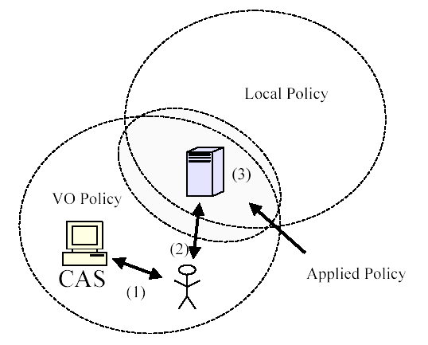
Securing GridMap: an example for improving Problem 3
GSI utilizes a gridmap file to map an
access user to a local user in order to
resolute the policy status for the access
user. For automatic processing, this file
is stored and maintained in cleartext
at a resource site.
CAS = Community Authorization Service
A TPM platform can have this important file encrypted while
keeping the system and the file maintenance automatic. TPM
performs encryption and decryption.

Slide 6
Attestation of a Secure MPC Environment An example for Problem 5
Platform attestation for secure multi-party computation:
A remote platform (eg, a Grid server) is attested by a remote user such that it has the following behaviour of “virtualized OS in curtained memory”:
    (1) a memory area is allocated to run a virtualized secure OS environment (virtual machine) which cannot even be accessed by the platform owner (eg, system administrator);
    (2) a proprietary code of the remote user is encrypted under a public key where the matching private key is in the TPM; the encrypted code is sent to the TPM;
    (3) TPM decrypts and loads the proprietary code to run in the VM for the remote user, …, then sends back the encrypted result.
No conventional security mechanism can offer a practical solution to this typical Grid computing scenario: Science Collaboration. It is the remote platform attestation of TC that plays the trick.

Slide 7
This Progress Report is about …
Milestone 1 of GGF TC-RG:
Prototyping of GSI+TPM (GSI augmentation with TPM)
  Using TPM to manage cryptographic keys
  (keys for authentication, GridMap file encryption, etc)
  Who are doing this
  HP Labs, ChinaGrid, Wuhan Univ, Huazhong Univ of Sci & Tech
  This report is “first two-month investigation” covering:
    Understanding and familiarity of TC
    Architecture design
    Milestone-1 focus (authentication, authorization, SSO, i.e., Problems 1-3 in Slide “Grid Security, Problems and Solutions”)
    Workability (platform availability? reasonable timeframe?)

Slide 8
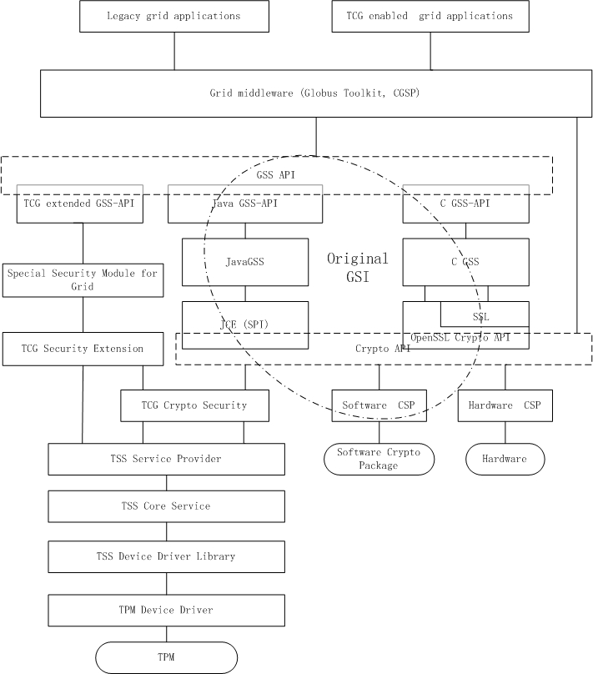
Architecture design

Slide 9
Workability (workplan)
Wuhan University has long been working on Trusted Computing
TPM embedded desktop platform passed test in Oct ’04
Huazhong Univ of Sci & Tech is responsible for developing security kernel for ChinaGrid Supporting Platform (CGSP)
Aiming at delivering open-source component for GT+ running on TCG compatible TPM (e.g., that for HP platforms);
  Linux v2.6
  OpenSSL for key management (things using symmetric keys)
  GSS (Generic Security Service) API implementation: Java
  TPM Device Driver implementation: C
Timeframe: for GSI+TPM deliverables:
  Architecture design: GGF15
  Specifications: GGF16 (March ’06)
  Open source code: End of July ’06

Slide 10
Q&A + Discussions
I’m now a notes taker …

Slide 11


