Slide 1
ACS Security Issues
ACS F2F
1st Aug, 2005
Sachiko Wada ASCADE, Inc.

Slide 2
To what extent does the OGSA Basic Profile cover concerning security issues ?
reference: "OGSA WSRF Basic Profile 1.0" chapter 8.
Integrity and Confidentiality of Message Exchange
The profile recommends the use of at least one of Transport Layer Security (TLS) or Message Layer Security (XML-Signature and/or XML Encryption).
Authentication
The profile recommends mutually authenticated Web services communication.
The profile only permits X.509 certificate-based authentication.
Authorization
If senders sends assertions that can be used for policy decisions, including access control decisions, the profile recommends that assertions must be SAML assertions or X.509 attribute certificates.
Key Information Exchange
The Profile defines key information exchange for message-level security by using the Metadata element in the EndpointReference of the WS-Addressing.

Slide 3
To what extent should the ACS cover concerning security issues ?
(My opinion)
What ACS should NOT define are:
The method of ensuring integrity and confidentiality of message.
The method of exchanging authentication and authorization information.
→ These are defined by OGSA-WG.
The latter is also being discussed by OGSA-AuthZ-WG.
The authentication process.
→ It should be implementation dependent.
The method of ensuring confidentiality of each Application Content in AA.
→ It should be application dependent since ACS does not interprets each content in AA.
What ACS should define are:
The method of ensuring integrity of AA.
The method of setting access control policy.
→ Detail is explained next slide...

Slide 4
The method of ensuring integrity of AA
The signature on AA is effective when AA is exchanged across multiple security domain
in order to ensure the integrity of AA.
ACS should define how to sign on AA (or each AA content?) to ensure interoperability between heterogeneous systems.
Key management method is out of ACS scope.
The method of setting access control policy.
There are two types of access control.
Access control on service interface
  ex) Who can create new AA in the Application Repository.
Access control on each content of AA or entire AA.
  ex) Who can read/write the content of AA or entire AA.
ACS should not define the former. This is a common issue among OGSA services and already discussed by OGSA-AuthZ-WG.
ACS may define the latter since this is ACS specific issue.
But I am not positive to define new policy definition schema...
ACS may include a policy description document for access control such as XACML.
* Should ACS expose which policy description language it supports ?

Slide 5
Example Scenario of Authentication and Authorization
In this example, each message contains a security token which is used to authenticate the user, and access control policy for services are stored in Access Control Service (e.g. Policy Decision Point in term of SAML).
Authorization Service
1. login
SAML extention
for Grid
is discussed by
OGSA-AuthZ-WG
Joe
Joe
security token
2.1 Register/Create
ApplicationRepository
Authentication Service
Joe
2.2 enquire
policy
3.1 submit Job
Joe can create
new AA
Joe
2.3 create
assertion
Joe, the owner of the AA, can access all the contents in AA.
3.2 GetContents
Joe
policy
AA
ApplicationArchiveEntry
Job Manager

Slide 6
Appendix
Related Standards
XML Encryption
XML Signature
WS-Security
SAML
XACML

Slide 7
XML Encryption (W3C Recommendation)
XML Encryption is a process for encrypting and decrypting parts of XML documents.
Unlike transport-level techniques that encrypt an entire request and response stream, XML Encryption allows content-level encryption that converts document fragments into illegible ciphertext, while other elements remain legible as plaintext.
example:
<?xml version='1.0'?>
<xxx:PaymentInfo xmlns="http://example.org/paymentv2">
<xxx:Name>John Smith</xxx:Name>
<xxx:CreditCard Limit="5,000" Currency="USD">
<xenc:EncryptedData
Type="http://www.w3.org/2001/04/xmlenc#Content"
xmlns:xenc="http://www.w3.org/2001/04/xmlenc#">
<xenc:EncryptionMethod Algorithm="..."/>
<ds:KeyInfo xmlns:ds="http://www.w3.org/2000/09/xmldsig#">
<ds:KeyName>John Smith</ds:KeyName>
</ds:KeyInfo>
<xenc:CipherData>
<xenc:CipherValue>A23B45C56</xenc:CipherValue>
</xenc:CipherData>
</xenc:EncryptedData>
</xxx:CreditCard>
</xxx:PaymentInfo>

Slide 8
XML Signature (W3C Recommendation)
XML Signature is a mechanism for ensuring the origin and integrity of XML documents. XML Signature standardizes the process of signing XML content and inserting it into XML documents, so that recipients can verify its origin and integrity.
example:
<ds:Signature Id="MyFirstSignature"
xmlns:ds="http://www.w3.org/2000/09/xmldsig#">
<ds:SignedInfo>
<ds:CanonicalizationMethod Algorithm="..."/>
<ds:SignatureMethod Algorithm="..."/>
<ds:Reference URI="...">
<ds:Transforms>
<ds:Transform Algorithm="..."/>
</ds:Transforms>
<ds:DigestMethod Algorithm="..."/>
<ds:DigestValue>j6lwx3rvEPO0vKtMup4Nb8nk=</ds:DigestValue>
</ds:Reference>
</ds:SignedInfo>
<ds:SignatureValue>MC0CFFrVLtRlk=...</ds:SignatureValue>
<ds:KeyInfo>
<ds:KeyValue>
<ds:DSAKeyValue>...</ds:DSAKeyValue>
</ds:KeyValue>
</ds:KeyInfo>
</ds:Signature>

Slide 9
WS-Security (OASIS Standard)
WS-Security is a mechanism for incorporating security information into SOAP messages. WS-Security uses security tokens for authentication, digital signatures for integrity, and content-level encryption for confidentiality based on XML Encryption and XML Signature.
example:
<S11:Envelope xmlns:S11="..." xmlns:wsse="..." xmlns:ds="..." xmlns:xenc="...">
<S11:Header>
<wsse:Security>
<!-- security token -->
<wsse:BinarySecurityToken ValueType="wsse:X509v3"
EncodingType="wsse:Base64Binary">
MIIEZzCCA9CgAwIBAgIQEmtJZc0...
</wsse:BinarySecurityToken>
<!-- Signature -->
<ds:Signature>
<ds:SignedInfo>
<ds:Reference URI="#myBody">
<ds:DigestMethod Algorithm="..."/>
<ds:DigestValue>EULddytSo1...</ds:DigestValue>
</ds:Reference>
</ds:SignedInfo>
<ds:SignatureValue>BL8jdfToEb1l/vXcMZNNjPOV...</ds:SignatureValue>
</ds:Signature>
continued >>

Slide 10
<!-- content-level encryption -->
<xenc:ReferenceList>
<xenc:DataReference URI="#bodyID"/>
</xenc:ReferenceList>
</wsse:Security>
</S11:Header>
<S11:Body wsu:Id="myBody" >
<!-- content-level encryption -->
<xenc:EncryptedData Id="bodyID">
<ds:KeyInfo>
<ds:KeyName>CN=Hiroshi Maruyama, C=JP</ds:KeyName>
</ds:KeyInfo>
<xenc:CipherData>
<xenc:CipherValue>Xhd1dfrDF...</xenc:CipherValue>
</xenc:CipherData>
</xenc:EncryptedData>
</S11:Body>
</S11:Envelope>
continued >>

Slide 11
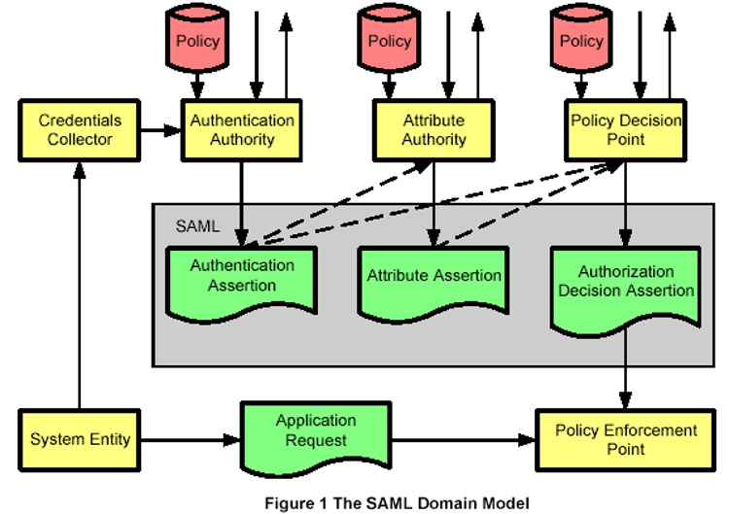
SAML (OASIS Standard)
SAML (Security Assertions Markup Language) is a framework for exchanging authentication and authorization information. Security typically involves checking the credentials presented by a party for authentication and authorization. SAML standardizes the representation of these credentials in an XML format called assertions, enhancing the interoperability between disparate applications.
examples:
Authentication Assertion
"the subject, whose name is Joe, was originally authenticated using a password mechanism at
2002-06-19T17:05:17.706Z."
Attribute Assertion
"Member status of the subject, whose name is Joe, is 'Gold'."
Authorization Decision
Assertion
"the subject, whose name is Joe, is permitted to purchase item X, but prohibited to purchase item Y".
Notes:
- Subject
An entity which requests authentication and/or access control, such as
a user or a service.
- Security assertion
A piece of information which certificates security information on a subject.
- Authentication assertion
A kind of security assertion. A piece of information which certificates
authentication information on a subject. For example, "the subject, whose name
is Joe, was originally authenticated using a password mechanism at
2002-06-19T17:05:17.706Z."
- Attribute assertion
A kind of security assertion. A piece of information which certificates
attribute information on a subject. For example, "Member status of the
subject, whose name is Joe, is 'Gold'."
- Authorization decision assertion
A kind of security assertion. A piace of information which certificates
actions a subject is permitted/prohibited to take. For example, "the subject,
whose name is Joe, is permitted to purchase item X, but prohibited to purchase
item Y".
- Single sign-on
A mechanism which enables log-in to multiple services requiring authentication
respectively by a single authentication. This is achieved by sharing
authentication information on users between the services.

Slide 12
XACML (OASIS Standard)
XACML (eXtensible Access Control Markup Language ) is a standard language for expressing access control, or authorization, policy, and a standard format for expressing queries over these policies.
example:
<Policy PolicyId="SamplePolicy" RuleCombiningAlgId="...">
<!-- This Policy only applies to requests on the SampleServer and action is "login" -->
<Target>
<Subjects><AnySubject/></Subjects>
<Resources>
<ResourceMatch MatchId="urn:oasis:names:tc:xacml:1.0:function:string-equal">
<AttributeValue DataType="http://www.w3.org/2001/XMLSchema#string">
SampleServer
</AttributeValue>
<ResourceAttributeDesignator DataType="http://www.w3.org/2001/XMLSchema#string"
AttributeId="urn:oasis:names:tc:xacml:1.0:resource:resource-id"/>
</ResourceMatch>
</Resources>
<Actions>
<ActionMatch MatchId="urn:oasis:names:tc:xacml:1.0:function:string-equal">
<AttributeValue DataType="http://www.w3.org/2001/XMLSchema#string">
login
</AttributeValue>
<ActionAttributeDesignator DataType="http://www.w3.org/2001/XMLSchema#string"
AttributeId="ServerAction"/>
</ActionMatch>
</Actions>
</Target>
</Policy>

