Slide 1
Mapping the DAIS Concepts
2
Simon Laws (IBM)
Sastry Malladi (ORACLE)
Savas Parastatidis (Univ. of Newcastle)

Slide 2
Introduction
DAIS on concepts
Decision on rendering on a particular infrastructure
Investigation into alternative approaches

Slide 3
Goals
The nature of the interactions with data services (the message formats)
The representation of data resources through service interfaces (realisations)
Accessing data resources from
  Different portTypes offered by the same service
  portTypes offered by different services
Providing names for data resources
Creation/generation of data resources through interactions (factory patterns)
Access to metadata about data resources and/or data services
Stateful interactions with data resources (e.g. interacting with a result set)
Stateful interactions with data services (e.g. setting a logging context)
Locating data resources (registries)
Third-party delivery of data resources

Slide 4
Non-goals
Orthogonal functionality (security, policies, transactions, coordination, reliable messaging, orchestration, etc.)
Notification
Representation of data resources outside the boundaries of services (data formats)

Slide 5
Approach
Scenarios
  Stateful interactions with data resources
  Sessions with data services
  Discovery of data resources
  Access to metadata about data resources and/or services
  Third-party delivery
Infrastructures
  Web Services-Interoperability (WS-I) only specifications
  WS-I plus WS-Context
  WS-I plus WS-RF

Slide 6
Scenario 1
Stateful interactions with data resources

Slide 7
Scenario 1
Stateful interactions with data resources
Using WS-I only

Slide 8
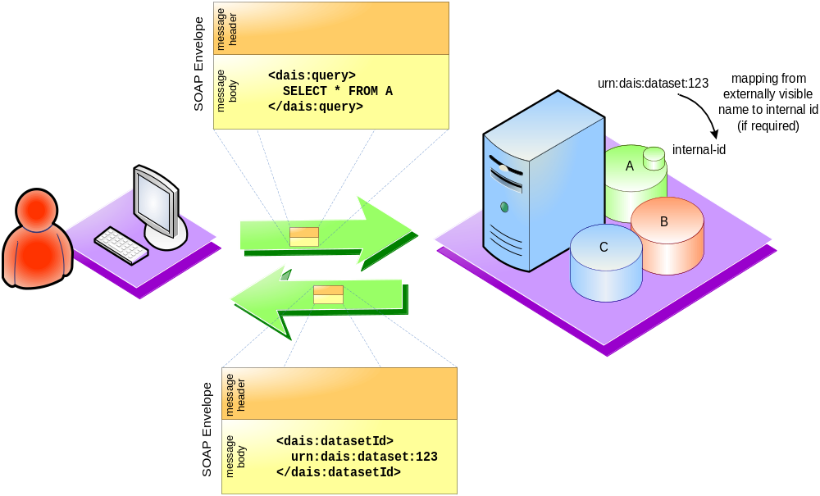
Scenario 1 - Using WS-I

Slide 9
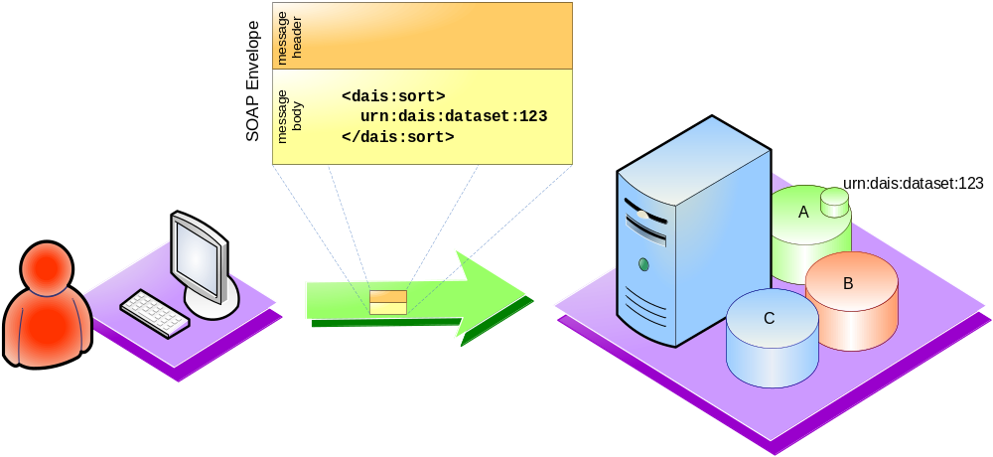
Scenario 1 - Using WS-I

Slide 10
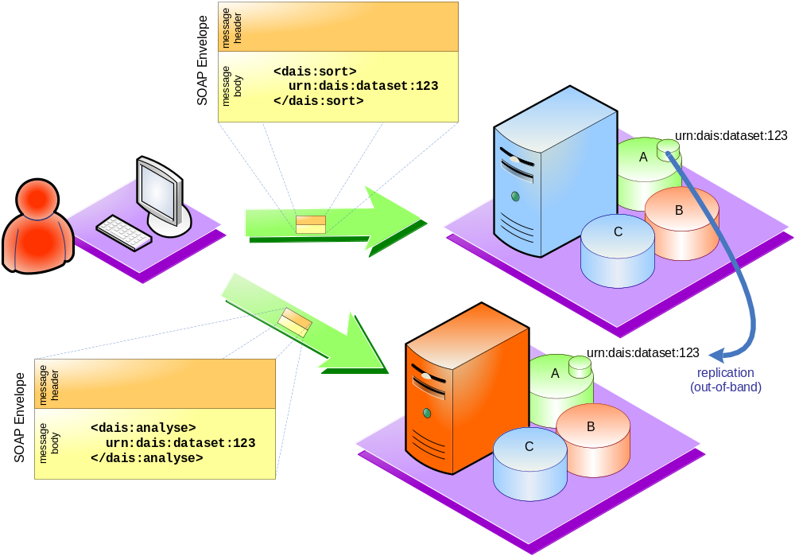
Scenario 1 - Using WS-I

Slide 11
Scenario 1
Stateful interactions with data resources
Using WS-Context

Slide 12
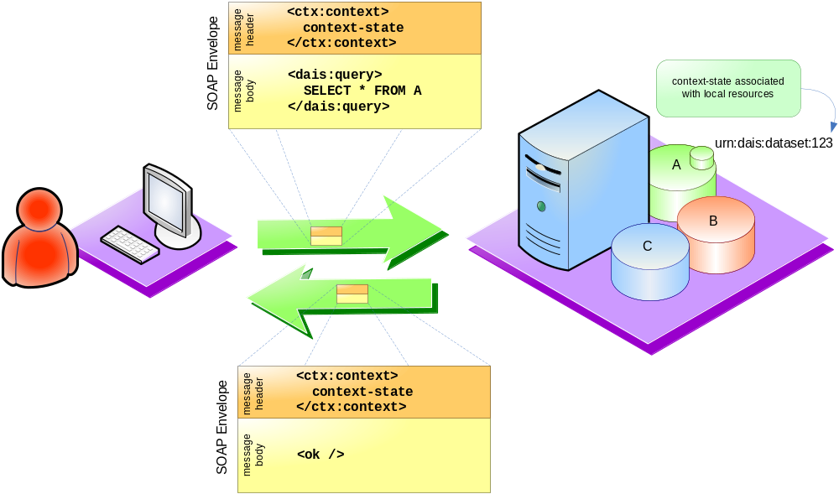
Scenario 1 - Using WS-Context

Slide 13
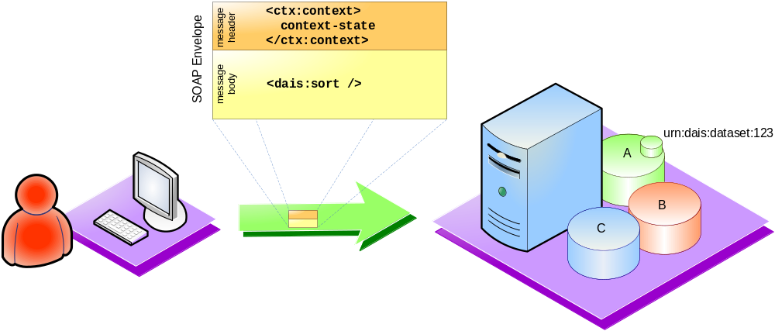
Scenario 1 - Using WS-Context

Slide 14
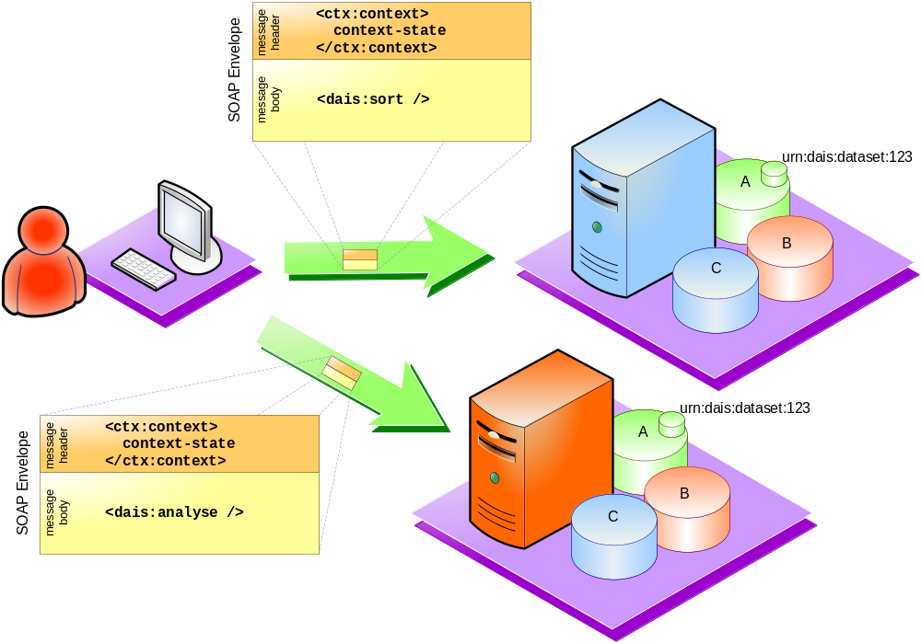
Scenario 1 - Using WS-Context

Slide 15
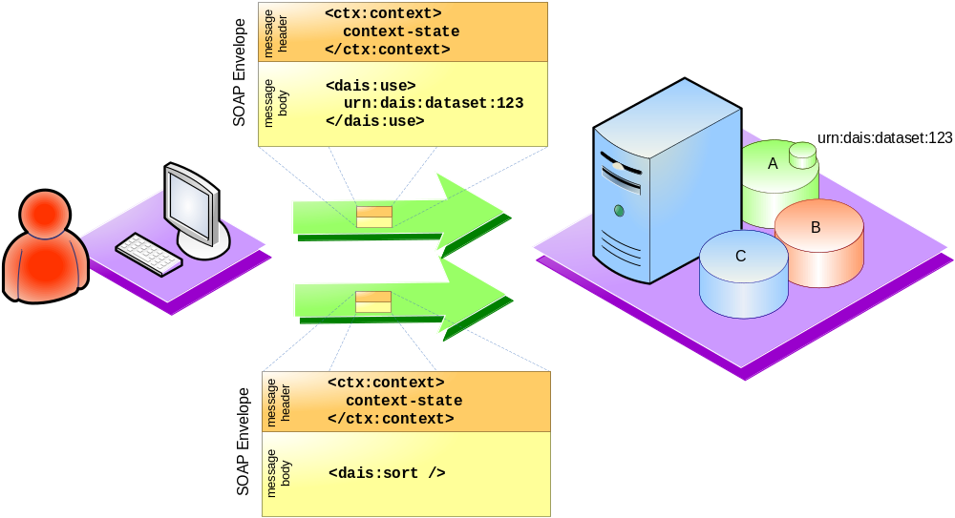
Scenario 1 - Using WS-Context

Slide 16
Scenario 1
Stateful interactions with data resources
Using WS-RF

Slide 17
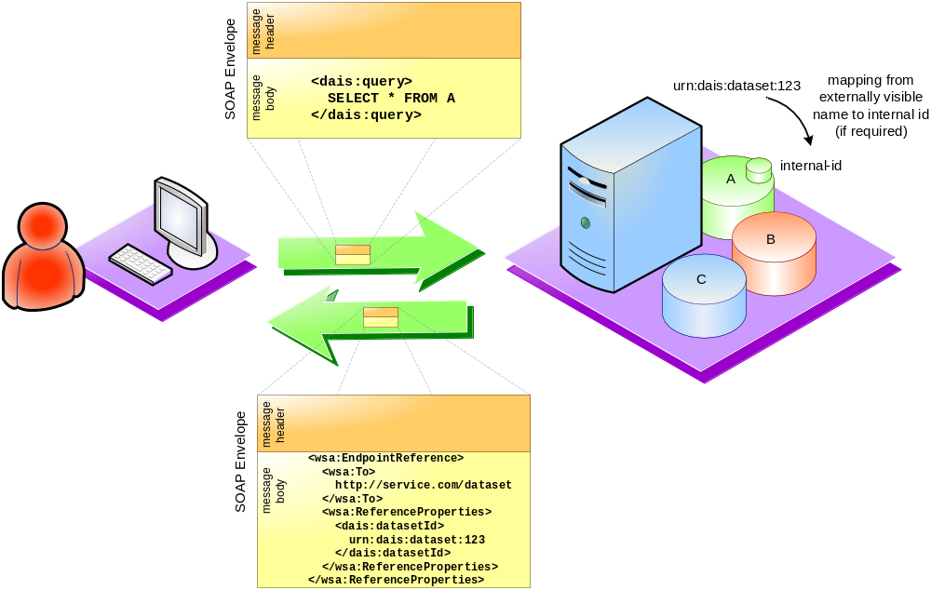
Scenario 1 - Using WS-RF

Slide 18
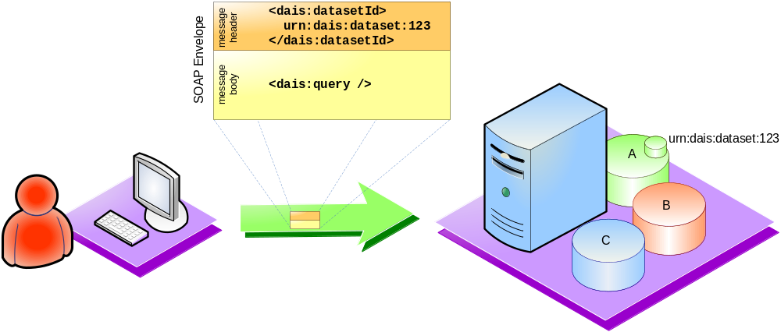
Scenario 1 - Using WS-RF

Slide 19
Scenario 2
Sessions

Slide 20
Scenario 2
Sessions
Using WS-I only

Slide 21
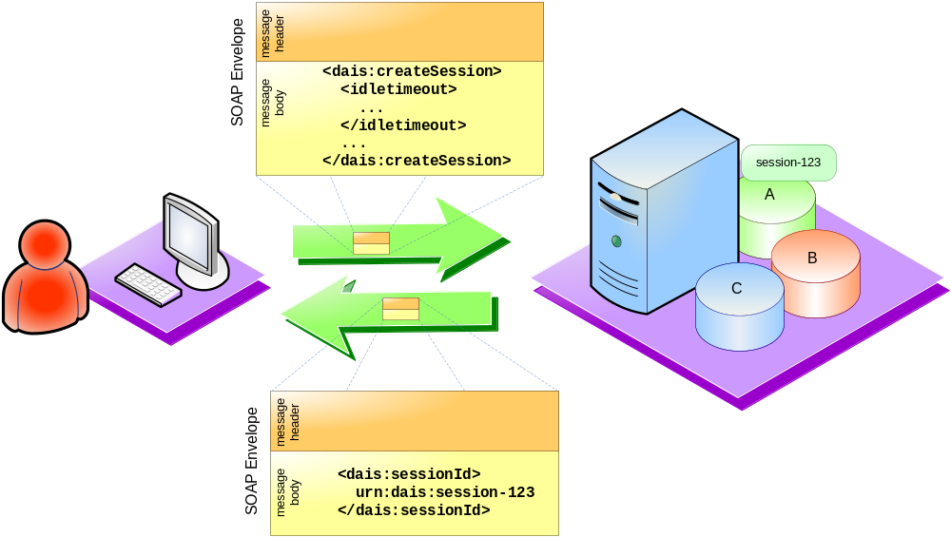
Scenario 2 – Using WS-I

Slide 22
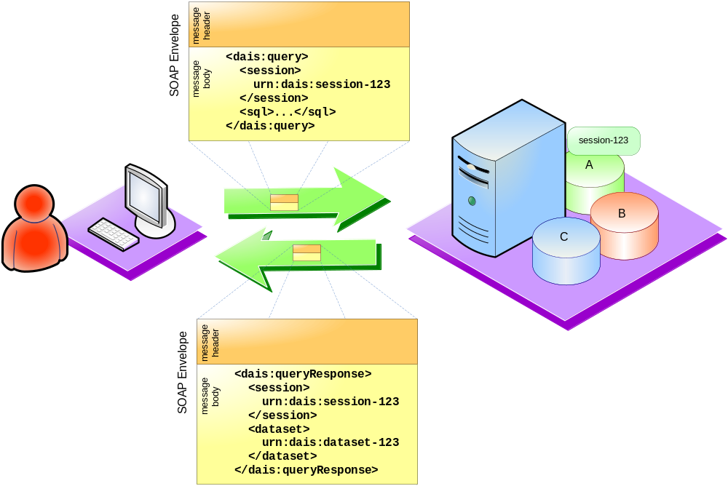
Scenario 2 – Using WS-I

Slide 23
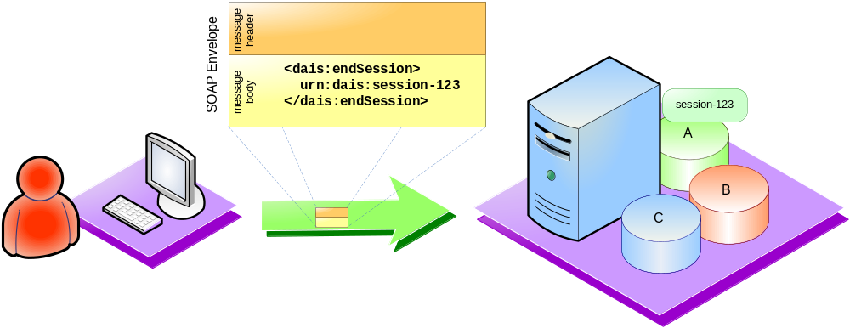
Scenario 2 – Using WS-I

Slide 24
Scenario 2
Sessions
Using WS-Context

Slide 25
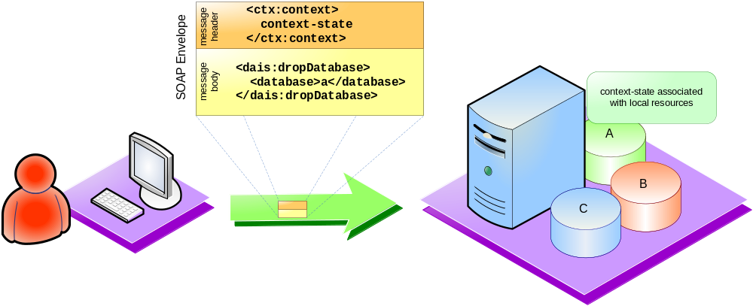
Scenario 2 – Using WS-Context

Slide 26
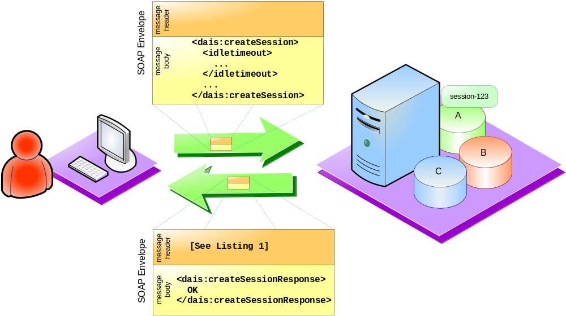
Scenario 2 – Using WS-Context

Slide 27
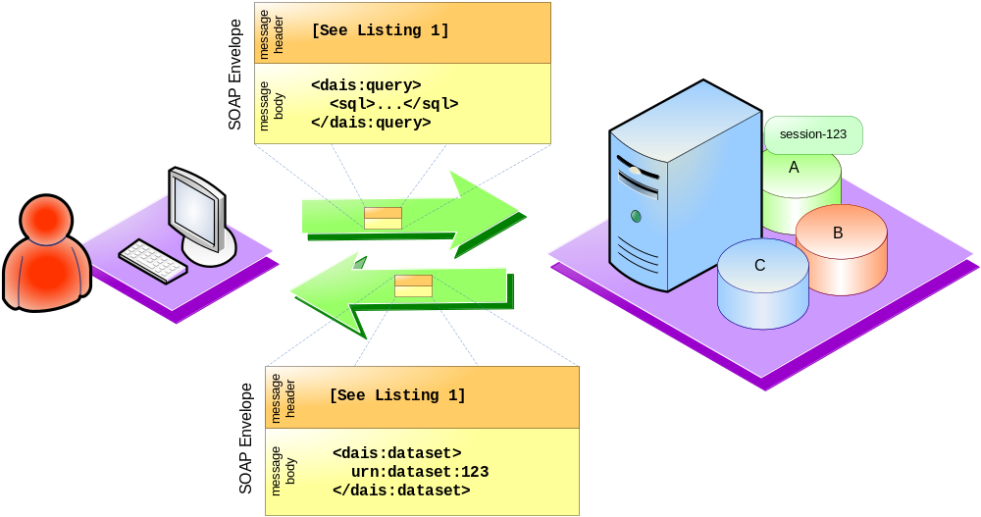
Scenario 2 – Using WS-Context

Slide 28
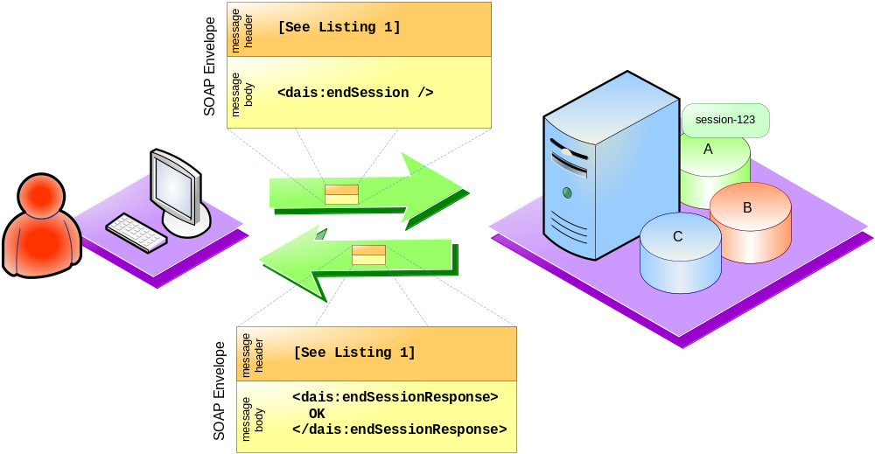
Scenario 2 – Using WS-Context

Slide 29
Scenario 2 – Using WS-Context
<context
xmlns="http://www.webservicestransactions.org/schemas/wsctx/2003/03"
timeout=idle_timeout_value>
<context-identifier>
urn:dais:session-123
</context-identifier>
<!-- Optional elements -->
<activity-list>
<service> <!-- wsmd:WSRef of participating service -->
<wsdl11:service name="MyService"
wsmd:portType="ex:myServiceType">
<wsdl11:port name="myPort"
binding="ex:myServiceBinding">
<soapbind:address
location="http://example.com/wsdl-example1/impl"/>
</wsdl11:port>
</wsdl11:service>
</service>
</activity-list>
</context>

Slide 30
Scenario 2
Sessions
Using WS-RF

Slide 31
Scenario 2 – Using WS-RF
Not used for sessions

Slide 32
Scenario 3
Discovery – Registries of data resources

Slide 33
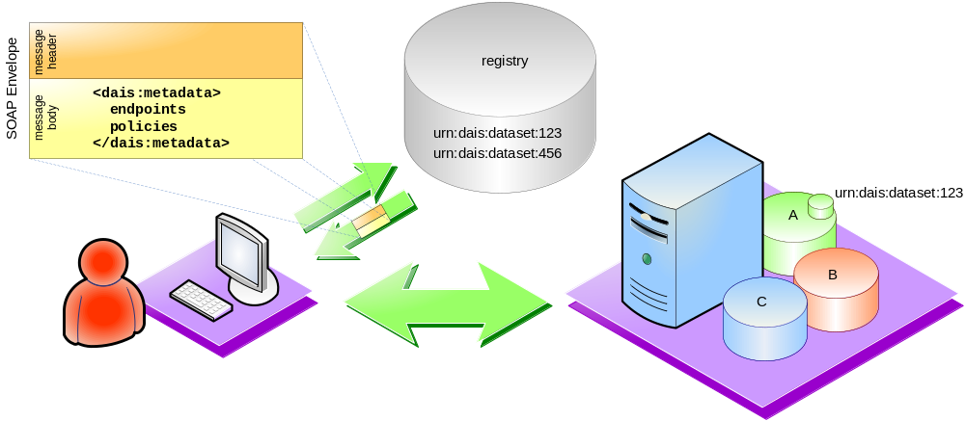
Scenario 3 – Using WS-I

Slide 34
Scenario 3
Discovery – Registries of data resources
Using WS-I only

Slide 35
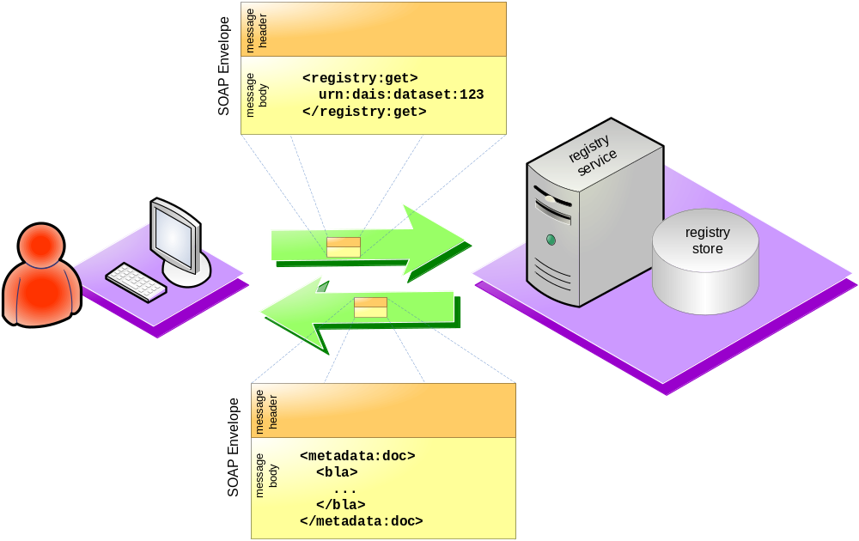
Scenario 3 – Using WS-I

Slide 36
Scenario 3
Discovery – Registries of data resources
Using WS-Context

Slide 37
Scenario 3 – Using WS-Context
No difference

Slide 38
Scenario 3
Discovery – Registries of data resources
Using WS-RF

Slide 39
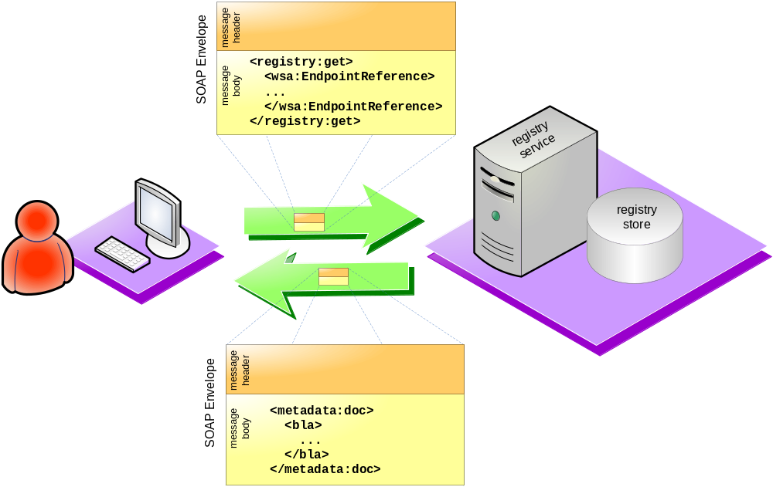
Scenario 3 – Using WS-RF

Slide 40
Scenario 4
Access to metadata

Slide 41
Scenario 4
Access to metadata
Using WS-I only

Slide 42
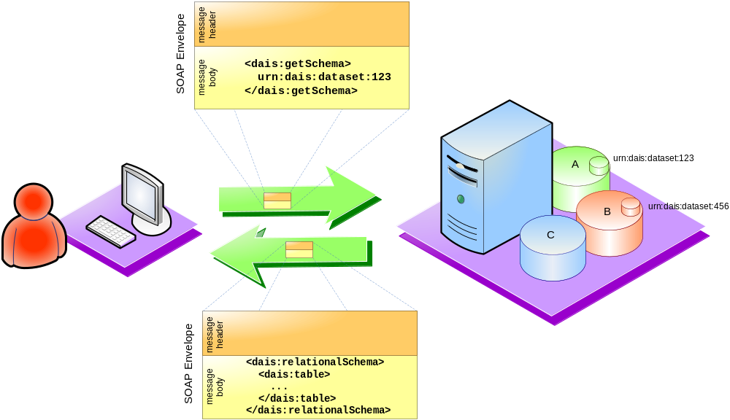
Scenario 4 – Using WS-I

Slide 43
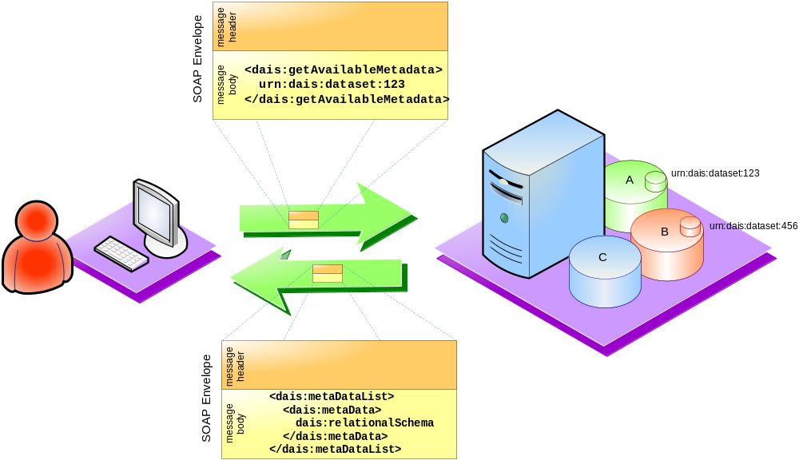
Scenario 4 – Using WS-I

Slide 44
Scenario 4
Access to metadata
Using WS-Context

Slide 45
Scenario 4 – Using WS-Context
No difference

Slide 46
Scenario 4
Access to metadata
Using WS-RF

Slide 47
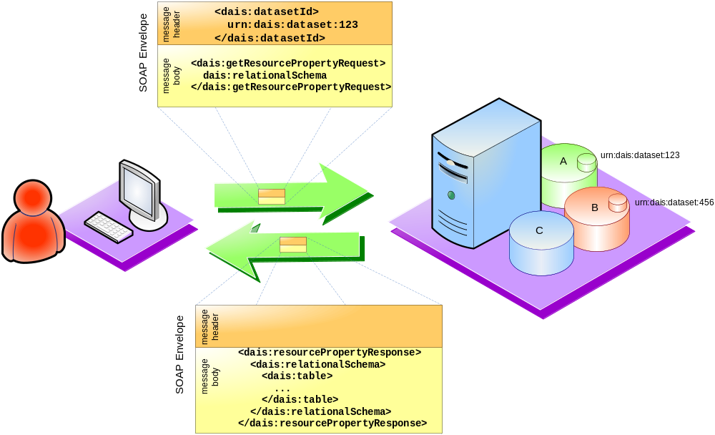
Scenario 4 – Using WS-RF

Slide 48
Scenario 5
Third-party delivery

Slide 49
Scenario 5
Third-party delivery
Using WS-I only

Slide 50
Scenario 5
Third-party delivery
Using WS-Context

Slide 51
Scenario 5
Third-party delivery
Using WS-RF

Slide 52
Observations

Slide 53
Observations/Issues/Questions
Stability of supporting infrastructure
Interoperability and adoption
Composability
Tooling
Conceptual model

Slide 54
Conclusions

Slide 55
Conclusions

