Slide 1

OGSA Rising
Hiro Kishimoto
Research Fellow
FUJITSU
Business Grid Consortium
Ian Foster
Argonne National Laboratory
University of Chicago
Globus Alliance

Slide 2
What is OGSA
Open service-oriented architecture based on Web services for addressing Grid scenarios
Component-oriented architecture
  Interchangeable components
Meta OS functionalities
  Distributed and heterogeneous environment
A rendering of these functions, based on Web service architecture and specifications

Slide 3
OGSA History
Announced at GGF4 (’02/2)
WG created (’02/9)
6 interim F2F meetings
OGSA Usecase document at GGF10 (’04/3)
Declared as GGF’s flagship architecture at GGF10 (’04/3)
OGSA document at GGF11 (’04/6)
  First version as informational document
  Companion OGSA Glossary document

Slide 4
OGSA Formation
OGSA-WG
  Designs overall architecture
  Integrates and adjust design-teams’ output
OGSA-WG design teams
  Informal domain expert groups within OGSA-WG
  May include co-chairs of other WG/RGs
  Output is included in OGSA specification
Relation to other WG/RGs
  Explain OGSA’s approach and get feedback
  Consign specification design work
  Two way street: OGSA-WG willing to receive innovative ideas and reflect in OGSA architecture

Slide 5
What’s completed
Collection of requirements
  Based on the OGSA use cases
  Set design goals
Representation of major capabilities
  Capability is interface, semantics, and behavior
  Built from multiple interacting services

Slide 6
OGSA-WG Use Case
Drives the definition and prioritization of OGSA capabilities and services
Gives the rationale for our choices
We want to use this to
To identify requirements
To define OGSA capabilities
  Sets of OGSA services that meet specific set of requirements.
To define relationships between GGF and other standard bodies

Slide 7
Reviewed Use Cases - I
Science Grid Use Cases
  Severe Storm Modeling (Dennis Gannon)
  National Fusion Collaboratory ( Kate Keahey )
Commercial Grid Use Cases
  Commercial Data Center ( Hiro Kishimoto, Andreas Savva, David Snelling )
  Online Media and Entertainment (Tan Lu, Boas Betzler )
  Grid Resource Reseller ( Jon MacLaren, William Lee )
  Inter Grid ( Jeffrin J. Von Reich )

Slide 8
Reviewed Use Cases – II
Grid Technology Use Cases
  Service-Based Distributed Query Processing ( Nedim Alpdemir, Norman Paton )
  Grid Workflow ( Takuya Araki)
  Interactive Grids ( Jeffrin J. Von Reich)
  Grid Lite (Jeffrin J. Von Reich )
WG use cases
  Persistent archives (PA RG)
  Mutual Authorisation (SA3 RG )
  Resource Usage Service (RUS WG )

Slide 9
What’s completed (cont)
“The Open Grid Services Architecture, Ver. 1.0”
  The document is now on GridForge
  https://forge.gridforum.org/projects/ogsa-wg/document/draft-ggf-ogsa-spec/en
Informational document, not recommendation
  Explains our current thinking on required capabilities, for discussion
  Depends on emerging specifications (e.g., WS-RF, WS-Notification)
  Insufficient to develop actual implementation
To be reviewed, revised and sent to the GGF Editor within three weeks
  Your feedback is needed!

Slide 10
OGSA-WG Next Steps
Create recommendation architecture document
  Version 2 of OGSA specification
Create roadmap document
Discuss in depth with related WG/RGs

Slide 11

OGSA Architecture II
12:30-2pm
OGSA Architecture I
10-11:30am
Cataloging
Provisioning
VO
Mgmt
Context Services
Data
Services
Integration
Policy
Mgmt
Access
Information Services
Context
Services
Execution Mgmt Services
Data
Services
Info
Services
Trouble-
shooting
Event
Mgmt
Discovery
Logging
Application
Mgmt
Workflow
Mgmt
Workload
Mgmt
Execution
Planning
Job
Mgmt
Execution
Mgmt
Services
Infra
Services
WSRF
WSN
WSDM
Naming
Infrastructure
Services
Reservation
Configuration
Deployment
Provisioning
Rsrc Mgmt
Services
Self Mgmt
Services
Security
Services
Resource Mgmt Services
Heterogeneity
Mgmt
Authentication
Self
Mgmt
Services
Optimization
OGSA Panel
2-3:30pm
Authorization
Security
Services
Service Level
Attainment
Integrity
QoS
Mgmt
Boundary
Traversal

Slide 12
Infrastructure Services
Our assumptions about the underlying Web services infrastructure
  To make statements about OGSA services concrete
  To guarantee interoperability among implementations
Web Service architecture and specifications
  XML, SOAP, WSDL v1.1 (WS-I basic profile)
  WS-Security, SAML, and XACML
  WS-Resource Framework, WS-Notification

Slide 13
Execution Mgmt Services
Resources
  Modeling of processing, storage, executables
  Resource management and provisioning
Resource selection
  Where to execute a service
Job management
  Management and monitoring jobs

Slide 14
EMS Interaction Pattern
App. Contents Service
Candidate Set Generator (Work -Resource mapping)
Provisioning
Deployment
Configuration
Information Services
Execution Planning Services
Reservation
Service
Container
Data
Container
Job Manager
Accounting Services

Slide 15
EMS Interaction Pattern
App. Contents Service
Candidate Set Generator (Work -Resource mapping)
Provisioning
Deployment
Configuration
Information Services
Execution Planning Services
OGSA Architecture I
10-11:30am
Reservation
Service
Container
Data
Container
Job Manager
Accounting Services

Slide 16
Resource Mgmt Services
Domain-specific capabilities
OGSA Capabilities
OGSA
functions
level
Execution
Mgmt
Data
Service
Security
Service
Infrastructure
Level
WSRF, WSDM
Resources
Resource
level

Slide 17
Resource Mgmt Services
Domain-specific capabilities
OGSA Capabilities
OGSA
functions
level
Execution
Mgmt
Data
Service
Security
Service
OGSA Architecture I
10-11:30am
Infrastructure
Level
WSRF, WSDM
Resources
Resource
level

Slide 18
Information Services
Information handling
  Applications
  Resources
  Services
Models
  Information producer/consumer paradigm
  Data model / query language
  Meta data model
  Message schema
  Producer / consumer description

Slide 19
Information Services
Information handling
  Applications
  Resources
  Services
Models
  Information producer/consumer paradigm
  Data model / query language
  Meta data model
  Message schema
  Producer / consumer description
OGSA Architecture I
10-11:30am

Slide 20
Data Services
Objectives
  Move data to where it is needed
  Manage replicated copies
  Run queries and updates
  Transform among formats
  Manage meta data
Data resource types
  Flat file, streams, DBMS, catalogues, derivations

Slide 21
Data Services
Objectives
  Move data to where it is needed
  Manage replicated copies
  Run queries and updates
  Transform into new format
  Manage meta data
Data resource types
  Flat file, streams, DBMS, catalogues, derivations
OGSA Architecture II
12:30-2am

Slide 22
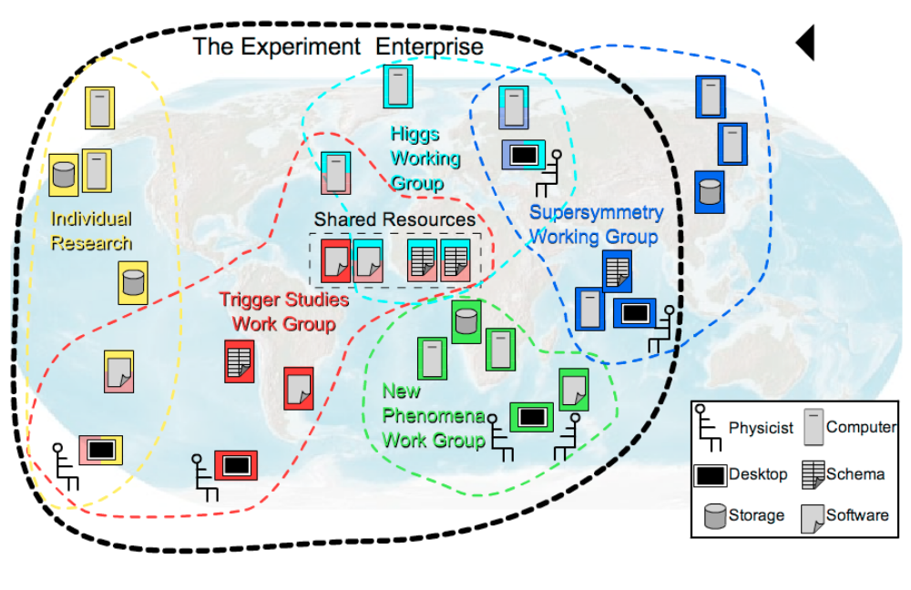
Security Services
Facilitate the enforcement of security-related policy within virtual organizations that span multiple domains
  Each domain has its own business objectives
  Each domain translates in an enforced security policy

Slide 23
Security Services
Facilitate the enforcement of security-related policy within virtual organizations that span multiple domains
  Each domain has its own business objectives
  Each domain translates in an enforced security policy
OGSA Architecture II
12:30-2am

Slide 24
Self-Mgmt Services
Reduce the cost and complexity of owning and operating an IT infrastructure
System components are
  Self-configuring
  Self-healing
  Self-optimizing
Policy- and model-based management
Service level attainment

Slide 25
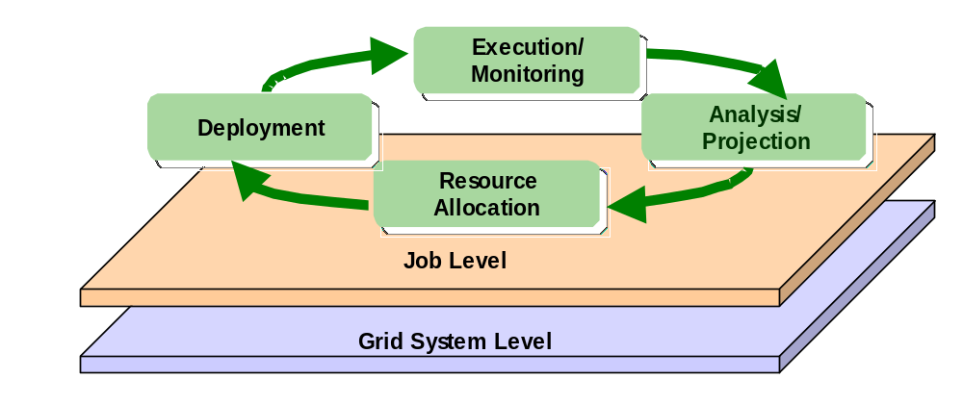
Service Level Attainment
Monitoring, analysis and projection, provision, and execution
Provisioning: deployment, configuration, and application contents service

Slide 26
Next Steps
Version 1 (informational)
  Solicit comments from related WG/RG
  Reflect them into the document
  Submit the document to GGF Editor within three weeks
Version 2 (recommendation)
  More feedback and refinement
  Major revision
  Detailed enough to implement
Roadmap document (version 1)

Slide 27
Goals for Version 2
Define specific interfaces (operations & behaviors) for capabilities identified in V1
  Either in collaboration with existing WGs …
  Or as input to future WGs
Refine statement of required capabilities
  Based on work of other WGs & other standards bodies
  Based on experience of early adopters
Delivery in one year

Slide 28
Goals for Roadmap
Define priorities for OGSA interfaces, based on community input
Identify dependencies among interfaces
Document community requirements for timing of various interfaces
Delivery of first draft in 3 months, final in 6 months

Slide 29
GGF Collaboration
Data Area WGs
  Working well: a series of joint phone calls
Security
  Frank Siebenlist provides connectivity
Execution Management Services
  Communication needs to be improved
Management
  Fred Maciel coordinates with CMM, WSDM

Slide 30
Other Standards Bodies
OASIS
  WSRF and WS-Notification
  WS-Security, etc.
  WSDM
DMTF
  Utility Computing
  CIM
  Server management
W3C
  Various

Slide 31



Open Source Grids
Several Grid projects are implementing OGSA components
OGSA-DAI

Slide 32
Business Grid Project
Next generation business application infrastructure
Three years project: 2003 - 2005
Fujitsu, Hitachi, NEC, and AIST
Jointly funded by the Ministry of Economy, Trade, and Industry (METI)
To be available open-source

Slide 33
Business Grid Project (cont)
Resource virtualization
  To handle distribution and heterogeneity
Service level attainment
  Automatic and policy-based management
Business application deployment
  Discover and allocate appropriate IT resources for the application
  Achieve site portability
Standard
Job Description
Business
Application
AP Server
DBMS
Automatic
Resource Allocation
Web Server
AP Server
Standard
Resource
Description
Business Applications
Logical Resource Pool
Virtualization
Physical Resource Pool

Slide 34
GT Release Schedule
3.2
Improved robustness,
scalability, performance,
  usability
4.0 β
Q2
4.0
Q3
4.2 β
Q4
3.2
March
2004
2005
4.0
  WSRF; some new functionality; further usability, performance enhancements
4.2
Q1 ‘05
Note: We are not waiting for finalization
of WSRF specs
4.2
New WSRF-based services
Maintain pre-WS services

Slide 35
Planned GT4.0 Components
GSI
New GridFTP
Pre-WS
GRAM
MDS2
JAVA
WS Core
(WSRF)
WS-Security
RFT
(WSRF)
WS-GRAM
(WSRF)
WS-Index
(WSRF)
C WS Core
(WSRF)
CAS
(WSRF)
RLS
CSF
(contribution)
SimpleCA
OGSA-DAI
pyGlobus
(contributed)
Authz
Framework
XIO
Security
Data Management
Resource Management
Information Services
WS
Core

Slide 36
NEESgrid Services
Equipment Site
Control
System
NEES-POP
Control client
NTCP
Participants/
Observers
NSDS
CHEF
Physical System
Central Services
NMDS
GridFTP
DAQ
System
GridFTP
Files
Ingestion
tool
NFMS
Files
Files
MyProxy

Slide 37
What We Need from You
Join OGSA sessions today!
  Architecture I & II (10-11:30am, 12:30-2pm)
  OGSA Panel (2-3:30pm)
Review OGSA document and comment
Input on priorities & requirements, ideally based on experiences with real implementations & deployments
Interoperability experiences

Slide 38
Summary
OGSA is an open service-oriented architecture based on Web services for addressing Grid scenarios
Informational architectural document is ready for your review, defines OGSA capabilities
Future priorities
  Version 2 & Roadmap
  Strengthen collaboration with related WG/RGs
Join OGSA sessions today!
  Architecture I & II (10-11:30am, 12:30-2pm)
  OGSA Panel (2-3:30pm)

Slide 39


