Slide 1

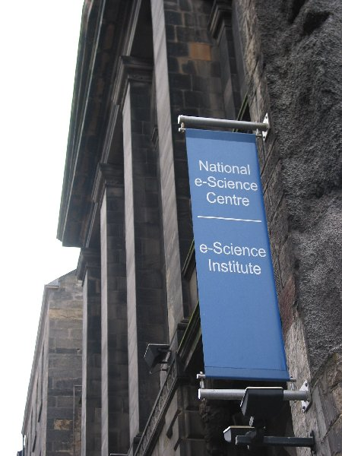
A Bright Future with OGSA Data Services
Malcolm Atkinson
Director www.nesc.ac.uk
7th June 2004

Slide 2
OGSA-DAI
Request to Registry for sources of data about “x”
Registry
GDSR
SOAP/HTTP
service creation
API interactions
Registry responds
with Factory
handle
Request to Factory for access to database
Factory
GDSF
Analyst
Factory returns handle of GDS to client
Factory creates GridDataService
Client queries GDS with SQL, XPath, XQuery etc
Database
(Xindice, MySQL
Oracle, DB2)
Query results
returned XML
Grid Data
Service
GDS
OR
delivered to consumer
as XML
Consumer
GDS interacts
with database

Slide 3


Extensibility
Should extensibility be
supported by foundation interfaces?
Data resources
  Unbounded variety
Data access languages
  Established standards
    With many variants
  SQL, OQL, semi-structured query, domain languages
Investment in DBs, DBMSs, File Stores, Bulk stores, …
  Not sensible to expect them to change to fit us
Data Access Models must be extensible
  Static extension used extensively by OGSA-DAI users

Slide 4


Move Computation to Data
Increasingly
necessary
Code scale
  Depends on wet-ware
    No noticeable rate of improvement
Data scale
  Grows Moore’s Law or Moore’s Law²
Analysis of data
  Extracts & derivatives used
    Often smaller – more value for current investigation
Implies move code to data
  SQL, Xquery, Java code, …
Extensibility mechanisms used by OGSA-DAIers
Java mobility (e.g. DataCutter), database procedures, …
Application control or higher-level service decisions

Slide 5
Integration is Everything
No business or research team is satisfied with one data resource
Domain-specialist driven
  Dynamic specification of combination function
  Iterative processes – range of time scales
Sources inevitably heterogeneous
  Content, structure & policies time-varying
Robust & stable steerable integration services
  Higher-level services over multiple resources
  Fundamental requirements for (re)negotiation
Federation or Virtualisation preceding integration or kit of integration tools to be interwoven with an application?

Slide 6
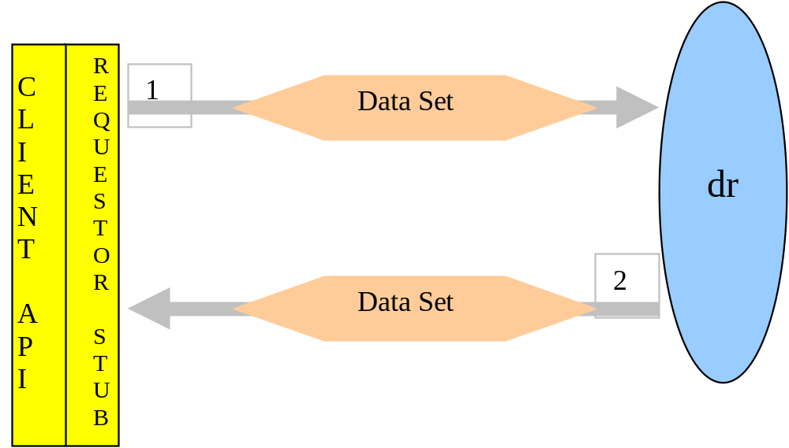
Multiple tasks / request
Ident
Type
Value
Ident
Type
Value
Ident
Type
Value
Ident
Type
Value
Ident
Type
Value
Ident
Type
Value
Ident
Type
Value
Ident
Type
Value
7
6
5
4
3
2
1
0

Slide 7
Be Direct
Breaks down
boundaries and merges data, execution & transport requirements.
Demands smart workflow enactment service & foundation services
Double Handling costs too much
  Memory cycles, bus capacity, cache disruption, …
Double Handling via discs pathologically bad
Data translation expensive
  Avoid or compose
Main memory is not big enough
Couple generator & consumer directly
  Data pipe from RAM to RAM
  Requires coupled computation execution

