Slide 1
Authentication Profiles

Slide 2
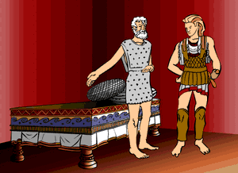
Background
How do we build trust domains?
How do we compare trust domains?
  Procrustean bed?
Trust can be built around:
  Shared responsibility.
  Common goals.

Slide 3
Trust domain Profiles
We currently have two profiles and a third is on the way.
  Classic PKI
    EGEE
  Site integrated proxy services (SIPS)
    KCAs
      FNAL
      CERN
  Credential stores
    NERSC

Slide 4
What is required for a Profile
Minimum requirements specification for community.
Publishing methods for community access.
Published set of policies
Auditable infrastructure.
Other

Slide 5
Next steps
Gather current Profile definitions and information.
Research process for registering or publishing Profiles
Draft Informational doc

