Slide 1
Grid File System
Directory Service
Specification
Manuel Pereira
IBM Almaden Research Center
mvp@almaden.ibm.com

Slide 2
Overview
Introduction
File System Directory Services
Namespace API Specification
  Service Objects
  Service Operations
  Complex Types
Federation of Directory Services
Object ID Description
Hard/Soft Links
Open Issues

Slide 3



Need for Namespace
Practical filesystem access to global data requires hierarchy and a unified namespace


Slide 4
Uniform, Global, and Hierarchical Namespace
Federation of individual files as well as filesystem trees
Two fundamental namespace components
  Virtual Directories
  Junctions

Slide 5
Filesystem Directory Service Objects
Object oriented service interface
Foundational communication objects
  Reply
  Entry

Slide 6
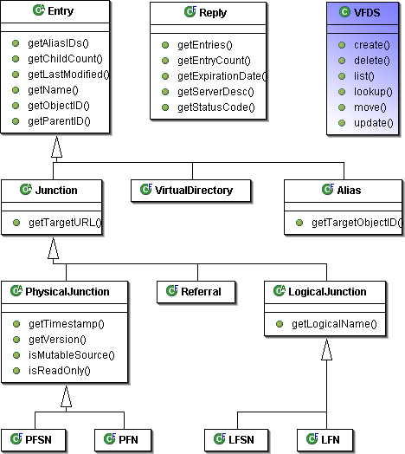
Filesystem Directory Service Objects

Slide 7
Services Operations
Basic operations include:
  Lookup
  List
  Create
  Delete
  Update
  Move

Slide 8
Complex Types
Objects used to represent the service
  Reply Object
  Entry Object
    Subclasses

Slide 9
Federation of Services
Resolving paths that span multiple namespace domains or service instances
  Service Referrals
  Delegated Resolution

Slide 10
Object ID Description
Object IDs are used as a per session object identification token
  Replaces previous VFH
  Unique per server instance

Slide 11
Hard/Soft Links
Namespace objects that point to other namespace objects
  To satisfy the requirement of hard and soft links
  To reduce redundancy
Aliases
  Cover both hard and soft links
  Eliminates orphaned links
  Reduces confusion regarding junctions

Slide 12
Open Issues
Security
  Access Control Lists (ACLs)
Replication of Repositories
Backup
Consistency Issues between physical file data and namespace entries
Interoperability

Slide 13
Thank you!

