Slide 1
GLOBALGRIDFORUM.ORG
Grid Scheduling Architecture
RG
GGF11
Honolulu
June, 2004

Slide 2
GGF Intellectual Property
All statements related to the activities of the GGF and addressed to the GGF are subject to all provisions of Section 17 of GFD-C.1, which grants to the GGF and its participants certain licenses and rights in such statements. Such statements include verbal statements in GGF meetings, as well as written and electronic communications made at any time or place, which are addressed to any GGF working group or portion thereof,
Where the GFSG knows of rights, or claimed rights, the GGF secretariat shall attempt to obtain from the claimant of such rights, a written assurance that upon approval by the GFSG of the relevant GGF document(s), any party will be able to obtain the right to implement, use and distribute the technology or works when implementing, using or distributing technology based upon the specific specification(s) under openly specified, reasonable, non-discriminatory terms. The working group or research group proposing the use of the technology with respect to which the proprietary rights are claimed may assist the GGF secretariat in this effort. The results of this procedure shall not affect advancement of document, except that the GFSG may defer approval where a delay may facilitate the obtaining of such assurances. The results will, however, be recorded by the GGF Secretariat, and made available. The GFSG may also direct that a summary of the results be included in any GFD published containing the specification.

Slide 3
Agenda
  Overview/Charter
  Use-Cases
  Identifying Required Components/Services
  OGSA job scheduling
  Next Steps

Slide 4
Charter
The goal of this research group is to define a scheduling architecture that supports cooperation between different scheduling instances for arbitrary Grid resources. Considered resources include network, software, data, storage and processing units. The research group will particularly address the interaction between resource management and data management. Co-allocation and the reservation of resources are key aspects of the new scheduling architecture, which will also include the integration of user or provider defined scheduling policies.
The group will begin with identifying a set of relevant use-cases based on experiences obtained by existing Grid projects. Then, it will determine the required components of a modular scheduling architecture and their interactions.
Services and protocols from other GGF groups are
considered as potential basic building blocks of
such an architecture and will be used wherever possible.

Slide 5

Goal: Grid Scheduling Architecture?
Grid-
User/Application
Grid-
Scheduler
Information
Services
Not about defining these scheduling algorithms !
Monitoring
Services
Security
Services
Grid
Middleware
Grid
Middleware
Grid
Middleware
Grid
Middleware
Accounting/Billing
Other
Grid Services
Local RMS
Local RMS
Local RMS
Local RMS
But about identifying all required services, protocols and interfaces!
time
time
time
time
Schedule
Schedule
Schedule
Schedule
Compute
Resources
Data
Resources
Network
Resources
Other
Resources/Services

Slide 6
Documents to work on
Requirements of Coordinated Grid Scheduling
  Collect use cases
  Derive requirements
Architecture for Grid Scheduling
  Identify components/services
  Match existing components/services
  Define required interfaces/protocols for scheduling

Slide 7
Use Cases
Contributions
  Migration Use Case (GridLab, K. Kurowski)
  Coordinated Simulation and Visualization (C3-Grid, R. Yahyapour)
  Knowledge Grid Scheduler (DEIS, A. Pugliese, D. Talia)
  Self-Organising GRM (A. Lazarevic, UK UCL, BT ExacT)
  Nimrod/G, GridBus (R. Buyya)
  OGSA Use-Case Doc made available in public comment period
    extract and extend the scheduling aspects (volunteers?)
Other Projects
  DataGrid, EGEE
  Platform CSF

Slide 8
Use-Case Example:
Coordinated Simulation and Visualization
Example of a job request:
A specified architecture with
  48 processing nodes,
  1 GB of available memory, and
  a specified licensed software package
  for 1 hour between 8am and 6pm of the following day
    Time must be known in advance due to interaction.
A specific visualization device (VR) during program execution
Minimum bandwidth between the VR device and the main computer during program execution
Input: a specified data set located at a data repository
at most 10 GGF-$
  preference of cheaper job execution over an earlier execution.

Slide 9
Use-Case Example:
Coordinated Simulation and Visualization
Expected output of a Grid scheduler:
resources
time
Data
Data Access
Storing Data
Network 1
Data Transfer
Data Transfer
Computer 1
Loading Data Parallel Computation Providing Data
Network 2
Communication for Computation
Computer 2
Parallel Computation
Software License
Software Usage
Storage
Data Storage
Network 3
Communication for Visualization
VR-Cave
Visualization

Slide 10
Use-Case Example:
Coordinated Simulation and Visualization
Functional Requirements:
  Cooperation between different resource providers
  Interaction with local resource management systems
  Support for reservations and service level agreements
  Orchestration of coordinated resources allocations
  Automatic handling of accounting and billing
  Monitoring
  Failure Transparency

Slide 11
Use Case Template
Template available on GridForge
  Summary
  Customers
  Scenario(s)
  Involved Resources
  Functional Requirements
  Workflow of Scheduling Process
  Involved Scheduling Components/Services
  Failure Considerations
  Security Considerations
  Performance Considerations
  Use Case Situation Analysis
  References
Goal: collection of different use-cases in this format
Next: identifying common generic use-cases
derived from OGSA Use Case document
revised and extended at GGF10

Slide 12
Required Services/Components
Grid-
User/Application
Grid-
Scheduler
Information
Services
Monitoring
Services
Security
Services
Grid
Middleware
Grid
Middleware
Grid
Middleware
Grid
Middleware
Accounting/Billing
Other
Grid Services
Local RMS
Local RMS
Local RMS
Local RMS
time
time
time
time
Schedule
Schedule
Schedule
Schedule
Compute
Resources
Data
Resources
Network
Resources
Other
Resources/Services

Slide 13
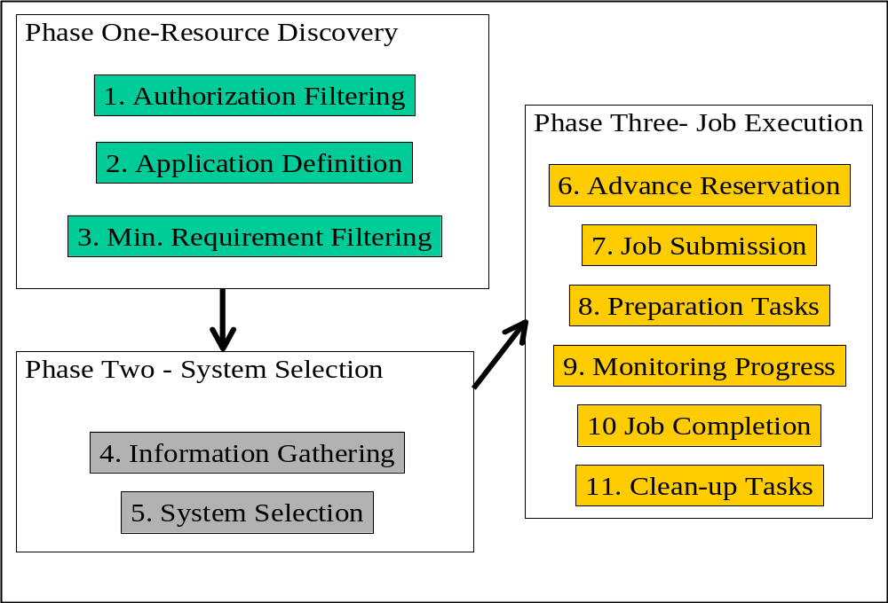
Activities of a Grid Scheduler
Detailing “10 Actions of Super Scheduling (GFD-I.4)”
Identifying required services/components
Source: Jennifer Schopf

Slide 14
Required Services/Components
Relevant to scheduling architecture
  Information Service
  Job/Workflow Description
  Requirement Description
  Resource Discovery
  Reservation
  Monitoring/Notification
  Job Execution
  Security
  Accounting/Billing
  Data Management
  Local RMS
  (…?)
Other services/components required?

Slide 15

OGSA Scheduling
Data Catalog
Data Provision
Virtual
Organization
Data Integration
Policy +
Agreement
Data Access
Context
Services
Data
Services
Status +
Monitoring
Services
Problem
Determination
Event
Information
Service
Logging
Service
Application
Content
Manager
Workflow
Manager
Workload
Manager
Broker
Execution
Planning
Service
Job
Manager
Job
Service
Job &
Workflow
Management
Infrastructure
Services
WS-RF
(OGSI)
Notification
WS
Distributed
Management
Resource
Management
Services
Security
Services
Reservation
Service
Service
Container
Deploy +
Configuration
Service
Provisioning
Authentication
Authorization
Delegation
Firewall
Transition

Slide 16
OGSA Philosophy
“
Demand
”
“
Supply
”
Workload Mgmt.
Environment
Resource Mgmt. Framework
Framework
Mgmt.
CMM
Reservation
Resource
Primary Interaction
Factory
User/Job
Policies
Job
Information Provider
Resource
Proxies
Factory
Allocation
Dependency management
Meta
-
Interaction
Resource Provisioning
(or Binding)
Optimizing Framework
Workload Optimizing Framework
Scheduling
Resource Optimizing Framework
Queuing Services
Capacity Management
Workload Optimization
Workload Optimization
Resource Placement
Workload Post Balancing
Resource
–
Workload
Admission Control (Resources)
Optimal Mapping
Workload Models (History/Prediction)
Quality of Service (Resources)
Workload Orchestration
Resource Selection
Admission Control (Workload)
Selection Context (e.g. VO)
SLA Management (Workload)
Represents one or more OGSA services

Slide 17
Information Service
Resource Discovery
Relevant for Grid Scheduling:
Access to static and dynamic information
Dynamic information include data about planned or forecasted future events
  e.g.: existing reservations, scheduled tasks, future availabilities
  need for anonimized information (privacy concerns)
information about all resource types
  including e.g. data and network

Slide 18
Job/Workflow Description
Requirement Description
Information about the job specifics (what is the job)
and job requirements (what is required for the job)
need for workflow description
  e.g. a DAG formulation
  need for extracting workflow information to schedule whole workflow

Slide 19
Reservation Management
Agreement and Negotiation
Interaction between scheduling instances, between resource/agreement providers and agreement initiators (higher-level scheduler)
  access to tentative information necessary
  negotiations might take very long
  individual scheduling objectives to be considered
  probably market-oriented and economic scheduling needed
Need for combining agreements from different providers
  coordinate complex resource requests or workflows
Maintain different negotiations at the same time
  probable several levels of negotiations, agreement commitment and reservation

Slide 20
Accounting and Billing
interaction to budget information
charging for allocations, reservations; preliminary allocation of budgets
re-funding in terms of resource/SLA failure, re-scheduling etc.

Slide 21
Job Execution Services
Link to execution services to fulfill scheduled allocations
feedback on resource or job failures
interface to cancel or modify scheduled job executions
monitoring of agreement and execution status

Slide 22
Monitoring Services
Monitoring of
  resource conditions
  agreements
  schedules
  program execution
  SLA conformance
  workflow
  …

Slide 23
Data Management
Access to information about the location of data sets
information about transfer costs
schedules about data transfers and data availability
coordination with network or other resources
similarities with general grid scheduling:
  access to similar services
  similar tasks to execute
  interaction necessary

Slide 24
Reviewing Existing Services/Components
Relevant to scheduling architecture
  Information Service (GIR)
  Job/Workflow Description (JSDL,WFM)
  Requirement Description (JSDL, GRAAP)
  Resource Discovery (OGSA, WSRF)
  Reservation (GRAAP)
  Monitoring (OGSI/WSRF, DAMED)
  Job Execution (DRMAA)
  Security (GSI)
  Accounting/Billing (GESA)
  Data Management (DAIS)
  Local RMS (SA)
Other groups to be considered?

Slide 25
Setup Liaisons
Liaisons to other groups
  GRAAP (Wolfgang Ziegler, Volker Sander)
  GESA, RUS (Steven Newhouse)
  DRMAA (Hrabri Rajic?)
  proposed GSO-WG (Wolfgang Ziegler)
  JSDL (Ali Anjomshoaa)
  OGSA (?)
Existing architectural approaches:
  Knowledge Grid Scheduler (DEIS, A. Pugliese, D. Talia)
  Self-Organising GRM (A. Lazarevic, UK UCL, BT ExacT)
  Koala (Dick Epema)
  GriPhyN (Richard Cavanaugh)
  Platform CSF (Christopher Smith)
  GridBus (Raj Buyya)
Volunteers for liaisons?

Slide 26
Next Steps
Collect and compile use-cases and create first document draft
Start requirements analysis
Document editors:
  Philipp Wieder, Wolfgang Ziegler, Dick Epema,
  Richard Cavanaugh, Ramin Yahyapour, Jarek Nabrzyski,
  Uwe Schwiegelshohn
  Volunteers?
Start discussion on the mailing list;
join gsa-rg@gridforum.org (currently about 65 subscribers)

