Slide 1
Web Services Data Access and Integration Specifications:
WS-DAI, WS-DAIR, WS-DAIX … and friends
Norman Paton
University of Manchester

Slide 2
Specifications
Web Services Data Access and Integration (WS-DAI):
  A paradigm-neutral specification of descriptive and operational features of services for accessing data.
The WS-DAI Realisations:
  WS-DAIR: for relational databases.
  WS-DAIX: for XML repositories.

Slide 3
DAIS Specification Landscape
Open Grid Services
Architecture
Scenarios for Mapping
DAIS Concepts
GWD-I
Is Informed By
WS-DAI
GWD-R
WS-DAIR
WS-DAIX
Extend

Slide 4
Terminology - 1
Data Service: a web service that conforms to one of the DAIS specifications.
Data Resource: any system that can act as a source or a sink of data (e.g. a relational database).
Consumer: an application that exploits a Data Service to access a Data Resource.
Data Set: an encoding of data suitable for externalising data outside a Data Resource.

Slide 5
Terminology - 2
Data Description: provides metadata about a data resource and the relationship of that resource to a service interface.
Data Access: provides access to data through a service interface.
Data Factory: exposes derived data through a service interface.
Data Management: manages the relationship between a service and the data resource that it exposes.

Slide 6
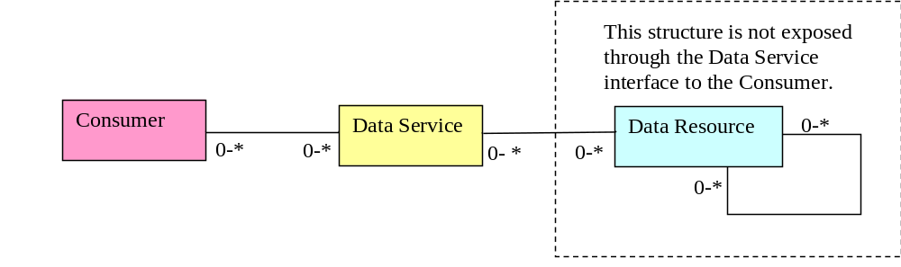
Data Service Model

Slide 7
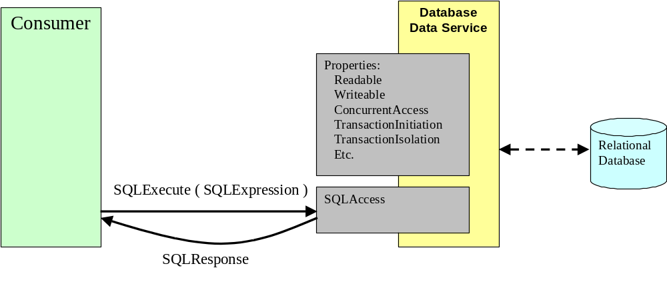
Data Access
Data Access collects together messages that access and/or modify a resource.

Slide 8
Behavioural Properties
The following behavioural properties are defined:
  Readable (boolean).
  Writeable (boolean).
  Concurrent Access (boolean).
  Transaction Initiation (enumeration).
  Transaction Isolation (enumeration).
  Sensitivity (enumeration).
Realisations MAY extend this list.

Slide 9
Data Access Message Patterns
To encourage consistency in the realisations, the following message pattern is provided by WS-DAI:
  <wsdai:RequestMessage>
  <wsdai:RequestDocument/>
  <wsdai:ResponseFormat/>?
  </wsdai:RequestMessage>
The ResponseFormat, if present, MUST contain a QName from the RequestMessageResponseTypeList informational property.

Slide 10
Data Factory
Data Factory collects together messages that implement the factory pattern.
This factory pattern is used principally to support flexible handling of the results of requests.

Slide 11
Data Factory - 2
Consumer
Database
Data Service
Properties
:
Readable
Writeable
ConcurrentAccess
TransactionInitiation
TransactionIsolation
Relational
SQLExecut
eF
actory
Etc.
Database
( SQL
Expression
ServiceTerms )
SQL
Factory
Reference to
RDBMS specific mechanism for
SQLResponse Data S
ervice
generating result set
SQL Response
Data Service
GetRowset
(
rowset
number
)
SQLR
esponse
Description
Row Set
SQLResponse
Access
Rowset

Slide 12
Message Patterns
To encourage consistency in the realisations, the following message pattern is provided by WS-DAI:
  <wsdai:RequestMessage>
  <wsdai:RequestDocument/>
  <wsdai:BehavioralProperties/>
  </wsdai:RequestMessage>

Slide 13
Mapping to WSDL
The Mapping to WSDL should be seen as indicative. A wider discussion of Mapping issues for DAIS is provided in:
  S. Laws, S. Malladi, S. Parastatidis, Scenarios for Mapping DAIS Concepts, Informational Draft, GGF12.
The WSDL mapping provided in the specifications is in the context of WSRF.
We are participating in the OGSA Data Architecture and the OGSA Naming design teams.

Slide 14
… and friends
In the next few slides:
  Data management (WSDM).
  Data movement (Infod-WG).
  Naming (OGSA, etc).
  Federation.
Not in the next few slides:
  File access (ADF-WG).
  Metadata modelling (CGS-WG).
  Storage Management (GSM-WG).

Slide 15
Data Management
Data Management is not yet defined.
Themes:
  Managing the resource.
  Managing the service.
  Managing the service-resource relationship.
Awaiting the outcome of Web Services Distributed Management (WSDM) [WSDM] TC in OASIS.

Slide 16
Data Movement
Third party and asynchronous delivery:
  Infod. Mechanisms:
    Infod service access resources via DAIS.
    DAIS result services implement Infod portTypes.
Third party synchronous delivery:
  Position vacant.
  DAIS result services could implement service-to-service or service-to-file portTypes.

Slide 17
Naming
Current DAIS position:
  Specifications cast in terms of WSRF.
  Exploration of naming options.
DAIS ethos:
  WS-DAI quite generic, should be able to be instantiated in many different ways.
  Realisations may take specifications into contexts with existing naming schemes.
DAIS is somewhat stalled on this issue.

Slide 18
Federation
DAIS interfaces should:
  Be usable to access a federation.
  Be usable by a federation to access resources.
In terms of the above:
  Is a property of the federation.
  May provide requirements on DAIS.

Slide 19
Federation Requirements
Thorough metadata:
  Logical, physical, …
Flexible delivery:
  Incremental.
  Third party.
Flexibility w.r.t. transparencies.
  Replication.
  Naming.
  …

Slide 20
Summary
Core of specifications has been stable for a year.
Completion delayed by maturity/presence of related specifications.
Activities:
  Cleaning/tightening of specifications.
  Revising in the light of implementation experiences.
  Working with related groups on boundary conditions, etc.

