Slide 1
CIM Overview
Andrea Westerinen

Slide 2
Agenda – Monday, Sept 20th
9-9:15am, Introductions (Tom Roney)
9:15-10:15am, DMTF Executive Overview (Troy Biegger)
10:30am-Noon, CIM Overview and Grid Service Example (Andrea Westerinen)
1-1:45pm, Application Management and Behavior and State (Karl Schopmeyer)
1:45-3pm, WBEM Architecture and XML Renderings (Jim Davis)
3:15-3:45pm, WBEM Open Source Overview (Jim Davis)
3:45-4:30pm, Pegasus and WBEM Services Overviews (Karl Schopmeyer and Jim Davis)
4:30-5pm, Q&A

Slide 3
Agenda – Wednesday, Sept 22nd
CGS Sessions
11am-12:30pm, Introductions (Tom Roney) + DMTF Executive Overview (Troy Biegger) + CIM Introduction (Andrea Westerinen)
3:30-5pm, CIM Overview and Grid Service Example (Andrea Westerinen) + Application Management and Behavior and State (Karl Schopmeyer)
7:30-9pm, WBEM Architecture, Open Source and XML Renderings (Jim Davis and Karl Schopmeyer)

Slide 4
Differing Aspects of a Model
Two very different aspects of a model exist – Semantics and rendering
  Each has their own requirements and restrictions
Semantics -> Rendering
  The model (CIM) dictates content and concepts / Ideally have one model
  Language constructs and rules dictate the rendering / Multiple renderings are possible (from abstract UML to specific XML Schema)

Slide 5
Modeling Considerations
Scope and coverage
Modeling concepts and principles
Using the model (And an example)

Slide 6
Scope – The Environment AND the Element
CIM’s scope addresses the "big picture“, but implementation can be limited to a single element
  Allows dive down into specific components when necessary
  Example: 20 second access to critical data - Is the problem in the server, the network, the storage or all three?
  To answer, need element details, and information on the interactions between the elements and business priorities
Configurations span many elements, to accomplish business goal
  Desirable for all the elements to understand the "larger" business goals and how they fit into accomplishing these goals
  Ideally, equipment understands the same config commands
  Example: Failing over from LA to Chicago

Slide 7
CIM’s Coverage (1)
Configuration and/or general management data (what is and what is desired)
  For example, supporting root cause analysis
Relationships
  Usage, component, …
  General abstractions but specific implementations
Design for evolution and extension (std + proprietary)
Not only about data, also about operations
  Domain-specific operations with parameters (ex: CreateOrModifyStoragePool)
Fits all the pieces together in a single conceptual model

Slide 8
CIM’s Coverage (2)
Applications and Services
Application Server
Database
Policy
Support
Mgmt Infrastructure / Events
Users and Security
Operating System
Systems, Devices/Storage, …
Physical
Network
CIM

Slide 9
Modeling Goals
Predictability
  Once the model is learned, the location of specific data is maintained and therefore "predictable"
“Stable” semantics that can be specialized and extended
Reuse of the model versus redefinition

Slide 10
OO Concepts
Abstraction (Determination of “essential” characteristics that distinguish and define an object’s conceptual boundaries)
Modularity (Decomposition of concepts into discrete units)
Encapsulation (Compartmentalization of structure and behavior; Separation of abstraction and implementation)
Hierarchy (Ordering of abstractions)

Slide 11
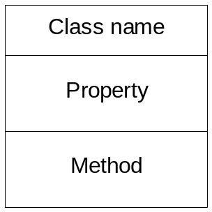

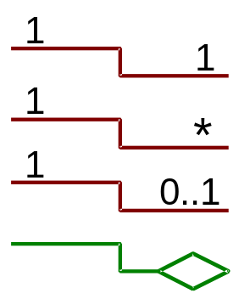
CIM’s Elements
Classes – Collection of definitions of state, behavior, and identity
  Properties
  Methods
Objects – Instances of a class
Class hierarchy – Subclassing
Associations - Relationships
  Dependency
  Identity
  Aggregation
  Composition
  And others

Slide 12
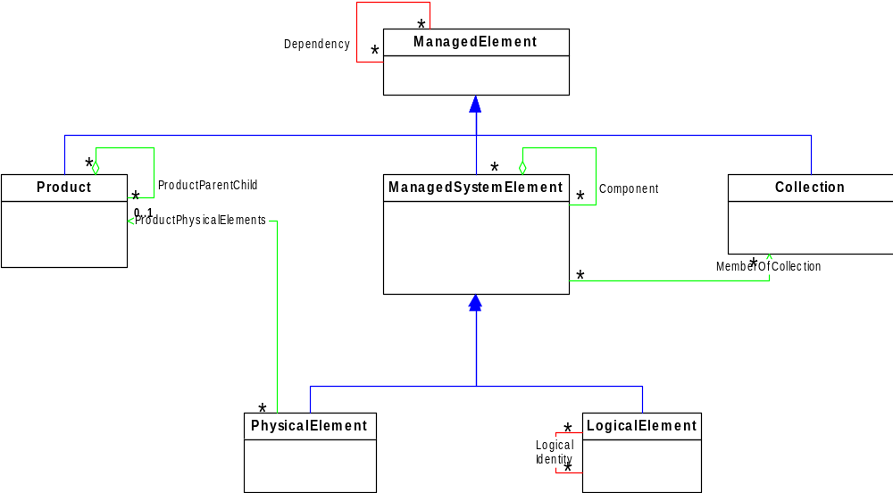
CIM’s UML
ASSOCIATIONS
INHERITANCE
AGGREGATION
(A kind of association)
METHODS

Slide 13
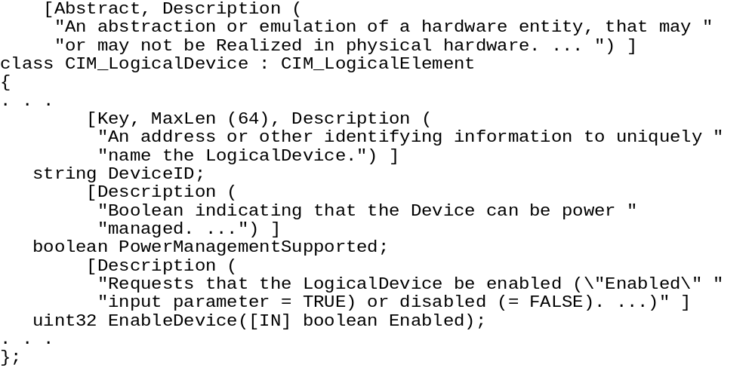
CIM’s MOF (An Abstract Rendering, Just One of the Possible Renderings)
Qualifiers
Class Name and Inheritance
Properties
Methods

Slide 14
CIM’s Structure – Core and Common Models
Infrastructure Specification
  “Meta”-model, high level concepts and language definitions
“Core” and “Common” Models
  Core Model contains info applicable to all management domains
  Common Models address specific domains - Systems, Devices, Applications, Networks, Users, ...
    Subclass from the Core Model
    Models overlap and cross-reference
  Vendor extensions encouraged

Slide 15
Using the CIM Schema
NEVER … “What class(es) do I need?”
ALWAYS … “What is being managed and modeled?”
  Who (Users and Security), What (Physical and Logical Elements), Where (Location), When (aspects of time), How (Services and Service Access Points) and Why ( ROI ! )
  Do any of the core or common models match the design points?
  Examine the CIM inheritance tree to find matching concepts / Read profiles or the MOF for details
  Iterate based on the use cases, data flow and what is found in CIM

Slide 16
CIM Grid Service Example
Instances of CIM_BatchService
Instance of
CIM_Computer
System
AcmeSpareManager
ServerA
AcmeJobManager
Failover (see
subsequent slide)
CIM_HostedService (assoc to
indicate where service is located)
CIM_QueueForBatchService (assoc
to indicate where jobs are distributed)
QueueBHigh
QueueB
QueueDHigh
QueueD
Instances of
CIM_JobQueue
QueueC
CIM_HostedJobDestination (assoc
to indicate where queues are located)
ServerB
ServerD
ServerC
Instances of CIM_ComputerSystem with CIM_Processor
associated via CIM_SystemDevice and CIM_Operating
System associated via CIM_RunningOS

Slide 17
Example – The Job Managers
"AcmeJobManager" is an instance of BatchService
  “Submit job" method is part of its functional/business interface, and not its management interface
  So, BatchService works as defined
"ServerA" hosts the AcmeJobManager
  Is an instance of ComputerSystem
  Used to manage the status of the system and the service
"RedundantJobManagers” is an instance of a RedundancySet
  For failover of the AcmeJobManager
  Associated with the "AcmeSpareManager" (idea that Acme is cheap and only has 1 spare for all its job managers across the Internet)

Slide 18
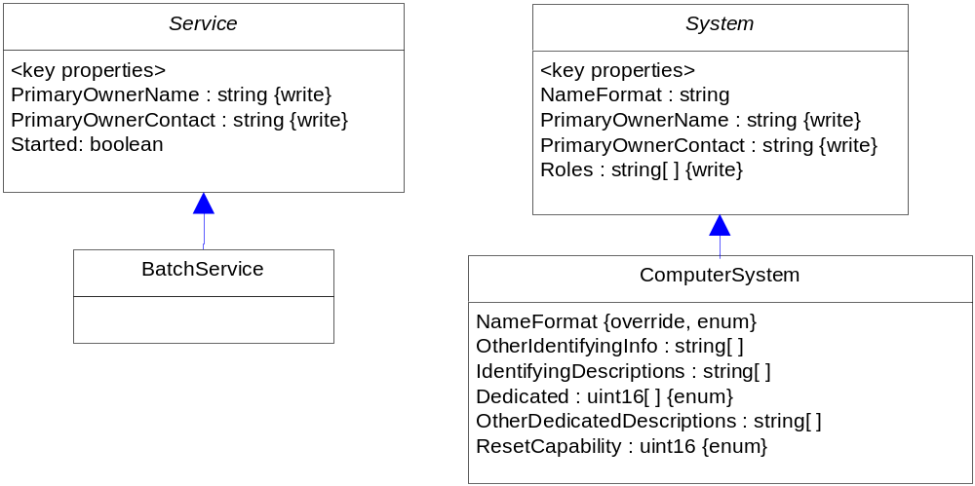
Service and System Subclasses of EnabledLogicalElement
Instances:
AcmeJobManager
AcmeSpareManager
Instances:
ServerA, ServerB,
ServerC, ServerD

Slide 19
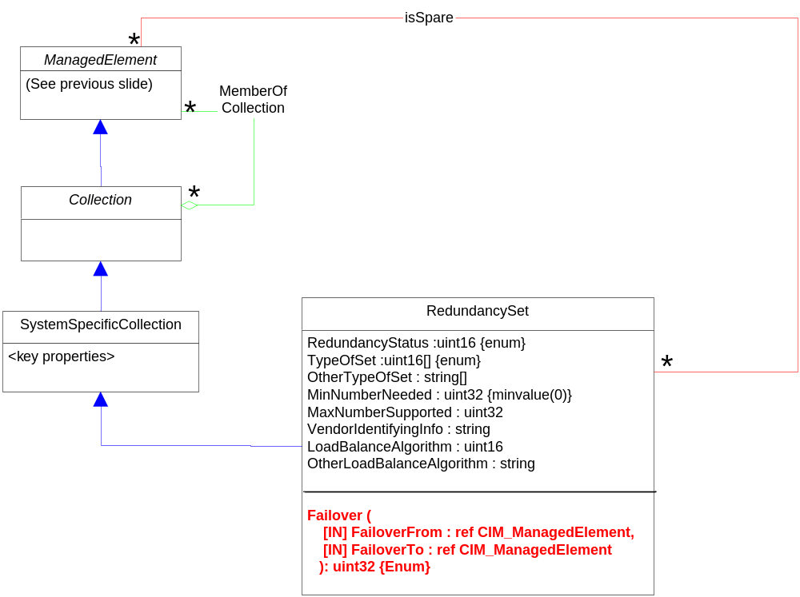
CIM Redundancy Modeling
Instance associates
AcmeJobManager and
other Acme managers to
the RedundancySet
Instance associates
AcmeSpareManager
Instance:
RedundantJobManagers

Slide 20
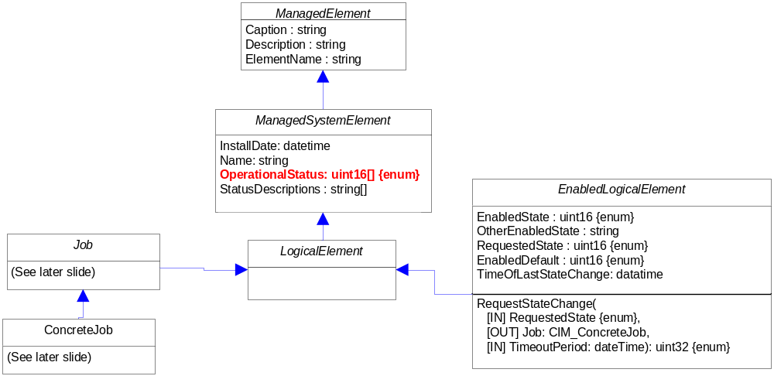
Background: CIM Class Derivation

Slide 21
Example – The Execution Servers
"ServerB", "ServerC" and "ServerD" are instances of ComputerSystem
  With SystemDevice associations to 4 instances of Processor (on B and D) and 2 instances of Processor (on C) / Servers B and C are running "Linux", while D runs "Microsoft Windows Server 2003"
"QueueBHigh", "QueueB", "QueueC", "QueueDHigh" and "QueueD" are instances of JobQueue on Servers B (2 queues), C (1 queue) and D (2 queues)
  Each has an associated QueueStatisticalData
Queues are associated to AcmeJobManager via the QueueForBatchService relationship
  AcmeJobManager distributes jobs to Servers B, C and D based on their queue backlogs, and OS

Slide 22
Example – Jobs and Notifications
Jobs are really instances of BatchJob, and are located in a queue using the JobDestinationJobs association
AcmeJobManager registers for Indications on all submitted Jobs
  If the Job's Run* properties indicate a time earlier than StartTime (ie, the job was scheduled to run at a specified time, but did not start on or before that time)
  Then another Indication is raised regarding an SLA violation

Slide 23
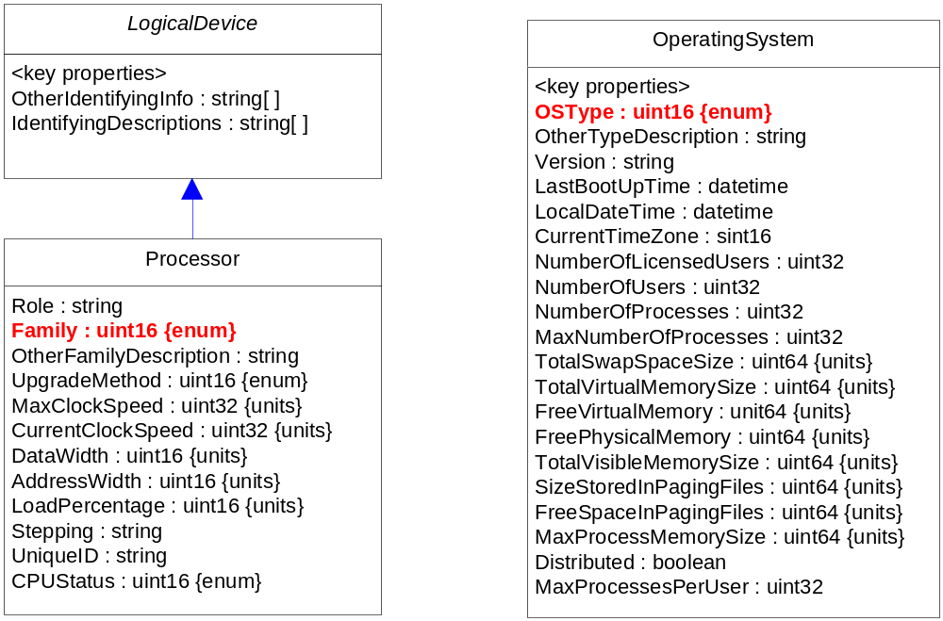
More Subclasses of EnabledLogical Element to Manage OS and Processor
Associated to a
System via
SystemDevice
Associated to a System
via InstalledOS and
RunningOS

Slide 24
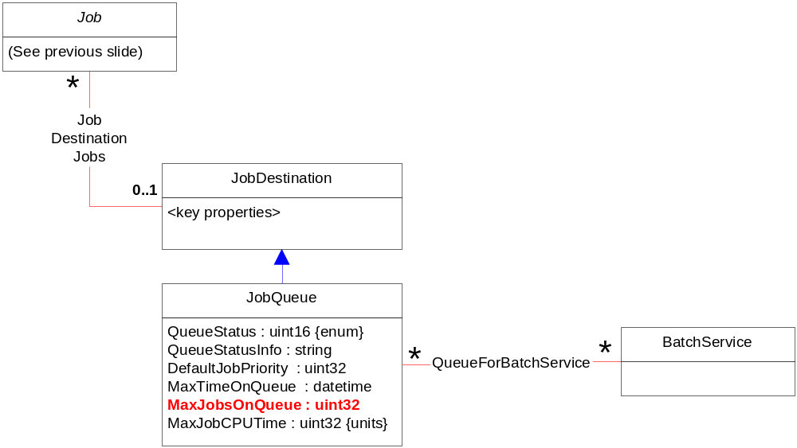
CIM Job Queues

Slide 25
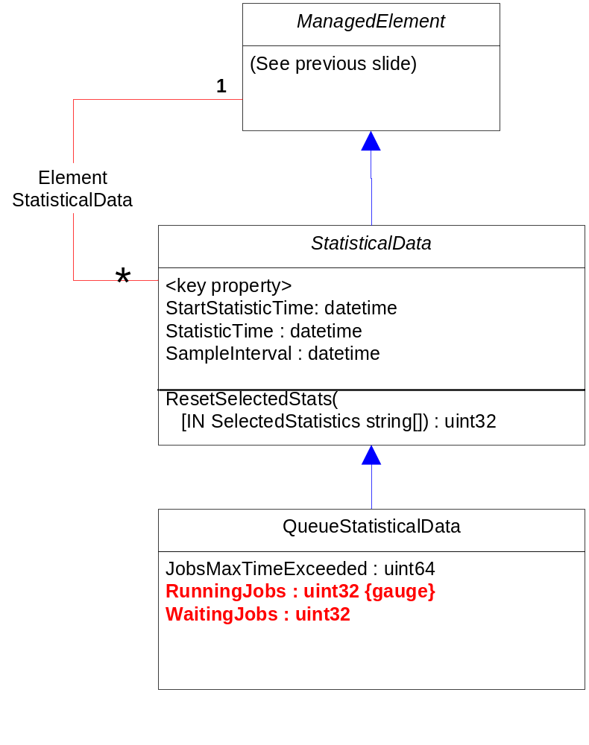
CIM Queue Statistics

Slide 26
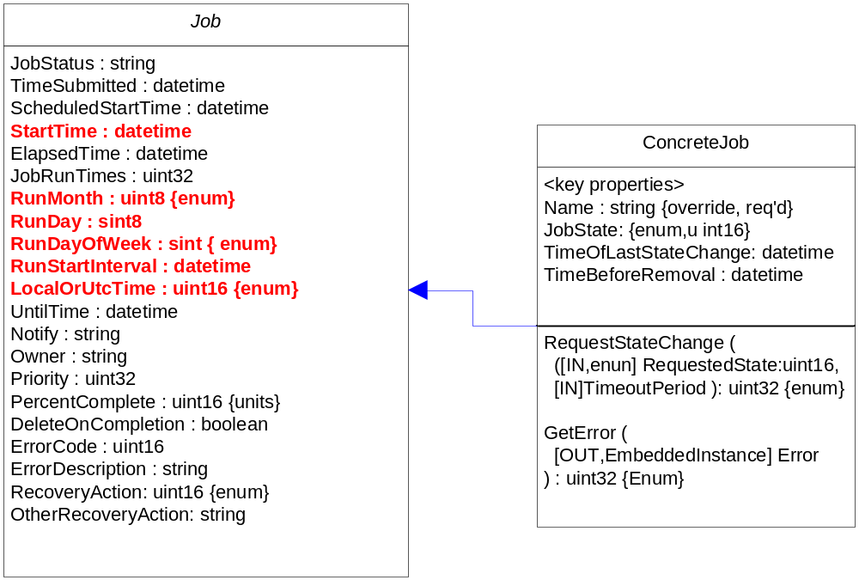
CIM Jobs

Slide 27
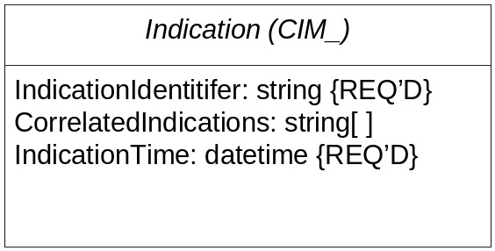
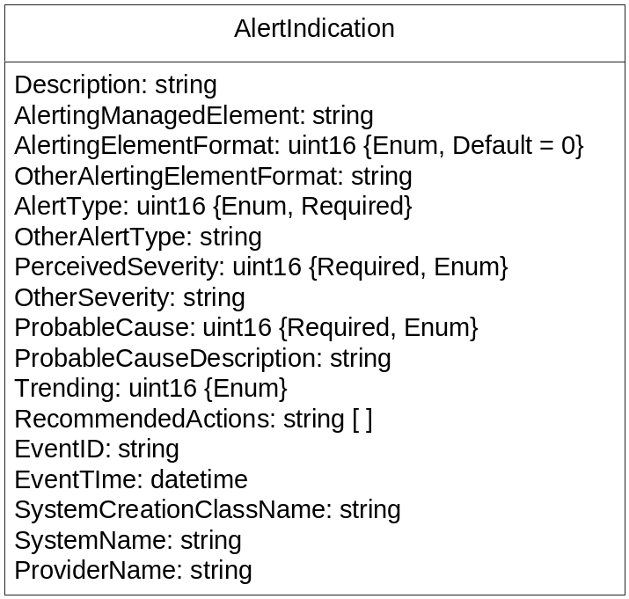
CIM Notifications

Slide 28
Backup

Slide 29



OO Example - Abstractions
Cheeseburger
Fun to cook!
Good to eat!

Slide 30
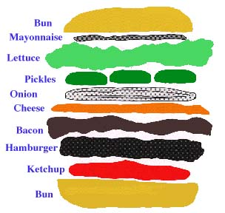
OO Example - Modularity

Slide 31


OO Example - Encapsulation
To cook the cheeseburger:
- Is the stove available?
Are the burners working?
Are the ingredients available?
To eat the cheeseburger:
- Is it made correctly?
Is my plate clean or disgusting?

Slide 32
OO Example - Hierarchy
Sandwich
Hamburger
French Dip
Cheeseburger

