Slide 1
Scheduling complex workflows in heterogeneous Grid environments
_
GSA-RG use case and proposed architecture
Philipp Wieder, Research Centre Jülich
GGF 12, September 21, 2004, Brussels, Belgium

Slide 2
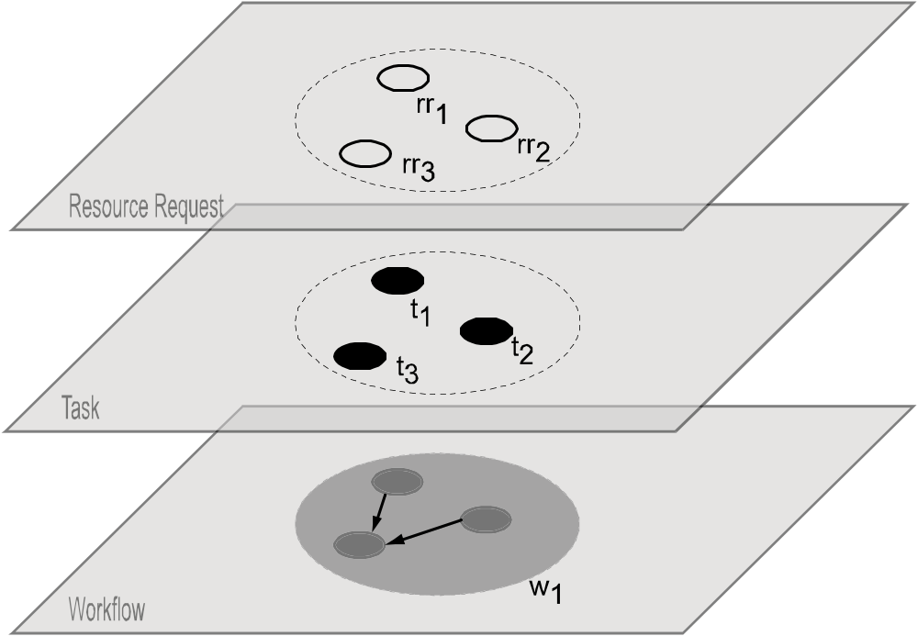
Job abstraction

Slide 3
Scheduling process I
Compose and submit the job request
  Work flow of job steps/tasks included
  No specific job description format required
Pre-process the job request
  Parse & validate
  May result in job’s translation/failure
Gather static resource information
  “Static” = Valid at least until job terminates
  E.g. software, max. number of nodes, …
Pre-select resources based on 3.
  Limit information providers queried dynamically
  Choreograph/manage services

Slide 4
Scheduling process II
Query dynamic resource information
  Limited to information providers selected in 4.
Generate the schedule and do advance reservation
  Negotiate with lower-level RM based on schedule generated
  Negotiation results in advance reservation or
  Re-scheduling (may include 5.)
Execute work flow
  Failure management crucial
Complete work flow
  Includes accounting & billing
  Delivery of results

Slide 5
Example process
Compose & submit
job request
Query dynamic
res. info
10 resource candidates left
Job request
translation
Generate &
Initiate
schedule
Pre-process
Negotiation/AR
failed
[not valid]
[failed]
[valid]
[successful]
Gather static
res. info
Execute
workflow
Total of 800
resource candidates
Executed by underlying RMs
Pre-select
resources
Accouting/
Billing/
Deliver data
30 resource candidates left

Slide 6
Functional requirements
Job parsing & job validation
Information retrieval (static & dynamic)
Resource pre-selection
Scheduling
Agreement negotiation & advance reservation
Work flow execution/processing
Billing & accounting
Authentication, authorization, user right delegation & job integrity verification
Service choreography & service management
Failure management

Slide 7
Components/services involved
Job composition & submission service
Scheduling & resource management service
Brokering service
Information service
Accounting service
Billing service
Execution service
Translation service
Negotiation service
[Local resource managers]

Slide 8
Services & interfaces
from outside world
Job composition &
submission service
Billing service
Translation service
Scheduling & resource
Brokering service
Accounting service
management service
Negotiation service
Information service
Execution service
to other RMs

Slide 9
Questions?
How to do the splits between specificity & general usability?
Where are the boundaries between local & global scheduling/resource management?
How to describe those?
Job scheduling vs. service choreography (everything a service → job == service?)
Relationship to OGSA: EMS, RMS, information services
…

