Slide 1
Transactional requirements for e-DiaMoND

Slide 2
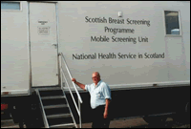
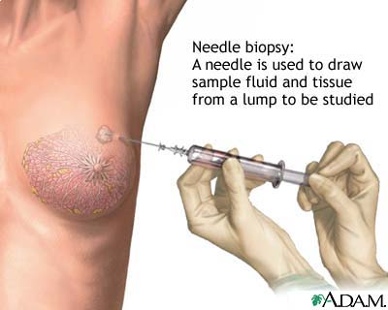


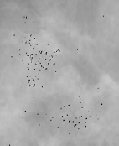
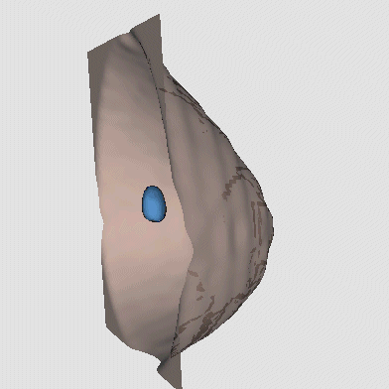

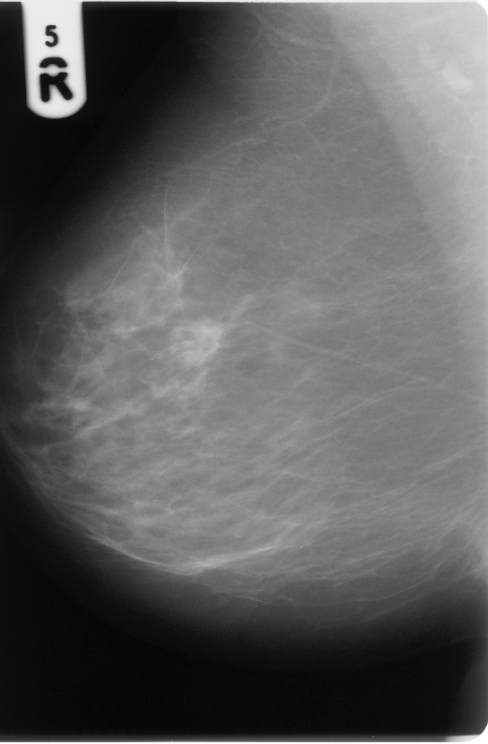
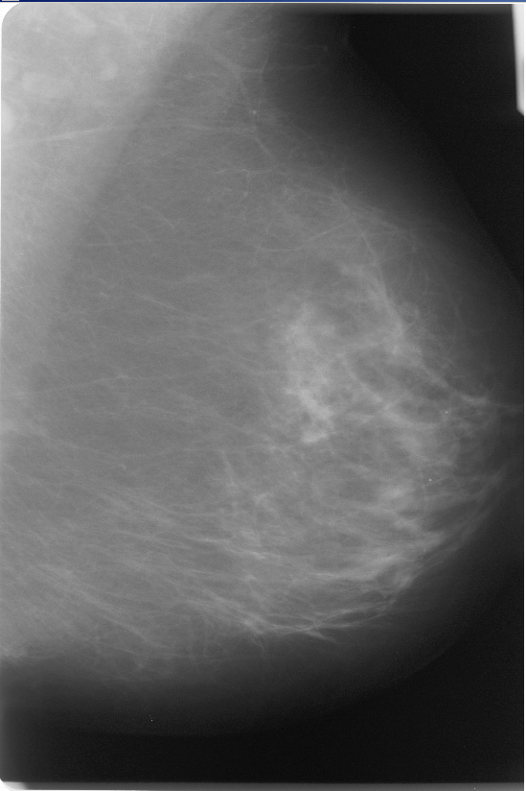
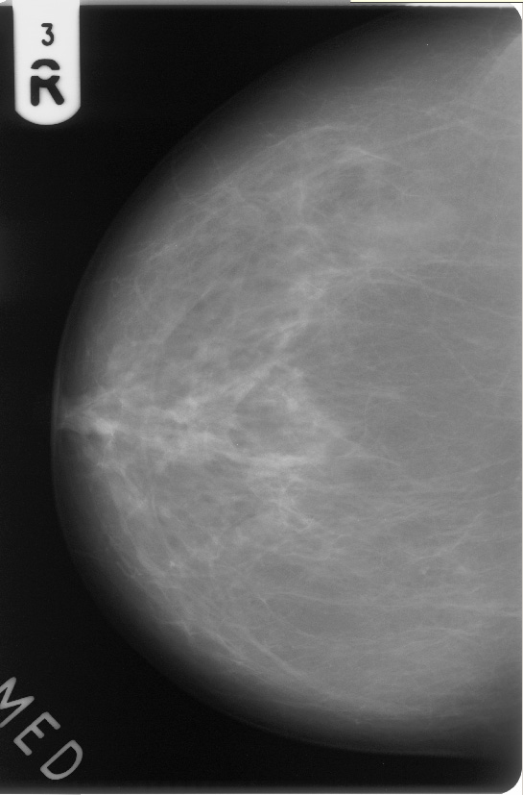
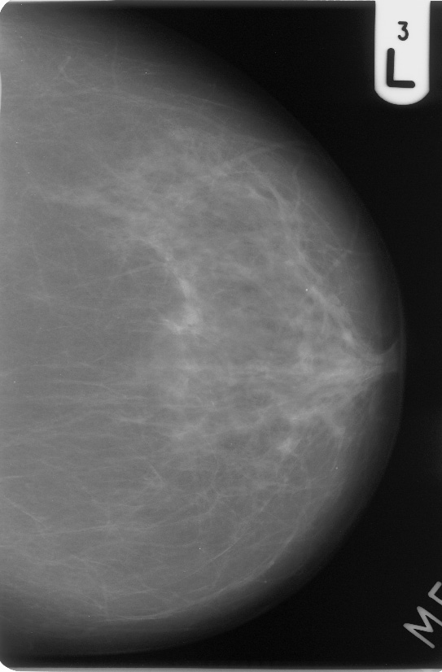

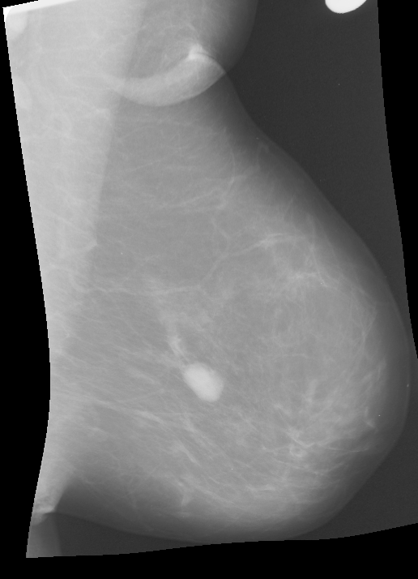
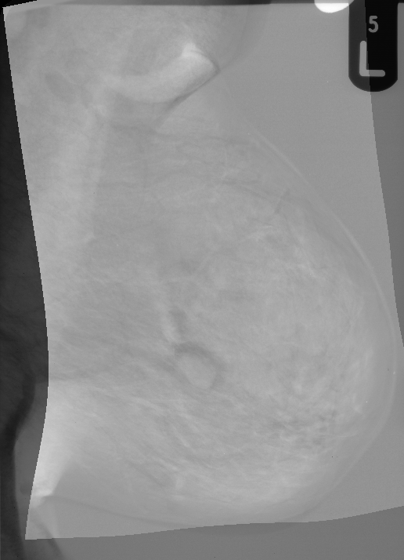
Breast Screening – Our vision
1 Trust → Many Trusts
Collaborative Working
Audit capability
Epidemiology
Radiology reporting
systems
Electronic
Patient Records
Patients
Letters
Screening
Case Information
Assessment/ Symptomatic
Biopsy
Other Modalities
MRI
PET
Ultrasound
2ndary Capture
Or FFD
X-Rays and
Case Information
Symptomatic/Assessment
Information
eDiaMoND
Grid
Better access to
Case information
And digital tools
Case and
Reading Information
SMF
CAD
3D Images
Training
Case and
Reading Information
Digital
Reading
Supplement Mentoring
With access to digital
Training cases and sharing
Of information across
clinics
Manage Training Cases
Perform Training
SMF
CAD
Temporal Comparison

Slide 3
Data Projections
Name: Mrs Jones
D.O.B.: 12/03/1953
Doctor: Dr Smith
UID: 23452374
<Name>Mrs Jones
</Name>
<D.O.B.>12/03/1953
</D.O.B.>
<Doctor>Dr Smith
</Doctor>
<UID>23452374
</UID>
<FILE>someURL
</FILE>
Parser
DB2
DICOM File (Large)
XML File (Small)
UID: 23452374
Name: Mrs Jones
D.O.B.: 12/03/1953
Doctor: Dr Smith
UID: 23452374
Content Manager

Slide 4
Data Loading
Dicom file is parsed and translated into XML
URL of Dicom file is added to the XML document
XML file is loaded into the Relational Database
XML file is loaded into the Content Management System
Content Management System pulls Dicom file

Slide 5
Data Load Transactional Requirements
Need to maintain referential integrity between DB2 and CM
Reversing an insert into DB2 would be non-trivial, so compensation would not be appropriate
Need to tolerate the time it takes for CM to retrieve the 32MB DICOM file
DICOM files are immutable
Being able to simultaneously load multiple files is desirable but not essential

Slide 6
Data Moving
Would like to be able to move all the files associated with a patient from one hospital to another
Once the files have been transferred they become the responsibility of the new hospital
Each hospital has its own rules for accessing data

Slide 7
Data Moving Transactional Requirements
As Data Load Requirements plus...
All the files associated with a patient need to be transferred within a single transaction
The data for the patient needs to be completely removed from the original node
The must be no danger of the data being lost

