Slide 1
NAREGI Middleware
(National Research Grid Initiative)
March 2005

Slide 2
NAREGI Middleware Objectives
Constructs Server Grid, realizing Meta-computing.
Allow users to execute complex jobs with various interactions on resources
across multiple sites on the Grid.
Stable set of middleware to allow scalable and sustainable operations of
centers as resource and VO hosting providers.
Grid-Enabled Nano-Applications
Grid Visualization
Grid PSE
Grid Programming
-Grid RPC
-Grid MPI
Grid Workflow
Packaging
Super Scheduler
Distributed
Information Service
（Globus,Condor,UNICORE➔OGSA)
Grid VM
High-Performance & Secure Grid Networking
SuperSINET
NII
IMS
Research
Organizations
etc
Computing Resources, NAREGI testbed

Slide 3
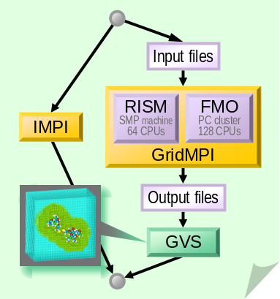
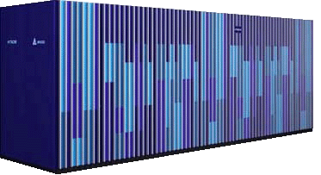
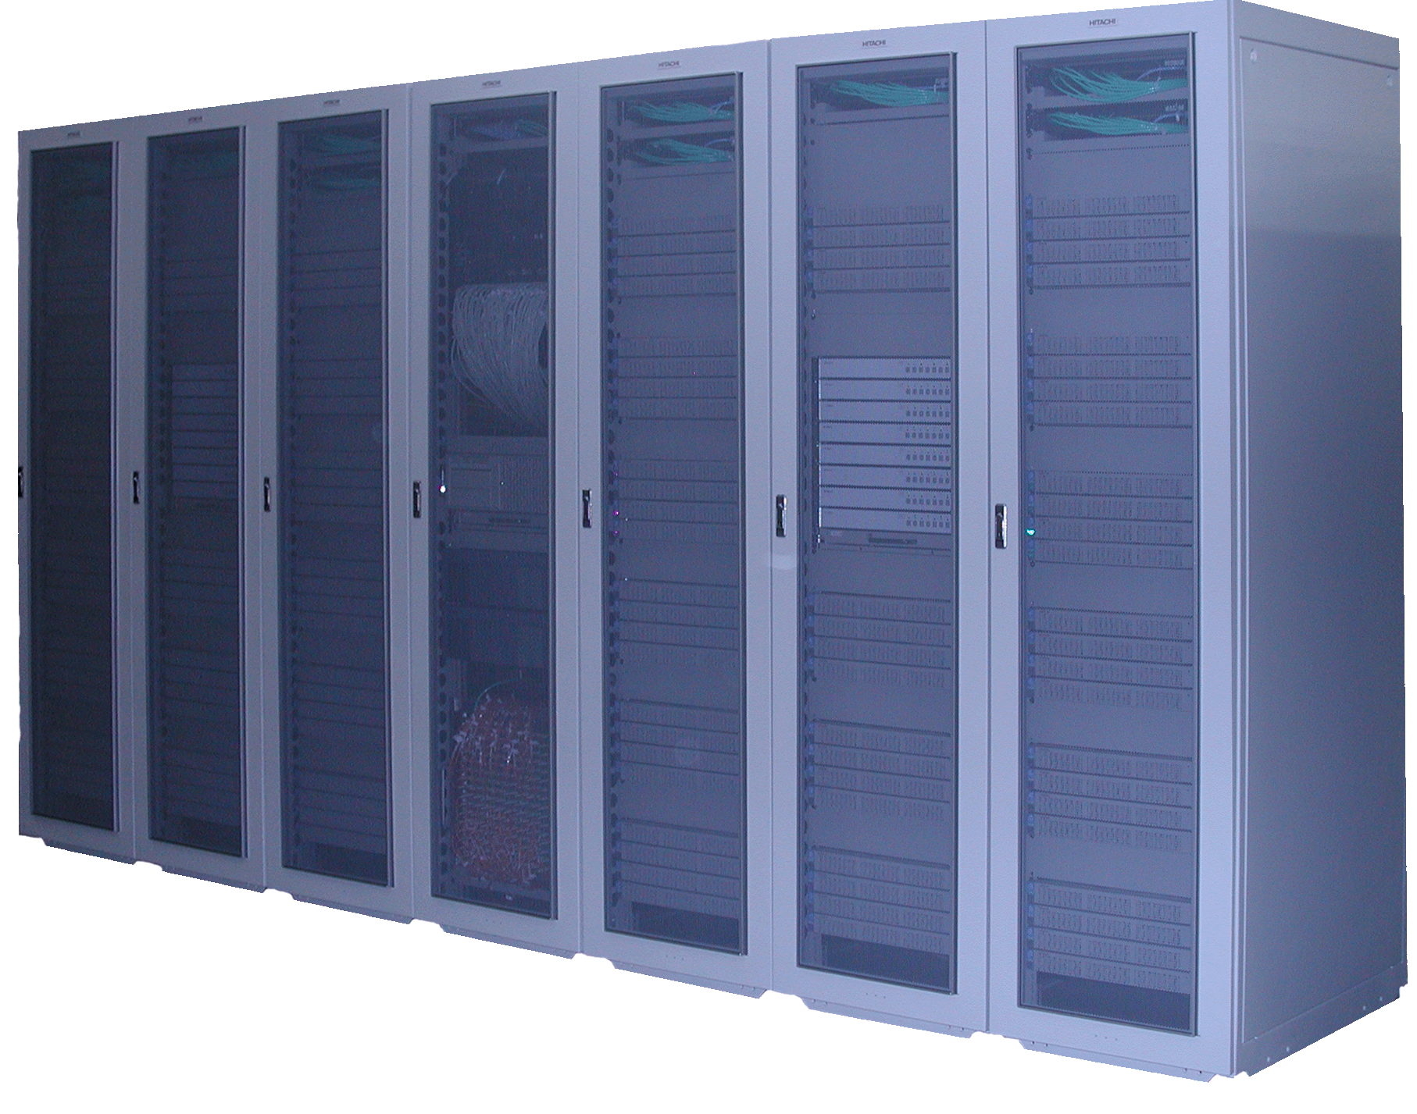

Coupled Simulation & NAREGI M/W Flow
RISM
source
Application requirement definition
FMO
source
Work-
flow
… Multi-Physics
simulation (MPI).
a: User
Registration
b: Deployment
c: Edit
CA
PSE
WFT
8: Visualization
1: Submission
Super
Scheduler
2: Resource discovery
Information
Service
5: IMPI starts
3: Negotiation
Agreement
9: Accounting
GridVM
GridVM
Co-Allocation
GridVM
6: MPI job starts
4: Reservation
Local
Scheduler
Local
Scheduler
Local
Scheduler
7: MPI init.
2: Monitoring
IMPI
Server
RISM
Job
FMO
Job
Solvent
sim.
GridMPI
Solute
sim.
Site A
Site B
(SMP machine)
Different
(sub) Jobs
Site C
(PC cluster)
Notes:
物性論的な解析と分子科学的な解析を結合してのシミュレーションがグリッド化されて、異なる機種の計算機上で最適に実行される例として、
NAREGIミドルウェアによる、マルチフィジックス連成解析MPIジョブがサイトをまたがって実行される場合の処理手順を示す。
後程、各ステップの説明を行うが、
a,b,c は、実行するジョブの準備ステップで
1-9 は、ジョブの投入後のNAREGIミドルの基本処理手順を示す。
これは、複雑とはいえ一つの大規模MPIジョブによってマルチフィジックス解析を行う、メタコンピューティングの実応用例だが、
少々複雑で実演には時間もかかるので、これから行うミドルウェア動作の実演としては、単純なMPIプログラムをサイトをまたがって
実行する場合について、順を追って説明を行う。

Slide 4

NAREGI Middleware and OGSA-EMS
WP3: PSE
WP3: WFT
Application
Contents
Service (ACS)
WP1:
UNICORE
NJS （as a WF engine）
Deployment
Register / Query
Job Manager
Deploy
Distributed
Information Services
Submit
Register
Resource Usage Services
SuperScheduler
Discover & Select
Reserve
UNICORE NJS (as a security framework)
Update
Information Services
Execution Planning Services
Reservation
Query
GridVM
Candidate Set Generator
Service
Container

Slide 5
NAREGI WP1 Software stack and standards
Super Scheduler, GridVM, and Distributed Information Service consist the core
of NAREGI middleware. We developed them as a set of interacting web services
following the OGSA architectural document V1, and used many standards for
interoperability, in particular WS-Agreement and JSDL.
WS-Agreement
  To make resource provisioning be scalable, we believe that bilateral resource matching is the best way. We are using WS-Agreement for this reason.
  Agreement based brokering is more secure than non-agreement based one, because the jobs, which do not match to local policy of site, will be rejected. This keeps the local resources safe, and autonomy of the site.
JSDL
  For resource matching, a meta descriptive framework, which is portable, extensible, and enables unified description of job submission and resources, and it's standardized schema are needed. Currently, we employ JSDL because it is the only one available.
We also use WS-Notification, OGSA-DAI, and other standards.

