Slide 1
OGSA Status and Future
GGF13 March 14, 2005 in Seoul
Hiro Kishimoto, OGSA-WG co-chair

Slide 2
GGF Intellectual Property Policy
All statements related to the activities of the GGF and addressed to the GGF are subject to all provisions of Section 17 of GFD-C.1, which grants to the GGF and its participants certain licenses and rights in such statements. Such statements include verbal statements in GGF meetings, as well as written and electronic communications made at any time or place, which are addressed to any GGF working group or portion thereof,
Where the GFSG knows of rights, or claimed rights, the GGF secretariat shall attempt to obtain from the claimant of such rights, a written assurance that upon approval by the GFSG of the relevant GGF document(s), any party will be able to obtain the right to implement, use and distribute the technology or works when implementing, using or distributing technology based upon the specific specification(s) under openly specified, reasonable, non-discriminatory terms. The working group or research group proposing the use of the technology with respect to which the proprietary rights are claimed may assist the GGF secretariat in this effort. The results of this procedure shall not affect advancement of document, except that the GFSG may defer approval where a delay may facilitate the obtaining of such assurances. The results will, however, be recorded by the GGF Secretariat, and made available. The GFSG may also direct that a summary of the results be included in any GFD published containing the specification.

Slide 3
Session Agenda
OGSA status update
  Hiro Kishimoto, co-chair
Profile Concept
  Dave Snelling, Architecture Aria Director
OGSA data service architecture
  Dave Berry, data design team lead

Slide 4
OGSA status update Outline
What is OGSA?
OGSA architecture v1.0 outline
Up-to-date objectives
OGSA sessions at GGF13

Slide 5
What is OGSA
Open service-oriented architecture based on Web services for addressing Grid scenarios
Component-oriented architecture
  Interchangeable components
Meta OS functionalities
  Distributed and heterogeneous environment
A rendering of these functions, based on Web service architecture and specifications
A GGF’s flagship architecture and the blueprint for industry standard grid computing

Slide 6
OGSA Design Philosophy
Service Oriented Architecture
  Interface Extension (WSDL 2.0 ‘extends’ attribute)
  Resources as First Class Entities
    Expressed as WSRF-Resource Properties
  Data type extensibility and introspection
  Dynamic service/resource creation and destruction
Component Based
  Elements of the Architecture are pluggable
Customizable
  Support for dynamic, domain specific content, ...
  Within the same standardized framework

Slide 7
OGSA Process
Use Case Driven
  21 Detailed Use Cases (~ 6 pages each)
Distributed Specification and Standardization
  Identify and/or develop open and accessible standard specifications
    Active current work in GGF, OASIS, W3C, and DMTF.
“Design Team” Working Model
  Facilitate cross fertilization within and outside GGF.
  Focus mind share (the most valuable commodity)
    e.g. DAIS-WG and OGSA-Data Design Team
Iterative Refinement
  Abstract service evolving to concrete specifications

Slide 8
OGSA Formation
OGSA-WG
  Designs overall architecture
  Integrates and adjust design-teams’ output
OGSA-WG design teams
  Domain expert sub-groups within OGSA
  May include co-chairs of other WG/RGs
  Output is included in OGSA document
Relation to other WG/RGs
  Explain OGSA’s approach and get feedback
  Consign specification design work
  Two way street: OGSA-WG willing to receive innovative ideas and reflect in OGSA architecture
  Take on a recommendation spec development
  Propose to create new WG to spec development

Slide 9
OGSA History
Announced at GGF4 (’02/2)
WG created (’02/9)
10 interim F2F meetings
Declared as GGF’s flagship architecture at GGF10 (’04/3)
OGSA Usecase document publication (’04/11)
OGSA document v1 and glossary publication (’05/3)
OGSA roadmap draft at GGF12 (’04/9)
3 regular weekly teleconferences (M, W * 2)
> 300 mailing list subscribers

Slide 10
OGSA informational documents
Usecase document (tier 1)
  Open Grid Services Architecture Use Cases (GFD.29)
  http://www.ggf.org/documents/GWD-I-E/GFD-I.029v2.pdf
Architecture documents v1.0
  The Open Grid Services Architecture (GFD.30)
  http://www.ggf.org/documents/GWD-I-E/GFD-I.030.pdf
OGSA glossary v1.0
  OGSA Glossary of Terms (GFD.44)
  http://www.ggf.org/documents/GWD-I-E/GFD-I.044.pdf
Resource management by CMM-WG
  Resource Management in OGSA (GFD.45)
  http://www.ggf.org/documents/GWD-I-E/GFD-I.045.pdf

Slide 11
OGSA status update Outline
What is OGSA?
OGSA architecture v1.0 outline
Up-to-date objectives
OGSA sessions at GGF13

Slide 12

Cataloging
Provisioning
VO
Mgmt
Context Services
Data
Services
Integration
Policy
Mgmt
Access
Information Services
Context
Services
Execution Mgmt Services
Data
Services
Info
Services
Trouble-
shooting
Event
Mgmt
Discovery
Logging
Application
Mgmt
Workflow
Mgmt
Workload
Mgmt
Execution
Planning
Job
Mgmt
Execution
Mgmt
Services
Infra
Services
WSRF
WSN
WSDM
Naming
Infrastructure
Services
Reservation
Configuration
Deployment
Provisioning
Rsrc Mgmt
Services
Self Mgmt
Services
Security
Services
Resource Mgmt Services
Heterogeneity
Mgmt
Authentication
Self
Mgmt
Services
Optimization
Authorization
Security
Services
Service Level
Attainment
Integrity
QoS
Mgmt
Boundary
Traversal

Slide 13
Execution Management Service
App. Contents Service
Candidate Set Generator (Work -Resource mapping)
Provisioning
Deployment
Configuration
A typical
configuration
of EMS
Information Services
Execution Planning Services
Reservation
Service
Container
Data
Container
Job Manager
Accounting Services
WS-Agreement
Job Submission Description Language
Configuration Description Language
Application Contents Service

Slide 14
Resource Management
Domain-specific capabilities
OGSA Capabilities
Data
Service
OGSA Services
Level
Execution
Mgmt
Security
Service
WSRF, WSDM
Infrastructure Level
Resources
Resource Level
OASIS WSRF, WSN
OASIS WSDM-TC
  Management of Web Service (MOWS)
  Management using Web Service (MUWS)
GGF CMM WG
  Resource Management in OGSA

Slide 15
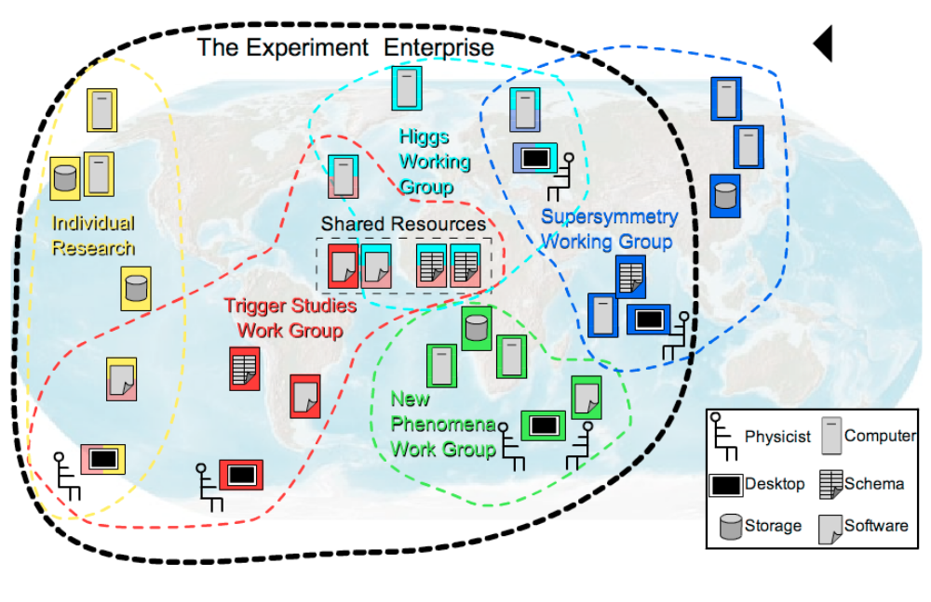
Security Services
Authorization, Roles, and Access Privileges
  Locally (site) managed
  SAML and XACML Basis
  Credential mapping provided by implementations.

Slide 16
Data Service Architecture
Dave Berry will present later in this session

Slide 17
Architecture Overview
Infrastructure Services
SYSTEM
MANAGEMENT
GRID
COMPUTING
UTILITY
COMPUTING
Use Cases &
Applications
Distributed query processing
Data Centre
Persistent Archive
ASP
Multi Media
VO Management
OGSA Self Mgmt
OGSA-EMS
DAIS
Core Services
Information
WSDM
Discovery
GGF-UR
WS-Base Notification
Naming
Privacy
Trust
GFD-C.16
WSRF-RP
WSRF-LT
Data Model
Infrastructure
Services
WSRF-RAP
WS-Security
SAML/XACML
X.509
WS-Addressing
HTTP(S)/SOAP
WSDL
CIM-XML/JSIM
Data Transport
GRID Computing, Utility Computing and System Management
are different views of the same important problem domain.

Slide 18
Architecture: Status
SYSTEM
MANAGEMENT
GRID
COMPUTING
UTILITY
COMPUTING
Use Cases &
Applications
Distributed query processing
Data Centre
Persistent Archive
ASP
Multi Media
VO Management
OGSA Self Mgmt
OGSA-EMS
DAIS
Core Services
Information
WSDM
Discovery
GGF-UR
WS-BaseNotification
Naming
Privacy
Trust
GFD-C.16
WSRF-RP
WSRF-LT
Data Model
WSRF-RAP
WS-Security
SAML/XACML
X.509
Base Profile
WS-Addressing
HTTP(S)/SOAP
WSDL
CIM-XML/JSIM
Data Transport
Hole
Gap
Evolving
Standard

Slide 19
OGSA status update Outline
What is OGSA?
OGSA architecture v1.0 outline
Up-to-date objectives
OGSA sessions at GGF13

Slide 20
OGSA document structure
Roadmap
document
Concepts and
Fundamentals
Usecase
document
inform
and
guide
Root document
Scenario
Service
Description
feedback
inform
and
guide
consistent
feedback
Candidate Profile
Profile
OGSA-WG documents
informational
Documents produced
By other GGF WGs or
Another SDOs
refer
Proposed
recomendation
Actual
specs

Slide 21
OGSA basic Profile
OGSA is dependent on a stable Web Services infrastructure but it is a design objective that it be infrastructure agnostic
Develop implementable basic profiles based on WSRF by June ‘05
Promote software developers to develop to the profiles by end of ‘05
Profile recommendations and informational documents must be consistent

Slide 22
OGSA Basic Profile v1.0
OGSA is dependent on a stable Web Services infrastructure but it is a design objective that it be infrastructure agnostic
  OGSA-WG is working on WSRF profile for OGSA
  There could be other profiles for OGSA
Normative reference specifications
  WS-I Basic profile 1.1 & Basic security profile 1.0
  WS-addressing
  WS Resource Framework & WS Notification
  WS-security
PB v1.0 Schedule
  Draft: 2005/3 (GGF13)
  Public Comment: 2005/6 (GGF14)
  GGF document: 2005/9
  Multiple reference implementations: 2005/12

Slide 23
Schedule (public comment start)
recommendation
  Basic profile: GGF14
  Naming profile: GGF15
  EM profile: GGF16
  Data profile: GGF16 ?
  Security profile: GGF16 ??
informational
  Roadmap: GGF14
  Profile template: GGF14
  OGSA v1.5 GGF16
Related recommendation
  OGSA BES: GGF13 (BoF)
  OGSA ByteIO: GGF13 (BoF)

Slide 24
OGSA status update Outline
What is OGSA?
OGSA architecture v1.0 outline
Up-to-date objectives
OGSA sessions at GGF13

Slide 25
OGSA Byte IO WG
March 14 (Mon) 3-4:30pm @ Emerald room 1&2
Simple data read API (WSDL)
Typical usecases
  Reading binary file
  Reading the results of certain DAIS queries
  Reading data from a sensor
Existing APIs, such as the POSIX API, should map easily
Open issues
  Store offsets on the service or the client?
  The interface should include write operations?
Schedule (usecase & spec)
  Public comment: 2005/10
  Recommendation: 2006 spring

Slide 26
OGSA Basic ES WG
Definition of services for service instantiation and management
Related WG/Project/OSS
  JSDL, SAGA, GRAAP, DRMAA
  Globus, UNICORE, Condor, Legion, Platform, SGE
  OMII, Business Grid, NaReGI
Advanced features, for example, scheduling, brokering, advance reservation, or provisioning, are out side of the charter
Schedule (spec)
  Public comment: 2005/11
  Recommendation: 2006 spring

Slide 27
Design team session
Basic Profile #1 & #2
Naming service
Basic data profile
EMS architecture
Data service architecture
Resource Mgmt & Info service arch
EGA Feedback session
Report session
Design team sessions likely to be detailed and yawnful
if you are not familiar with regular discussions
up to now (e.g. telecoms and F2F meetings).

Slide 28
Q&A

