Slide 1
WS-DAI
Susan Malaika,
Mario Antonioletti, Amy Krause, Simon Laws, Norman Paton
Session Name, DAIS-WG Session 1
28-30 June, 2005 (GGF14 in Chicago)

Slide 2
GGF Intellectual Property Policy
All statements related to the activities of the GGF and addressed to the GGF are subject to all provisions of Appendix B of GFD-C.1, which grants to the GGF and its participants certain licenses and rights in such statements. Such statements include verbal statements in GGF meetings, as well as written and electronic communications made at any time or place, which are addressed to any GGF working group or portion thereof,
Where the GFSG knows of rights, or claimed rights, the GGF secretariat shall attempt to obtain from the claimant of such rights, a written assurance that upon approval by the GFSG of the relevant GGF document(s), any party will be able to obtain the right to implement, use and distribute the technology or works when implementing, using or distributing technology based upon the specific specification(s) under openly specified, reasonable, non-discriminatory terms. The working group or research group proposing the use of the technology with respect to which the proprietary rights are claimed may assist the GGF secretariat in this effort. The results of this procedure shall not affect advancement of document, except that the GFSG may defer approval where a delay may facilitate the obtaining of such assurances. The results will, however, be recorded by the GGF Secretariat, and made available. The GFSG may also direct that a summary of the results be included in any GFD published containing the specification.

Slide 3
Agenda
Overview and Goals
The Approach and Model
Choices for DAIS implementers
The Interfaces
What’s Next ….
A Related Activity
Summary

Slide 4
Goal
Goal: To describe how to access (includes update) existing data resources in a grid or Web Services environment. These data resources include:
  Relational databases
  XML databases
  Object databases
  Files
WS-DAI:
  A core specification describes generic interfaces that can be extended to support specific kinds of data resources are defined in a core specification (WS-DAI).
Related DAIS Specifications:
  Define how specific data resources and systems can be described and manipulated through extensions to WS-DAI.
Data Service:
  A web service that implements one or more of the DAIS specified interfaces to provide access to data resources

Slide 5
DAIS Specifications Overview
Sets general pattern
for other DAIS
realizations.
WS-DAI
WS-DAIR
WS-DAIX
WS-DAIO
Files
Currently being defined
In DAIS
Draft based on Posix.
Looking for a willing author.

Slide 6
DAIS Specifications
DAIS Core (WS-DAI)
  Properties
    Describes core properties and a core specific message for retrieving all core properties
  Generic query
    Describes a message containing any query expression targeted at a named resource
DAIS realizations
  Properties
    Describe realization properties and realization specific message for retrieving realization properties
  Specific query
    Describe the messages that can be sent to a named resource
    Non-query messages can also be defined

Slide 7
Specification dependency: the bigger picture
W3C WS-Addressing
GGF OGSA
GGF OGSA Naming
Oasis WS-RF
W3C XPath
ISO SQL
DMTF CIM
W3C XQuery
WS-DAI
XUpdate
WS-DAIR
WS-DAIX
WS-DAIO

Slide 8
WS-DAI Delivery Patterns
Direct:
  A data consumer can expect a direct response, containing the requested data, following a request made to a data service
Indirect:
  A data consumer does not expect results to be contained in the response to a request made to a data service
Subscription Based (not part of WS-DAI)
  A data consumer (or third party) supplies a profile describing the data of interest and the conditions under which it will be delivered.

Slide 9
Direct and Indirect Delivery
Direct delivery
Consumer
Data Service
Indirect delivery
Consumer
Data Service
Consumer
Data Service
Notes:
This has an animation. Note the appearance of the data service does not signify the creation of the service but rather the fact that the service suddenly becomes visible to the consumer.

Slide 10
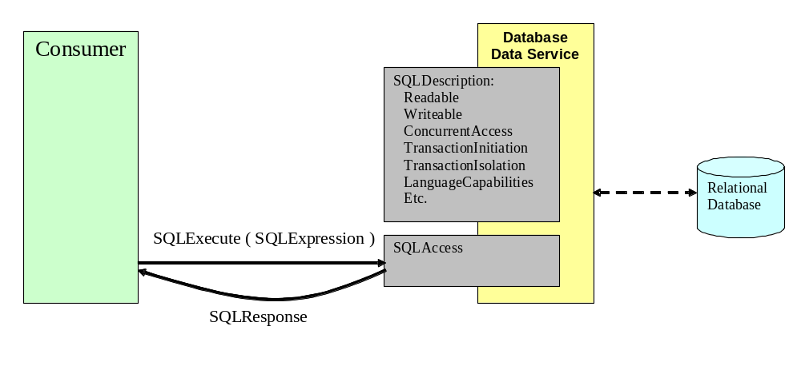
Direct delivery: a more concrete example

Slide 11
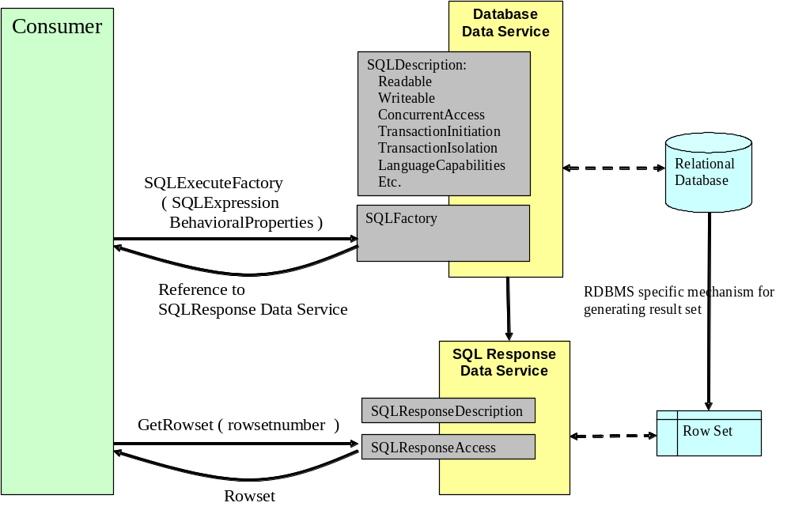
Indirect delivery: a more concrete example

Slide 12
Data Resources and Data Sets
Data Resource:
  Represents any system that can act as a source or sink of data. Examples of data resources include relational or XML databases, file systems, sensor networks, etc.
Data Set:
  A data set is an encoding of data suitable for externalization outside a data service, for example, as an XML document or as a binary stream. The concept of a data set is introduced to describe data as it appears in the messages passing to and from data services, i.e. between the consumer and the data service.

Slide 13
Data Resource Types
  Externally managed data resource: A data resource that contains and provides access to data conforming to a model associated with a WS-DAI realization. An externally managed data resource:
    1. Normally has an existence outside the DAIS service.
    2. Has its lifetime managed in ways that are not specified in the WS-DAI specifications.
  Example: A relational database
  Service managed data resource: A data resource that contains and provides access to data conforming to a model associated with a WS-DAI realization. A service managed resource:
    1. Does not normally have an existence outside the service-oriented middleware.
    2. Has its lifetime managed in ways that are specified in the WS-DAI specification
  Example: A query result rowset preserved by a WS-DAI implementation for subsequent access. Such a rowset is used for indirect delivery

Slide 14
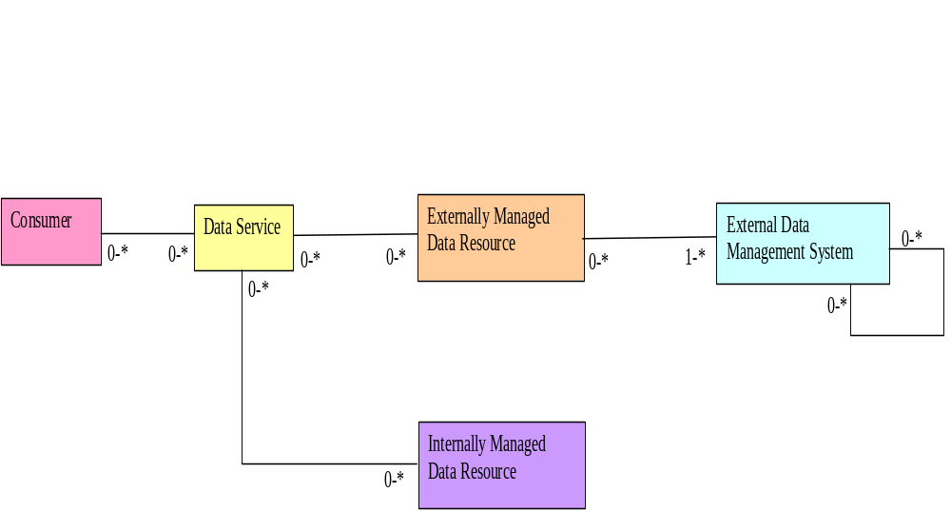
Data Resources

Slide 15
More Terminology
Data Catalogue
  An optional data catalogue lists all resources accessible through a service. It also provides an operation to resolve names. Through the catalogue it is possible to determine the:
    The return formats a resource supports in response to a query directed to the resource (the MessageMap)
    The port types supported when a DAIS factory operation is applied to the resource (the MessageConfigurationMap)
Data Conduit
  A data conduit provides messages to manage the lifetime of a data resource and to support querying over the properties of a data resource.
  The data conduit is an optional component of a DAIS service

Slide 16
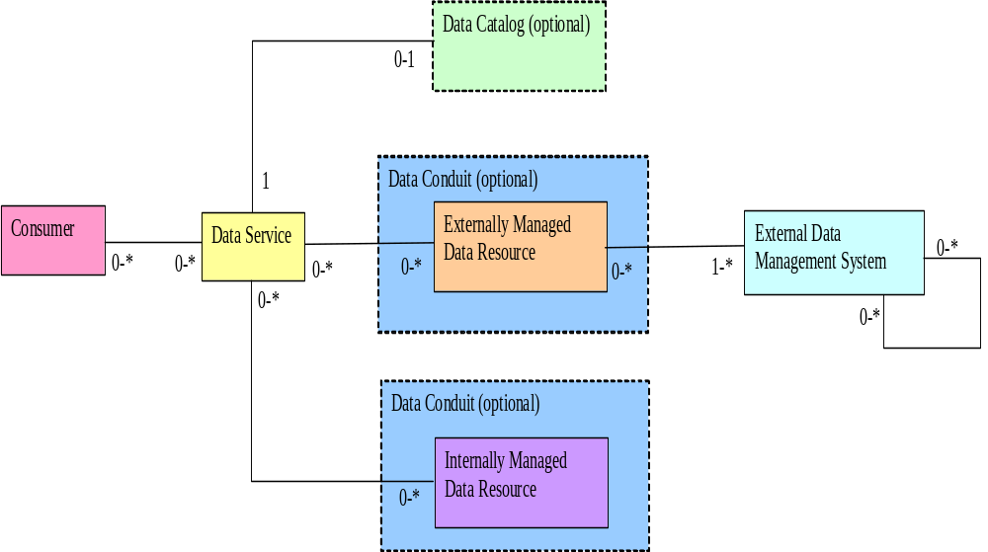
Data Resources

Slide 17
Choices for DAIS Implementers
Two choices are available for DAIS implementers
(1) Non WSRF Enabled Resources
  There is no conduit WS-Resource in this case.
  Messages to a resource must contain a name
  Explicit methods for the following are available:
    To access resource properties
    To destroy a service managed resource
      Soft state lifetime management is not available

Slide 18
Choices for DAIS Implementers
(2) WSRF Enabled Resources
  A conduit WS-Resource provides a route to a single named data resource
  Messages to a resource have an optional name parameter
  WS-ResourceProperties provide access to a generic properties structure regardless of the type of the resource
  WS-ResourceLifetime provide explicit and softstate lifetime management of resources
  The data catalogue resolve message returns an end point when supplied with a resource name

Slide 19
WSRF Considerations
The messages exchanged in the WSRF and non-WSRF case are compatible structurally
The intention is to make it possible for:
  Applications to migrate smoothly from accessing non-WSRF enabled resources to WSRF enabled resources
  Data services to migrate smoothly from exposing non-WSRF enabled resources to exposing WSRF enabled resources
If a service offers some WSRF Enabled Resources, then all the resources it offers should be WSRF enabled

Slide 20
Overview Of Interface Components
A service endpoint
“Resource1”
“Resource2”
“Resource3”
GetCatalogue()
Resolve(name)
Catalogue
(Optional)
Non WSRF Lifetime
(Optional)
Destroy (name)
GetResoureProperty()
Destroy()
SetTerminationTime()
WSRF Conduit
(Optional)
Core
“Core Properties”
GetDataResourcePorpertyDocument(name)
GenericQuery(name)
“CIM defined properties”
GetSQLPropertyDocument(name)
SQLExecute(name)
SQLExecuteFactory(name)
Relational

Slide 21
Non WSRF Realization
A service endpoint
“Resource1”
“Resource2”
“Resource3”
GetCatalogue()
Resolve(name) – [Returns the name you already have]
Catalogue
(Optional)
Non WSRF Lifetime
(Optional)
Destroy (name)
Core
“Core Properties”
GetDataResourcePorpertyDocument(name)
GenericQuery(name)
“CIM defined properties”
GetSQLPropertyDocument(name)
SQLExecute(name)
SQLExecuteFactory(name)
Relational

Slide 22
WSRF Realization
A service endpoint
“Resource1”
“Resource2”
“Resource3”
GetCatalogue()
Resolve(name) – [Returns the EPR of the “resource” ws resource]
Catalogue
(Optional)
WSRF Conduit
(Optional)
GetResoureProperty()
Destroy()
SetTerminationTime()
Core
“Core Properties”
GetDataResourcePorpertyDocument(name)
GenericQuery(name)
“CIM defined properties”
GetSQLPropertyDocument(name)
SQLExecute(name)
SQLExecuteFactory(name)
Relational

Slide 23
Generic conduit based WS-Resources
A service endpoint
Resource1
<DataResource>
<DataResourceAbstractName>Resource1</>
some other properties
</>
Resource2
<DataResource>
<DataResourceAbstractName>Resource2</>
some other properties
</>

Slide 24
Next Steps
Short Term
  Submit specifications as proposed recommendations
  Process the outstanding issues, e.g.,
    Review aspects of WSRF support
    Review the WS-DAI catalogue contents, e.g.,
      Determine if it is necessary to make it possible to find out if a resource is:
        A service managed resource or an externally managed resource
        A WSRF enabled resource or a non WSRF enabled resource
    Review the specifications for consistency

Slide 25
A Related Activity
DMTF
  Goal: XML schemas publicized by the DMTF so DAIS and others can refer to appropriate namespaces in specifications.
  Activity: Extending CIM (Common Information Model) is being extended to include additional items, such as relational tables, that are useful for DAIS and others
  DMTF groups GGF DAIS are interacting with:
    The DMTF WIP Group (WBEM [Web Based Enterprise Management] Infrastructure and Protocols Group)
      To define a namespace
    The DMTF WS-CIM Group (a sub-team of the WIP Group)
      To define an XML representation of the CIM model
    The DMTF Database Group
      To extend the database model to include constructs that DAIS and others need

Slide 26
Summary
Participate in the DAIS 2 Session in GGF14
Read the draft specifications and comment
Look under current documents:
  Grid_Data_Service – WS-DAI
  Relational_Realization – WS-DAIR
  XML_Realization – WS-DAIX
  Object_Realization -WS-DAIO
Join the DAIS tele-cons (Tuesday’s at noon eastern)!
Try to implement and let us know how you get on.
  OGSA-DAI will be implementing the DAIS specs.
  A second independent implementation is required to reach recommendation status
http://forge.gridforum.org/projects/dais-wg/

