Slide 1
DAIS Relational Specification
WS-DAIR
Mario Antonioletti
Simon Laws, Susan Malaika, Norman Paton, Amy Krause
DAIS Specifications 2, DAIS-WG Session 2
28-30 June, 2005 (GGF14 in Chicago)

Slide 2
GGF Intellectual Property Policy
All statements related to the activities of the GGF and addressed to the GGF are subject to all provisions of Appendix B of GFD-C.1, which grants to the GGF and its participants certain licenses and rights in such statements. Such statements include verbal statements in GGF meetings, as well as written and electronic communications made at any time or place, which are addressed to any GGF working group or portion thereof,
Where the GFSG knows of rights, or claimed rights, the GGF secretariat shall attempt to obtain from the claimant of such rights, a written assurance that upon approval by the GFSG of the relevant GGF document(s), any party will be able to obtain the right to implement, use and distribute the technology or works when implementing, using or distributing technology based upon the specific specification(s) under openly specified, reasonable, non-discriminatory terms. The working group or research group proposing the use of the technology with respect to which the proprietary rights are claimed may assist the GGF secretariat in this effort. The results of this procedure shall not affect advancement of document, except that the GFSG may defer approval where a delay may facilitate the obtaining of such assurances. The results will, however, be recorded by the GGF Secretariat, and made available. The GFSG may also direct that a summary of the results be included in any GFD published containing the specification.

Slide 3
Overview
Some background
Interface types
Some examples
Property documents
Changes since GGF13
WS-DAIR to do list

Slide 4
WS-DAIR Background
WS-DAIR:
  Extends WS-DAI defined interfaces for relational data resources
Relational data resources are assumed to be:
  Composed of tabular data structures
    e.g. relations and result sets
  Accessed using SQL or through row iteration.
Not defining new universal query/update languages
  WS-DAIR exposes existing relational data resources capabilities
  Aim is not to parse SQL

Slide 5
Interface Types
SQLAccess
Data Access
SQLResponseAccess
SQLRowSetAccess
Data Factory
SQLAccessFactory
SQLResponseFactory
SQLAccessDescription
Data Description
ResponseAccessDescription
SQLResponseDescription

Slide 6
Direct Access Example
Consumer
Database
Data Service
SQLExecute (
SQLExecuteRequest (
SQLRequest (
SQLExpression,
SQLExecuteRequestParameters)
ResponseFormat))
RelationalDescription
Readable, Writeable, etc
Relational Schema, etc
SQLAccess
Relational
Database
SQLExecuteResponse (
SQLResponse (
RowSet, UpdateCount,
ReturnValue, OutputParameter,
SQLCommunicationsArea))

Slide 7
Indirect Access Example
Consumer
SQLExecuteFactory (
SQLExecuteFactoryRequest (
SQLProperties (……, etc)
SQLRequest (
SQLExpression,
SQLExecuteRequestParameters)
ResponseFormat))
Database
Data Service
RelationalDescription
……, etc
SQLFactory
Relational
Database
SQLExecuteFactoryResponse (
EndPointReference (
SQLResponseAccess))
SQLResponse
Data Service
GetSQLRowSet (
GetSQLRowSetRequest (
RowSetNumber))
SQLResponseDescription
NumberOfRowSets, etc
SQLResponseAccess
SQLRowSet
GetSQLRowSetResponse (
RowSet))

Slide 8
Another Indirect Data Example
Consumer
SQLExecuteFactory (
SQLExecuteFactoryRequest (
SQLProperties (……, etc)
SQLExpression,
SQLExpressionParameters,
ResponseFormat))
Relational
Data Service
SQLAccessDescription
……, etc
SQLAccessFactory
Relational
Database
SQLExecuteFactoryResponse (
Reference (SQLResponseAccess))
SQLResponse
Data Service
Consumer
SQLRowSetSelectionFactory(
SQLRowSetSelectionFactoryRequest (SQLRowSetSelectionNumber))
SQLResponseDescription
……, etc
SQLResponseFactory
SQLRowSet
SQLRowSetSelectionFactoryResponse (Reference ( SQLRowSetAccess))
Consumer
RowSet
Data Service
GetTuples (
GetTuplesRequest (
SQLRequest (StartPosition,Count)))
SQLRowSetDescription
……, etc
WebRowSet
SQLRowSetAccess
GetTuplesResponse (
SQLResponse (SQLRowSet,
SQLCommunicationsArea))

Slide 9
Document Description
Provides information about
  Underlying data resource
  Relationship between the data resource-data service relationship
  Service information
Expressed as property documents
  Have an operation to access document
    If WSRF is not used
      Returns the whole properties document back
Document | Operation
SQLPropertyDocument | GetSQLPropertyDocument
SQLResponsePropertyDocument | GetResponsePropertyDocument + …
RowsetPropertyDocument | GetRowsetPropertyDocument

Slide 10

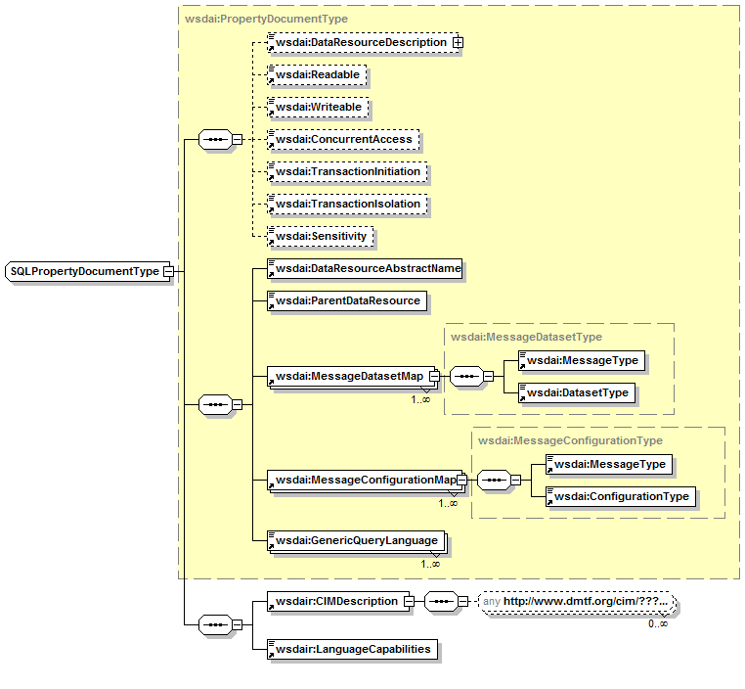
SQLPropertyDocument
Associated with SQLAccess interface
Two main extension points
  LanguageCapabilities
  CIMDescription
Language capabilities:
  Allows language support to be described
CIM description
  No explicit reference to CIM elements
  CIM XML content TBD
  Use:
    <xsd:any namespace=“DMTF-CIM-Namespace”/>
    Namespace TBD
  On-going collaboration with DMTF
    Looking for volunteers
    Talk to Susan Malaika
Properties defined in WS-DAI
Properties defined in WS-DAIR

Slide 11
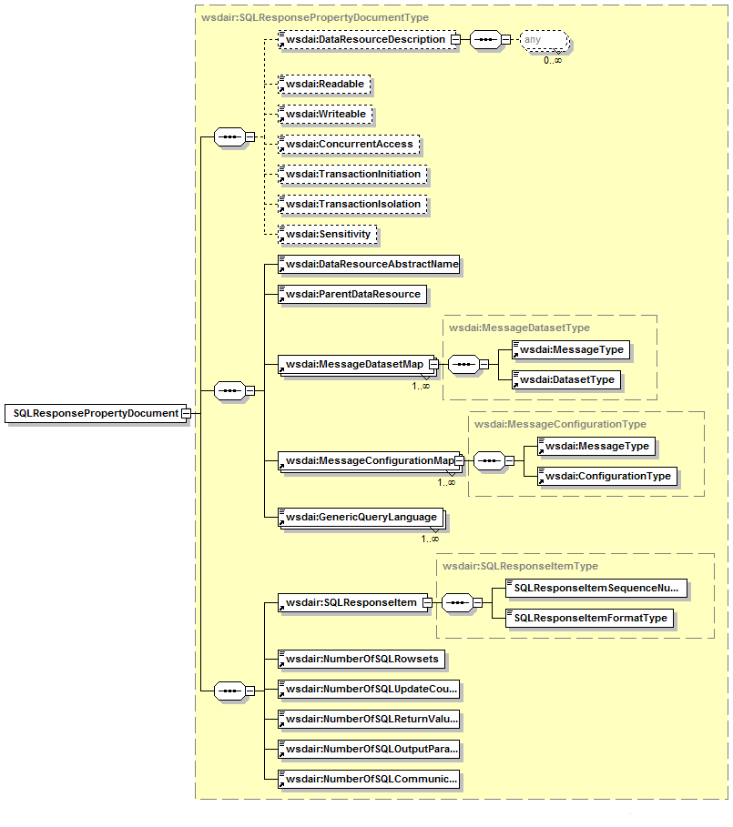
SQLResponsePropertyDocument
Associated with the SQLResponse interface
Have items:
  SQLResponseItem
  NumberOfSQLRowsets
  NumberOfSQLUpdateCount
  NumberOfSQLReturnValues
  NumberOfSQLOutputParameters
  NumberOfSQLCommunicationsAreas
Properties defined in WS-DAI
Properties defined in WS-DAIR

Slide 12
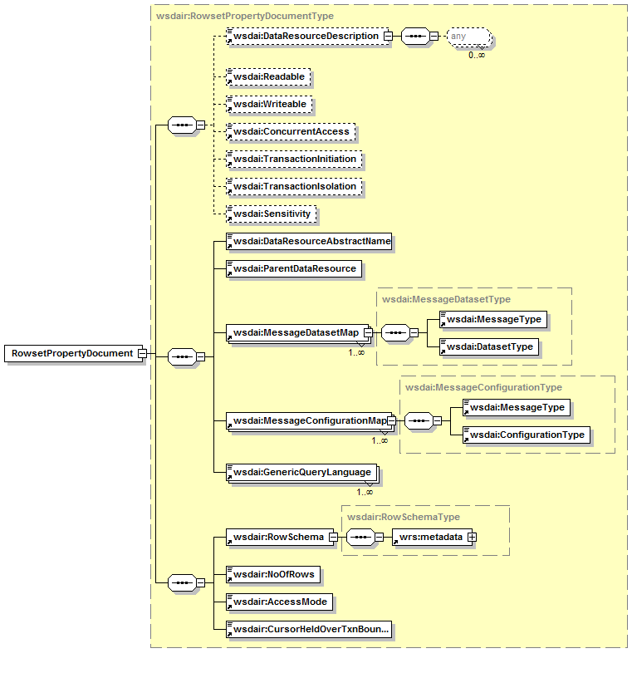
RowsetPropertyDocument
Related to RowsetAccess
Properties describe rowsets
  RowSchema
    Use web rows set schema
  Number of rows
  Access Mode
  CursorHeldOverTxBoundary
Properties defined in WS-DAI
Properties defined in WS-DAIR

Slide 13
Other changes since GGF13
Large number of small changes that help readability
  Or at least that was the aim
Slight refactoring to accommodate new core model
  New property document access operations
  Operations contain an optional name of data resource targeted
Updated:
  XML Schema
  WSDL
Publicly available:
  DAIS-WG Grid Forge site →
  Current Documents →
  Grid Data Service Specification WSDL
Tidied up and made some clarifications in document

Slide 14

WS-DAIR things to do
Remove remaining inconsistencies in:
  WS-DAI and the WS-DAIR document
  WSDL/XSD and the WS-DAIR spec
Need some more explanatory text
Get document ready for submission
Solicit comments/feedback (and fix)
  http://forge.gridforum.org/projects/dais-wg
Collaborate with DMTF to help with the CIM XML model generation
Submit document

Slide 15

Questions?

