Slide 1
Web Services Distributed Management: An Interoperability Demonstration
Heather Kreger, IBM
Bryan Murray, HP

Slide 2
Agenda
Management Roadmap
WSDM Introduction
Demonstration Setup
Blackberry demo
WS Demo
Grid relations
Summary

Slide 3
Management Using Web Services:
Roadmap, Strategy and Architecture
Paper authored by IBM, HP and CA and published on June 2, 2005
Characterizes challenges facing the IT systems management community
  Aligning IT resources management with Business Objectives
  Managing the increasing complexity of IT environment with solutions from many vendors
  Increasing the agility of the IT infrastructure and processes
  Leverage automation of management processes – minimize costs
Defines a architecture and roadmap for the evolution of management systems to address and support the challenges of emerging business environments.

Slide 4





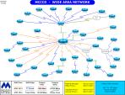

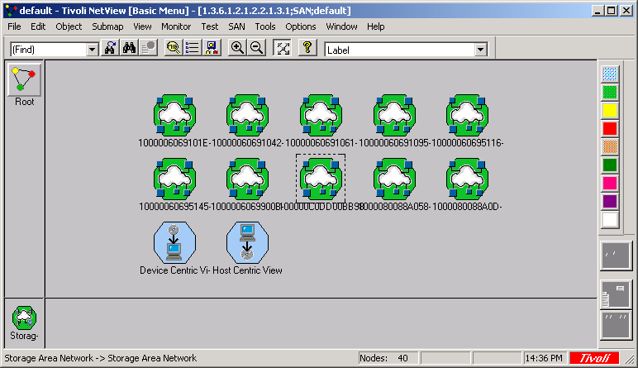

Customer Challenges
ATM
Tivoli
Event Console
Event Correlation
Teller
Home banking
SNMP
TEC
CIM
JMX
Logs
firewall
IBM
Zone
OpenView
topology
OV Plugin
Config Files
router
Novell
SNMP
IP
Cisco
zSeries
Dell
system
HP
pSeries
system
system
Tivoli Storage Manager
recovery
System
Operating system
SNMP
Operating system
CIM
Operating system
zOS
Operating system
HPUX
database
AIX
database
Linux
database
Windows
Database
Application Server
BMC Database
Manager
Application Server
Application Server
DB2
Application Server
Application
Oracle
Application
Sybase
Application
Application
“IF my Banking application is down,
then kill off HR and bring up banking”
CRM/SAP
WebSphere
NYSE
JBoss
BEA
Tibco
Bank
HR
Invest
.net
NetWeaver

Slide 5
Grids
firewall
firewall
Multiply the diversity of systems
Multiply the diversity of managers
Add Firewall and Security Issues
Add legal issues
And what manager can span all of this?
router
router
system
system
system
system
system
system
database
database
database
database
database
database
Application
Application
Application
Application
Application
Application
firewall
firewall
router
router
system
system
system
system
system
system
database
database
database
database
database
database
Application
Application
Application
Application
Application
Application

Slide 6
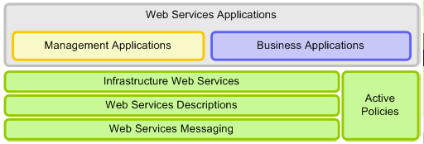
Foundation - Web Services Architecture
  Common approach for manageability to simplify the integration of management solutions for existing systems and systems based upon emerging Service-Oriented Architectures (SOA)
  Web services based architecture that supports, integrates, and unifies several management models and technologies in a way to manage any IT resource in a platform and language-neutral manner
  Management is a Web services application, like other business applications – Management Integration

Slide 7
Foundation - Web Services Architecture
WS-Security Policy
HTTP
XML
WS-Security
WS-RM
WS-MetadataExch
WS-Coordination
WS-Atomic Trans
WS-Res Properties
WS-Service Group
WS-Notification
XML Schema
WSDL
WS-Addr
WS-Policy
BPEL

Slide 8
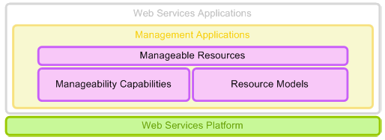
Resources
WSDM Identity
WSDM Metrics
WSDM Configuration
WSDM State
WSDM OpStatus
WSDM Relationships
…
CIM
TMF
OMA
SNMP
…
DMTF WS-CIM
WSDM MOWS
…
Standards already in progress,
More will evolve…

Slide 9
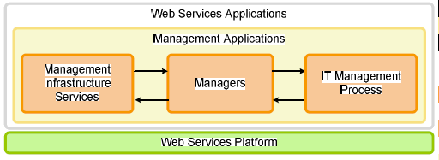
Managers
Examples of what may evolve in managers, what standards are needed is to be determined
Metering
Monitoring Svcs
Event Mediators
Metric Mediators
Inv.Scanning
Policy Enforcers
Policy Mgrs
Monitor
Provision
Configuration

Slide 10
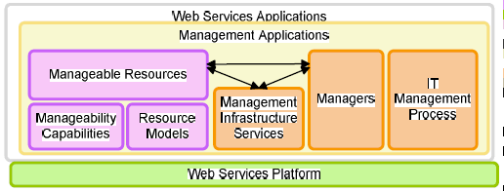
Management Roadmap - Architecture

Slide 11
Roadmap Summary
Provides a vision and architectural foundation for solving the needs of our customers to simplify the management of heterogeneous environments today and advanced management in the future
  Leveraging technology and standards for increased IT agility, reduce IT complexity, and automation of IT management processes.
  Web services as a technology foundation for management
Outlines a Journey
  Implementations based on web services standards are beginning to emerge
  Call to action for the Management Community
    Engage in the development and standardization of the architectural components
    Provide feedback on the paper including new ideas and technologies needed to make the strategy complete
For more information visit
  http://www-128.ibm.com/developerworks/webservices/library/specification/ws-mroadmap/
  http://devresource.hp.com/drc/resources/muwsarch/index.jsp
  http://www3.ca.com/technologies/CollateralList.asp?CCT=19505&ID=3339

Slide 12
A Common Platform for Management
Web Services & Management Requirements
OASIS WSDM
access to
manageable resources
description of
manageable resources
Focus on
manageability
DMTF
access to CIM
resource models
description of CIM
resource models
Focus on resource
models
GGF
access to virtual
resources
description of
virtual resources
Focus on grid
application
Multiple management standards communities need a common management platform of Web Services to access resources in a common way.

Slide 13
Web Services Distributed Management
Leverage Web services foundation to enable interoperability between managers and manageable resources
Management USING Web Services (MUWS)
  Web services to describe and access manageability of resources
  Management applications use Web services just like other applications use Web services
Management OF Web Services (MOWS)
  An application of Management Using Web Services for the Web Service as the IT resource
OASIS WSDM standard approved March 2005

Slide 14
Web Services Platform Standards for WSDM
XML Schema – captures information model
SOAP – XML messaging
WSDL – describes message exchanges (e.g. operations)
WS-ResourceProperties
  Discover resource properties
  Get/set resource properties
  Value change notifications
WS-ResourceLifetime
  Know when a resource is/will be destroyed
  Destroy a resource
WS-ServiceGroup
  Query a group of resources
  Register a resource
WS-BaseNotification
  Subscribe to notifications
  Notify message wrapper
WS-Topics – description of notification messages and topic classification

Slide 15
Management Roadmap, WSDM, and Grid
WSDM MOWS
(Web Service)
WS-CIM
Grid Services
WS-Notification
WS-RF Resource Properties
WS-Addressing
WSDL
SOAP
XML
WSDM MUWS
CIM Model

Slide 16
Management Using Web Services
Profile on use of WS-Resource Framework and WS-Notification
Resource management model agnostic
Manageable Resource
Advice on advertising and discovering WSDM manageable resources
Standard management event format
Resource Identification
Relationships between resources
Meta Information on interface properties, operations
Captures common resource management aspects from models as Manageability Capabilities

Slide 17
Management Using Web Services
Manageable Resource:
  Is a Web Service
    Described by WSDL, WS-Resource Properties, Meta information, Policies,
  Is a WS-RF WS-Resource
  MUST support WSDM’s Identity capability with properties (ResourceID).
  Advertises the properties/operations (message exchanges) of the resource to be managed

Slide 18
Management Using Web Services
Capabilities - Set of descriptions to enable a management task
WSDL, WS-Resource documents, Meta Information, Policies, Notification topics
  Identity, Description
  ManageabilityCharacteristics
  Metrics
  Operational Status, State
  Configuration
  Correlatable Names
  Relationships

Slide 19
Capabilities
Identity - Defining standard means to determine if two resources are ‘the same’
Description - Description of resource being managed
ManageabilityCharacteristics - Describes management abilities of resources
CorrelateableProperties - Describes how to compare the properties of two resources to determine if the resources are ‘the same’, dialects incl. xpath & pbm.
Metrics - Defining expression of standard metric types/behaviors (heavily influenced by DMTF Metrics WG)

Slide 20
Capabilities
State – Pattern for representing the current state and state transitions of a resource
OperationalStatus – High level view of the health of the resource with just a few interoperable values
Configuration - Defines the properties which are settable and together compose a resource’s configuration
Relationships - Defining schema to describe relationships and access relationships as resources when they have properties and behavior

Slide 21
Capabilities – Advertising
Defining standard events for resource factories to emit when resources are created or destroyed
Registry Advisory: If you have a ManageableResource registry then you should expose them using Services Group interfaces with ResourceId and ManageabilityCapabilities content model
Listen for Advertisement and destruction events
Follow relationships on known resources
Discovery

Slide 22
WSDM Event Format
(son of CBE)
Defining extensible, standard format for management events, passed using WS-Notification
Contains common information fields:
  ReportTime, EventId
  Source – ResourceId, ComponentAddress
  Reporter – ResourceId, ComponentAddress
  Situation – SituationCategory, SuccessDisposition, Situation Time, Severity, Priority, Message, MessageId

Slide 23
Management Of Web Services
Use Web services for management of same
Unification Of manageability and operational capabilities
Integration of management and business
  Management gains visibility into business
  Business applications and processes can leverage manageability capability
Management model
  Identity
  Web Service Identification
  Metrics – Requests processed…
  Operational status
  Request processing observations

Slide 24
Demo Setup
IBM
BB
Mgr
HP
Ent
Mgr
3 WSDM stacks :
HP - Apache MUSE
IBM - ETTK
Blackberry – J2ME port of ETTK
Blackberry Demo
Blackberry
IBM SpaceCo
Weather station
Weather station Demo
HP NASA
Weather station
HP Landing site client
HP Landing site
Client Manager
IBM SpaceCo
WeatherStation
Manager

Slide 25
Apache MUSE WSDM Stack
Apache Muse
Apache Pubscribe
Apache WSRF
XML Beans
Apache Axis
Apache Tomcat
Java 1.4
Apache Muse URIs
http://ws.apache.org/ws-fx/wsrf/
http://ws.apache.org/ws-fx/pubscribe/
http://ws.apache.org/ws-fx/muse/

Slide 26
IBM ETTK stack
ETTK V2.3 WSDM
ETTK V2.3 WS-BaseNotification
ETTK V2.3 WS-RF Resource Properties
WebSphere Embedded Express 6.0
IBM ETTK: http://www.alphaworks.ibm.com/tech/ettk

Slide 27
Blackberry Stack
102K
WSDM (12k)
WSN (32k)
WSRF (19k)
KSoap (40k)
J2ME JVM

Slide 28



Scenario: Sales-R-Us
Blackberry Software Management
The Problem
Sales PDAs run tools and
communicate with main corporate
applications for Parts, Pricing,
Sale, Expense and EMail
Salesmen are downloading
virus infected games which
are infecting the Sale-R-Us
Servers and causing outages, causing loss of business

Slide 29



Scenario 1: Sales-R-Us
Blackberry Software Management
The Solution
Enterprise Mgr
BBMgr
Autonomic manager detects
unauthorized applications and
uninstalls them and reports
violations to enterprise manager

Slide 30
Enterprise
Service Manager
Components :
Blackberry Device (IBM)
Autonomic Device Manager (IBM)
- Knows about Blackberry by configuration
Service Manager (HP)
- Knows about Blackberry manageability exposed by Device Manager
Apache
Stack
BB
Stack
Autonomic
Blackberry
Device Manager
IBM ETTK
Stack

Slide 31
Blackberry Interface
Operations
GetResourceProperties
GetMultipleResourceProperties
GetResourcePropertiesDocument
SetResourceProperties (update)
  Date, Time, Color (this faults)
Subscribe
ShowSubscriptions
Resource Properties
ResourceId
OperationalStatus
BB:Date,
BB:Time,
BB:Serial#,
BB:BatteryLevel,
BB:BatteryStatus,
BB:AllocatedStorage,
BB:FreeStorage,
BB:total code module size (0(n) calc)

Slide 32

Enterprise
Service Manager
*DeviceManager exposes itself as a manageability endpoint for the Blackberry.
*ServiceManager represents this autonomic blackberry as a blackberry resource.
3. Policy violation notification
6. Policy compliance restored notification
1. Unauthorized software is installed on the Blackberry.
2. CodeModuleSize Changed Notification, Illegal SW found, Device Manager shows Blackberry as non-compliant (yellow)
Autonomic
Blackberry
Device Manager
4. Invokes uninstall operation
5. CodeModuleSize Changed Notification, No illegal SW found, Device Manager shows Blackberry as compliant (green)

Slide 33
Key Messages
Small Footprint
Creating self managing manageable resources
Multi-level managers
  Specific device manager
    Represented as a Blackberry
  More generic enterprise manager
    Regards Blackberry as a ‘smart resource’ with autonomic manager as part of the resource

Slide 34
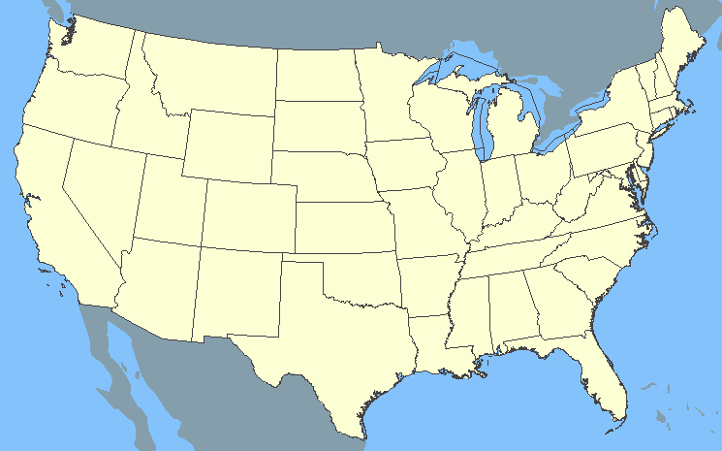

Scenario 2: SpaceCo
Weather Station Management
Problem
Space Weather Station Network
Landing Site Clients
X
Replicated weather stations at every landing site – need accurate weather conditions
Unreliable weather reports cause landing site to be removed from consideration

Slide 35
Scenario 2: SpaceCo
Weather Station Management
Solution
Space Weather Station Network
Landing Site Clients
X
Weather station mgr
Landing site client
manager
Weather station manager recalibrates unreliable weather stations
Landing site client manager updates client with best choice of weather station

Slide 36



Weather Station Demo
Implementation Details
Space Co WS $0.07
Firewall
Landing site manager
Weather Display
Weather Station manager
NASA WS $0.23
Weather Stations on different platforms, managed equally by Weather Station Manager
Weather Client availability can still be managed
  Without full management authority over weather stations
Limited management is possible though the firewall

Slide 37
Weather Station Demo
Interaction Diagram
Apache
Apache
3
ETTK
ETTK
Space Co WS
2
4
1
Landing site manager
Weather Display
Weather Station manager
NASA WS
Apache
Client polls for weather data
Service mgr recalibrates weather station, taking it offline
Weather station sends notification it is going offline
Client mgr tells client to use alternate data source

Slide 38
Weather Station Interface
Operations:
GetResourceProperty
Subscribe
Recalibrate
Resource Properties:
ResourceId
OperationalStatus
ManageabilityCapability
Topic
Temperature
Humidity
Visibility
Price

Slide 39
Landing Site Client Interface
Operations:
GetResourceProperty
SetWeatherStation
Resource Properties:
ResourceId
Relationship
  With weather station service being used

Slide 40
Weather Demo Key Points
Limited, but appropriate, management through firewall
Consistent interface facilitates management across platforms and vendors
Autonomic management enabled through access to a subset of state and notifications
Combination of service manager and client manager assures a client receives a continuous stream of quality data

Slide 41
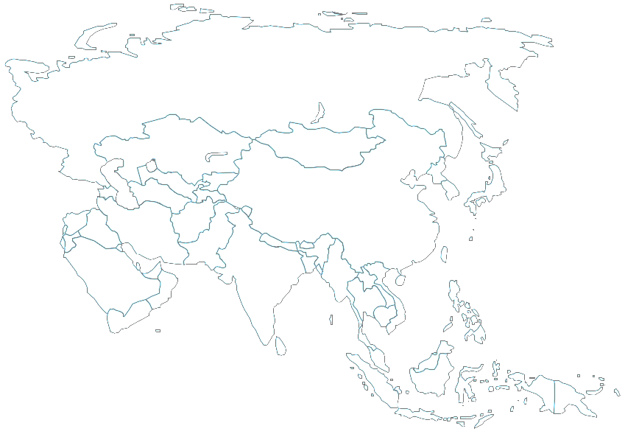
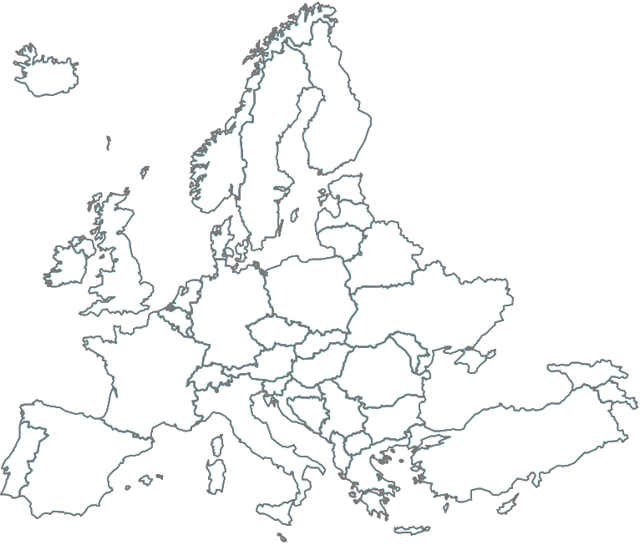
WSDM Benefits
Benefits of WSDM
  Web Services Foundation for management
  Leverage existing skills, runtimes and tools
  Heterogeneity
  Allows integration with other industry management initiatives
Sales-R-Us and SpaceCo achieved competitive advantage through improved business availability and reliability
  Common management solution of worldwide IT resources including web services enabling more robust deployments of Web service SOA applications
  A scalable solution for managing IT environments, from simple to enterprise level
  Integrates Management and Business
  Cost management with common, interoperable management solutions vs custom solutions

Slide 42
Relationships between WSDM and Grid
Many of the goals of WSDM are also goals of the Grid and OGSA
Autonomic: the system is able to manage itself
Resource orientation: resources are treated as addressable entities
Provisioning

Slide 43
WSDM and CDDLM
CDDLM Component Model
  CDDLM components designed to deploy services
  Component itself a service operating at some resource
  All components are WSRF endpoints
  MUWS defines for Component Model: Identity, State, Manageability Characteristics, WSDM Events - Lifecycle/State Transition
  WSDM provides a "wrapper" around non manageable services
CDDLM Deployment APIs
  Comprises two types of WSRF endpoint
    Portal, files/configuration descriptors uploaded to, to create systems
    System, represents a system at some point in its lifecycle
  Lifecycle of systems is that of the component model, so inherits the same features: identity, state, read-only resources, events
  The portal endpoint adds extra system state resources, and an extra event notifying subscribers of the creation of new systems

Slide 44
Implementations are appearing
  Open Source Apache Foundation Implementation with contributors: HP, Globus, Hitachi, and others
    http://ws.apache.org/ws-fx/wsrf/
    http://ws.apache.org/ws-fx/pubscribe/
    http://ws.apache.org/ws-fx/muse/
  IBM, ETTK supporting WSDM 1.0 (May 2005)
    http://www.alphaworks.ibm.com/tech/ettk
  HP, SOA Manager
    http://devresource.hp.com/drc/resources/lcm4ws_overview/index.jsp
  CA, CA WSDM
    http://www3.ca.com/Solutions/Product.asp?ID=4714

Slide 45
Summary
Common Web Services foundation for management
  Platform neutral and standards based
    Vetted by OASIS TC and organization
    Highly interoperable (multi-vendor interoperability events held for both WSDM and underlying specifications)
  Unification of business and manageability capability
    Operational visibility for business apps and processes
    Business visibility for management
  Scales from small devices to enterprise-scale
    Composable
    Unified management protocol

Slide 46
Resources
OASIS Web Services Distributed Management TC
  http://www.oasis-open.org/committees/tc_home.php?wg_abbrev=wsdm
Overview Articles:
  A Little Wisdom about WSDM, Heather Kreger, http://www-128.ibm.com/developerworks/webservices/library/ws-wisdom/
  WSDM Wisdom: discovering resources, Bryan Murray, http://devresource.hp.com/drc/resources/st_resdisc.jsp
Management Using Web Services: an Architecture and Roadmap
  http://www-128.ibm.com/developerworks/webservices/library/specification/ws-mroadmap/
  http://devresource.hp.com/drc/resources/muwsarch/index.jsp

