Slide 1
Grid Scheduling Architecture –
Research Group
Ramin Yahyapour
Philipp Wieder
GSA-RG
29 June, 2005 (GGF14 in Chicago)

Slide 2
GGF Intellectual Property Policy
All statements related to the activities of the GGF and addressed to the GGF are subject to all provisions of Appendix B of GFD-C.1, which grants to the GGF and its participants certain licenses and rights in such statements. Such statements include verbal statements in GGF meetings, as well as written and electronic communications made at any time or place, which are addressed to any GGF working group or portion thereof,
Where the GFSG knows of rights, or claimed rights, the GGF secretariat shall attempt to obtain from the claimant of such rights, a written assurance that upon approval by the GFSG of the relevant GGF document(s), any party will be able to obtain the right to implement, use and distribute the technology or works when implementing, using or distributing technology based upon the specific specification(s) under openly specified, reasonable, non-discriminatory terms. The working group or research group proposing the use of the technology with respect to which the proprietary rights are claimed may assist the GGF secretariat in this effort. The results of this procedure shall not affect advancement of document, except that the GFSG may defer approval where a delay may facilitate the obtaining of such assurances. The results will, however, be recorded by the GGF Secretariat, and made available. The GFSG may also direct that a summary of the results be included in any GFD published containing the specification.
Sign into
participants list !

Slide 3
Session Agenda
Status of Doc 1: Use-Case Document
  Review of Profiles
Status of Doc 2: Requirements Document
  Architectural Discussion
  Presentation for OGSA-RSS
Discussion of next steps

Slide 4
Charter for beginners
The goal of this research group is to define a scheduling architecture that supports cooperation between different scheduling instances for arbitrary Grid resources. Considered resources include network, software, data, storage and processing units. The research group will particularly address the interaction between resource management and data management. Co-allocation and the reservation of resources are key aspects of the new scheduling architecture, which will also include the integration of user or provider defined scheduling policies.
The group will begin with identifying a set of relevant use-cases based on experiences obtained by existing Grid projects. Then, it will determine the required components of a modular scheduling architecture and their interactions.
Services and protocols from other GGF groups are considered as potential basic building blocks of such an architecture and will be used wherever possible.

Slide 5
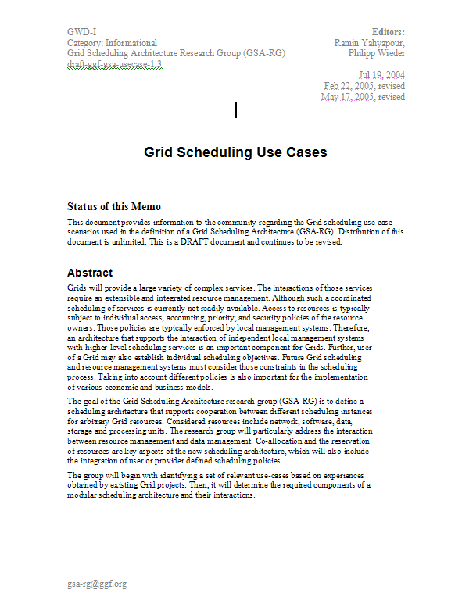
Roadmap
Compile Use-Cases
Ongoing process
for further revisions
Derive Use-Case Profiles
Doc 1: Use-Case
Identify Requirements
for Scheduling Architecture
Ongoing process
for further revisions
Architectural Picture
Required Component Services
Doc 2: Requirements/
Architecture
Ongoing process
for further revisions
Review of existing
services and protocols
Doc 3: Existing Services
Review

Slide 6
Session Agenda
Status of Doc 1: Use-Case Document
  Review of Profiles
Status of Doc 2: Requirements Document
  Architectural Discussion
  Presentation for OGSA-RSS
Discussion of next steps

Slide 7
Action 1:
Use case document
Collects growing set of Grid scheduling use cases
Provides currently six use cases
  Three use cases with focus on requirements and processes
  Three descriptions of existing solutions
  More use case contributions have been promised
Derives & defines several usage profiles
  Simple job submission
  Job execution with Advance Reservation
  etc.
First version to be submitted to GGF editor in the next weeks
  Additional contributions will go in future version
  Iterative revision process is planned to update doc
Information & input to requirements document

Slide 8
Requirements from Use-Cases
Decision-making of time and place of resource allocation
Automatic resource selection and optional reservation
Facilitating Grid scheduling services and user-centric Grid scheduling strategies
Communication between higher-scheduling instances (Grid/Super/Meta-Scheduling) and lower-level scheduling instances (Local RMS)
Negotiation of agreements
Support for real-time or deadline constraints
Economy-based scheduling
Orchestration:
  Co-allocation of resources
  Scheduling of workflows
OGSA EMS:
Workload optimization, Candidate Set Generator, etc.

Slide 9
Profiles derived from Use-Cases
Tried to identify different use-cases/requirement sets
based on existing systems:
  Simple Job Submission Profile
  Single-Site Execution with Service Guarantees Profile
  Job Execution with Advance Reservation Profile
  Multi-Resource Co-Allocation Profile
  Job/Data Staging Profile
  Complex Workflow Profile
  Economic/Market-Based Grid Profile

Slide 10
Profile 1:
Simple Job Submission Profile
No complex workflow
No reservation requirements
No co-allocation of resources
The lower-level schedulers do not support any service level guarantees.
  No information about the actual execution time is known in advance.
A higher-level scheduler receiving this job requests only uses static and dynamic information which are available in an information service.
  Based on some heuristic or algorithm it selects a lower-level scheduler and forwards the request to the local RMS
There is no real Grid scheduling involved in this scenario
  Work just as a broker/dispatcher which forwards a job to remote sites.

Slide 11
Profile 2:
Single-Site Execution with Service Guarantees Profile
Included in Profile 1:
No co-allocation or complex workflows.
Support for including service guarantees in terms of start and end time for a resource allocation are given from the scheduling system.
  E.g. exact start and end time.
  Or latest start and/or end time.
This profile supports more sophisticated local resource management
systems which provide information about the service property.
  E.g. a queuing system with a backfilling scheduling strategy can provide a deadline for your job; however a job may start/finish earlier.
Communication/negotiation between a higher-level and a lower-level scheduler needed.

Slide 12
Profile 3:
Job Execution with Advance Reservation Profile
Very similar to basic job submission profile:
includes the ability to make a concise reservation when a job resource allocation will take place.
While Profile 2 just uses information from lower-level schedulers about job execution, this scenario requires an actual advance reservation mechanism to guarantee a specific time.
  A higher-level scheduler can actively request from a lower system to make a reservation for tomorrow 10:00-12:00.
  This usually requires different lower-level scheduler who can cope with such reservations beyond simple queuing.
This profile may be merged with the previous profile; however, in view of existing RMS implementations, there may be more systems fulfilling the profile but not this one. Therefore a distinction may be reasonable.

Slide 13
Profile 4:
Multi-Resource Co-Allocation Profile
Several resources are required and need to be coordinated.
In many use-cases these resources have to be available at the same time.
A higher-level scheduler will need to synchronize different Grid resources.
Information about resources actually available required.
Knowledge about idle timeslots from information services or through some negotiation protocol between higher-level and lower-level scheduler.
Higher-level scheduler makes co-allocation decisions.
Advance reservation needed.

Slide 14
Profile 5:
Job/Data Staging Profile
Simple profile in which the availability/transfer of data is taking into account.
A scheduler must consider the time needed to make given data available on the target resource.
Simple workflow with planned/coordinated staging of data as part of the scheduling request.

Slide 15
Profile 6:
Complex Workflow Profile
The job can comprise a complex workflow for which a higher-level scheduler should be able to make an advance planning for the static parts it can foresee.
The workflow implies temporal dependencies between different resource allocations.

Slide 16
Profile 7:
Economic/Market-Based Grid Profile
Resource allocations may generate cost and the budget has to be taken into account.
The negotiation for resource offers between lower- and higher-level schedulers comes into play.
In general negotiation models cost/utility/preference-functions are considered for identifying the most suitable resource allocation.

Slide 17
Session Agenda
Status on Doc 1: Use-Case Document
  Review of Profiles
Status on Doc 2: Requirements Document
  Architectural Discussion
  Presentation for OGSA-RSS
Discussion on next steps

Slide 18
Action 2:
Requirements Document
Identifies components & interactions for a modular scheduling architecture
Introduces terminology
  Scheduling instance and relation between instances
  What else? – Basic terminology,
  but no dictionary
Derives service requirements from
use cases
  Descriptive, no WSDL, protocols, etc.
Compares requirements with existing solutions
Done
Current
activity
Description of services & their interaction

Slide 19
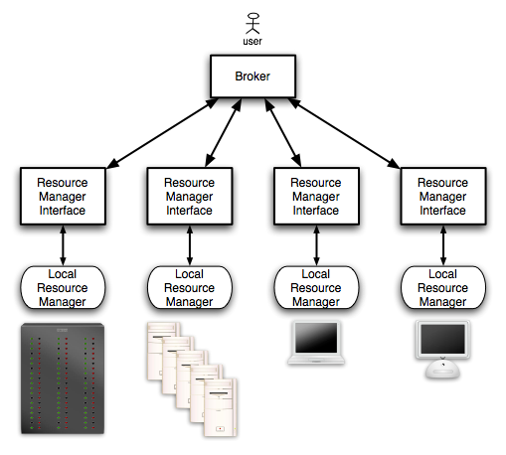
Example for Scheduling-Structures:
Enterprise/Campus Grids

Slide 20
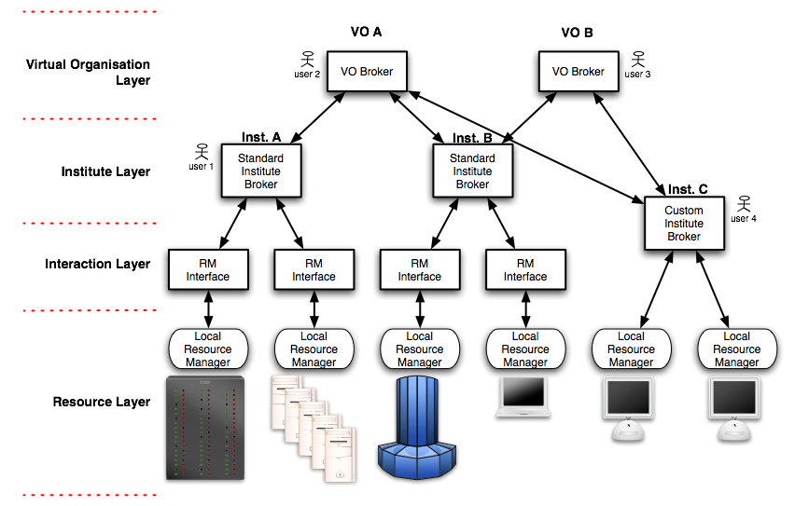
Example for Scheduling-Structures:
Structured HPC Grids

Slide 21
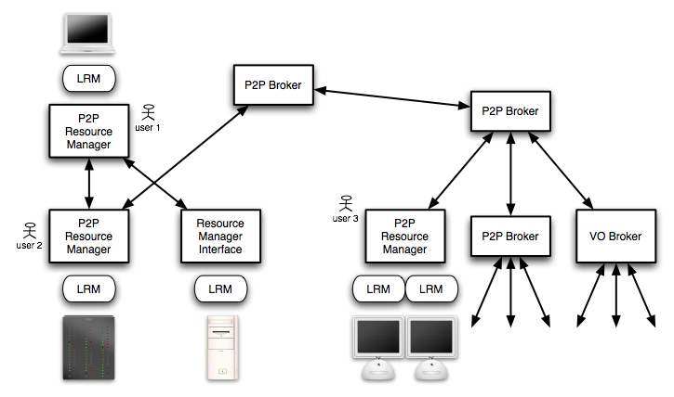
Example for Scheduling-Structures:
Global Grids

Slide 22
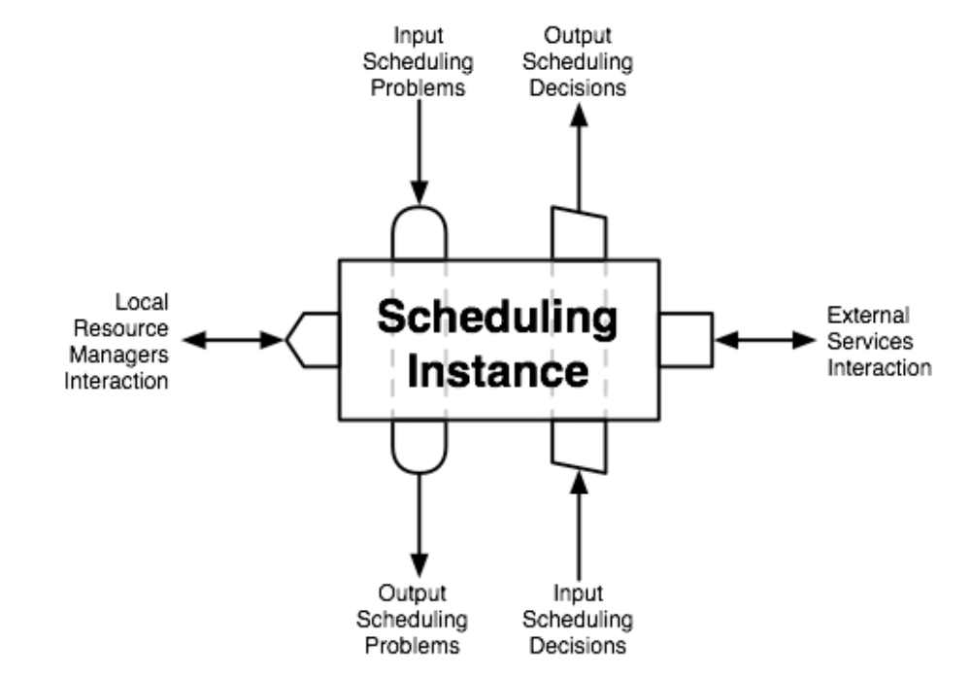
Scheduling Instance
Cornerstone of a scheduling architecture
  Gets scheduling problems as inputs
  and returns scheduling solutions
Distinction between higher-level
and lower-level instances
Lower-level designates scheduler close to the resource
Higher-level scheduler initiate communication with other schedulers to find resource allocations

Slide 23
OGSA EMS - Services
Candidate Set Generator (Work -Resource mapping)
Provisioning
Deployment
Configuration
Information Services
Execution Planning Services
Reservation
Service
Container
Data
Container
Job Manager
Accounting Services
Interactions of EMS services to execute a legacy BLAST job.
Taken from OGSA V1.0. GFD.30.

Slide 24
OGSA-RSS-BOF
OGSA-Resource Selection Service has a BOF today:
2 p.m. - 3:30 p.m.; Room: Regent 2
Covers the definition of key services
Cooperation with GSA-RG
Presentation by Mathias Dalheimer

Slide 25
Required Services/Components
Relevant to scheduling architecture
  Information Service
  Job/Workflow Description
  Requirement Description
  Resource Discovery
  Reservation
  Monitoring/Notification
  Job Execution
  Security
  Accounting/Billing
  Data Management
  Local RMS
  Prediction

Slide 26
Action Items and Next Step
Submit Use-Case document to editor
Describe required services and elaborate on interaction of services
Next step will be: Review existing available services
If you want to participate in the work you are invited to subscribe to the mailing list:
gsa-rg@gridforum.org
Comments and contributions are appreciated!

