Slide 1
GGF TM-RG
GGF14
Group Results

Slide 2
Intellectual Property Policy
I acknowledge that participation in GGFx is subject to the GGF Intellectual Property Policy.
Intellectual Property Notices Note Well: All statements related to the activities of the GGF and addressed to the GGF are subject to all provisions of Section 17 of GFD-C.1 (.pdf), which grants to the GGF and its participants certain licenses and rights in such statements. Such statements include verbal statements in GGF meetings, as well as written and electronic communications made at any time or place, which are addressed to: the GGF plenary session,
any GGF working group or portion thereof,
the GFSG, or any member thereof on behalf of the GFSG,
the GFAC, or any member thereof on behalf of the GFAC,
any GGF mailing list, including any working group or research group list, or any other list functioning under GGF auspices,
the GFD Editor or the GWD process
Statements made outside of a GGF meeting, mailing list or other function, that are clearly not intended to be input to an GGF activity, group or function, are not subject to these provisions.
Excerpt from Section 17 of GFD-C.1 Where the GFSG knows of rights, or claimed rights, the GGF secretariat shall attempt to obtain from the claimant of such rights, a written assurance that upon approval by the GFSG of the relevant GGF document(s), any party will be able to obtain the right to implement, use and distribute the technology or works when implementing, using or distributing technology based upon the specific specification(s) under openly specified, reasonable, non-discriminatory terms. The working group or research group proposing the use of the technology with respect to which the proprietary rights are claimed may assist the GGF secretariat in this effort. The results of this procedure shall not affect advancement of document, except that the GFSG may defer approval where a delay may facilitate the obtaining of such assurances. The results will, however, be recorded by the GGF Secretariat, and made available. The GFSG may also direct that a summary of the results be included in any GFD published containing the specification.
GGF Intellectual Property Policies are adapted from the IETF Intellectual Property Policies that support the Internet Standards Process.

Slide 3
TM-RG Group History
  Founded at GGF10 Berlin (03/2004)
    Co-Chairs
      Torsten Steinbach (IBM)
      Jim Webber (University of Newcastle)
      Can Türker (ETH Zürich)
  Agreed Group Charter
    https://forge.gridforum.org/projects/tm-rg/document/TM-RG_Charter/en/2
  Meetings GGF
    GGF11, GGF12, GGF13
  Chairing issue
    Jim & Can had to resign end of 2004
    Tony Fletcher (Choreology) became co-chair

Slide 4
TM-RG – The People
Active People
  Tony Fletcher (Choreology)
  Dieter Gawlick (Oracle)
  Torsten Steinbach (IBM)
  Jim Webber (University of Newcastle)
  Robert Haugen (Choreology)
  Malik Saheb (Arjuna)
  Mark Little (Arjuna)
  Jörg Seitter (Brunel University, London)
About 60 people on the mailing list

Slide 5
TM-RG Group Status
Groups Tasks:
  Collect Transactional Use Cases ✓
  https://forge.gridforum.org/projects/tm-rg/document/Transaction_Use_cases/en/4
  Educational Sessions on transactional specifications ✓
    (BTP, WS-Coor/AT/BA, WS-CAF)
  Analyze realization of use cases using the specs
    Current task to do
    So far no common agreement within group if existing specifications are sufficient or not
  Informational paper
    Groups report available: (✓)
    https://forge.gridforum.org/projects/tm-rg/document/ Report_of_the_Transaction_Management_Research_Group/en/3

Slide 6
Use Case Document
  Available on GridForge:
https://forge.gridforum.org/projects/tm-rg/document/Transaction_Use_cases/en/4
  Use Cases (per category):
    Agreement Negotiation and execution
      Trip Support
      Grid Resource Allocation
      Credit Verification
      TWIST - Financial Instrument trading
    Information Dissemination
      Speculative Computation
    Information Aggregation
      Distributed available-to-promise
    Process Tracking
      Long-running Computations on the Grid (Checkpointing)

Slide 7
Options Model
(Unplanned) outcome of discussions around “Agreement Negotiation and Execution“ use cases
https://forge.gridforum.org/projects/tm-rg/document/Options_Model_Proposal/en/1
Options:
  An option is a reservation of a resource (or parts of it) bound to some condition.
  The typical condition is a time constraint.
    If the option is not confirmed within a certain period of time it will automatically expire.

Slide 8
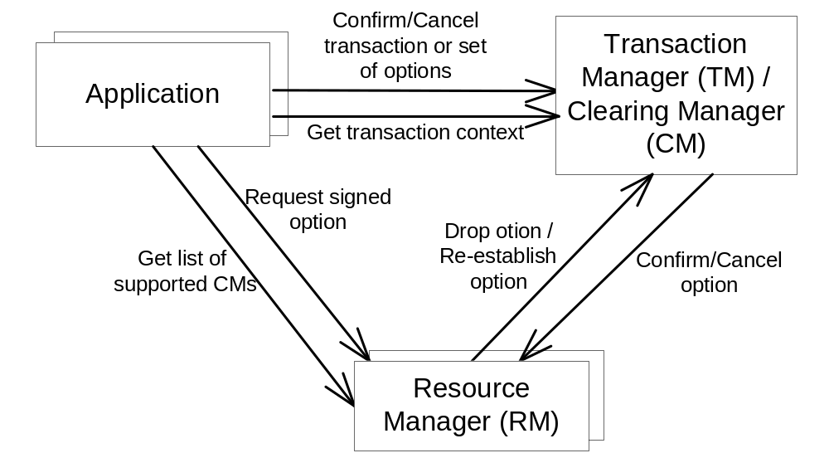
Options Model Architecture

Slide 9
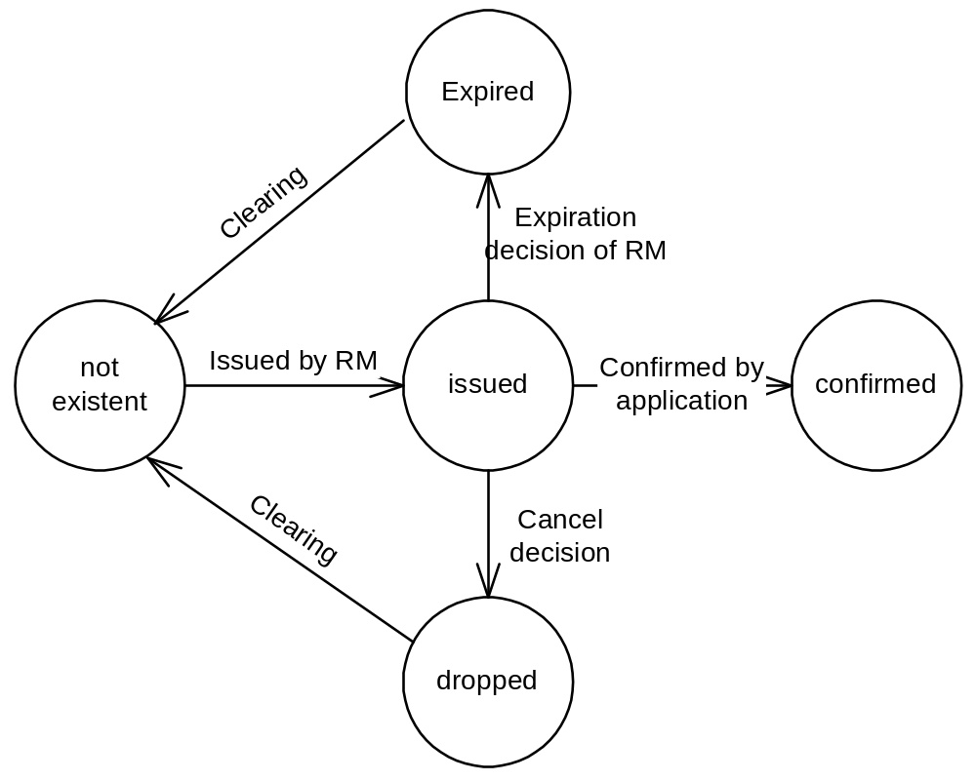
Option Model States

Slide 10
Other Transactional Challenges in the Grid
Control Recoverability
    Message-based communication imposes possibility for work to be externalized once it is committed but not yet recoverable (Credit Verification Use Case)
    Coordinate Distributed Processes for recoverability via synchronized checkpoints (see Checkpointing Use Case)

Slide 11
Future
Outstanding task:
  Analysis of transactional specs with regard to identified use cases
Chairing issue:
  Tony has to resign at GGF14 since his company (Choreology) has shrunk and can no longer support his involvement
  Torsten now has to resign as well due to different assignment within IBM
TM RG will now shut down in a controlled manner, if nobody else stands up and takes the lead

Slide 12
Group Results
There are basically three results we can claim:
  Use Cases
  Recoverability Findings
  Options Model

Slide 13
Recommendations
Pick up use cases and refine and add new ones if necessary
Perform analysis if existing transactional specs are suitable for implementing the use cases
Perform reference implementation of options model
    A sample implementation already being done by Joerg Seitter (joerg@data-grid.org) in context of master thesis about options model (supervised by Peter van Santen, Brunel University of London)
    Check status at www.seitter.net/optionsmodel
Identify solution for recoverability/visibility issue (Credit Verification Use Case)

Slide 14
Backup

Slide 15
Typical Properties of a Grid
Options Model Details
Req. 1: Resources are used very dynamically and with late binding. One can not tell which concrete resource is used at development time and usually not even at deployment time.
Req. 2: Resources are shared very dynamically and to a large extent by multiple clients.
Req. 3: A concrete resource can be integrated in and disintegrated from a grid very dynamically.
Req. 4: There is typically no persistent legal relationship between client and resources. Instead ad-hoc legal relationships are established during runtime.

Slide 16
Distributed Transaction Management
Options Model Details
ACID with Distributed 2PC
  Scalability Problem in terms of resource sharing
Compensation
  Problems with dynamic resource availability

Slide 17
Usage of Options in a Transaction
Options Model Details
To gather a set of resources required to accomplish a certain task.
  Once all required options are retrieved they are committed in an atomic way.
To reserve one or more sets of alternative resources and decide later which ones to confirm.
  Once a complete set of required resources are retrieved they are confirmed. The others are cancelled or they just expire.

Slide 18
Option Clearing
Options Model Details
An option is a promise of the resource manager (legal issue)
Imagine an option valid for 2 hours a confirmation is sent 1 second before expiration:
  Someone needs to decide if this was in time or not (you nee to consider message transfers and other latencies).
Proposed Solution: Clearing Manager (CM)
  Resource Manager must not drop an option without asking CM for approval

Slide 19
Option Clearing Consequences
Options Model Details
Coordinating options to the Resource Manager can be done asynchronously
  High fault-tolerance (see Req. 3)
  High scalability (see Req. 2)
Clearing Manager is the legal instance
  Dynamic agreement between application and resource managers (see. Req. 1)
  Ad-hoc legal relationships are managed (see. Req. 4)

Slide 20
Option Model Protocols
Options Model Details
Application-2-RM
  Application to retrieve list of supported CMs.
  Application to request an option (signed with public key of CM).
Application-2-CM
  Application to confirm a certain option explicitly.
  Application to open, commit or cancel a transaction.
    Options are passed with commit/rollback call
  Application to pass 1-out-of-N confirmation groups with commit call.
CM-2-RM
  RM to ask the CM to drop a certain option it has registered.
  CM to tell RM that a certain option has been confirmed or cancelled.

