Slide 1
OGSA EMS
GGF15, October, 2005 in Boston

Slide 2
GGF Intellectual Property Policy
All statements related to the activities of the GGF and addressed to the GGF are subject to all provisions of Section 17 of GFD-C.1, which grants to the GGF and its participants certain licenses and rights in such statements. Such statements include verbal statements in GGF meetings, as well as written and electronic communications made at any time or place, which are addressed to any GGF working group or portion thereof,
Where the GFSG knows of rights, or claimed rights, the GGF secretariat shall attempt to obtain from the claimant of such rights, a written assurance that upon approval by the GFSG of the relevant GGF document(s), any party will be able to obtain the right to implement, use and distribute the technology or works when implementing, using or distributing technology based upon the specific specification(s) under openly specified, reasonable, non-discriminatory terms. The working group or research group proposing the use of the technology with respect to which the proprietary rights are claimed may assist the GGF secretariat in this effort. The results of this procedure shall not affect advancement of document, except that the GFSG may defer approval where a delay may facilitate the obtaining of such assurances. The results will, however, be recorded by the GGF Secretariat, and made available. The GFSG may also direct that a summary of the results be included in any GFD published containing the specification.

Slide 3
Agenda
Background on EMS
  Basic model
  WG’s working
    BES
    RSS
    ACS
    CDDLM
  Issues punted so far
Configuration, deployment, provisioning
  Andrew’s thoughts
  Stuart’s thoughts
What to tackle next?

Slide 4
OGSA-EMS Background
Basic problem: provision, execute and manage services (including legacy applications) in a grid
  Some use cases
    start up a cache service
    on-demand, utility computing
    start up and manage a set of legacy applications
Want to be able to “instantiate” a service and have the grid figure it out, and provide management interfaces throughout the lifetime of the service

Slide 5
EMS addresses issues such as:
Where can a service execute? What are the locations it can execute because of resource restrictions such as memory, CPU and binary type, available libraries, and available licenses? Given the above, what policy restrictions are in place that may further limit the candidate set of execution locations?
Where should the service execute? Once it is known where the service can execute, the question is where should it execute? This may involve different selection algorithms that optimize different objective functions or are trying to enforce different policies or service level agreements.
Prepare the service to execute. Just because a service can execute somewhere does not necessarily mean it can execute there without some setup. Setup could include deployment and configuration of binaries, libraries, staging data, or other operations to prepare the local execution environment to execute the service.
Get the service executing. Once everything is ready, actually start the service and register it in the appropriate places.
Manage (monitor, restart, move, etc.). Once the service is started in must be managed and monitored. What if it fails? Or fails to meet its service agreements. Should it be restarted in another location? What about state? Should the state be “checkpointed” periodically to ensure restartability? Is the service participating in some sort of fault-detection and recovery scheme?

Slide 6
EMS Services fall into three sets
Resources that model processing, storage, executables, resource management, and provisioning
Job management and monitoring services; and
Resource selection services that collectively decide where to execute a service.

Slide 7
Typical Pattern
Candidate Set Generator (Work -Resource mapping)
Provisioning
Deployment
Configuration
Information Services
Execution Planning Services
Reservation
Service
Container
Persistent State Handle Service
Job Manager
Accounting Services

Slide 8
EMS: Collaborative Work Example
ACS
App. Contents Service
Candidate Set Generator (Work -Resource mapping)
RSS
Provisioning
Deployment
Configuration
CDDLM
Information Services
Execution Planning Services
Reservation
information
JSDL
BES
GRAAP
Service
Container
Data
Container
Job Manager
Accounting Services
EMS

Slide 9
Other issues punted
Accounting/auditing, logging
“Provisioning” – getting ready to run
High availability/fault-tolerance hooks/services
Disk/storage/caches, etc.
Reservations/agreements

Slide 10
Andrew’s thoughts on “provisioning”
My definition of “provisioning an application” is more like “installing”
  Doing what is necessary to prepare the application for execution in a hosting environment (e.g., Unix OS, Windows, .Net, JVM, whatever)
  This may mean “installing” binaries, libraries, databases, configuration files, mucking with registries, etc.
  It does not extend to specific input file staging – to me that is a separate, but important issue described by JSDL
  Whether an application can be “provisioned” on (in?) a hosting environment will depend on many factors, e.g., binary availability, licensing, other installed software, etc.
  As an EMS guy – let me describe what I want functionally from the provisioning “system”

Slide 11
What I’d like to have
An namable abstract “application”
  /applications/biochemistry/sequence/BLAST
“Application” knows about its requirements in terms of resources, licenses, etc.
  Application can export this information to information services in some form – e.g., metadata, resource properties, whatever
  There is a well-known algorithm for determining “compatibility” between applications and containers
Application knows how to “install” itself on a variety of container types
  I expect these containers to be represented as BES containers
  The application can give me an estimate on how long it will take to install itself on a specific container
  Application may know the containers on which it is already installed

Slide 12
What I want
Assume an “application” type
  Application {
    long install_time_estimate(BES_container);
    Result_type install(BES_container);
    Service_group already_installed();
    }
Also assume that applications push all the needed info to info services, and that the target container has been decided
  BES_container fred;
  Application BLAST;
  If (BLAST.install_time_estimate(fred)< threshold)
  If (BLAST.install(fred)==INSTALL_OK) {..} else {…}

Slide 13
“Stuart’s” thoughts or
“What Andrew really wants ☺”
From: OGSA Glossary of Terms, GFD44
  Provisioning:
    The activity of specifying, reserving, allocating and deploying the set of resources required to accomplish a task
  Deployment:
    The process of installing components and related contents (e.g. programs and data) on a set of resources to meet the requirements of the job to which they have been allocated.
    Deployment may be followed by resource configuration.
CDDLM specs are done; reference implementations
in progress, close to be done
Start from CDDLM, specify what else needs to be supported and go from there

Slide 14
EMS addresses issues such as:
Where can a service execute? What are the locations it can execute because of resource restrictions such as memory, CPU and binary type, available libraries, and available licenses? Given the above, what policy restrictions are in place that may further limit the candidate set of execution locations?
Where should the service execute? Once it is known where the service can execute, the question is where should it execute? This may involve different selection algorithms that optimize different objective functions or are trying to enforce different policies or service level agreements.
Prepare the service to execute. Just because a service can execute somewhere does not necessarily mean it can execute there without some setup. Setup could include deployment and configuration of binaries, libraries, staging data, or other operations to prepare the local execution environment to execute the service.
Get the service executing. Once everything is ready, actually start the service and register it in the appropriate places.
Manage (monitor, restart, move, etc.). Once the service is started in must be managed and monitored. What if it fails? Or fails to meet its service agreements. Should it be restarted in another location? What about state? Should the state be “checkpointed” periodically to ensure restartability? Is the service participating in some sort of fault-detection and recovery scheme?

Slide 15
CDDLM is about
…what it name says: Configuration Description Deployment, and Lifecycle Management
It is not about:
  Scheduling, candidate set generation, discovery, repository, accounting, containers, reservations, agreements, naming….. etc.

Slide 16
The CDDLM High Level Architecture
From CDDLM Foundation Spec
CDDLM Deployment API
deploy
Configuration Description Language (CDL)
describe
CDDLM Component model
(a wrapper around the service)
Deployed service

Slide 17
Interaction of CDDLM and Other Management Components
1.Job Submission
Job
Management
2. Deployment Request
3. Rtrn resource requirements,
& CDDLM job ID
4. Resource Request
7. Allocated Resource
CDDLM I/F
8. Designate resources
11. Return status
Resource
Allocation
(Candidate Set Gen.)
CDDLM
5. Resource
Brokering
6. Allocated
Resource
9. Transfer files and
Initiate Local Program
10. Return machine job ID
Local Resource
Management
Wrapper
(Container)
Resources

Slide 18
Direct Repository Use
ACS
Application
Archive
Application Repository
Candidate Set Generator (Work -Resource mapping)
Provisioning Deployment Configuration
Information Services
Execution Planning Services
Reservation
Service
Container
Job Manager
Accounting Services

Slide 19
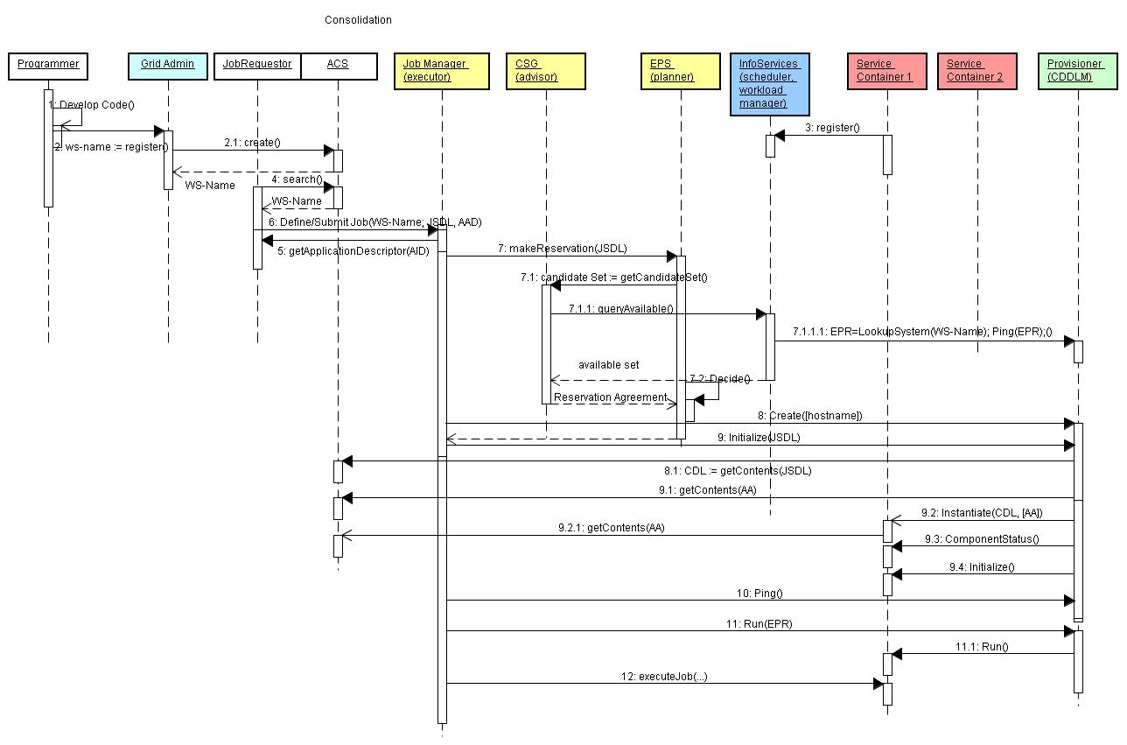

Slide 20
Using Data Services to Access Repository
ACS
Application
Archive
ARI
Application Repository
Candidate Set Generator (Work -Resource mapping)
Provisioning Deployment Configuration
Data Services
(GridFTP, …)
Information Services
Execution Planning Services
Reservation
Service
Container
Job Manager
Accounting Services

Slide 21
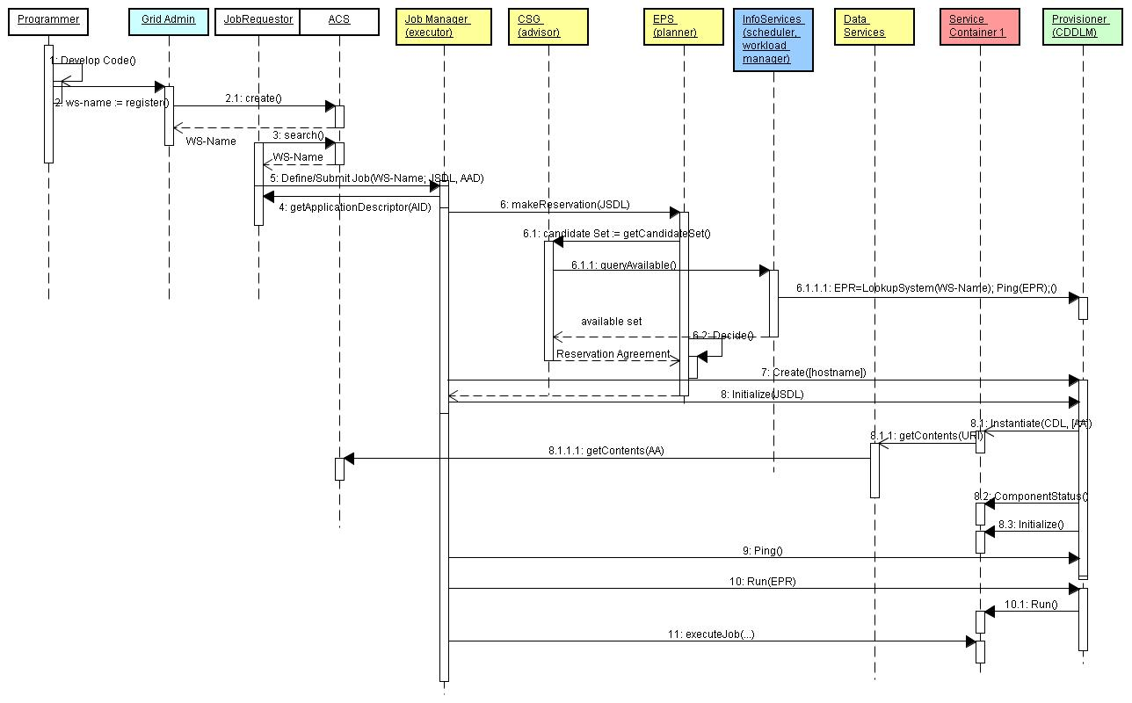

Slide 22
Splitting Content from Execution
ACS
Application
Archive
ARI
Application Repository
Candidate Set Generator (Work -Resource mapping)
Provisioning Deployment Configuration
Information Services
Execution Planning Services
Reservation
Service
Container
Job Manager
Accounting Services

Slide 23
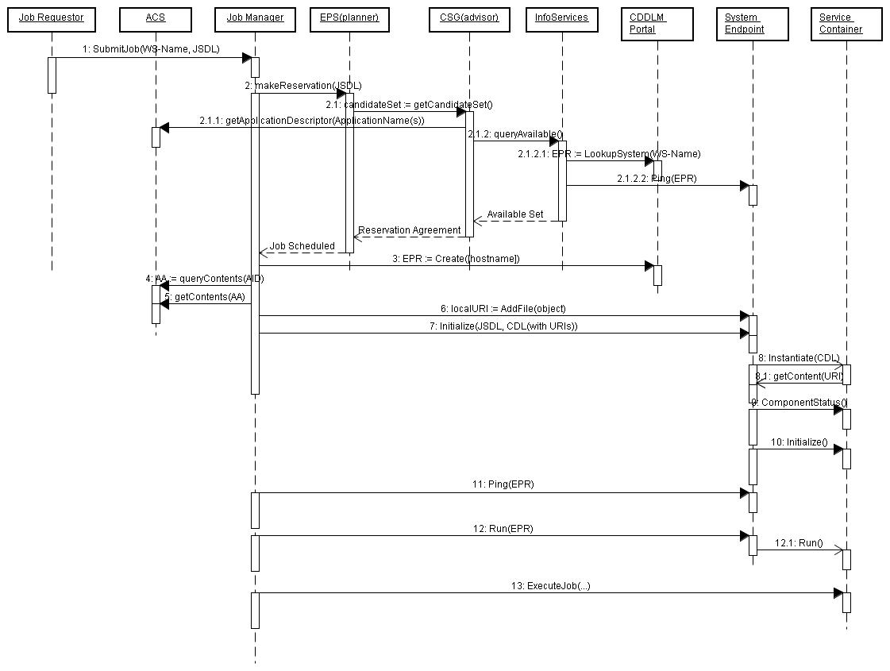

Slide 24
What to tackle next?

