Slide 1
Grid Scheduling Architecture –
Research Group
Ramin Yahyapour
Philipp Wieder
GSA-RG
29 October, 2005 (GGF15 in Boston)

Slide 2
GGF Intellectual Property Policy
All statements related to the activities of the GGF and addressed to the GGF are subject to all provisions of Appendix B of GFD-C.1, which grants to the GGF and its participants certain licenses and rights in such statements. Such statements include verbal statements in GGF meetings, as well as written and electronic communications made at any time or place, which are addressed to any GGF working group or portion thereof,
Where the GFSG knows of rights, or claimed rights, the GGF secretariat shall attempt to obtain from the claimant of such rights, a written assurance that upon approval by the GFSG of the relevant GGF document(s), any party will be able to obtain the right to implement, use and distribute the technology or works when implementing, using or distributing technology based upon the specific specification(s) under openly specified, reasonable, non-discriminatory terms. The working group or research group proposing the use of the technology with respect to which the proprietary rights are claimed may assist the GGF secretariat in this effort. The results of this procedure shall not affect advancement of document, except that the GFSG may defer approval where a delay may facilitate the obtaining of such assurances. The results will, however, be recorded by the GGF Secretariat, and made available. The GFSG may also direct that a summary of the results be included in any GFD published containing the specification.
Sign into
participants list !

Slide 3
Session Agenda
Update on group status/Documents progress
  Grid Scheduling Use-Cases
  Requirements/Architecture Document
Work on Requirements Documents
Discussion on next steps

Slide 4
Charter for beginners
The goal of this research group is to define a scheduling architecture that supports cooperation between different scheduling instances for arbitrary Grid resources. Considered resources include network, software, data, storage and processing units. The research group will particularly address the interaction between resource management and data management. Co-allocation and the reservation of resources are key aspects of the new scheduling architecture, which will also include the integration of user or provider defined scheduling policies.
The group will begin with identifying a set of relevant use-cases based on experiences obtained by existing Grid projects. Then, it will determine the required components of a modular scheduling architecture and their interactions.
Services and protocols from other GGF groups are considered as potential basic building blocks of such an architecture and will be used wherever possible.

Slide 5
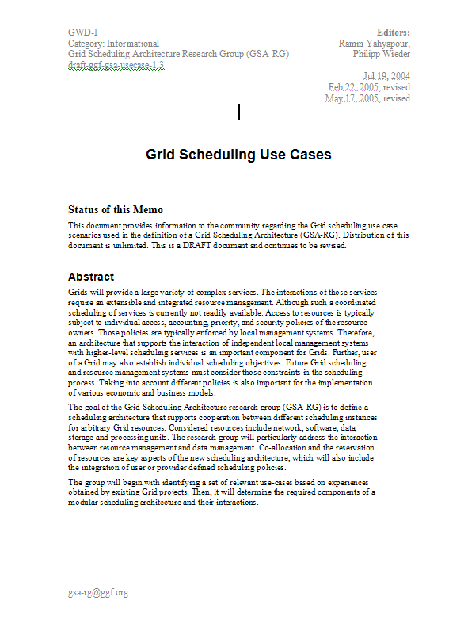
Roadmap
Compile Use-Cases
Ongoing process
for further revisions
Derive Use-Case Profiles
Doc 1: Use-Case
Identify Requirements
for Scheduling Architecture
Ongoing process
for further revisions
Architectural Picture
Required Component Services
Doc 2: Requirements/
Architecture
Ongoing process
for further revisions
Review of existing
services and protocols
Doc 3: Existing Services
Review

Slide 6
Action 1:
Grid Scheduling Use-Case Document
Submitted to editor
In Public Comment period
  See http://www.ggf.org/ggf_docs_public.htm
Deadline Oct 30th for comments
Use the mailing list or GridForge for commenting
Comments are appreciated (including positive comments)
Additional use-cases are still welcome
  This document will be updated with newer revisions,

Slide 7
Included Use-Cases
Scheduling complex workflows
Scheduling Component-based Applications for High Performance Heterogeneous Computing
Application-Oriented Scheduling in the KNOWLEDGE GRID
GRASP (Grid Resource Allocation Services Package) Scheduling in Loosely-Coupled Grids with GridWay
Agent-based scheduling with Calana
Meta-Scheduling /Co-Allocation in the VIOLA Testbed

Slide 8
Profiles derived from Use-Cases
Tried to identify different use-cases/requirement sets
based on existing systems:
  Simple Job Submission Profile
  Single-Site Execution with Service Guarantees Profile
  Job Execution with Advance Reservation Profile
  Multi-Resource Co-Allocation Profile
  Job/Data Staging Profile
  Complex Workflow Profile
  Economic/Market-Based Grid Profile

Slide 9
Identified Requirements from Use-Cases
Decision-making of time and place of resource allocation
Automatic resource selection and optional reservation
Facilitating Grid scheduling services and user-centric Grid scheduling strategies
Communication between higher-scheduling instances (Grid/Super/Meta-Scheduling) and lower-level scheduling instances (Local RMS)
Negotiation of agreements
Support for real-time or deadline constraints
Economy-based scheduling
Orchestration:
  Co-allocation of resources
  Scheduling of workflows

Slide 10
Comments from OGSA-RSS
Matthias?

Slide 11
Action 2:
Requirements Document
Identifies components & interactions for a modular scheduling architecture
Introduces terminology
  Scheduling instance and relation between instances
  What else? – Basic terminology,
  but no dictionary
Derives service requirements from
use cases
  Descriptive, no WSDL, protocols, etc.
Compares requirements with existing solutions
Done
Current
activity
Description of services & their interaction

Slide 12
Document Sections
Section | Name(s) | Status
Information Service
Job-/Workflow Requirement Description | A. Oleksiak, Z. Sheng, Ph. Wieder | 1st version
Resource Discovery
Reservation Management, Agreement and Negotiation
Accounting/Billing | R. Dooley | 1st version
Job Management
Monitoring
Interaction with Data Management
Interaction with Network Management
Performance Prediction | A. Oleksiak | 1st version

Slide 13
Comments on current doc version
Philipp?

Slide 14
Action Items and Next Step
Use-Case Document
  React on public comments and revise document accordingly
  (complete for GGF16)
Requirements Document
  Complete document sections for required services and elaborate on interaction of services
  1st complete version for GGF16
Next step will be the review existing available services
  Use GGF16 for discussion
  Compile first contributions for GGF17
If you want to participate in the work you are invited to subscribe to the mailing list:
gsa-rg@gridforum.org

Slide 15
Old Backups

Slide 16
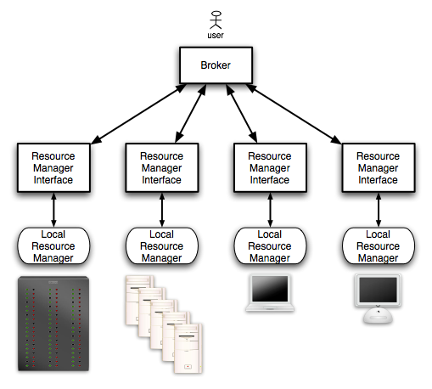
Example for Scheduling-Structures:
Enterprise/Campus Grids

Slide 17
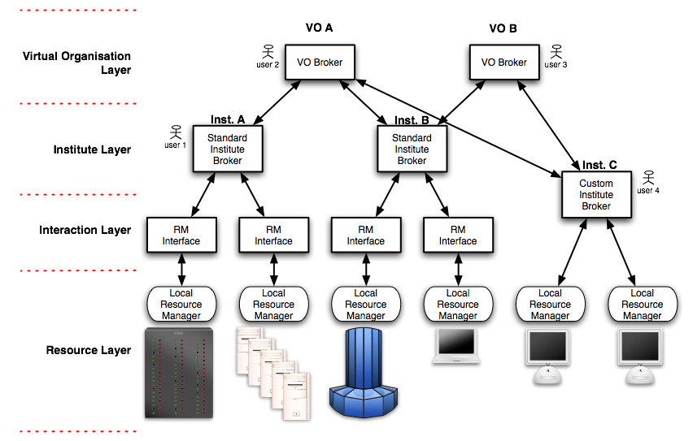
Example for Scheduling-Structures:
Structured HPC Grids

Slide 18
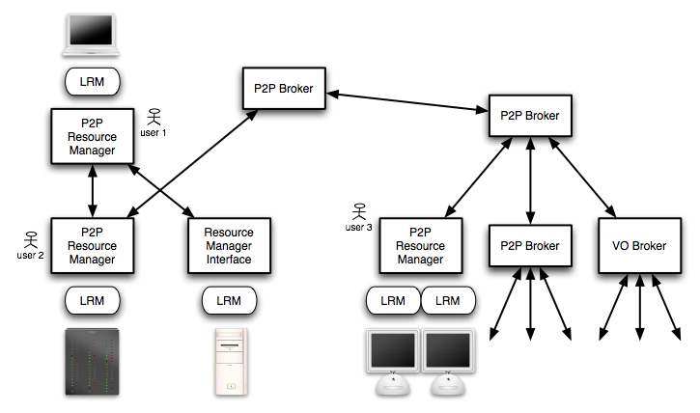
Example for Scheduling-Structures:
Global Grids

Slide 19
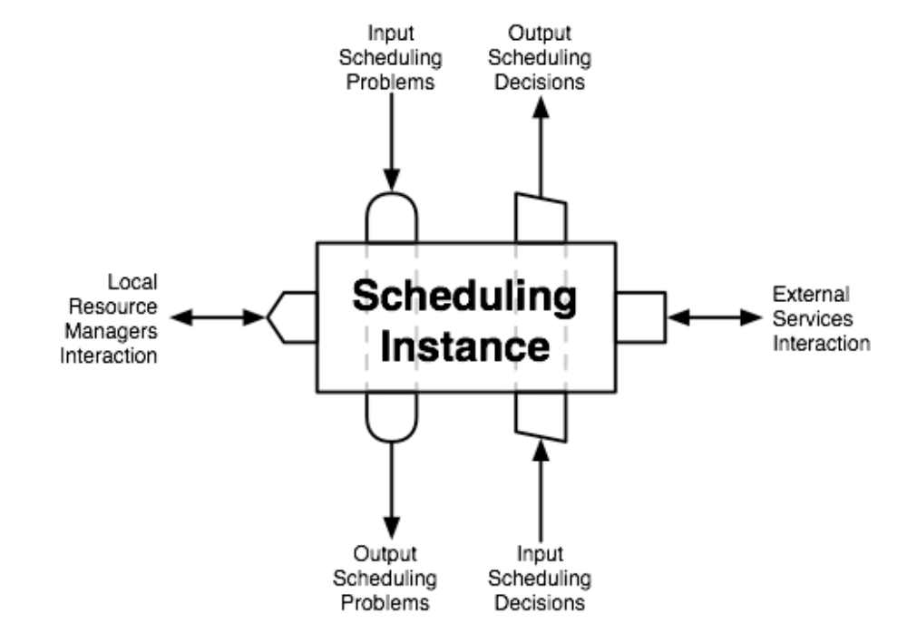
Scheduling Instance
Cornerstone of a scheduling architecture
  Gets scheduling problems as inputs
  and returns scheduling solutions
Distinction between higher-level
and lower-level instances
Lower-level designates scheduler close to the resource
Higher-level scheduler initiate communication with other schedulers to find resource allocations

Slide 20
Profile 1:
Simple Job Submission Profile
No complex workflow
No reservation requirements
No co-allocation of resources
The lower-level schedulers do not support any service level guarantees.
  No information about the actual execution time is known in advance.
A higher-level scheduler receiving this job requests only uses static and dynamic information which are available in an information service.
  Based on some heuristic or algorithm it selects a lower-level scheduler and forwards the request to the local RMS
There is no real Grid scheduling involved in this scenario
  Work just as a broker/dispatcher which forwards a job to remote sites.

Slide 21
Profile 2:
Single-Site Execution with Service Guarantees Profile
Included in Profile 1:
No co-allocation or complex workflows.
Support for including service guarantees in terms of start and end time for a resource allocation are given from the scheduling system.
  E.g. exact start and end time.
  Or latest start and/or end time.
This profile supports more sophisticated local resource management
systems which provide information about the service property.
  E.g. a queuing system with a backfilling scheduling strategy can provide a deadline for your job; however a job may start/finish earlier.
Communication/negotiation between a higher-level and a lower-level scheduler needed.

Slide 22
Profile 3:
Job Execution with Advance Reservation Profile
Very similar to basic job submission profile:
includes the ability to make a concise reservation when a job resource allocation will take place.
While Profile 2 just uses information from lower-level schedulers about job execution, this scenario requires an actual advance reservation mechanism to guarantee a specific time.
  A higher-level scheduler can actively request from a lower system to make a reservation for tomorrow 10:00-12:00.
  This usually requires different lower-level scheduler who can cope with such reservations beyond simple queuing.
This profile may be merged with the previous profile; however, in view of existing RMS implementations, there may be more systems fulfilling the profile but not this one. Therefore a distinction may be reasonable.

Slide 23
Profile 4:
Multi-Resource Co-Allocation Profile
Several resources are required and need to be coordinated.
In many use-cases these resources have to be available at the same time.
A higher-level scheduler will need to synchronize different Grid resources.
Information about resources actually available required.
Knowledge about idle timeslots from information services or through some negotiation protocol between higher-level and lower-level scheduler.
Higher-level scheduler makes co-allocation decisions.
Advance reservation needed.

Slide 24
Profile 5:
Job/Data Staging Profile
Simple profile in which the availability/transfer of data is taking into account.
A scheduler must consider the time needed to make given data available on the target resource.
Simple workflow with planned/coordinated staging of data as part of the scheduling request.

Slide 25
Profile 6:
Complex Workflow Profile
The job can comprise a complex workflow for which a higher-level scheduler should be able to make an advance planning for the static parts it can foresee.
The workflow implies temporal dependencies between different resource allocations.

Slide 26
Profile 7:
Economic/Market-Based Grid Profile
Resource allocations may generate cost and the budget has to be taken into account.
The negotiation for resource offers between lower- and higher-level schedulers comes into play.
In general negotiation models cost/utility/preference-functions are considered for identifying the most suitable resource allocation.

