Slide 1
OGSA-RSS WG
Resource Selection Services
GGF15, Oct. 3 – 6, Boston
Mathias Dalheimer

Slide 2

Intellectual Property Policy
I acknowledge that participation in GGF15 is subject to the GGF Intellectual Property Policy.
Intellectual Property Notices Note Well: All statements related to the activities of the GGF and addressed to the GGF are subject to all provisions of Section 17 of GFD-C.1 (.pdf), which grants to the GGF and its participants certain licenses and rights in such statements. Such statements include verbal statements in GGF meetings, as well as written and electronic communications made at any time or place, which are addressed to: the GGF plenary session,
any GGF working group or portion thereof,
the GFSG, or any member thereof on behalf of the GFSG,
the GFAC, or any member thereof on behalf of the GFAC,
any GGF mailing list, including any working group or research group list, or any other list functioning under GGF auspices,
the GFD Editor or the GWD process
Statements made outside of a GGF meeting, mailing list or other function, that are clearly not intended to be input to an GGF activity, group or function, are not subject to these provisions.
Excerpt from Section 17 of GFD-C.1 Where the GFSG knows of rights, or claimed rights, the GGF secretariat shall attempt to obtain from the claimant of such rights, a written assurance that upon approval by the GFSG of the relevant GGF document(s), any party will be able to obtain the right to implement, use and distribute the technology or works when implementing, using or distributing technology based upon the specific specification(s) under openly specified, reasonable, non-discriminatory terms. The working group or research group proposing the use of the technology with respect to which the proprietary rights are claimed may assist the GGF secretariat in this effort. The results of this procedure shall not affect advancement of document, except that the GFSG may defer approval where a delay may facilitate the obtaining of such assurances. The results will, however, be recorded by the GGF Secretariat, and made available. The GFSG may also direct that a summary of the results be included in any GFD published containing the specification.
GGF Intellectual Property Policies are adapted from the IETF Intellectual Property Policies that support the Internet Standards Process.

Slide 3
OGSA-EMS Framework
Candidate Set Generator
(Work -Resource mapping)
RSS Services to be defined
Provisioning
Deployment
Configuration
Information Services
Execution Planning Services
Reservation
Service
Container
Data
Container
Job Manager
Accounting Services

Slide 4
OGSA-RSS: Objectives
Objective:
  Definition of Resource Selection Services within the OGSA-EMS framework
Two Services:
  Candidate Set Generator (CSG)
  Execution Planning System (EPS)
Focus on simple scheduling:
  No workflow, no data dependencies

Slide 5
Related groups
OGSA-* groups
  Namely OGSA-EMS WG, OGSA-WG
  We are part of the OGSA framework
Grid Scheduling Architecture Research Group (GSA-RG)
  Overlap: They deal with a more general model
  Joint work: We use their use cases and provide feedback
  Joint people: Some people are involved in both groups
GRAAP
  No collaboration so far

Slide 6
More information
Join mailing list
  subscribe ogsa-rss-wg to majordomo@ggf.org
Visit our gridforge space
  http://forge.gridforum.org/projects/ogsa-rss-wg

Slide 7
Current work
Service description milestone:
  Provides informative architecture specification
  Foster collaboration with other WGs
  Outline:
    What do current scheduling systems look like?
    Analysis of GSA-RG’s use case document
    What is the architectural framework within OGSA-EMS?
    Which services can be used, which services will use ours
    Outline of CSG and EPS
    Which functionality is provided?

Slide 8
Use case analysis:
Functional Requirements
Core
Functions
Advanced
Functions

Slide 9
Use case analysis:
Basic functionality
Most schedulers implement:
  Static information gathering
  Application performance estimation (e.g. Walltimes)
  Resource preselection
  Dynamic resource information query
  Generation of schedule
  Advance Reservation
  Execution of workflow / application start
  Completion of workflow / job monitoring
There is an overlap of Job Manager functionality with grid scheduling functionality.
Out of scope for the
moment, but needs
consideration later

Slide 10
Use case analysis:
Advanced functionality
Some scheduler also contain:
  Co-Allocation ( 3 out of 7)
  Re-scheduling functionality (2 out of 7)
  Billing (1 out of 7)
  Data Handling (none)
Out of scope.

Slide 11
The plan changed yesterday
Initially, we wanted to collect information on what data is used by mos schedulers
But: We feel that we need to discuss how CDDLM & ACS fit into our picture.

Slide 12
Service interaction
How do scheduler services interact with their environment?
This leads us to the definition of the interfaces for
  Candidate Set Generator (CSG)
  Execution Planning System (EPS)
We focus on CSG for now.

Slide 13
Resource Selection without CDDLM
JM
EPS
CSG
IS
SC
RS
- abstract JSDL
- selection policy
- abstract JSDL
- publish
information
- query static
information
- query additional information
?
- result
concrete EPRs
- concretized
JSDL
- query dynamic information
Complete JSDL
- EPR to SC

Slide 14
CSG: Resource mapping
We need a way to decide whether a JSDL-specified job can be executed on a machine or not.
Therefore: The IS must provide information for all properties of JSDL for all machines.
We can’t decide whether a machine can be modified in order to make it an execution candidate.

Slide 15
CDDLM: Container Deployment
CDDLM Portal Service can be asked to create a system
The system can then be initialized
  During initialization, the dependencies of an application are resolved.
  This determines which applications need to be installed.
  If this can’t be done, an Fault is sent back
Then: Start or stop the system

Slide 16
CDDLM & CSG
Basically, CDDLM can decide which software is needed to run a specific JSDL job
We can decide whether the hardware is sufficient
Put this together!

Slide 17
Architecture
Job Manager
EPS
CSG: Central Part
Info
System
CSG: local Part
Resource
Provider
CDDLM
ACS
Resource
Resource
Resource

Slide 18
Resource Selection with CDDLM
JM
EPS
CSG
CDDLM
IS
RS
CDDLM
CDDLM
- abstract JSDL
- selection policy
- abstract JSDL
- ask feasibility
Portal EPR
?
- query additional information
- result
Complete JSDL
- EPR to CDDLM
- createSystem, startSystem, monitor, stopSystem

Slide 19
Advantages
We can do resource discovery this way
CSG may present an EPR to the EPS, which can then be queried etc.
Local CSG part may implement strategies according to local policies
  “not this job, because it runs not well here”

Slide 20
CDDLM Deployment API
Adresses the use case of deploying an JSDL-described job on resources.
Portal EPR controls the deployment of a system
  There is no such thing as “tell me how long it would take to deploy this JSDL-described job”
  This would be nice.

Slide 21
Thank you.
Visit us:
http://forge.gridforum.org/projects/ogsa-rss-wg

Slide 22
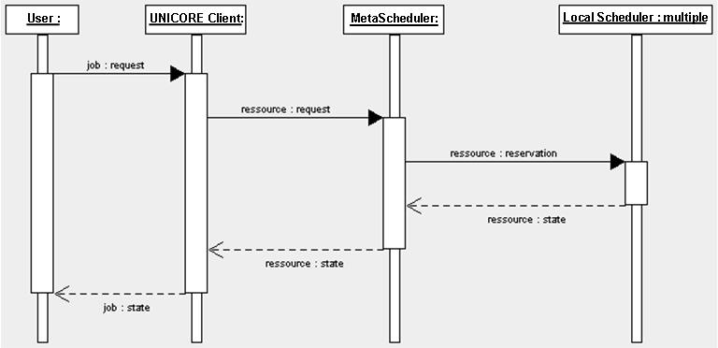
Interaction diagram: VIOLA scheduler (I)

Slide 23
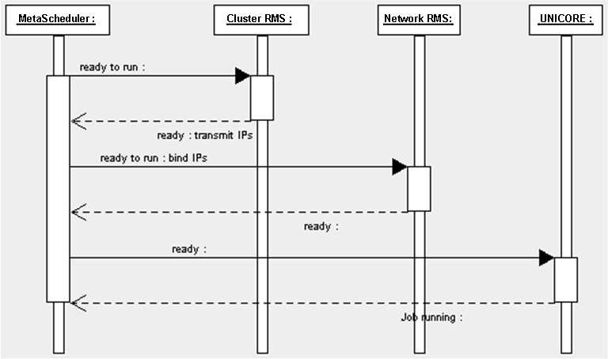
Interaction diagram: VIOLA scheduler (II)

Slide 24
Interaction diagram: Calana Scheduler
JM
Broker
Agent₁
Agent_{n}
CFB: Call for Bids
SC: Service
Container
RS: Reservation
Service
SC/
RS
SC/
RS
request
CFB
getRes
getRes
Bid
Result
response
cancel
useRes
Site A
Site B

Slide 25
CDDLM: Overview

Slide 26
A deployable system

Slide 27
Steps to deploy a service
Portal EPR creates a system EPR
System EPR can be used to
  Initialize the system (eventually a fault occurs)
  Run the system
  Stop the system

Slide 28
Use case analysis:
What data is used?
Unfortunately, the use cases do not contain specific information about what data is used during the scheduling process.
We estimate:
  ...
But: We need more exact information.

Slide 29
Brainstorming: Which data is used?
Resource-related
  CPU type, ...
Software-related
  Architecture dependencies, ...

Slide 30
Open issue: What data is used
GSA-RG use case document provides no information regarding which data is used during the scheduling process
This is vital for the definition of the RSS
Therefore:
  Initial brainstorming here
  Ask use case authors to add some notes on data

Slide 31
Community poll:
Feature we must support
Advance reservation
Arbitrary Selection policies
...

