Slide 1
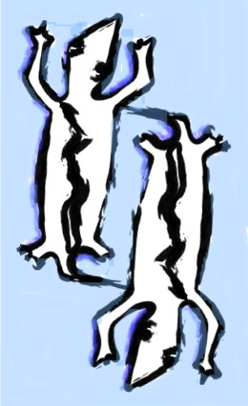
Continuous query model to accessing and operating on stream data
Beth Plale
Computer Science Dept.
Indiana University

Slide 2
Data streams:
Indefinite sequence of events (or messages, tuples)
Often time marked
  Generation time, that is, timestamp, and
  Logical time
Events continuously generated
  pushed or pulled from providers to remote consumers

Slide 3
Problem Statement
Data streams (e.g., from sensor networks, instruments) are growing in pervasivness and importance
Bringing streaming sources to a grid by wrapping each sensor and instrument as grid or web service is a naïve solution.
It is the data in the streams that is of broad value, not the instruments.
  Select few will ‘steer’ instruments
Need fresh solution that provides access to collections of data streams (not collections of instruments.)

Slide 4
Stream Model
Q1, Q2, Q3 are continuous queries specified in modified subset of SQL
R1
R3
Q1
R5
runtime
Q3
runtime
R4
R2
Q2
runtime
R5 = Q3(R3,R4)
R3 = Q1(R1)
R4 = Q2(R2)
R1 = observ source 1
R2 = observ source 2

Slide 5
A collection of streams is bound by coherence and meaning
R1
R3
Q1
R5
runtime
Q3
runtime
R4
R2
Q2
runtime

Slide 6
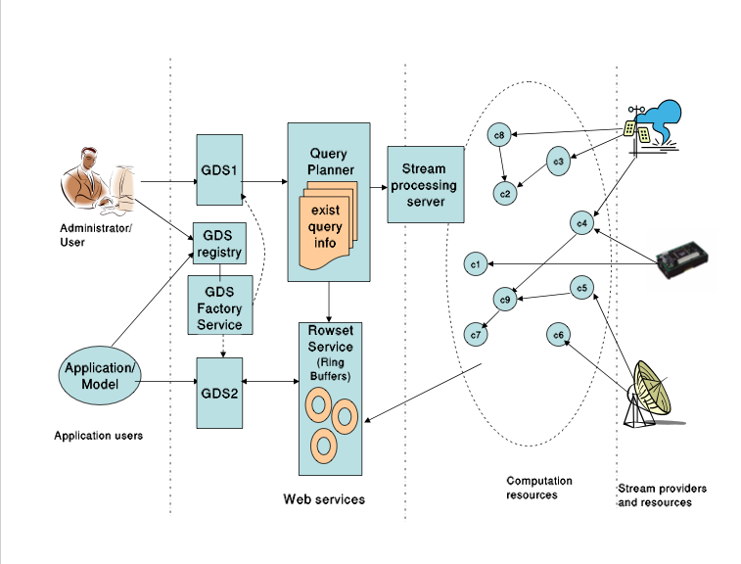
netCDF + metadata
on pub/sub system

Slide 7
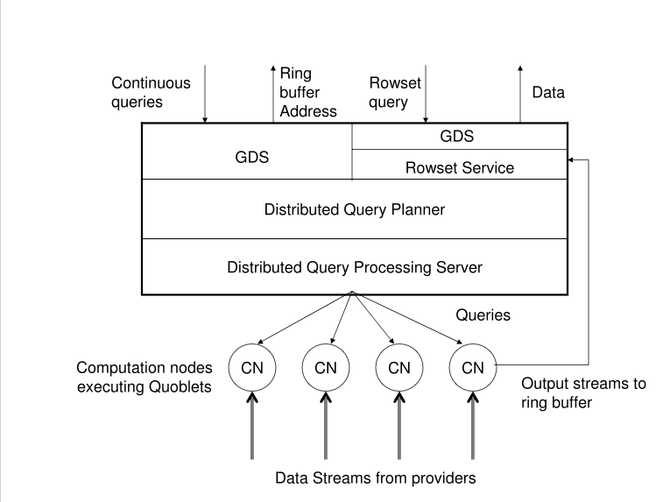

Slide 9
Stream BOF questions
What do we mean by a "data stream"?
  Indefinite sequence of events (or messages, tuples)
  Often time marked
    Generation time, that is, timestamp, and
    Logical time
  Events continuously generated
    pushed or pulled from providers to remote consumers
Grids have to consider attributes such as security, persistence, and quality of service. Do these raise any particular questions for streams?
What are the important use cases? Are there unusual or non-obvious cases that we need to consider?

Slide 10
Stream BOF questions
What is the natural programming model for streams in a distributed environment?
  Multiple models exist and should be supported
How do we connect one stream to another?
  Database model, a stream (relation) are connected through their participation in a query
How do streams fit into a service-oriented architecture?
  Service provides access. Result streams are the resource (WSRF-style)
The OGSA Data Architecture currently has sections on Provisioning,Querying, Replication, Caching, etc. Do these apply to streams as well as static data? Are there any particular aspects of streams that affect any of these sections?

Slide 11
Related Research
Common Middleware Instrument Architecture (CIMA), McMullen, Bramley et al.
GATES,
  Aggarwal, HPDC04
Data Cutter, Saltz
Grid Stream Database Manager (GSDM)
  Koparanova and Risch, AxGrids 2003
  Stores into O-O DBMS
DQP
  Manchester and Newcastle
DB community: Widom, Borealis, NiagaraCQ
Notes:
Schooner: expert system for decision making
Autopilot: rules and fuzzy logic
Both static …. i.e., require rules set up in advance
Active disks: query actual database, stream results to user
Snodgrass: origins of my work. Queries for decisions about performance; heavily tied to actual database
Continual queries: queries over database triggered by changes to web pages. No streaming data.
Performing computation over streaming data:
ABACUS: optimal placement of functions in a cluster
Distributed labs: couple other mechanisms for decision making and computation
DataCutter: filter-stream programming model; decision making done by
writing C++ code that inherits a ‘filter’ parent class.
Dv: flowgraph of computations (sci visualization) under scheduler control. Scheduler chooses where to execute flowgraph
nodes so that end-to-end deadline can be met with high probability

Slide 12
http://www.cs.indiana.edu/dde/projects/Calder.html
Calder extends dQUOB (http://www.cs.indiana.edu/dde/projects/dquob.html).
dQUOB v1.0, which is available for release as open source, includes the stream processing system components of Calder.

Slide 13
Specifying Long-Running Queries: An Example
SELECT (caps, acars, nexradII)
WHERE
REGION(90W, 30N, 62.5KM)
START now
EXPIRE 1hr
RANGE 6 min
Select from 3 data types,
CAPS radar, ACARS data, and NEXRAD Doppler level II,
Filter out events not falling within 80 mile radius around New Orleans
Execute beginning immediately and terminating execution in 1 hour. Set sliding window size (RANGE) as window over which joins are carried out

Slide 14
Retrieving results from rowset service: Rowset Request API
getTuple(timestamp, ringBufferID)
getRangeTuple(startTS, endTS, ringBufferID)
getMostRecent(lastRecent, num_events, ringBufferID)
getStream(ringbufferID)
Results obtained through request to rowset service of form:
-- single event based on timestamp,
-- range of events bounded by time range,
-- most recent n events, or
-- stream of events.

