Slide 1
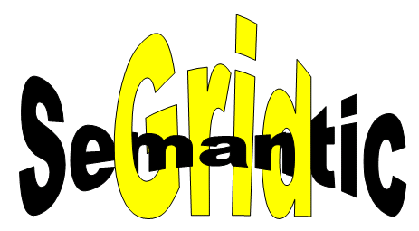
How many streams can you find in these pictures?
David De Roure
University of Southampton
www.semanticgrid.org

Slide 2
Combe Chem pilot project
Video
Simulation
Properties
Analysis
Structures
Database
Diffractometer
X-Ray
e-Lab
Properties
e-Lab
Grid Middleware

Slide 3
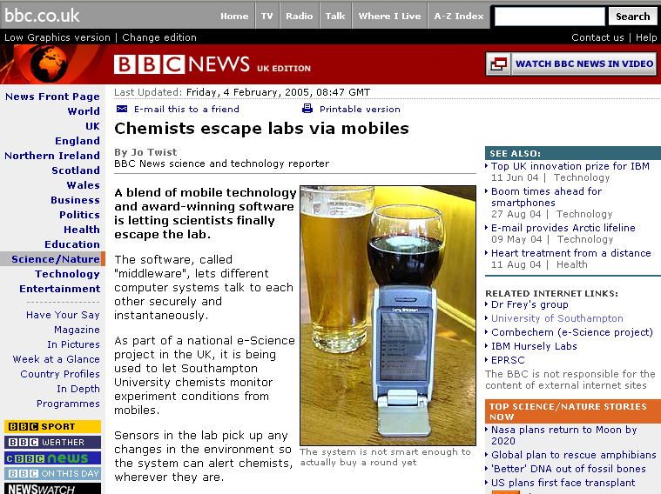
In the bar

Slide 4
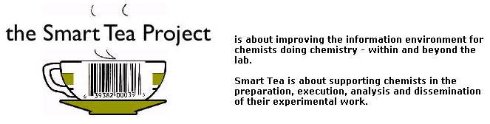
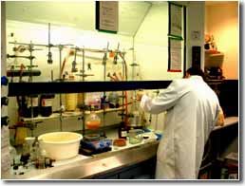
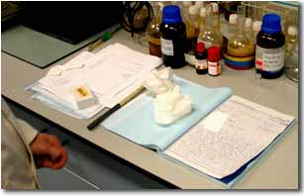
CombeChem Smart Tea
www.smarttea.org

Slide 5
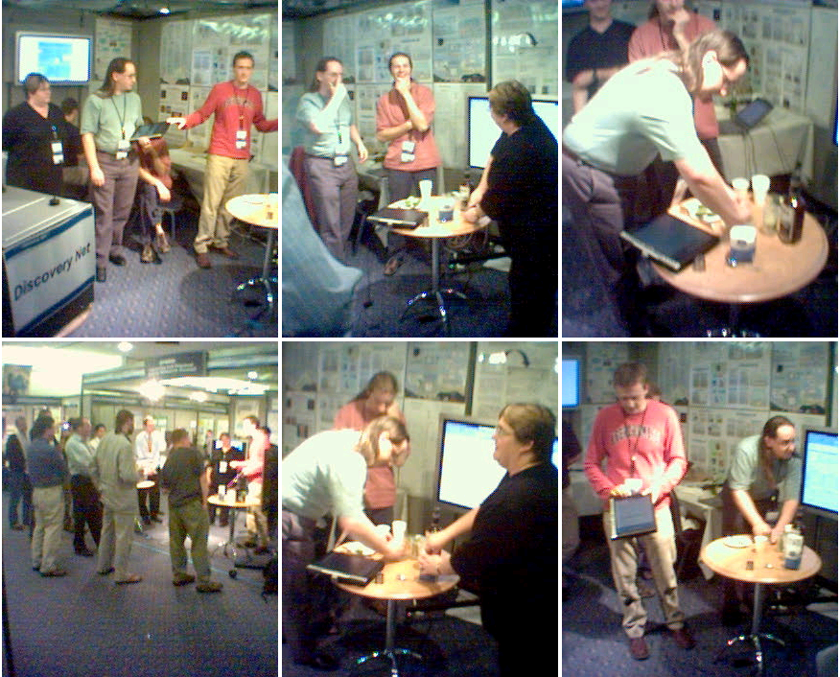

Slide 6
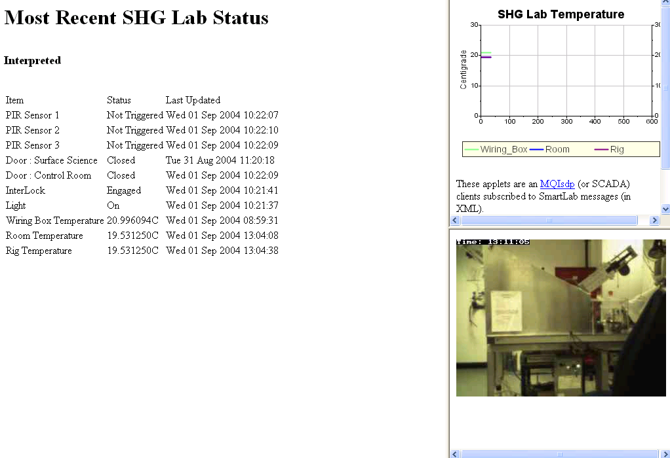
Smart Lab Snapshot

Slide 7


eBank
Virtual Learning Environment
Undergraduate Students
Digital Library
E-Scientists
Graduate Students
E-Scientists
Reprints
E-Scientists
Peer-Reviewed Journal & Conference Papers
Technical Reports
Grid
Preprints & Metadata
Entire E-Science Cycle
Encompassing experimentation, analysis, publication, research, learning
E-Experimentation
Local
Web
Publisher Holdings
Institutional Archive
Certified Experimental Results & Analyses
Data, Metadata & Ontologies

Slide 8

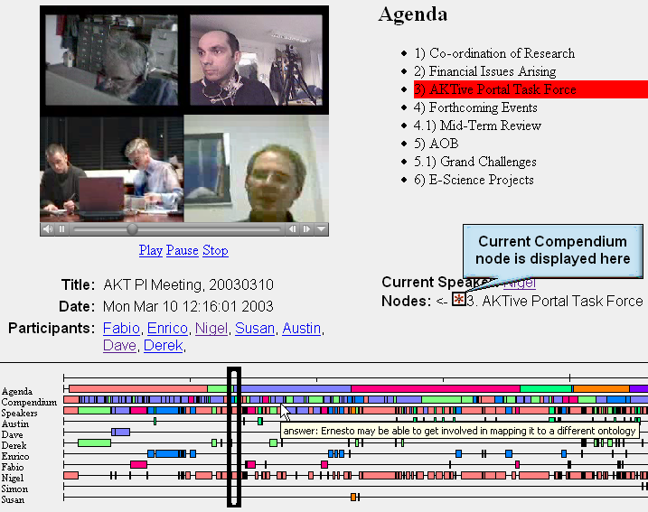
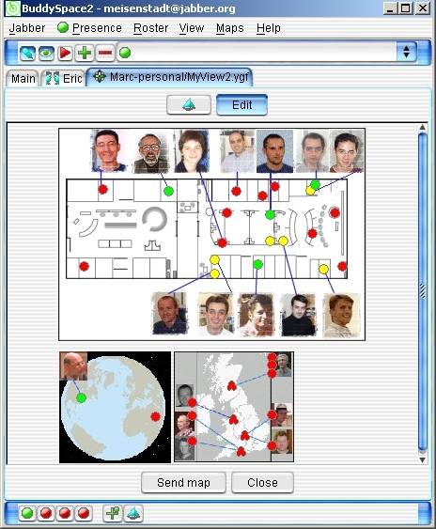
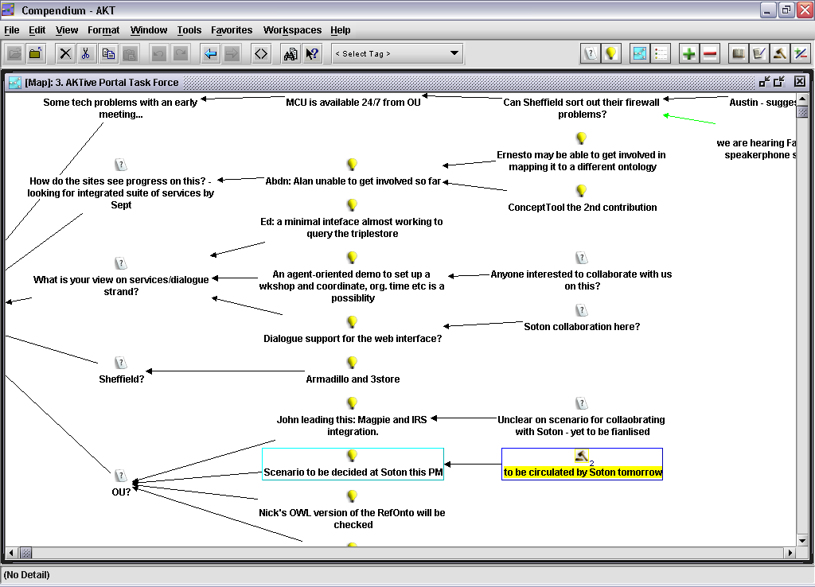
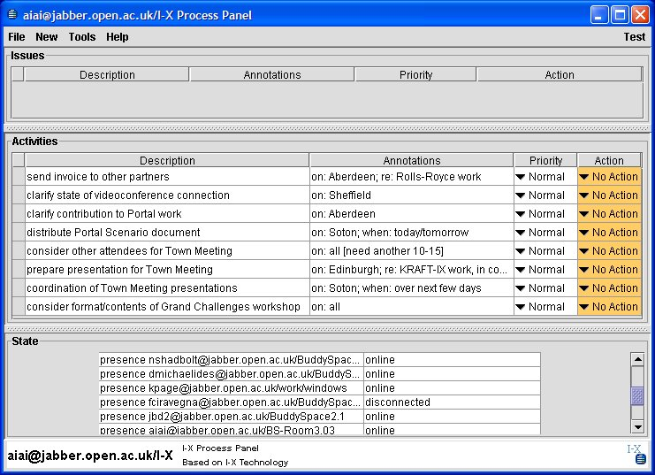
Meeting Replay
BuddySpace
Compendium
Jabber Server
Compendium
BuddySpace
I-X Process panels
I-X Process panels
KMI, AIAI

Slide 9
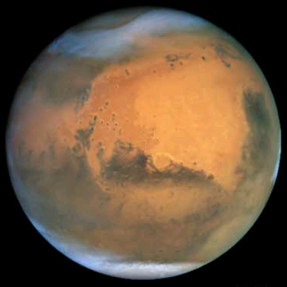
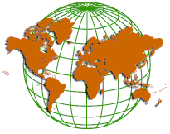
NASA Scenario
1. Astronauts debrief on EVA
Compendium maps from trained compendium astronaut
Remote Science Team (RST) on earth e.g. geologists
Mars
Video and
Science Data
Plan for next
Day’s EVA
2. Virtual meeting of RST
using CoAKTinG tools

Slide 10
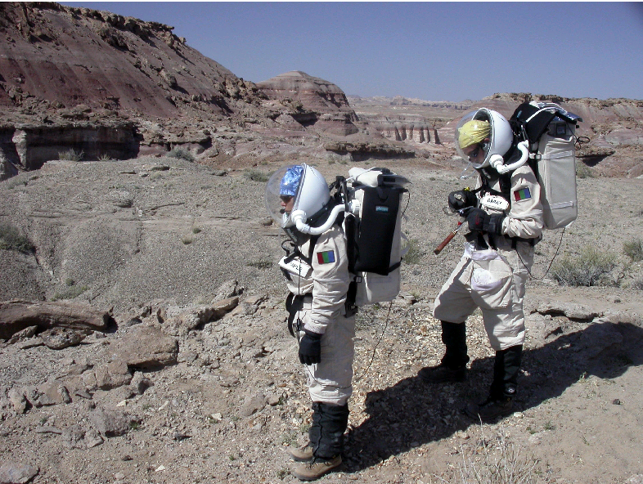
Image from NASA

Slide 11
Discussion points
Video (etc) – describe it, switch it, don’t feel it needs to be squeezed through message transport
  NB may be bidirectional
Notifications – content- and topic- based pub-sub routing is a very powerful model (for Grid computing!)
Interaction / annotation generates streams!
Think inside the stream – richness, metadata
  Content streams and associated metadata streams don’t need to be entwined – they may have different sources and destinations, they may be multicast

Slide 12
Questions
What is a stream?
  Temporal, flow describable as one entity, has endpoints
  May join part way through, leave anytime
Grid-specific attributes
  How does e.g. content-based pub-sub fit grid security models?
Important use cases
  sensors, interaction, something with rich metadata
Natural programming model
  Pub-sub works well!
  Handles on flows or endpoints
Connecting streams
  See above

