Slide 1
OGSA Data Replication Services Working Group
GGF8
Wednesday, June 25, 2003

Slide 2
OREP Sessions at GGF9
1. Monday 10 a.m. - 11:30 a.m. (Mayfair)
  Led by Ann Chervenak
  Replica Location Service Specification discussion
2. Monday 2 p.m. - 5:30 p.m. (Sheraton 4)
  Led by Norman Paton, others
  Representing Data Services in OGSA
3. Tuesday 12 noon – 1:30 p.m. (Mayfair)
  Led by Ceceile Madsen
  Data Distribution issues related to Replication

Slide 3
OGSA Data Replication Services Working Group
Co-chairs:
  Ann Chervenak, USC Information Sciences Institute
  Cecile Madsen, IBM
Secretary:
  Andre Merzky, Zentrum für Informationstechnik Berlin (ZIB)
Web site:
  http://www.ggf.org
Mailing list
  orep-wg@ggf.org
  Subscribe by sending email to majordomo@ggf.org with body subscribe orep-wg

Slide 4
Recent Meetings
GGF8
  Steps toward a fully service-oriented Replica Location Service Design
  From simple grid service wrapper around existing RLS to replicaSet service based on serviceGroups
July 30-31 OREP Meetings
  Designing a service-oriented Replica Location Service
  Based on data services
  Extending ServiceGroups to provide support for policy

Slide 5
Outline
Overview of Service-Oriented RLS
Background
  Data Services (DAIS)
  ServiceGroups (OGSI)
Representing replicaSets as services
Designing replicaSets as ServiceGroups
Optional Indexes for replicaSets
Supporting Policy in replicaSets
Components of replicaSets
  Factories, SDEs, Methods

Slide 6
Replica Location Services
Register existence of replicas of data items
  Replicas according to some semantic definition of replica, such as byte-to-byte copies, versions, etc.
  Logical identifier or equivalence class associates replicated data items
Respond to queries about replicas
  Return identifier or locators for individual replicas
May enforce policies about replicas
  Authorization, maintaining semantic definitions, etc.

Slide 7
Overview of
Replica Location Service Design
Data items are exposed as Grid services called data services
  Data services are uniquely identified by Grid Service Handles (GSHs)
Replicated data services are effectively members of an equivalence class according to some semantic definition of equivalence
A replica set equivalence class should be exposed as a Grid service called a replicaSet service
The replicaSet service design should be based on and extend the OGSI ServiceGroup, which is a collection of Grid services

Slide 8
Overview of Replica Location Service Design (Continued)
The replicaSet service should be have associated policies for authorization and semantics (what constitutes a member of the equivalence class)
The RLS design may include additional indexes for aggregating information about multiple replicaSet ServiceGroups
  For availability and performance
  These indexes should also be designed as extensions of ServiceGroups

Slide 9
Background: Data Services
The OGSA Data Services Specification is being standardized through the DAIS Working Group
  DAIS/OREP session Monday 2-5:30pm, DAIS session Monday 8-9:30pm
A data service is an OGSI Grid service that represents and encapsulates a data virtualization, which is an abstract view of some data
Service data elements (SDEs) describe key parameters of the data virtualization
Support one or more interfaces:
  Inspect SDEs
  Access the data
  Derive new data virtualizations
  Manage data virtualizations

Slide 10
Relevant Aspects of Data Services for Replica Location Services
OGSI service data elements (SDEs) are used to describe aspects of a data service’s data virtualization as well as metadata
OGSI Grid Service Handles are used to globally and uniquely identify data services
Data services inherit basic lifetime management capabilities from OGSI Grid Services
Data services may be created dynamically using data factories

Slide 11
Relevant Aspects of Data Services (Continued)
Data services implement one or more of the four base data interfaces: DataDescription, DataAccess, DataFactory and DataManagement
We are most concerned with DataDescription
  Defines service data describing the data virtualization
  Allows clients to inspect this service data
Access these SDEs using:
  FindServiceData operations from the Grid service portType
  Subscription/notification operations from the Notification portType

Slide 12
Background: ServiceGroups
Defined in Open Grid Services Infrastructure (OGSI) Version 1.0 specification
ServiceGroups are Grid services that maintain information about a group of other Grid services
A ServiceGroup contains entries for member services
  Entries are represented as Service Data Elements (SDEs) of the ServiceGroup
Each ServiceGroup entry SDE value is a triple with:
  A memberServiceLocator
  An optional serviceGroupEntryLocator for a service associated with an entry, used for managing entry
  Content

Slide 13
ServiceGroups (Continued)
Used to implement service registries
Also specialized indexes, such as for information services

Slide 14
Outline
Overview of Service-Oriented RLS
Background
  Data Services (DAIS)
  ServiceGroups (OGSI)
Representing replicaSets as services
Designing replicaSets as ServiceGroups
Optional Indexes for replicaSets
Supporting Policy in replicaSets
Components of replicaSets
  Factories, SDEs, Methods

Slide 15
Representing ReplicaSets as Services
Replicated data items are defined by an equivalence class
Expose these equivalence sets as services
Thus define a replicaSet Grid service as a virtualization of the set of replicas that make up an equivalence class
This equivalence class is globally and uniquely identified by a Grid Service Handle
Effectively, a replicaSet service provides a mapping from the locator (handle) of the equivalence set service to one or more locators for member data services

Slide 16
Representing ReplicaSets as Services (Continued)
Represent information about data services that are members of the replicaSet service as service data elements (SDEs) of the replicaSet service
ReplicaSet service data may also include information about policies that the replicaSet service supports
A client may use standard inspection and subscription/notification methods to inspect a replicaSet service and obtain information about its members and policies

Slide 17
Designing ReplicaSets as ServiceGroups
Maintain information about a group of other Grid services
Each entry in the ServiceGroup is a service data element SDE consisting of three values:
  the locator of the serviceGroupEntry service used for management of the entry
  the locator of the member data service
  content associated with the entry
Extend the ServiceGroupRegistration port type’s add and remove methods

Slide 18
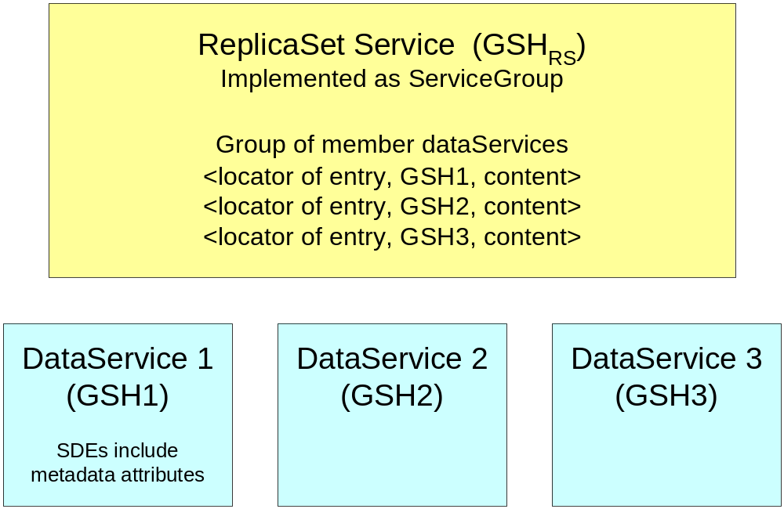
DataServices and ReplicaSet Services
Maps from GSH of ReplicaSet Service to GSHs of member replica DataServices

Slide 19
Optional Indexes for ReplicaSet Services
A client may directly inspect a replicaSet
  Must respond to queries about its service data, including information about its members
Do not require separate Replica Location Service index services from a functionality perspective
Indexes may be useful for availability and performance reasons
  Aggregate information about data services that make up one or more replicaSet services
  Improve availability by answering queries about replicaSet members even if a particular replicaSet service is unavailable due to temporary failure
  Improve performance by allowing bulk query operations on indexes

Slide 20
Designing Indexes
These could also be implemented as ServiceGroups
ServiceGroupEntries would include:
  locators to member replicaSet services
  content fields that include data services in corresponding replicaSet equivalence class

Slide 21
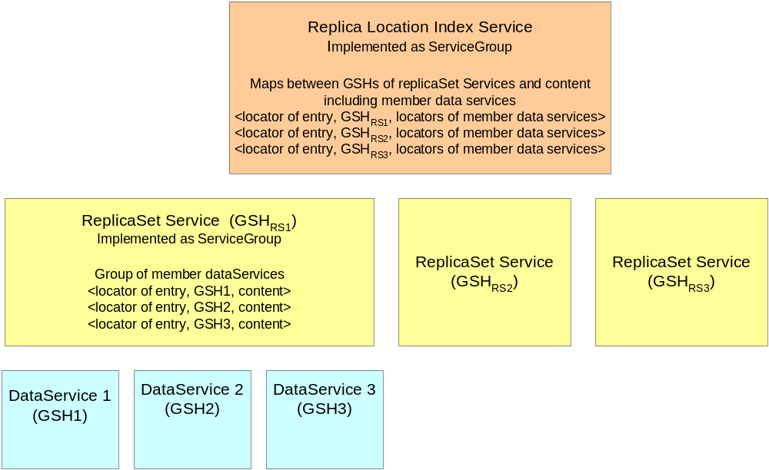
Replica Location Index Service

Slide 22
Scenario for Creating a New Replica and Adding it to a ReplicaSet
Client A invokes data factory port type on an existing data service to create a new derived data service that is a replica of the original
Client A invokes the add operation on the replicaSet
  The replicaSet enforces authorization, semantic and other policies
  If allowed, the new data service is added to the replicaSet service
The replicaSet service may send information about its membership to one or more aggregating indexes

Slide 23
Outline
Overview of Service-Oriented RLS
Background
  Data Services (DAIS)
  ServiceGroups (OGSI)
Representing replicaSets as services
Designing replicaSets as ServiceGroups
Optional Indexes for replicaSets
Supporting Policy in replicaSets
Components of replicaSets
  Factories, SDEs, Methods

Slide 24
Enforcing Policies in ReplicaSet Services
A replicaSet service may enforce policies about the equivalence set of replicas
  Access control policies determine who is allowed to add or remove data services as members
  Semantic policies specify the meaning of replication and which data services may be members of a replicaSet
  Policies determine what attributes may be associated as service data elements
The extent to which the assertions about replica semantics are verified or enforced depend on the replicaSet service implementation
  Policies enforced at time members are added
  Policies maintained over time

Slide 25
Possible Standard Semantic
Policies for ReplicaSets
Byte-for-byte copy of data items, such as files
Data objects that contain the same information in different formats
Data objects that are equivalent to a specified degree
Data objects that are derived from a common parent
Versions of data objects
Replicas that have been synchronized within a specific time period
Partial replicas of data objects

Slide 26
Specialized ReplicaSet Services
Can implement specialized replicaSet services for implementing higher-level behaviors
E.g., replicaSet services could maintain policy relationships among members of the equivalence class, such as byte-for-byte copies
  Use subscription to be notified of any changes in the contents of member data services
  Propagate these changes among replicas according to a particular coherency scheme
Alternatively: periodically introspect on the members of the replicaSet to check coherence and remove non-complying members

Slide 27
Basic components of replicaSets
Factories
Service data elements (SDEs)
Methods/Port types

Slide 28
replicaSet Factories
Used to create new equivalence classes for replicas
Extend the ServiceGroupFactory to support policy specification for authorization, replica semantics, etc.
  Relates to the Factory port type of OGSI specification
  Also to the Agreement Factory being specified through GRAAP Working Group of GGF
Policies may eventually be considered as part of the published agreement terms
SDEs specify assertions that instances created by the factory can support
  There may be mechanisms associated with these assertions

Slide 29
replicaSet Factory (continued)
Different factory services may support different assertions, extensions and mechanisms
Examples:
  Byte for Byte Copy replicaSetFactory
  Versioning replicaSetFactory
A call to a replicaSetFactory service to create a new replicaSet service instance would specify one of the advertised policies of the factory
The newly-created replicaSet service would include SDEs describing the policies that replicaSet supports

Slide 30
replicaSet Service Data Elements
SDEs must describe the policies supported by the service, including authorization, replica semantics or other policies
In addition, the replicaSet contains SDEs that describe its members
  optional locator of the ServiceGroupEntry management service
  locator of the member service
  content associated with the entry
Content in the SDE entries can be added at registration time or pulled later from the underlying data service
Open question: what content needs to be associated with replicaSet entries?

Slide 31
replicaSet SDEs (continued)
Some content will come from the individual data services that are members of the ServiceGroup
  These services have service data elements (SDEs)
  Could represent complete or partial member data service SDEs
  Or may summarize or aggregate data service SDEs in some manner for the replicaSet content field
We would need to provide additional mechanisms to summarize or aggregate SDEs from a member data service
  Likely these would be useful for additional services besides ReplicaSets that use ServiceGroups.
We may find it useful to define a schema for the content entry in the replicaSet ServiceGroup.

Slide 32
replicaSet Methods
Inherit from ServiceGroup (service data only), ServiceGroupEntry and ServiceGroupRegistration port types:
  Publishes service group entries as service data elements
  Add, delete entries
  Use the addExtensibility features of the ServiceGroupRegistration add call to define the content to be added to the replicaSet service entry
SDEs of replicaSets can be accessed:
  By query oeprations of the GridService port type such as FindServiceDataByName
  Using the Notification portType to support subscription and notification

Slide 33
Next Steps
More work on Factories and WS-Agreement
  Specifying policies and enforcement guarantees as part of negotiated agreements
Content of replicaSet entries
  What content from underlying data services should be stored in the replicaSet
Prototype of replicaSet service
  Based on GT3 Index Service

Slide 34
Follow-On Meetings
Meeting at SC in Phoenix in November?
Bi-weekly or monthly teleconferences
Face-to-face meeting before GGF10
  Early February

