Slide 1
Workflow and myGrid
Justin Ferris
IT Innovation Centre
7 October 2003
Life Sciences Grid
GGF9

Slide 2
Contents
myGrid: some background
What problems are we are trying to solve?
What we’ve built
Demonstration
What’s coming next
Downloading and using our software
Questions
Notes:
Hello, I’d going to talk about the myGrid project and in particular discuss and demonstrate the workflow tools that we’ve produced.
I’ll provide some background on myGrid: the broad aims of the project and the approach we’re taking.
After this I’ll describe Graves disease research as a typical scenario for users of project components.
I’ll then briefly cover components that we’ve build and will describe in more detail the workflow components.
I’ll describe the challenges that are ahead of us for workflow before providing references and taking any questions

Slide 3
myGrid (1): Background and aims
UK Research council-funded pilot project
November 2001 – April 2004
Provide grid / eScience middleware for bioinformaticians
Vision: workbench and component infrastructure for managing in silico and wet lab experiments
Notes:
myGrid is a UK research council-funded project involving a number of academic and industrial partners
It’s broad aims are to produce grid middleware such as infrastructure for resource discovery and workflow
Enactment to make the information grid appropriate for bioinformatics.

Slide 4
myGrid(2): The approach we’re taking
Build something that people can use on a day-to-day basis within the bioinformatics and wider e-Science community
Provide a basis for the research and demonstration of the benefits of new technologies (e.g. Semantic Web) in eScience
Deliver tools and specifications in a form that can be easily taken further both during and beyond the end of the project

Slide 5
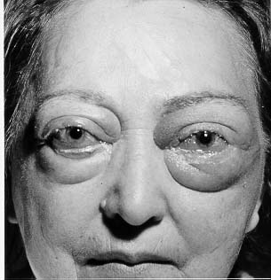
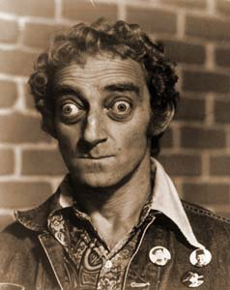
What sort of biology problems is myGrid aiming to help solve?
Graves’ Disease
  Autoimmune disease of the thyroid in which the immune system of an individual attacks cells in the thyroid gland resulting in hyperthyroidism
  Weight loss, trembling, muscle weakness, increased pulse rate, increased sweating and heat intolerance, goitre, exophtalmos
Notes:
We chose Graves’ disease as a driver research problem.

Slide 6

What sort of biology problems is myGrid aiming to help solve?
Grave’s Disease is caused by the stimulation of the thyrotrophin receptor by thyroid-stimulating autoantibodies secreted by lymphocytes of the immune system.
What is the molecular basis for this autoimmune response?
TSH
Pituitary
Gland
TSH Receptor
Thyroid
Cell
-ve feedback
effect
Thyroid Hormones Released

Slide 7
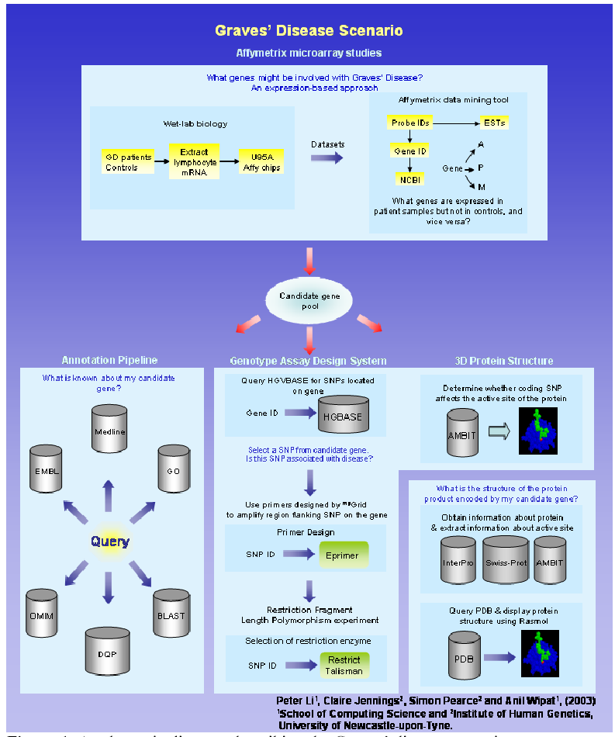
A biologist’s approach to the problem
Combine lab biology and in-silico experiments
Exploratory
Ad-hoc
Collaborative
Provenance and record keeping

Slide 8
myGrid Architecture
External Services
^{my}Grid Services
^{my}Grid Client
Notification
Notification
Client
^{M}IR
Bio-databases
User Proxy
User Gateway
Workbench
UDDI
Registry View
Service
Browser
SOAP-LAB
EMBOSS
Finding Service
Domain
Services
Enactment Engine
Taverna
Workflow Environment

Slide 9
SoapLab (1)
High quality web service interfaces to tens of analyses from EMBOSS running at EBI.
  e.g. seqret, getorf, plotorf, emma, prophet, prophecy
  Martin Senger @ EBI, hinxton, UK
  http://industry.ebi.ac.uk/soaplab/
EMBOSS high-quality FREE Open Source software for sequence analysis
  around 100 molecular biology applications
  http://www.hgmp.mrc.ac.uk/Software/EMBOSS/

Slide 10
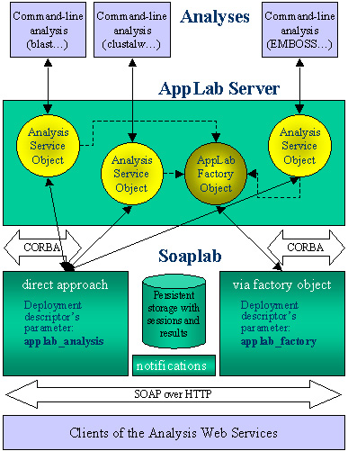
SoapLab (2)
  Factory Interface
  CreateJob
  Run
  WaitFor
  GetResults
  Destroy

Slide 11
FreeFluo (1)
IT Innovation Open Source Enactment Engine (LGPL)
  http://freefluo.sourceforge.net
  LGPL License
Workflows are modelled as Directed Acyclic Graphs (DAGs)
  Concurrent and sequential data flows
  Iteration and conditionals
  Web service invocation
  Corba invocation and stateful services
Workflow definition languages.
  WSFL subset
  XScufl cc

Slide 12
FreeFluo (2)
Dynamic Web Service selection and invocation
  UDDI used to discover and bind to services at runtime
  Run time WSDL download and inspection, including support for complex types
Users can interact with execution by exposing themselves as Web Services
  Service provider selection
  Data filtering
Deployment
  User desktop or as a shared Web Service
  At a service provider to wrap/encapsulate/combine/deliver local tools and data to remote users

Slide 13
Taverna (1)
Graphical workflow authoring and execution tool
  Tom Oinn, Tim Carver, Darren Marvin
  http://taverna.sourceforge.net
  LGPL license
Simple Conceptual Unified Flow Language (Scufl)
  Processors, co-ordination constraints, data links, flow sources and sinks
  XML version is XScufl
Graphical composition
  Import workflows or services from WSDL descriptions
Execution and monitoring
  Run workflows using integrated FreeFluo engine
  Monitor status and view results

Slide 14
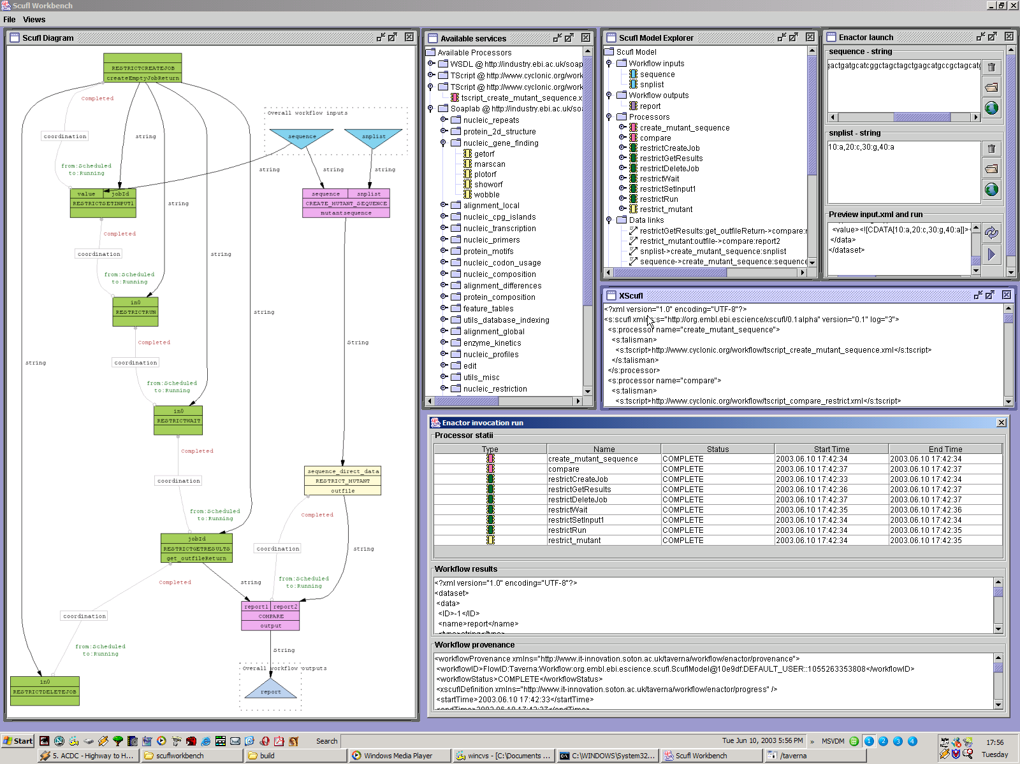
Taverna (2)

Slide 15
Talisman (1)
Rapid Application Development tool
  Build web applications by deploying simple XML ‘Page’ description
  http://talisman.sourceforge.net
  Tom Oinn @ EBI, hinxton, UK
  ‘Pages’ comprise mark-up for GUI components and ‘Actions’ to perform
  Built-in actions include SoapLab invocations, FreeFluo workflow execution, SQL queries of databases.
  Rapid prototyping and production deployment of applications

Slide 16
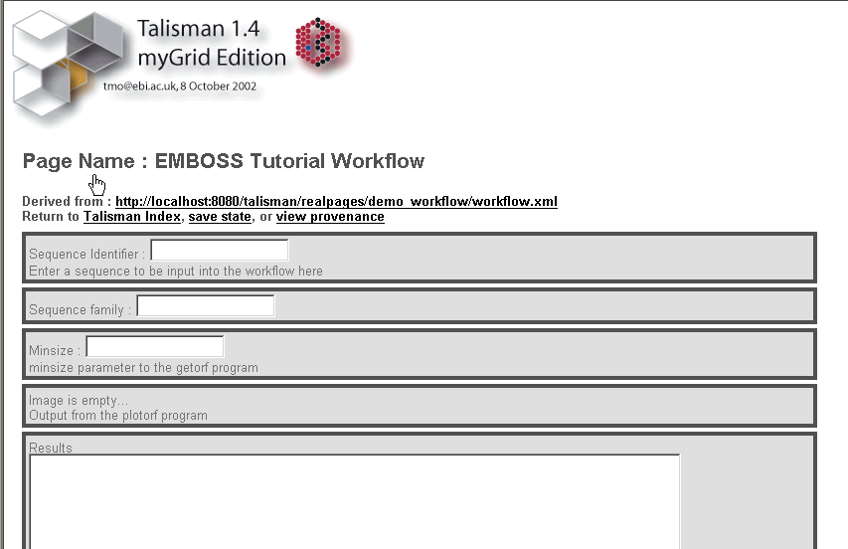
Talisman (2)
Rapid application development

Slide 17
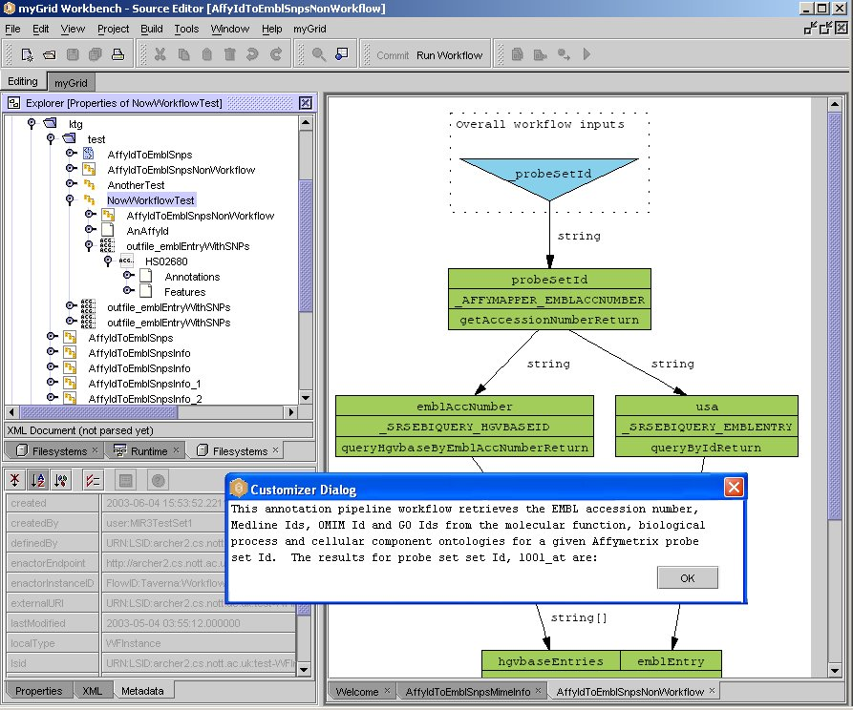
What we’ve built: Workbench
myView on the mIR
Workflow
Metadata about
workflow
note about
workflow

Slide 18
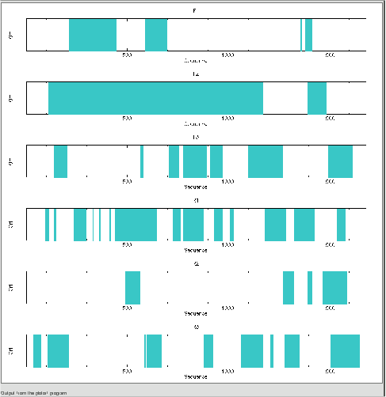
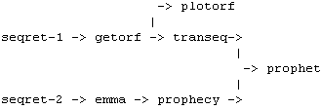
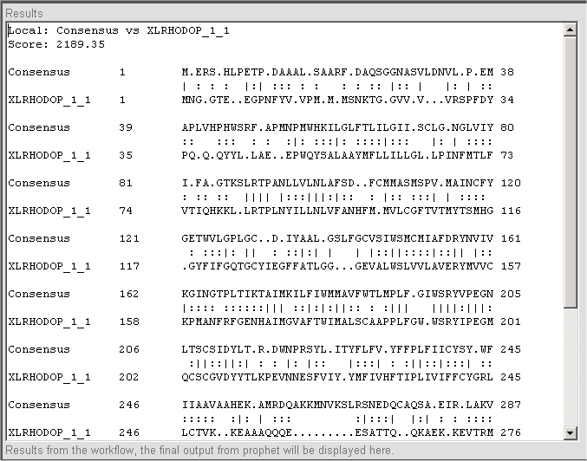
Demonstration

Slide 19
What we’ve built: summary
Taverna
  build, edit and run workflows
  simple import of services using WSDL
  Plugin processor framework
  Runs workflows using embedded FreeFluo
FreeFluo
  parallel and sequential flows, data iteration, nested flows
  web services, SoapLab
  provenance and status reporting
  Plugin language and processor framework
Talisman
  Rapidly build and deploy web GUIs for sets of workflows, services and other tools
Workbench
  Demonstrator
  Semantic discovery

Slide 20
What’s coming next (1)?
Long running workflows
  Robust persistence of workflow state
  Client runs workflow, shuts down and gets status and results later
  Service invocation can take a considerable length of time
  Asynchronous messaging between workflow engine and services
    Message correlation
Large Data sets and pipelining
  Streaming data between services
  Buffering and staging of intermediate data sets
  Control flow vs. data flow
Interacting with running workflows
  Suspend, resume, break points, step through
  Finer grained status information

Slide 21
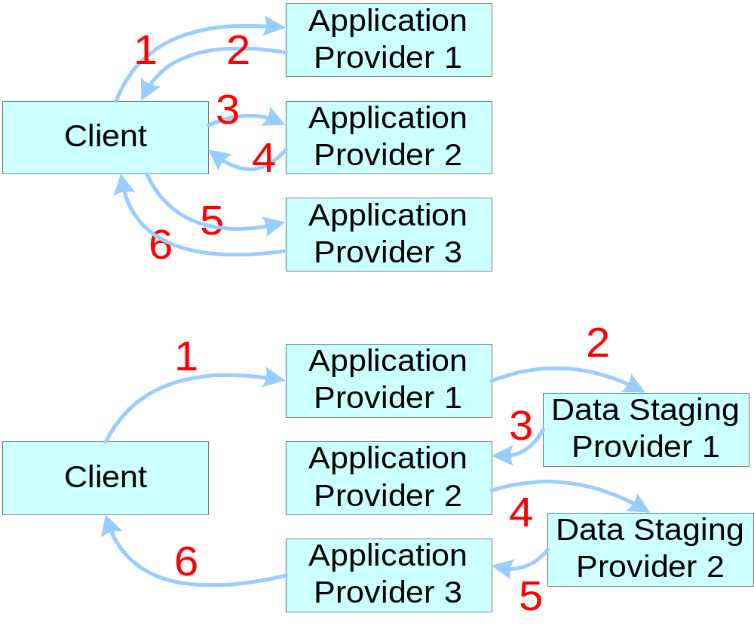
What’s coming next (2)?

Slide 22
Downloading and using our software
Taverna
  http://taverna.sourceforge.net
FreeFluo
  http://freefluo.sourceforge.net
Talisman
  http://talisman.sourceforge.net
myGrid
  http://www.mygrid.org.uk

Slide 23
Questions?

Slide 24
