Slide 1


High level Knowledge-based Grid Services for Bioinformaticans
Carole Goble, University of Manchester, UK
myGrid project
http://www.mygrid.org.uk
Notes:
It’s a framework for application integration
Integrative encycloepedia of life – it’s the same as myGrid.
Basic strategy is annotation, integration and presentation.
It’s a middleware project – you don’t have to buy into everything. Its toolkits.

Slide 2
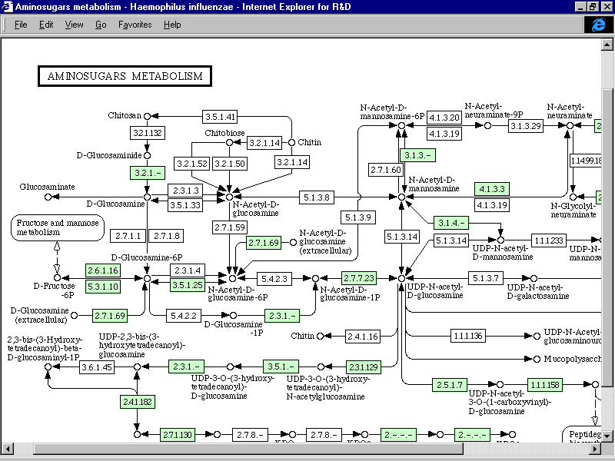
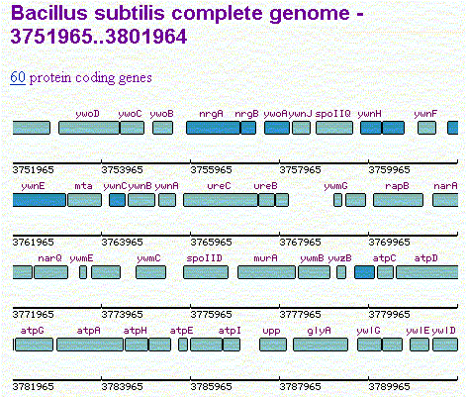
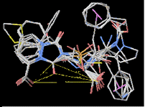
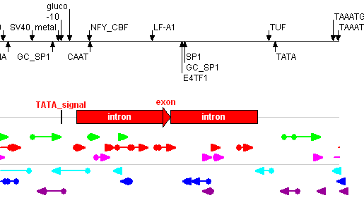
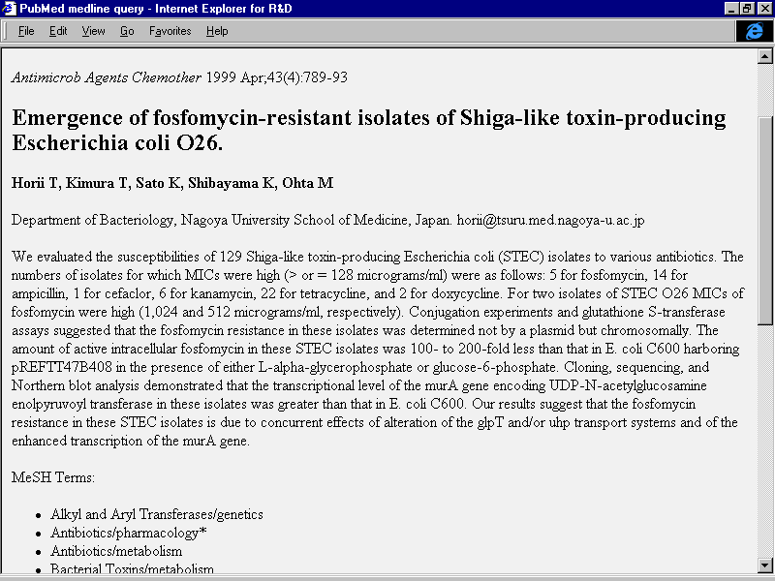
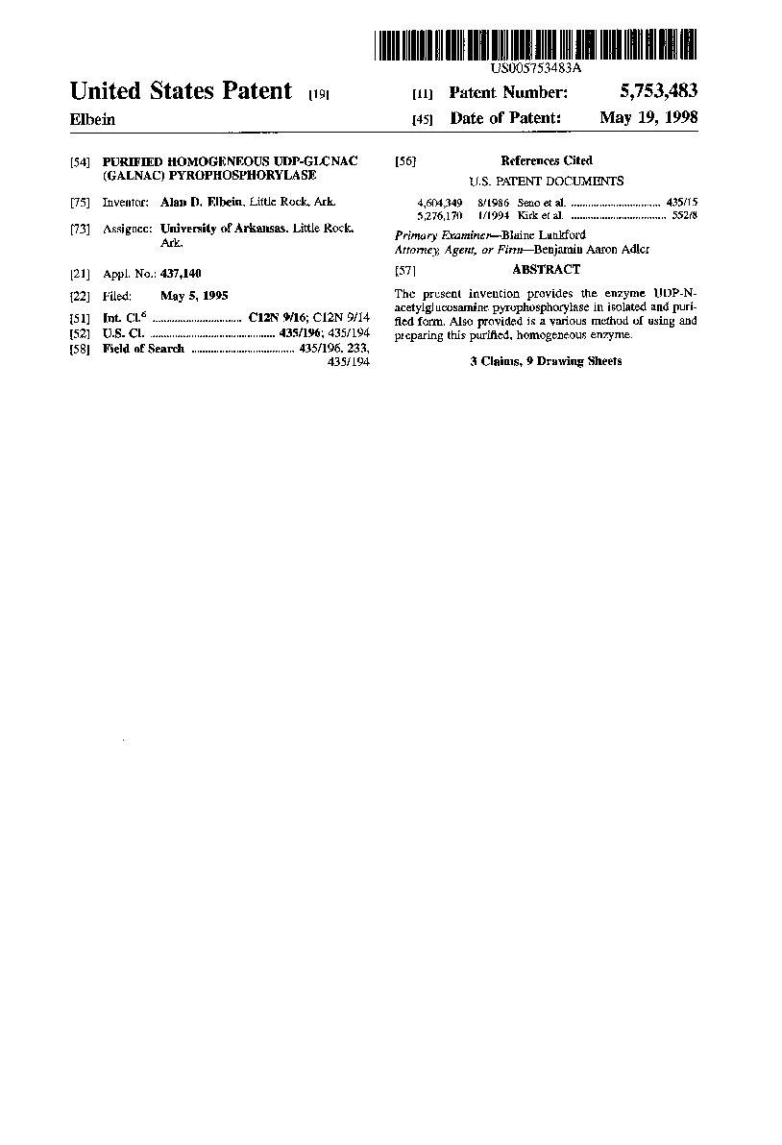
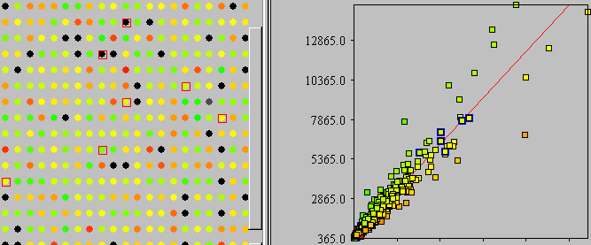
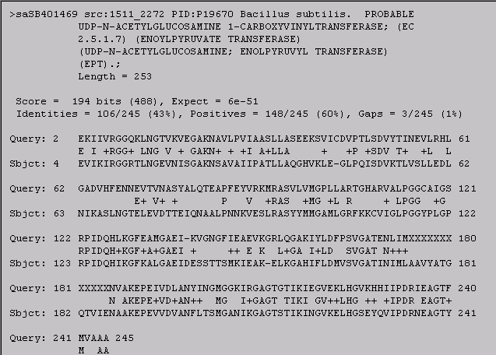
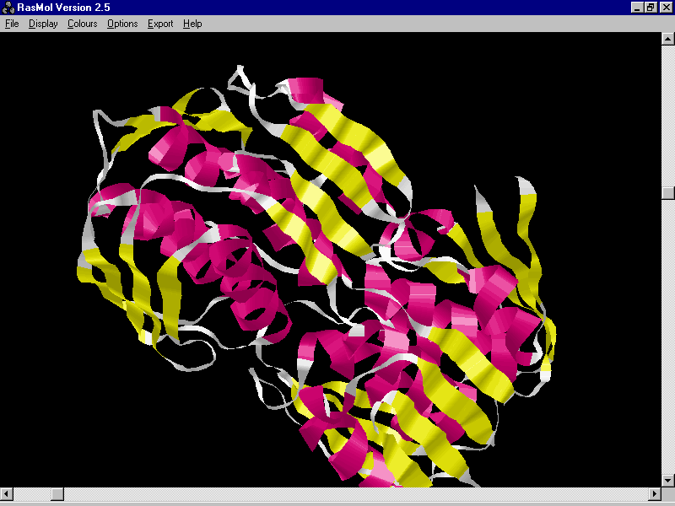
Integration of Pharma information
ID MURA_BACSU STANDARD; PRT; 429 AA.
DE PROBABLE UDP-N-ACETYLGLUCOSAMINE 1-CARBOXYVINYLTRANSFERASE
DE (EC 2.5.1.7) (ENOYLPYRUVATE TRANSFERASE) (UDP-N-ACETYLGLUCOSAMINE
DE ENOLPYRUVYL TRANSFERASE) (EPT).
GN MURA OR MURZ.
OS BACILLUS SUBTILIS.
OC BACTERIA; FIRMICUTES; BACILLUS/CLOSTRIDIUM GROUP; BACILLACEAE;
OC BACILLUS.
KW PEPTIDOGLYCAN SYNTHESIS; CELL WALL; TRANSFERASE.
FT ACT_SITE 116 116 BINDS PEP (BY SIMILARITY).
FT CONFLICT 374 374 S -> A (IN REF. 3).
SQ SEQUENCE 429 AA; 46016 MW; 02018C5C CRC32;
MEKLNIAGGD SLNGTVHISG AKNSAVALIP ATILANSEVT IEGLPEISDI ETLRDLLKEI
GGNVHFENGE MVVDPTSMIS MPLPNGKVKK LRASYYLMGA MLGRFKQAVI GLPGGCHLGP
RPIDQHIKGF EALGAEVTNE QGAIYLRAER LRGARIYLDV VSVGATINIM LAAVLAEGKT
IIENAAKEPE IIDVATLLTS MGAKIKGAGT NVIRIDGVKE LHGCKHTIIP DRIEAGTFMI

Slide 3
Challenges for Pharma
Access to and understanding of distributed, heterogeneous information resources is critical
Complex, time consuming process, because ...
  1000’s of relevant information sources, an explosion in availability of;
    experimental data
    scientists’ annotations
    text documents; abstracts, eJournal articles, monthly reports, patents, ...
  Rapidly changing domain concepts and terminology and analysis approaches
  Constantly evolving data structures
  Continuous creation of new data sources
  Highly heterogeneous sources and applications
  Data and results of uneven quality, depth, scope
  But still growing

Slide 4
e-Collaborations = Virtual Organisations
Collaboration for understanding the data/information and consensus is essential
Within the Organisation
  across the organisation functionally and geographically (world-wide)
  along the pipeline and up the hierarchy
Externally With Other:
  Pharmas, Biotechs, CROs, Clinical Investigators, Academics, Advisors, Regulatory Agencies
Sharing knowledge and expertise

Slide 5
Personalised Workspace
Leverage resources of the entire organisation and external partners, but target the needs/interests of individual scientist
  Find the right information for the current investigation
  Discovery of information/expertise that was not explicitly sought
  Visualisation of data/information
  Capture work flow and analysis processes of investigators

Slide 6
Building the IT Environment
Eliminate redundant application development and use best of breed
Build components/services, not one-off applications
Components/services must be visible to the organisation (not hidden in libraries)
Ease of use of components
Standard interfaces and objects promote a component/service marketplace - aids the build vs buy decision
Therefore - we need standard service and object descriptions through industry consortia

Slide 7



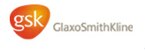










myGrid
EPSRC UK e-Science pilot project
Open Source Upper Middleware for Bioinformatics
Data intensive not compute intensive
Sharing knowledge and sharing components
IBM

Slide 8
myGrid in a nutshell
An example of a “second generation” open service-based Grid project, specifically a testbed for the OGSI, OGSA and OGSA-DAI base services;
  myGrid Information Repository that is OGSA-DAI compliant
Developing high level services for data intensive integration, rather than computationally intensive problems;
  Workflow & distributed query processing
Developing high level services for e-Science experimental management;
  Provenance, change notification and personalisation
Developing Semantic Grid capabilities and knowledge-based technologies, such as semantic-based resource discovery and matching.
  Metadata descriptions and ontologies for service discovery, component discovery and linking components.
Notes:
In silico experiments are workflows (see other talks)

Slide 9
Open architecture & shared components
Incorporating third party tools and services
  Working in the public domain consuming public repositories
  SoapLab, a soap-based programmatic interface to command-line applications
  EMBOSS Suite, BLAST, Swiss-Prot, OpenBQS, etc….~ 300 services
Incorporation of third party tools and applications
  Talisman, a rapid application development tool for annotation pipelines using by the InterPro programme
Lab book application to show off myGrid core components
  Graves disease (defective immune system cause of hyperthyroidis)
  Circadian rhythms in Drosophila
Notes:
The leading cause of hyperthyroidism, Graves' disease represents a basic defect in the immune system, causing production of immunoglobulins (antibodies) which stimulate and attack the thyroid gland, causing growth of the gland and overproduction of thyroid hormone. Similar antibodies may also attack the tissues in the eye muscles and in the pretibial skin (the skin on the front of the lower leg).

Slide 10
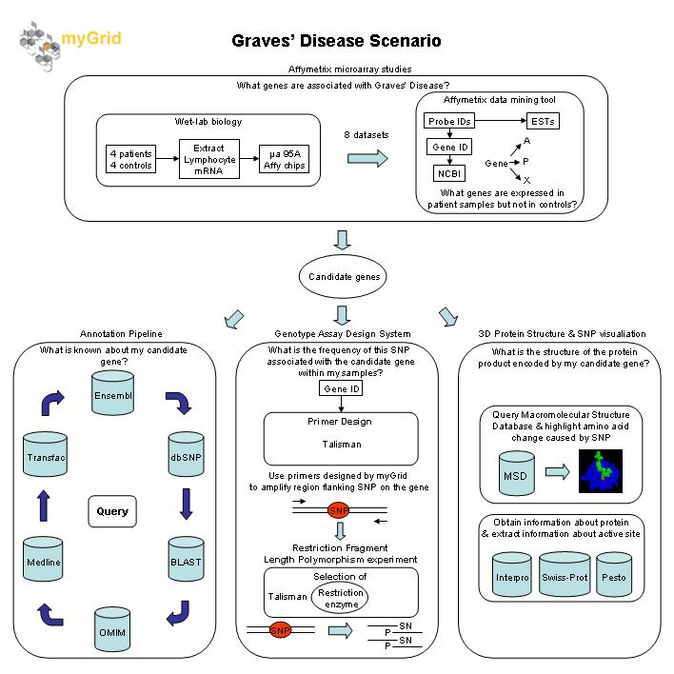
Notes:
Restriction Fragment Length Polymorphism. In English: Restriction enzymes recognise & cut DNA at specific sequences. Individuals have slightly different DNA sequences, and these differences (i.e. SNP's) may occur at sites that are recognised by restriction enzymes. So if you cut the DNA of two individuals with restriction enzymes, you may end up with different fragments lengths if there are differences in their DNA sequence. Person 1: ------X----X---- Person 2: -----------X---- X = Restriction enzyme cutting site. Person 2 is missing one of the sites because their DNA is slightly different. The RFLP assay for Person 1 would show three bands, and that for Person 2, two bands. When you see those "genetic fingerprints" with all the different bands, that's type of RFLP assay. See also: http://cancerweb.ncl.ac.uk/cgi-bin/omd?query=RFLP –
Restriction Fragment Length Polymorphism.
there are enzymes that break DNA into chuncks. they are called Restriction Endonucleases as they are restricted as to which sites they cleave DNA; they also cleabe inside the DNA, as opposed to Exonucleases that chew it up from the enbd.
Now imagine that you have an enzyme that breaks DNA between CAROLE and GOBLE, then the string
ROBERTSTEVENSCAROLEGOBLEROBERTSTEVENSCAROLEGOBLE
would be broken into three fragments. If, however, we mutate the string to:
ROBERTSTEVENSCAROLxGOBLEROBERTSTEVENSCAROLEGOBLE
we only get two fragments, one much bigger than before. We can run these fragmenyts out on a gel to se e the differences. As individuals undergo point mutations, they all have different RFLPs. this is essentially how DNA finger printing works.
Robert.
At 16:17 25/01/2003 +0000, you wrote:
"design RFLP assays for genetics studies of heart disease and Graves disease. "
what is a RFLP assay?
Carole

Slide 11
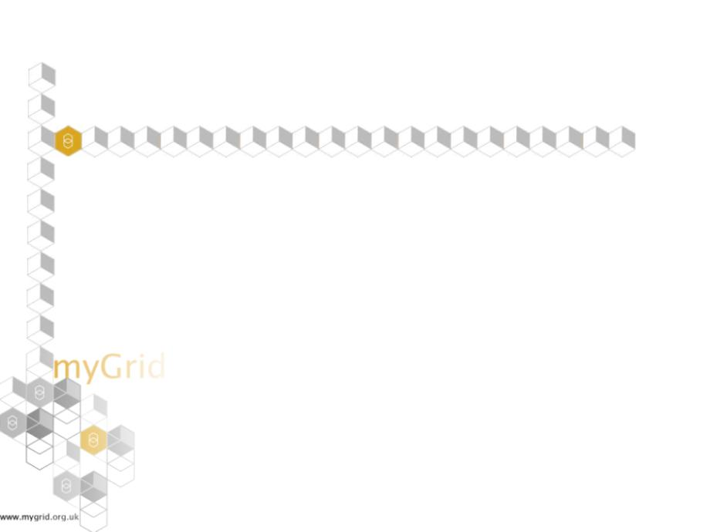
Experiment life cycle
Personalised registries
Personalised workflows
Info repository views
Personalised annotations
Personalised metadata
Security
Resource & service discovery
Repository creation
Workflow creation
Database query formation
Forming experiments
Personalisation
Discoverying and reusing
experiments and resources
Executing experiments
Workflow discovery & refinement
Resource & service discovery
Repository creation
Provenance
Workflow enactment
Distributed Query processing
Job execution
Provenance generation
Single sign-on authorisation
Event notification
Providing services & experiments
Managing experiments
Service registration
Workflow deposition
Metadata Annotation
Third party registration
Information repository
Metadata management
Provenance management
Workflow evolution
Event notification

Slide 12


in silico Exploratory Experiments
Experimental orchestration
Exploratory
Hypothesis driven
Not prescriptive
Methodology free
Ad hoc
Clear Understanding
Standard
Well defined
Predictive
Predictive / stable integration
  Production workflows over known resources
  Organisation wide
  Emphasis on performance and resilience
  E.g. Data capture, cleaning and replication protocols
Ad hoc virtual organisations
  No a priori agreements
  Discovery/exploratory workflows by biologists
  Personal
  Different resources
  Grids
Notes:
Longevity and flexibility of the integration

Slide 13

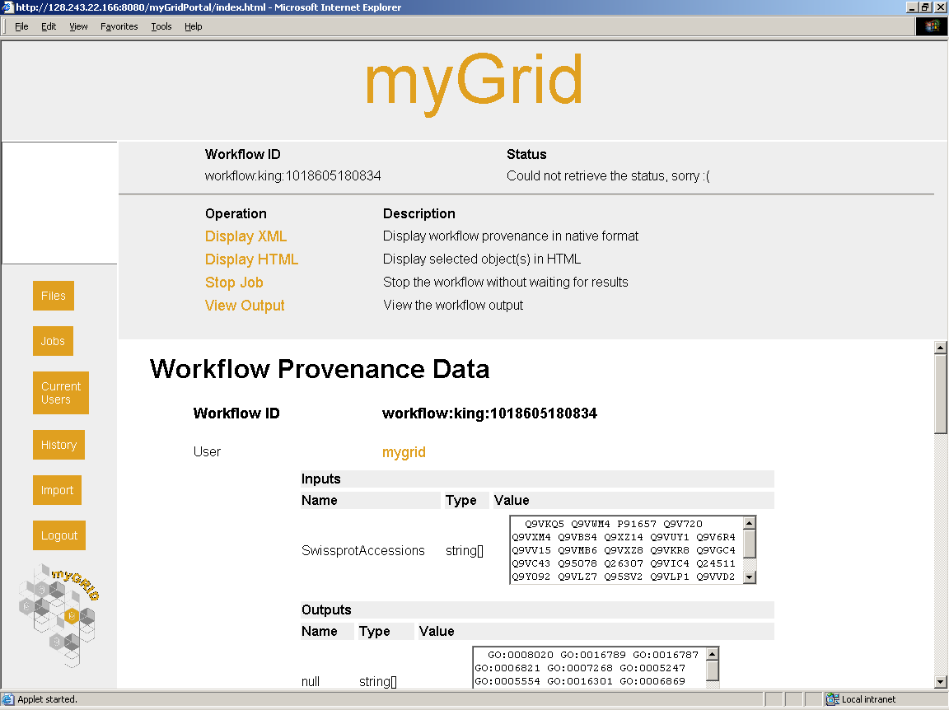
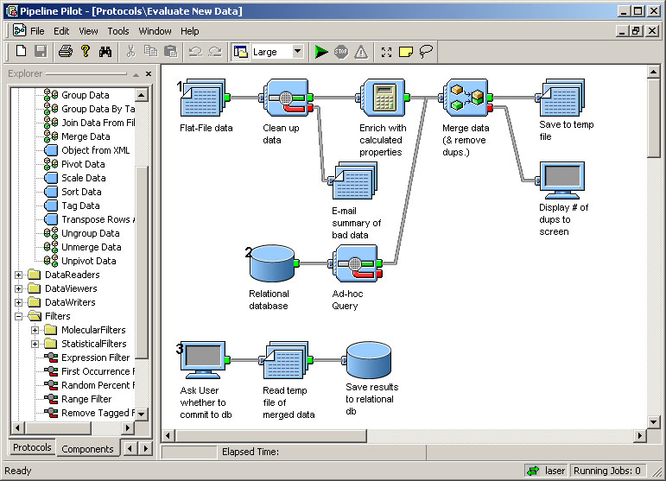
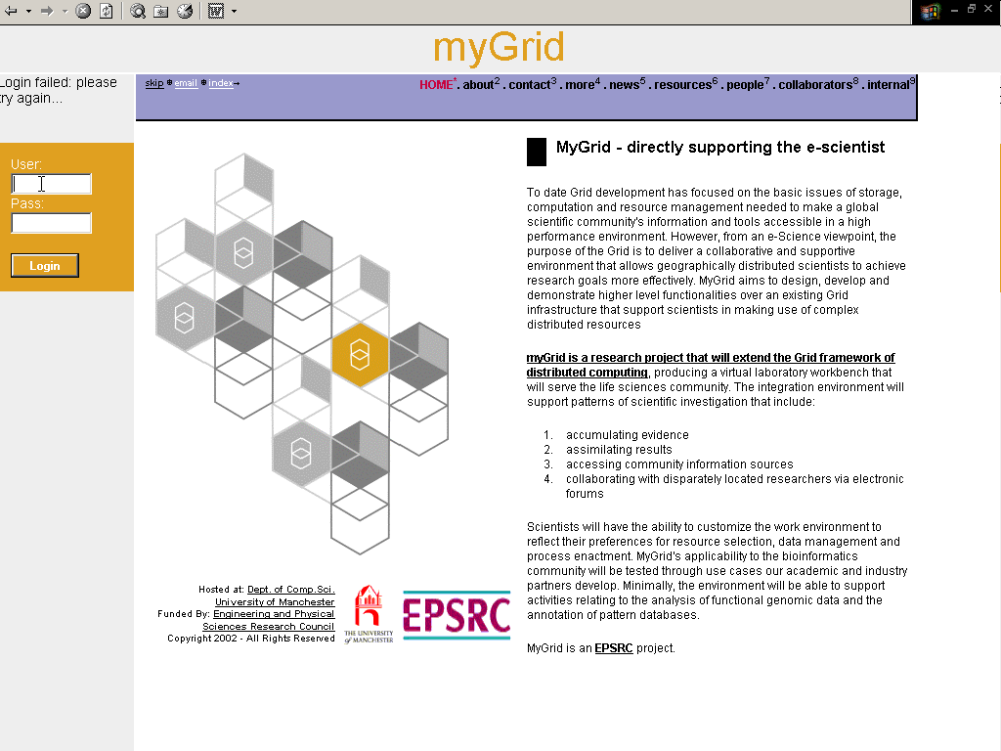
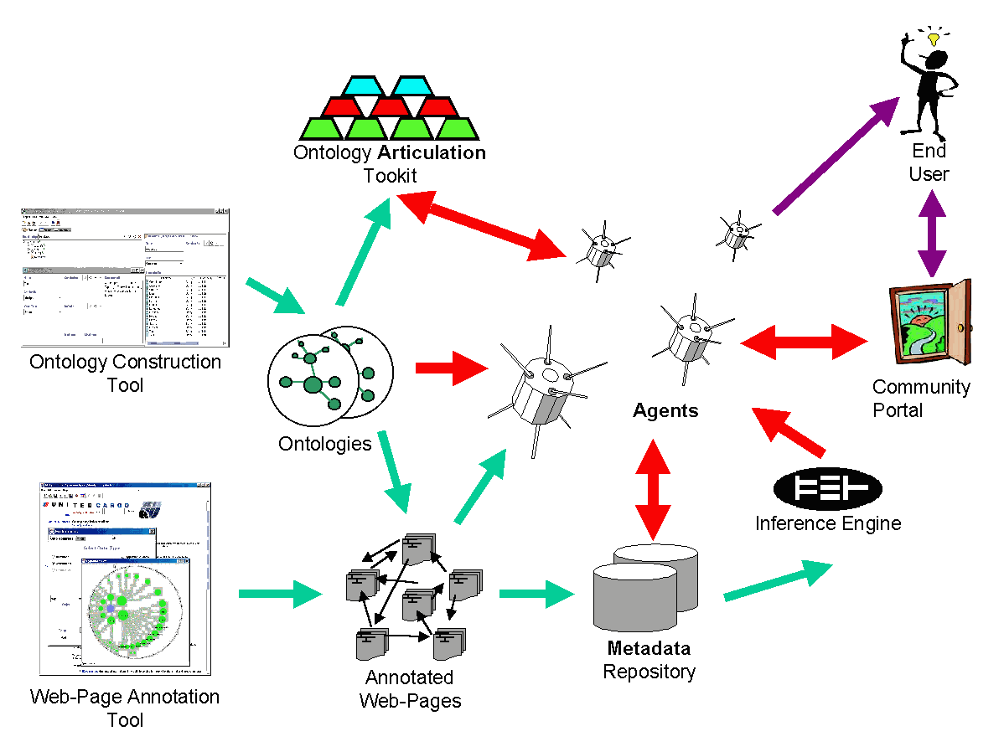


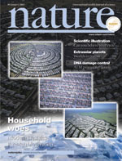




myGrid
UTOPIA
Third party applications
LabBook application
Web Portal
Gateway
Ontology
Services
Shared metadata and data
repositories mIR
Resource annotations
Semantic-based Services
Inference engines
Service & resource
registration &
discovery
Personalisation
e-Science Services
Change & event
notification
Literature
Provenance
SoapLab
Databases
Distributed Query Processing
Workflow
Integration Services
SoapLab
Analytical
Tools
Notes:
Three layers of services
Semantic knowledge services
Integration services
e-Science support services
Resource Integration
Resource Integration and Coordination
Workflow coordination – knowledge integration (D-Net)
Database integration.
Experimental workflows rather than production workflows.
Dynamically formed and executed.
e-Science support
Provenance & Change Propagation
Personalisation & Collaborative working.
Security & ownership
Publication, discovery, interoperation, composition, decommissioning of myGrid services
Bioinformatics services published as Web services (Grid Services)
Service based architecture
Publication, discovery, interoperation, composition, decommissioning of myGrid services
Bioinformatics services published as Web services (Grid Services)
Ontologies and metadata

Slide 14
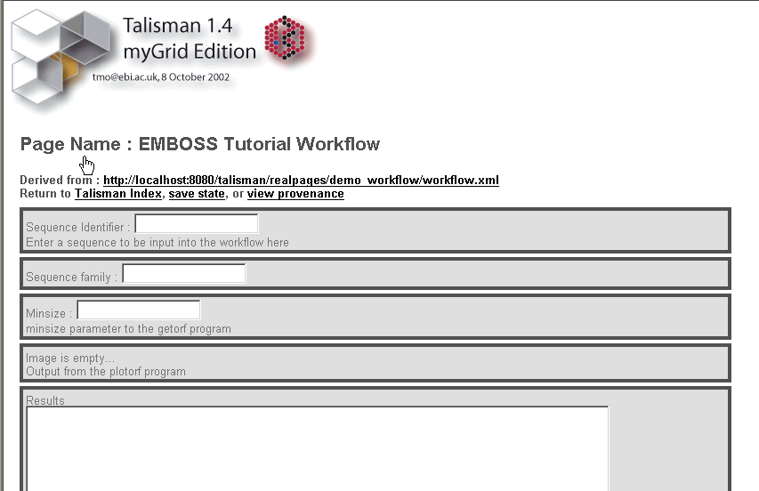
myGrid Components ~ Demo
Pre-existing third party application
Service invocation
Workflow enactment
DNA sequence
getOrf
transeq
prophet
plotorf
Proteins from a family
emma
prophecy
Classical bioinformatics: detecting whether an uncharacterised protein domain is conserved across a group of proteins
Notes:
Also have used components within pre-existing third party application, which is talisman, how the expert bioinformatician, or app builder could use to provide a service for their user community. Second half of the demo performs a slightly more complex workflow, taking a single sequence, generating out a multiple alignment profile, and then using this to search. [If you want more of a biological explanation of what is going on here, it is running the EMBOSS, for which you already have Alan's explanation.]
This example also shows a few things the first doesn't which is a branching workflow, and graphical capabilities. There are two animations here, one which shows the workflow running entirely within talisman, and the other invoking the workflow through the enactment engine, in what appears to talisman to be a single step.
The first doesn't actually use mygrid per se. Both examples show a representation of the open reading frames as a graphical plot, which looks quite cute.

Slide 15
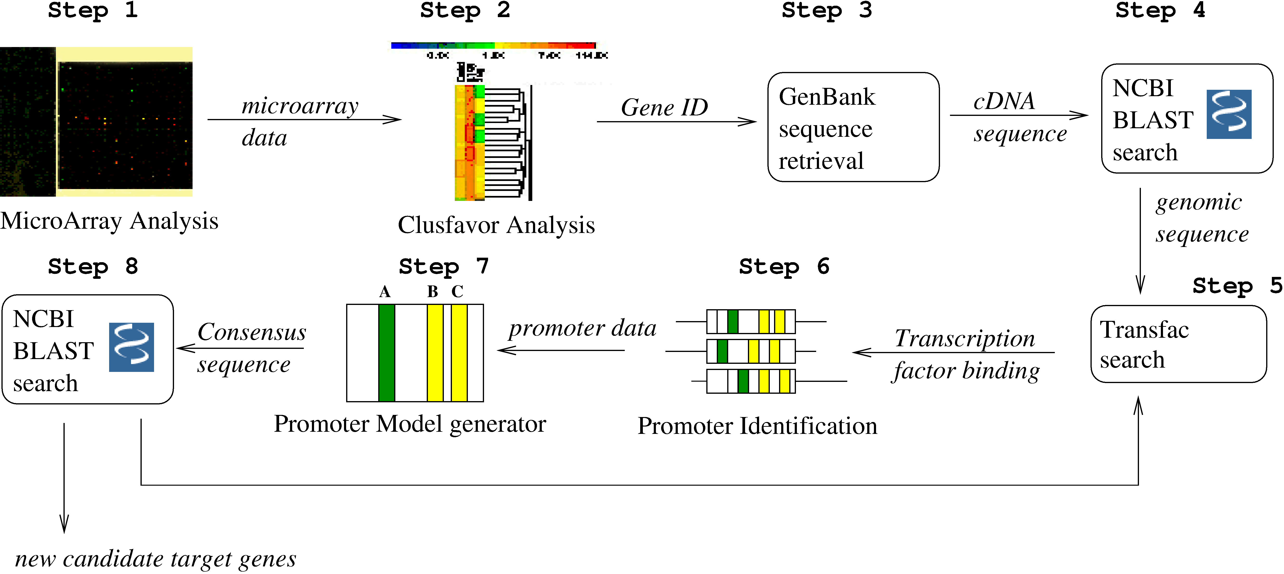
Workflow
Workflow enactment engine
  IBM’s Web Service
  Flow Language (WSFL)
Dynamic workflow service invocation and service discovery
  Choose services when running workflow
  Shared development with Comb-e-Chem
User interactivity during workflow enactment
  Not a batch script!
  Requires user proxies,
Ontologies for describing and finding workflows and guiding service composition
  Service A outputs compatible with Service B inputs
  Blastn compares a nucleotide query sequence against a nucleotide sequence database (usually – intelligent misuse of services…)
Notes:
Free text extraction;
Know how.
Associate base resources with derived data.
Specialise/Customise/Personalise
Evolution – notification, knowledge
Quality & best practice
It would be good if the workflows were good.
= good experimental practice.

Slide 16
Provenance
Experiment is repeatable, if not reproducible, and explained by provenance records
Who, what, where, why, when, (w)how?
The tracability of knowledge as it is evolves and as it is derived.
Methods in papers.
Immutable metadata
Migration – travels with its data but may not be stored with it.
Aggregates as data aggregates
Private vs Shared provenance records.
The Life Sciences ID (LSID)
Credit.
  Derivation paths ~ workflows, queries
  Annotations ~ notes
  Evolution paths ~ workflow →
  workflow
Notes:
Workflow logs.
Event notification service.
Incremental view management.
Workflow and query evolution How did I do it last time
Provenance – tracability of knowledge.
Discovery, interoperation, fusion, sharing
Process is as important as outcome
Science is dynamic – change happens
Scientific discovery is personal & global
Ad-hoc solutions, people-powered
Homology is a cow homolog (and it’s a GPCR)
Last 2 are in parallel

Slide 17
Notification & Personalisation
Has PDB changed since I last ran this?
Has the record I derived my record from changed?
Has the workflow I adapted my workflow from changed?
Did the provenance record change?
Has a service I am using right now gone? Has an equivalent one sprung up?
Event notification service.
Dynamic creation of personal data sets in mIR
Personal views over repositories.
Personalisation of workflows.
Personal notification
Annotation of datasets and workflows.
Personalised service registries – what I think the service does, which services can GSK employees use

Slide 18
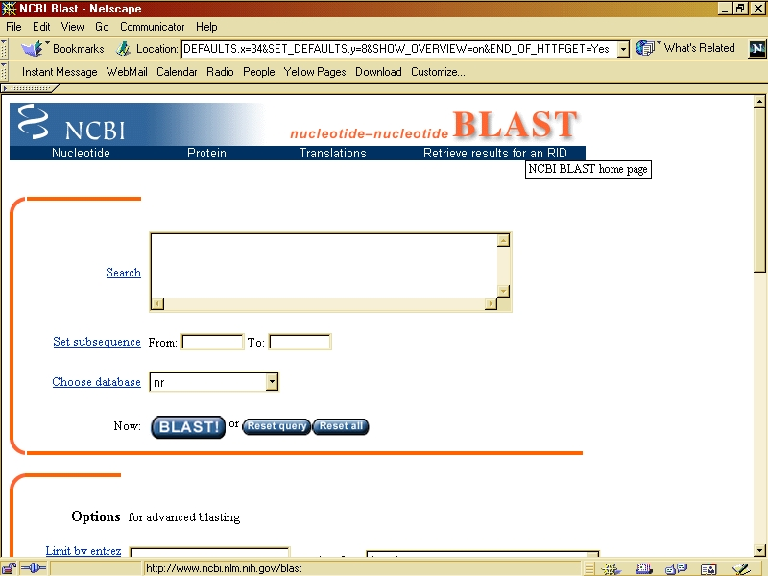
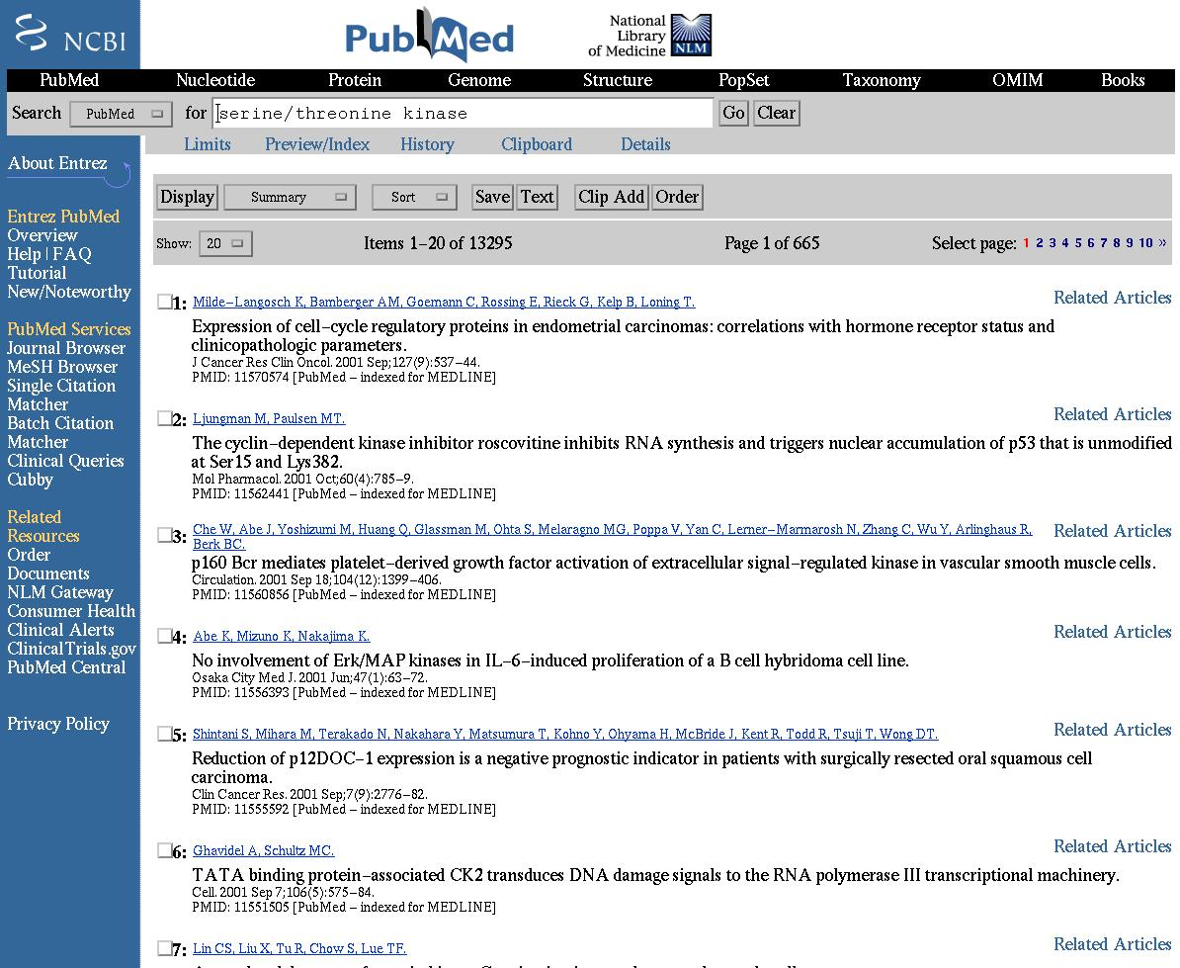
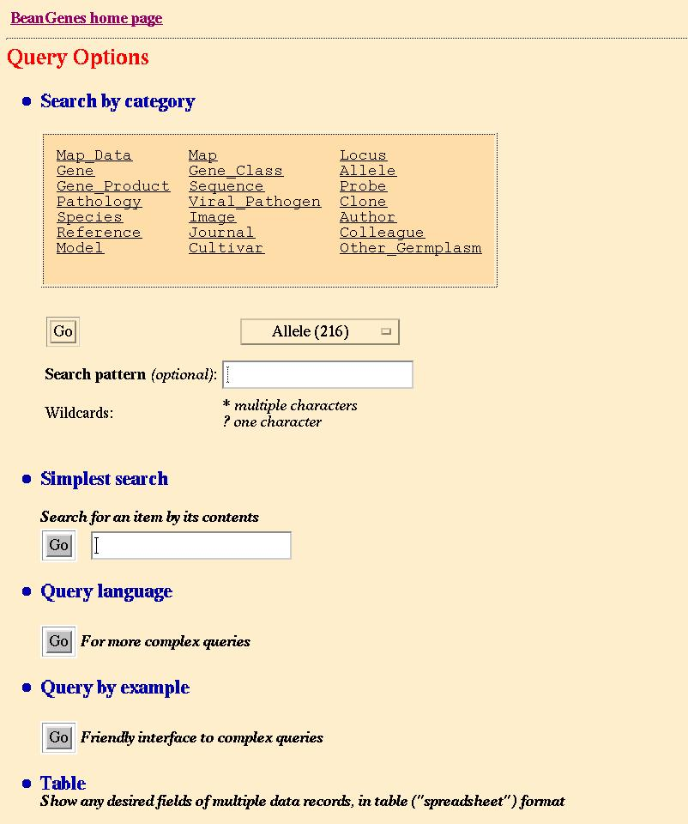
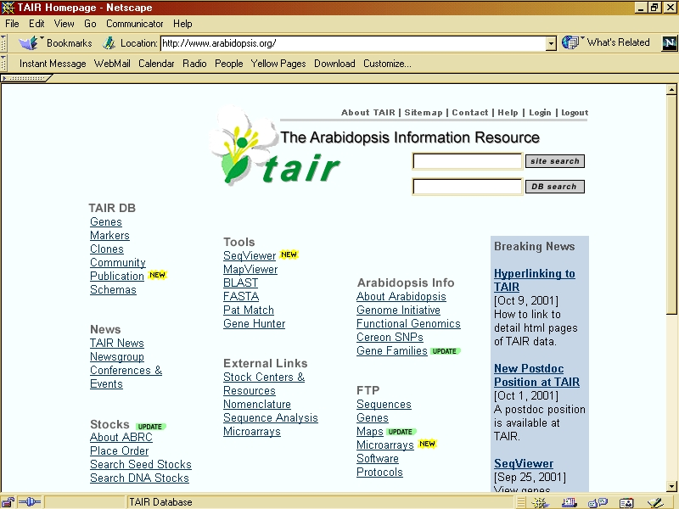
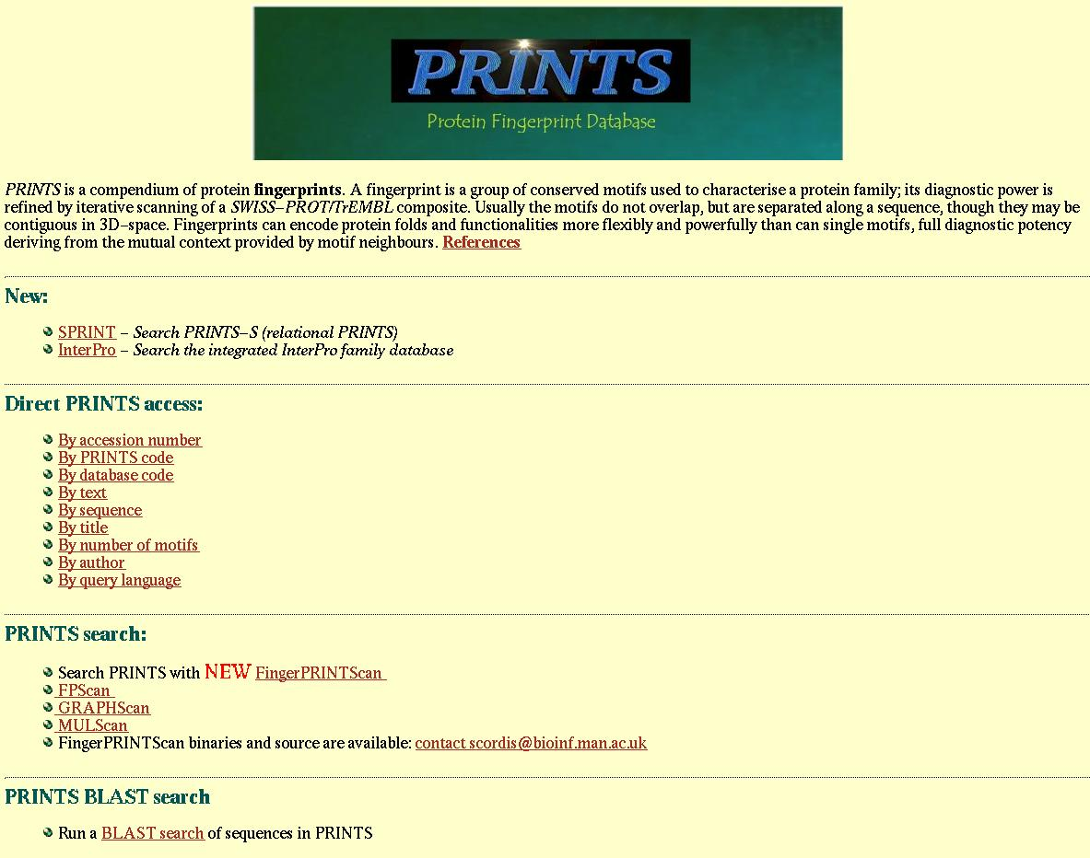
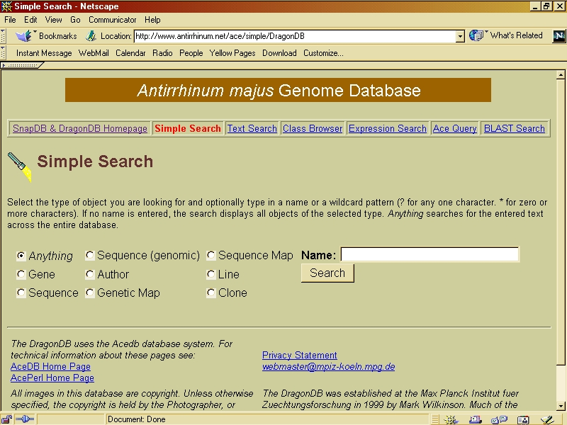
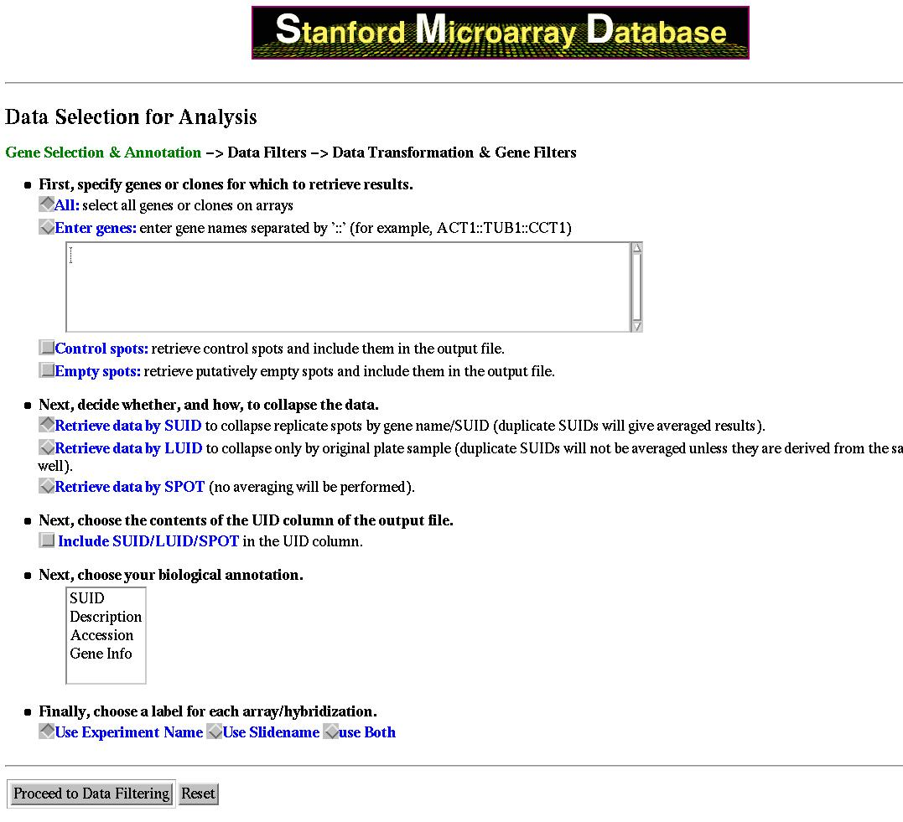
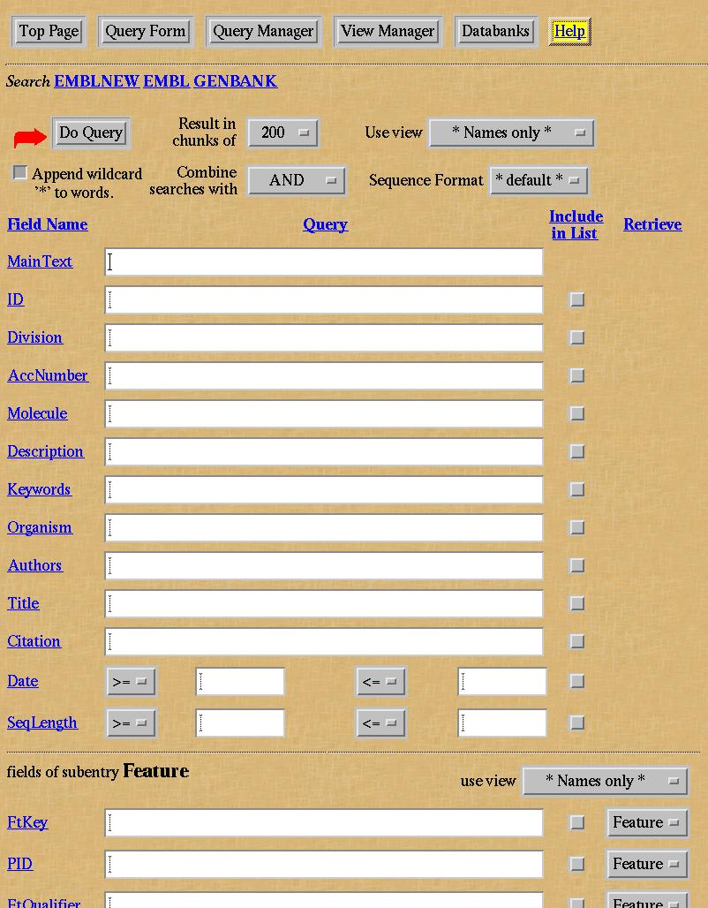
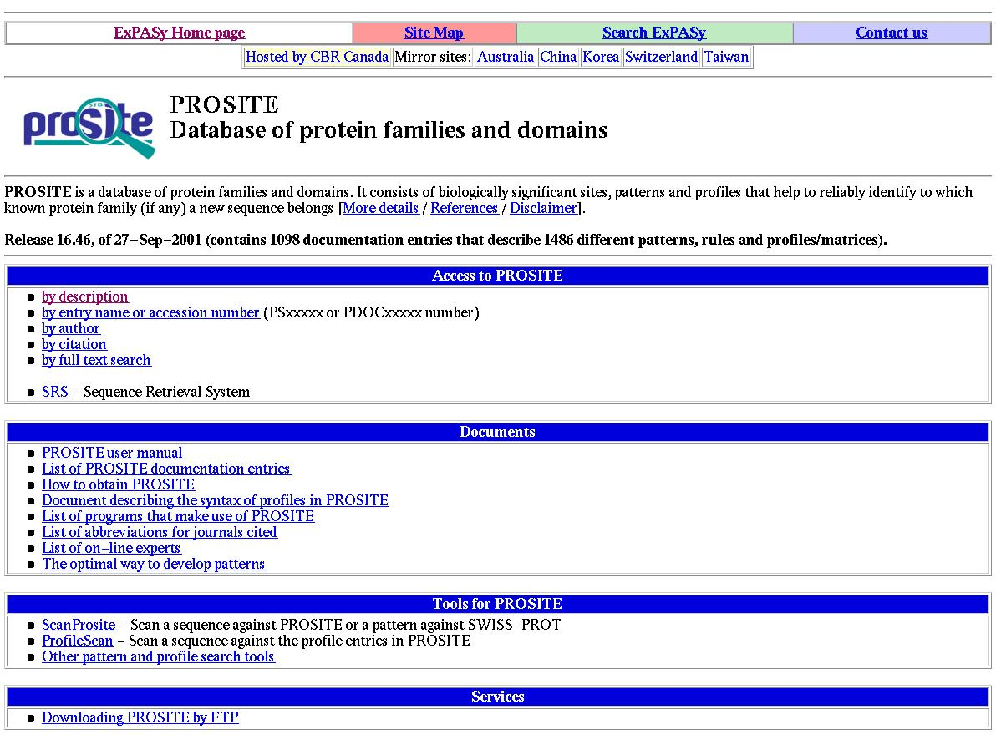
Service based architecture
Each bio resource is a service
  Database, archive, analysis, tool, person, instrument, a workflow …
Each myGrid architectural component is a service
  Workflow enactment engine, event notification service, registry, scheduler…
Services come and go
Services are not owned by the user
Service registration and discovery
Find them
  Publication, registration, discovery, matchmaking, deregistration.
Run them.
  Execution, monitoring, exception handling.
Organise them.
  Interoperation, composition, substitution.

Slide 19
Service Discovery
Find appropriate type of services
  sequence alignment
Find appropriate instances of that service
  BLAST @ NCBI
Assist in forming an appropriate assembly of discovered services.
Find, select and execute instances of services while the workflow is being enacted.
Knowledge in the head of expert bioinformatian
We use ontologies in DAML+OIL / OWL

Slide 20
Semantic Discovery
Semantic Discovery using ontologies expressed and reasoned over in the DAML+OIL language
A shared vocabulary for describing a service.
Service classifications, searching, organisation & indexing, matching and substitution
  “BLAST” Finds tblastx, tblastn, psi-blast, and marks_super_blast.
  “Alignment” Finds ClustalW, Blast, Smith-Waterman, Needleman-Wunsch
Expanded selection of services presented based on expansion of in-hand object
Not the only way to find a service.

Slide 21
Role of Ontologies in myGrid
Service matching
and provisioning
Describing & Linking
Provenance records
Composing and validating workflows and service compositions & negotiations
Service & resource
registration &
discovery
Ontologies
Change & event
Notification topics
Resource annotations
Help
Controlling contents of
metadata and data
Knowledge-based guidance
and recommendation
Schema mediation
Notes:
Labelling data items in databases
Semantic typing for controlling inputs and outputs
Use by distributed query processing
Linking & browsing XML-based myGrid information components
COHSE
Work to link with the Life Science Identifier (I3C)
Generate BioMOBY Central service classification

Slide 22

Bioinformaticians
Graves Disease
Exemplars
Generic
Applications
Lab Book
Workflow Editor
Portal
Talisman
Tool Providers
Gateway
Service Registration
& Discovery
Personalisation
Information
Repository
Knowledge Mgt
Provenance
Core
components
Metadata Mgt
Notification
Workflow enactment
Distributed Query Processing
Service providers
Soaplab
Communication fabric
Bio Services
Text Extraction
Services
Notes:
Metadata and agents
Data/computation layer
Information layer
Knowledge layer (applications – including mining)

Slide 23
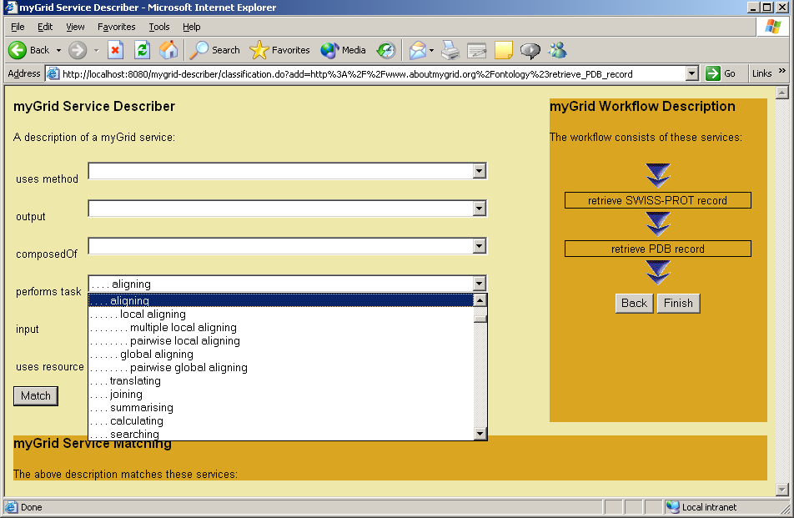
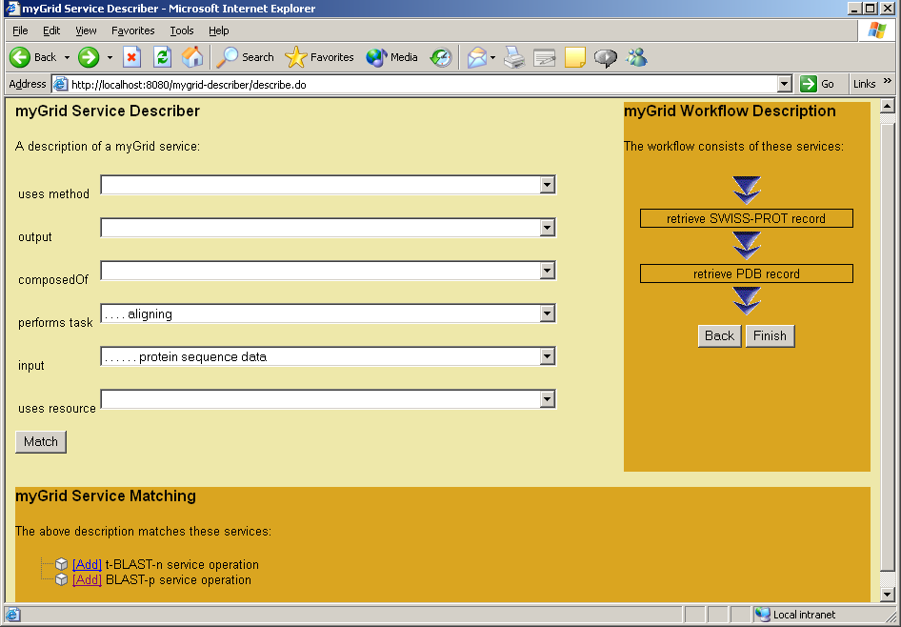
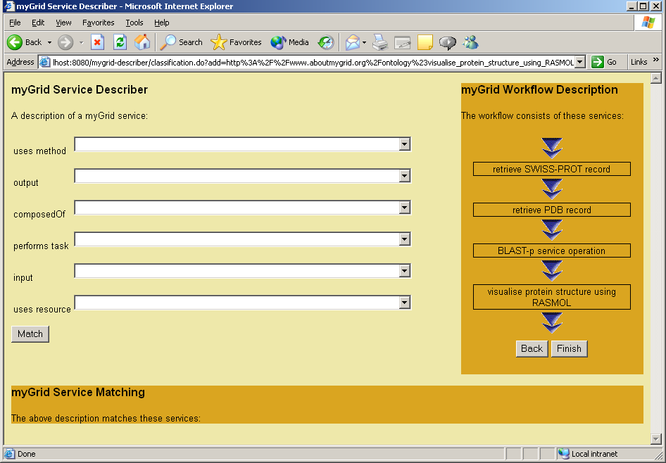
1. User selects values from a drop down list to create a property based description of their required service. Values are constrained to provide only sensible alternatives.
2. Once the user has entered a partial description they submit it for matching. The results are displayed below.
3. The user adds the operation to the growing workflow.
4. The workflow specification is complete and ready to match against those in the workflow repository.

Slide 24
Architecture
Slide
Jump
Knowledge
Services
Semantic registration
Registry
Knowledge
Service
Registry
Ontology Server
Structural registration
UDDI
Reasoner
Service
Matcher
Registry
View
Notification
Service
UDDI-M
Notification
Service
Service Discovery
JMS
Workflow
enactment
engine
Provenance
service
Test
Data
Build/Edit
Workflow
mIR
WSFL
Component Discovery
Information
Extraction
Distributed
Query Processor
Job Execution
mInfo Repository
Workflow templates
Workflow
instances
PASTA
Service
Service
Service
Metadata
Concepts
Provenance
Data
SoapLab
DB2
DB2
Notes:
Discover workflow?
Discover a query? Do we use the same registry structure for query/annotation/workflow/service?
Is a workflow a service? This would tie it in with BioMOBY.
Leases on registries to renew the service registry.

Slide 25
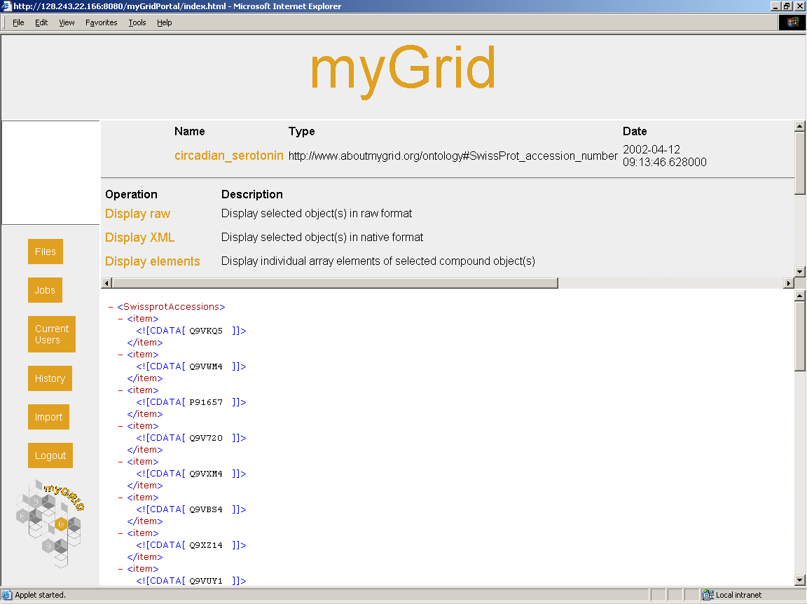
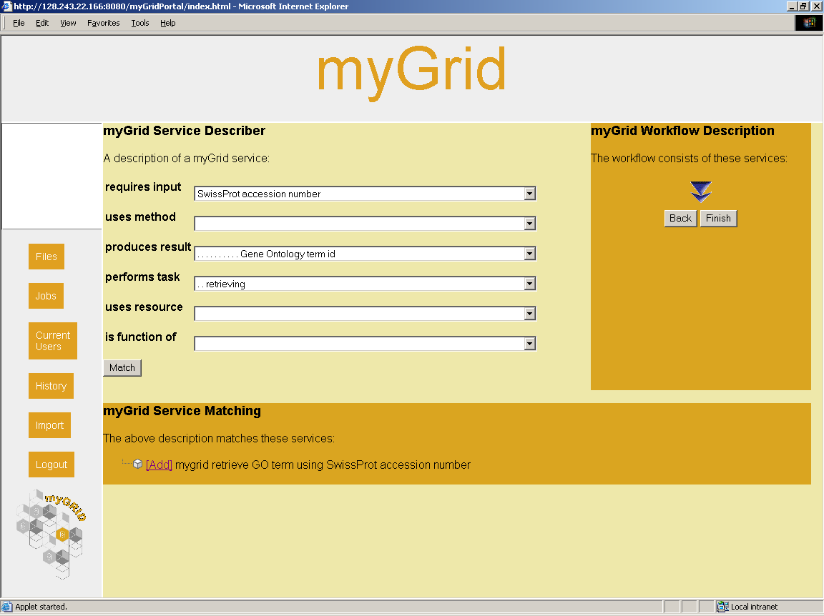
How do the functions of a cluster of proteins interrelate? myGrid 0.1
Some proteins in my personal repository
Find services that takes a protein and gives their functions and pick the best match.

Slide 26
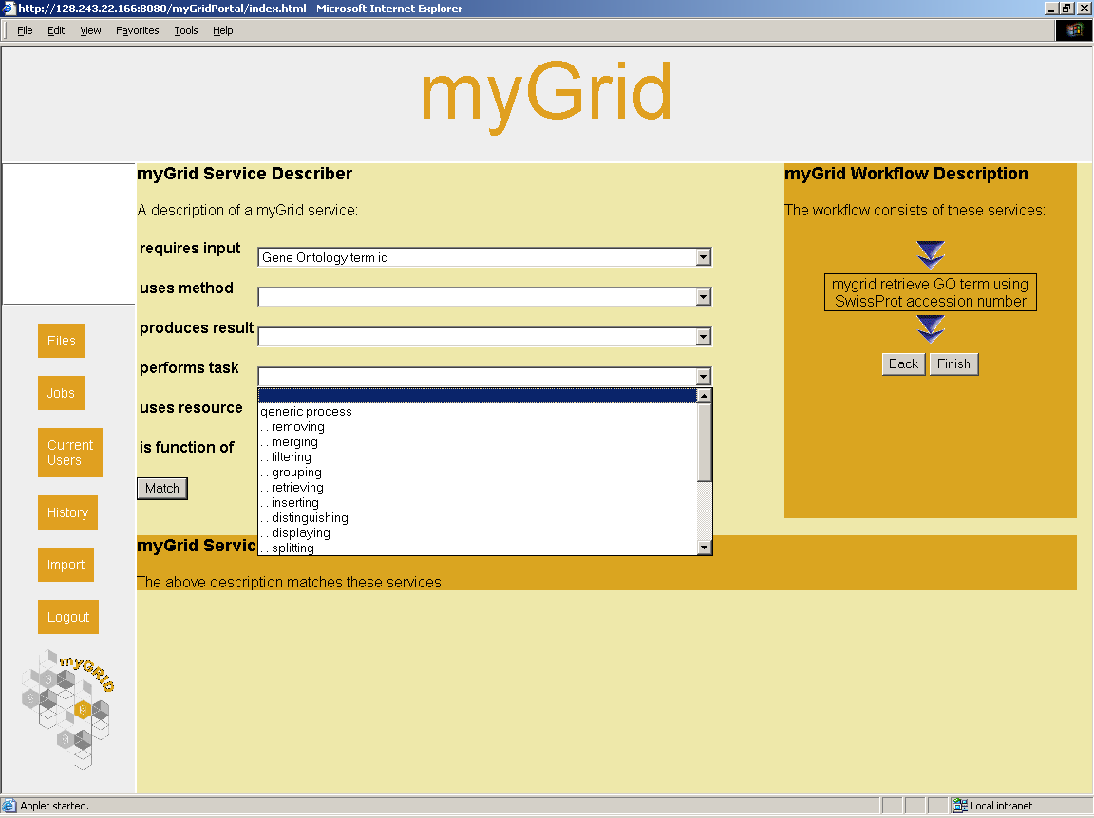
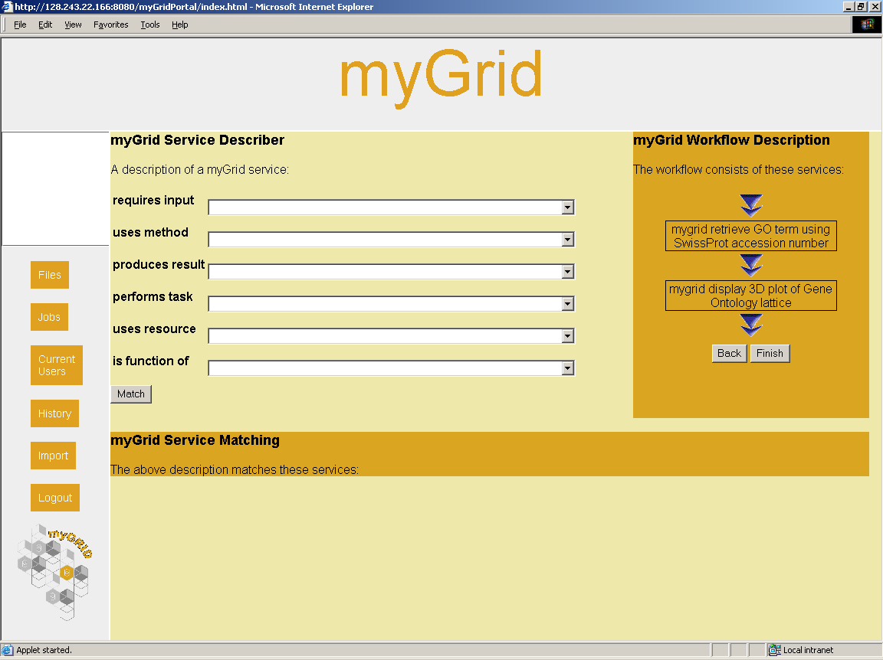
Find services that takes a protein and gives their functions and pick the best match.
Find another that displays the proteins base on their function. Ontology restricts inputs & outputs
Build a description of a workflow of composed services linked together

Slide 27
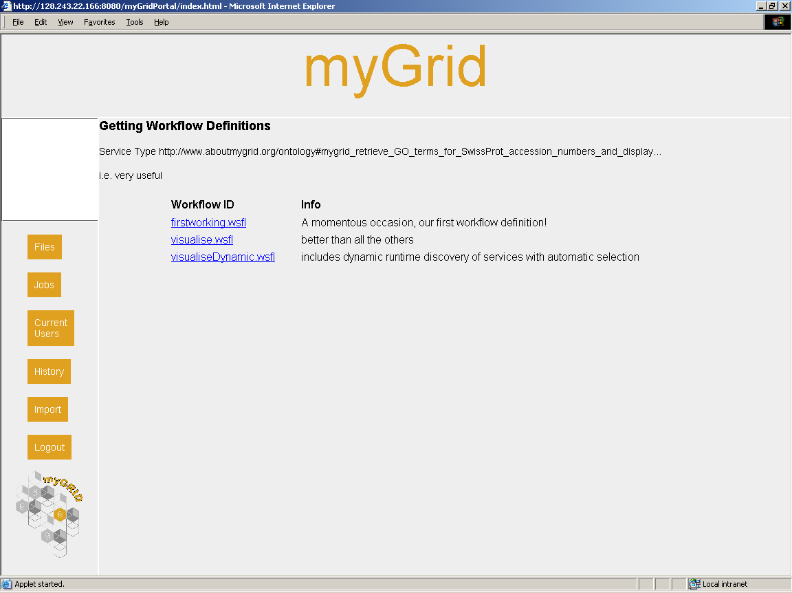
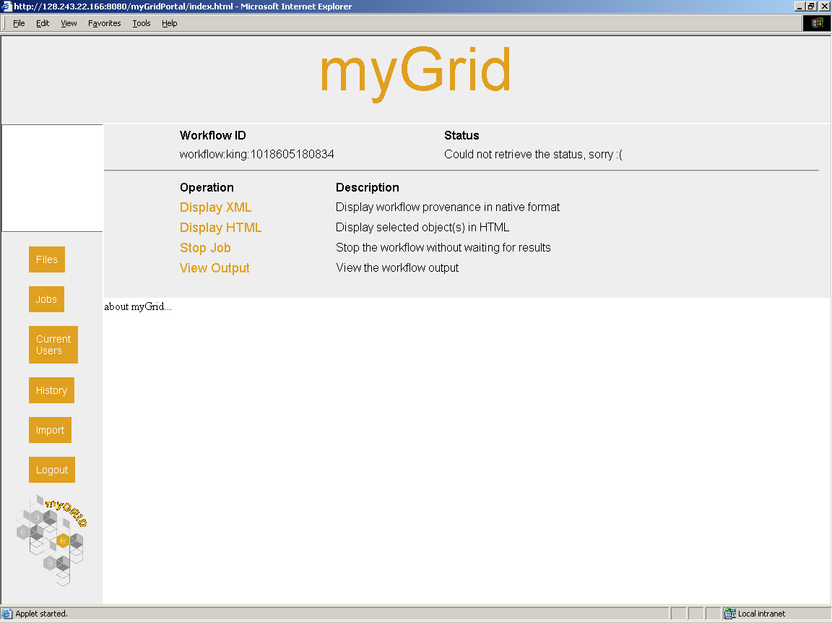
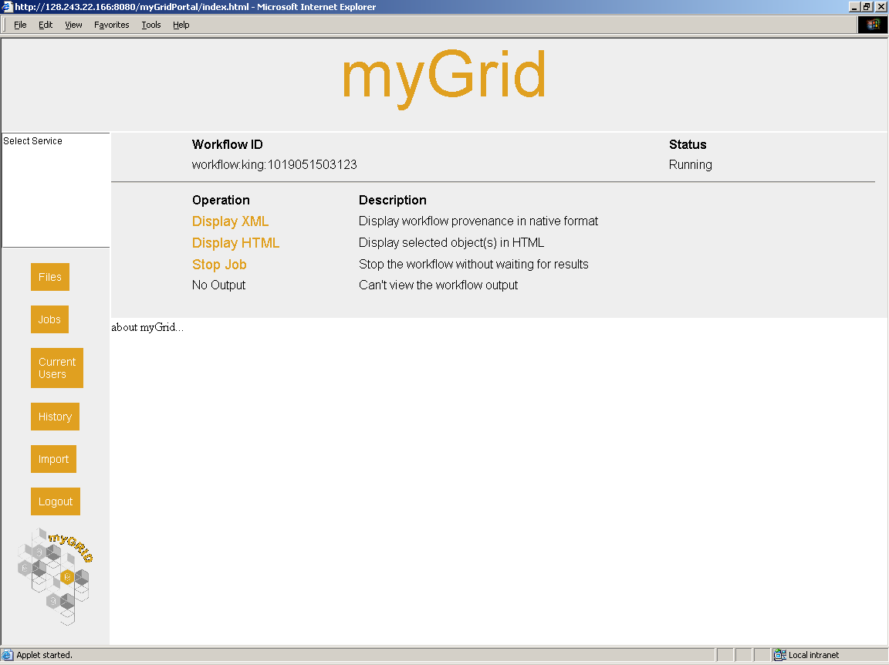
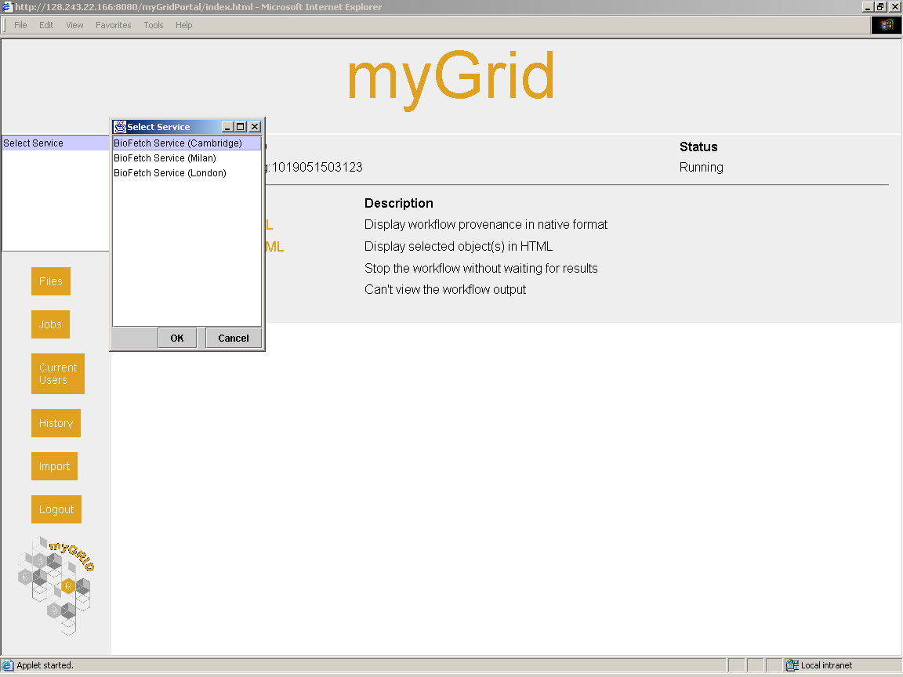
See if a workflow that is appropriate already exists. It could have been made anyone who will share with you.
Pick one and enact it.
While its running pick the best service instance that can run the service at that time automatically or with the users intervention.

Slide 28
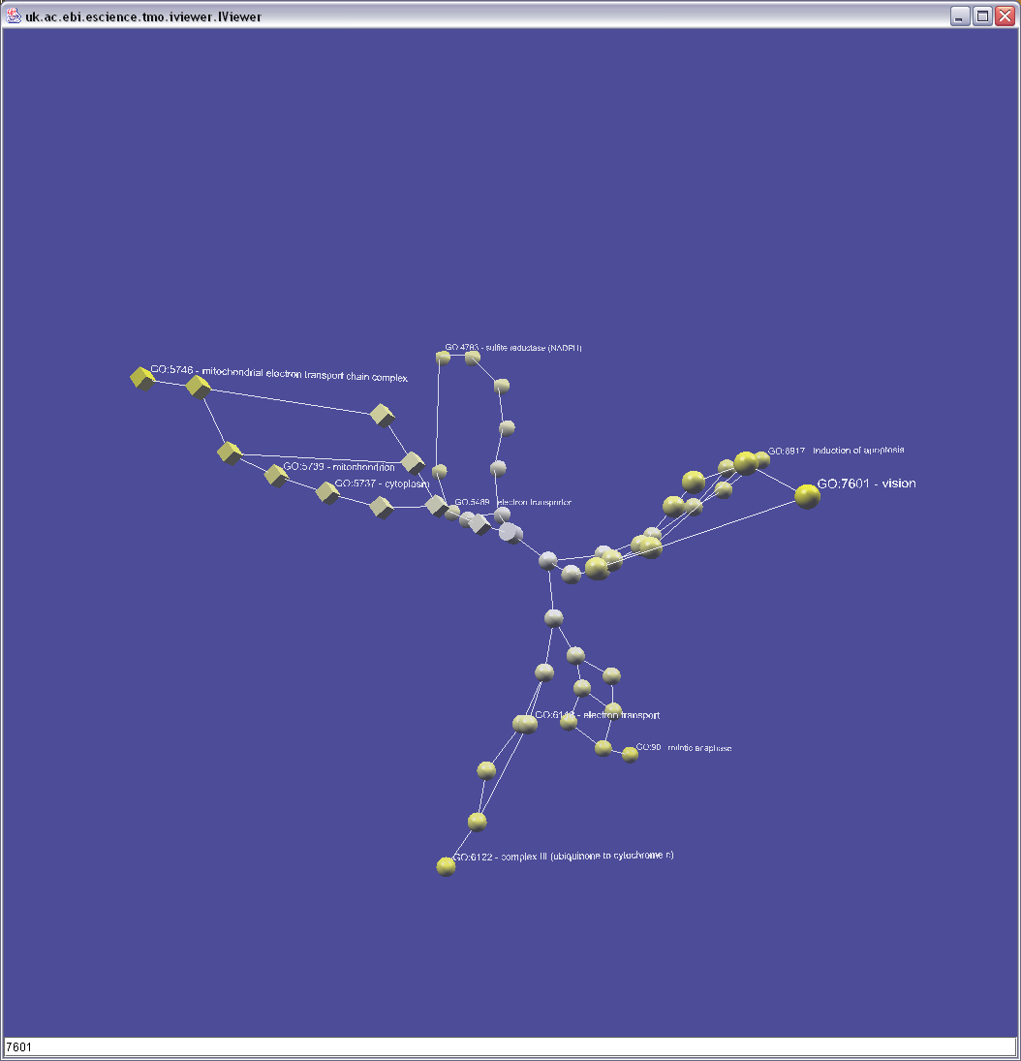
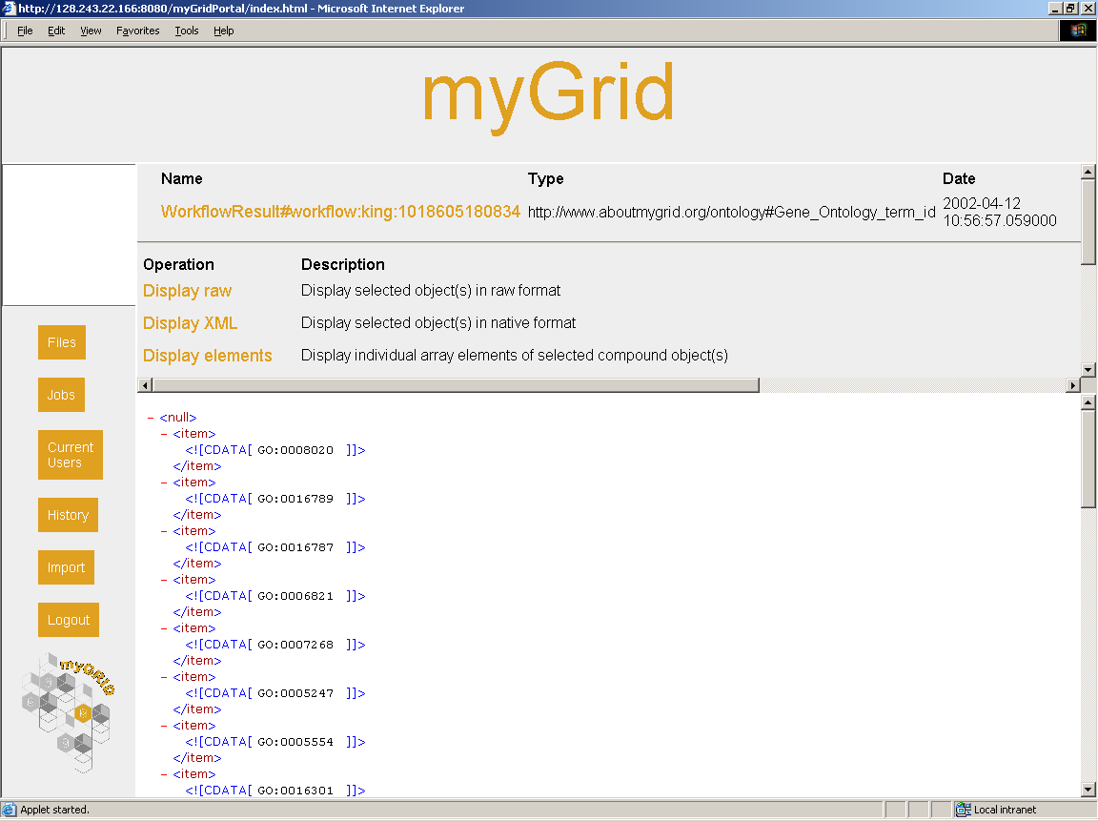
The workflow finishes with the final display service
Results are put into the Information Repository, with a concept from the ontology to tell you and myGrid what they mean.
A full provenance record is linked with the results. We could redo or reuse the workflow.

Slide 29
Summary
Completed first year.
Demonstrator in June 2003 for lab book with Graves disease exemplar.
Ontology, workflow enactment engine, soaplab available for open download
Implementations of first cut event notification, ontology, information repository, distributed query processor, registry, portal, gateway, bio services available.
Integrated with BioMOBY and I3C initiatives
Don’t have to buy into everything – free standing components.

Slide 30
http://www.mygrid.org.uk/

