Slide 1
GGF.ORG
GRAAP-WG
Grid Resource Allocation Agreement Protocol Working Group
http://forge.gridforum.org/projects/graap-wg
GGF9
Chicago, USA
October, 2003

Slide 2
Requirements
Address Service Management
  A framework defining the policies and behaviors associated with service accesses
Generic/extensible negotiation model
  Negotiation may take place over multiple interactions between initiator and provider
  Agreement must support extensible monitoring for conformance checking
Reuse of OGSI mechanisms
  Agreements realized as transient grid services, and created via specialized ogsi:Factory pattern
  Flexible lifetime negotiation for Agreements building on existing soft-state management
  ServiceData for monitoring/introspection
Domain independence
  Define the patterns needed for creating agreements, not agreements for any particular domain

Slide 3
Key concepts
Agreement
  A representation of an on-going relationship between a provider and initiator
    An Initiator begins the relationship by requesting creation
    A Provider maintains relationship by holding the state of the agreement
      A bi-directional agreement may have each party acting in both roles
  An Agreement is composed of a set of Terms with a structured grouping
An Agreement Term contains:
  Domain specific definition of content
  State concerning the commitment by the parties to the current value
  State concerning the freedom to re-negotiate these values
Negotiation is the process of updating term states to reach a final condition
  This is the core of the WS-Agreement specification

Slide 4
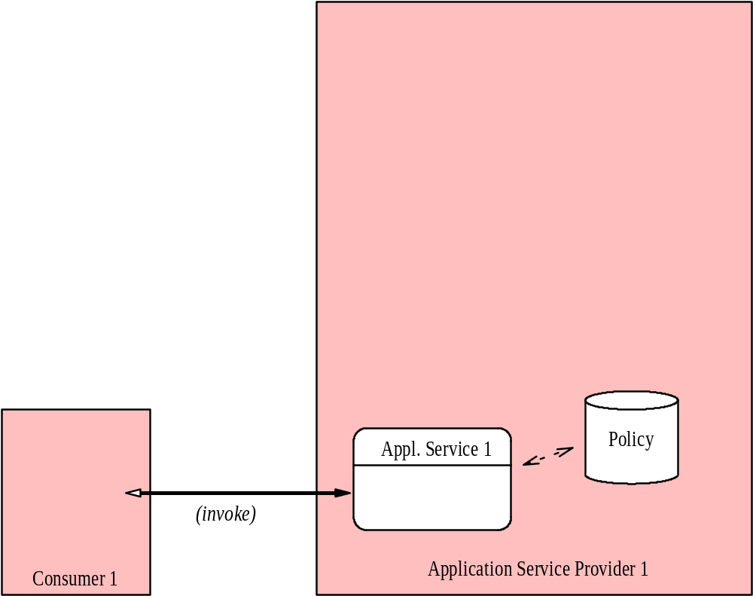
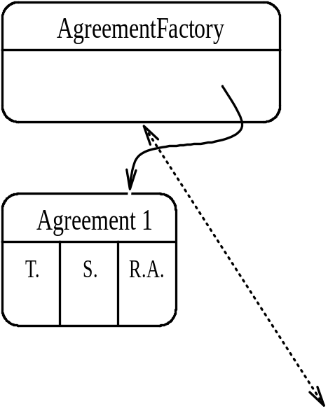
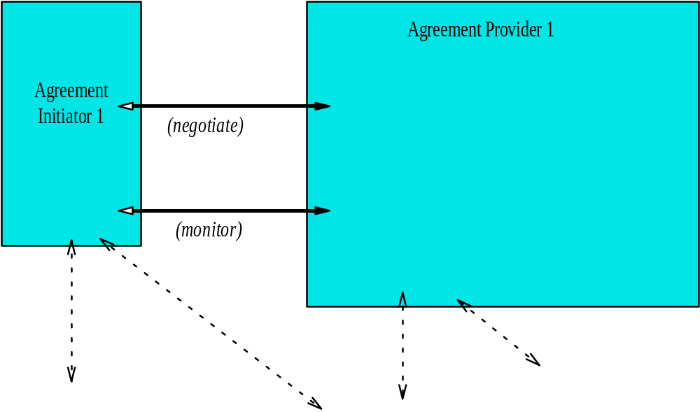
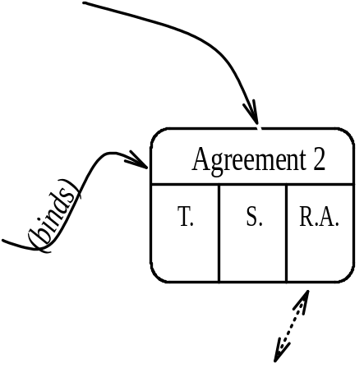
WS-Agreement “Architecture”
Notes:
The big picture. Green layer is provisioning/negotiation domain. The pink layer is the actual provided-service domain. Green corresponds to job-submission mechanisms. Pink corresponds to actual executing job and any client/interactions it might have. Agreement 2 represents advance reservation (it affects policy of computational resource). Agreement 1 represents actual job (it exploits policy which promised resource availability).

Slide 5
Proposed Services/portTypes
AgreementFactory::createService()
  Extends ogsi:Factory
  Coarse-grained
  Conventional fault/response model
  Batch negotiation of complex terms
  Analogy: enables one-shot job submission
Agreement::renegotiate()
  Grid Service containing the state (terms) of the agreement
  Fine-grained
  Allows complex multi-message negotiation
  Permits adaptation of provisioning terms

Slide 6
Relation with invited groups
Provides a foundation for service management in many domains
With respect to PE/RM and invited groups, discussions under way with GESA and JSDL on applicability of WS-Agreement in their domains
  WS-Agreement can provide a structure and a process for describing the desired behavior for these groups

Slide 7
Relationship between Agreement & Agreement “Target”
 | Creating Agreement Creates Target | Creating Agreement does NOT Create Target
Agreement Target is a Grid Service | AgreementFactory is equivalent to the GridServiceFactory | Agreement describes behavior for interactions with an existing grid service (perhaps another factory)
Agreement Target is not a Grid Service | New activity is created under the agreement, but is not accessible as grid service (e.g. a Unix account) | Parameters for interaction with existing service setup (e.g. Network bandwidth)

Slide 8
Negotiation Interfaces
AgreementFactory
  Persistent service
  Ex: façade to scheduler(s)
  Creates Agreement services
Agreement
  Transient service instance
  Ex: job entry virtualized into a service
  Encapsulates state of negotiation
  Lifetime maps to lifetime of “terms of service”

