Slide 1
Grid File System Services
Osamu Tatebe (AIST)
Arun Jagatheesan (SDSC)
Jane Xu (IBM)

Slide 2
Outline
Grid File System Services
Requirements
Key concepts/functionality
Proposed Services
Relation with other services and groups

Slide 3
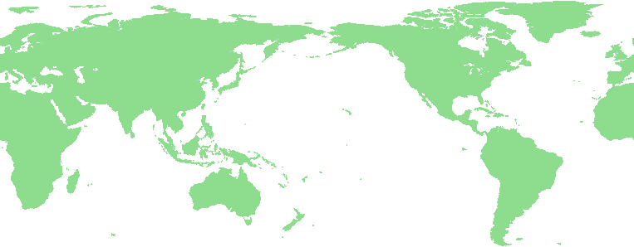
Grid File System Services
Grid File System federates and shares virtualized data from file systems in a Grid
  Virtual hierarchical namespace with access permission and metadata
  Reliable POSIX-like I/O interfaces for the Grid file system
Virtual Directory
Tree
/grid
Grid File System services
ggf
jp
Replica services
Data services
aist
gtrc
file1
file2
Mapping
file1
file2
file3
file4
Grid File System

Slide 4
Requirements
Address need for management of millions or billions of file-based data dispersed in a Grid
Address need for sharing file management
  Secure, transparent, and efficient file sharing
Provide POSIX-like I/O Interfaces
  Required by most applications
  Optimization techniques
    Read-ahead, write-behind, bulk transfer

Slide 5
Key concepts
Service-oriented treatment of file system (file data management and access)
  Virtualized global logical hierarchical namespace
  File system directory tree (with access permission and other metadata) treated in the same way as other resources
    Grid Service Handles for each file system directory (sub-)tree
    Share file system (sub-)tree and access control for secure file sharing
  POSIX like I/O interfaces provided to access and manage file-based data
    Most applications use POSIX I/O API
Interaction with File Access Services and Replica Services
  Common interface to physical file system and storage
  Descriptor-based file access to a specific file
    open, read, write, seek, . . .
  Will be provided by Data Services

Slide 6
Proposed Services
Virtual File System Directory Services (VFDS)
  File system metadata management services
    Virtual file system directory
    owner, file type, ACL, access times, size, checksum type, checksum, . . .
    MIME data type, . . .
  Look-up services with ACLs
    Directory-based pathname (or URI) to a GSH (or a so-called inode number)
Grid File System Services
  Extends VFDS and File Access Services
  Provides reliable POSIX-like I/O interfaces for the Grid File System
    Virtual pathname, virtual filename

Slide 7

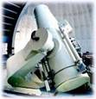
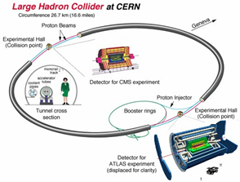
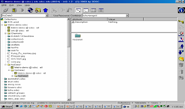


Grid File System Architecture
browser
Applications (Astronomy, Physics, Life Science, buisiness apps, . . .)
Hierarchical Logical Name space + ACL + metadata
Grid File System Services (provides POSIX-like I/O interface)
Virtual File System Directory Services
(provides look-up and metadata access interfaces)
File Access Service (provides POSIX-like I/O interface)
Coordinated with other groups
Data Sources

Slide 8
Relation with other services and groups
Grid File System Services
Virtual File System
Directory Services
Replica Services
Data Services
File Access Services
Database Access Services
File Access Services
  Provides POSIX-like I/O interface with physical pathname
  May be included in Data Services and Replica Service
    DAIS, OREP, and . . .
  We feel specification needs a new WG

