Slide 1
Grid3 and a few thoughts on federating grids
Rob Gardner
University of Chicago
rwg@hep.uchicago.edu
GGF PGM
May 7, 2004

Slide 2
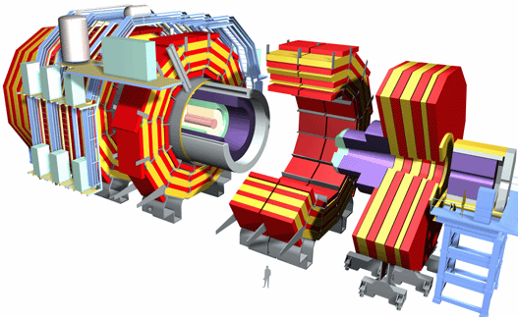
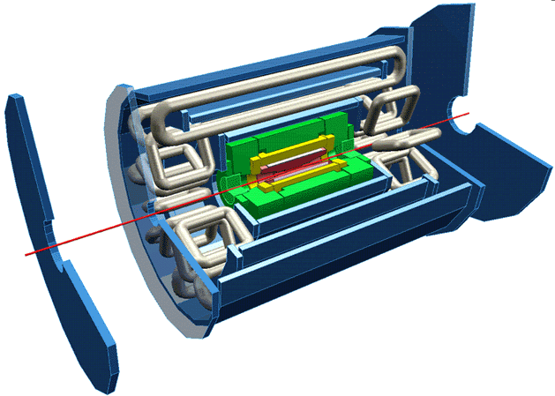




Grid2003: an application grid laboratory
CERN LHC: USCMS
testbeds & data challenges
CERN LHC: US ATLAS
testbeds & data challenges
Grid3
end-to-end
HENP
applications
virtual data research
virtual data grid laboratory

Slide 3
Grid3 at a Glance
Grid environment built from core Globus and Condor middleware, as delivered through the Virtual Data Toolkit (VDT)
  GRAM, GridFTP, MDS, RLS, VDS, VOMS, …
…equipped with VO and multi-VO security, monitoring, and operations services
…allowing federation with other Grids where possible, eg. CERN LHC Computing Grid (LCG)
  USATLAS: GriPhyN VDS execution on LCG sites
  USCMS: storage element interoperability (SRM/dCache)

Slide 4
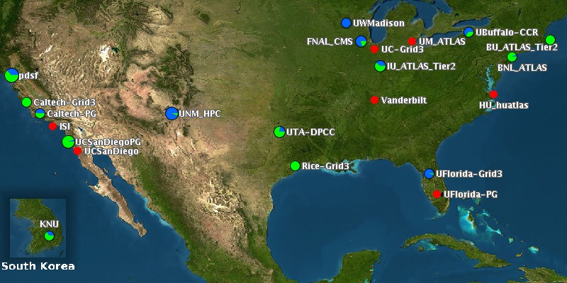
Grid3 – a snapshot of sites
27 sites, multi-VO
shared resources
~2000 CPUs
dynamic – roll in/out

Slide 5
Grid Design
Simple approach:
  Sites consisting of
    Computing element (CE)
    Storage element (SE)
    Information and monitoring services
  VO level, and multi-VO
    VO information services
    Operations (iGOC)
Minimal use of grid-wide systems
  No centralized resource broker, replica/metadata catalogs, or command line interface
    to be provided by individual VO’s
VO
VO
iGOC
site
site
…
site
site
site
site
site
site
CE
SE

Slide 6
Site Services and Installation
Goal is to install and configure with minimal human intervention
Use Pacman tool and distributed software “caches”
Registers site with VO and Grid3 level services
Accounts, application install areas & working directories
four hour
install
and validate
%pacman –get iVDGL:Grid3
Grid3 Site
VDT
VO service
GIIS register
Info providers
Grid3 Schema
Log management
$app
$tmp
Compute Element
Storage

Slide 7
VDT 1.1.4
Virtual Data System 1.2.3
ClassAds 0.9.5
Condor 6.6.1
EDG CRL Update 1.2.5
EDG Make Gridmap 2.1.0
Fault Tolerant Shell (ftsh) 2.0.0
Globus 2.4.3 plus patches
GLUE Information providers, (CVS version 1.79, 25-July-2003)
GLUE Schema 1.1, extended version 1
GPT 3.1
GSI-Enabled OpenSSH 3.0
Java SDK 1.4.1
KX509 2031111
Monalisa 0.95
MyProxy 1.11
Netlogger 2.2
PyGlobus 1.0
PyGlobus URL Copy 1.1.2.11
RLS 2.1.4
UberFTP 1.3

Slide 8
Multi-VO Security Model
VOMS
servers
DOEGrids Certificate Authority
PPDG and iVDGL Registration Authorities, with VO or site sponsorship
Automated multi-VO authorization, using VOMS
Each VO manages a service and it’s members
Each Grid3 site is able to generate a Globus gridmap file with an authenticated SOAP query to each VO service
Site-specific adjustments or mappings
SDSS
US CMS
Grid3 gridmap
US ATLAS
Grid3 Sites
BTeV
LSC
iVDGL

Slide 9
Information Services
Information Index Service (GIIS)
Automated Resource registration to Index Service
MDS Grid3 Schema development & Information Provider verification
MDS tuning
Grid3 Index Service
VO Index Service (6)
Grid3 Site Resources
ATLAS GIIS
Boston GRIS
Boston U
Chicago
GRID3 Location
Grid3 Data_DIR
GRID3 GIIS
ANL
ANL
BNL
Boston U
Chicago
BNL
UFL GRIS
USCMS GIIS
Grid3 Location
Grid3 Data DIR
Grid3 Applications
Grid3 Temporary DIR
UFL
FNAL
RiceU
CalTech
UFL
FNAL
RiceU
CalTech

Slide 10
Monitoring Services and Tools
Globus MDS
  GLUE and Grid3 schema based information services
Ganglia
  cluster monitoring information such as CPU and network load, memory and disk usage
MonALISA
  Agent based monitoring gathering system
ACDC Job Monitoring System
  Grid submitted jobs to query the job managers and collect information
Metrics Data Viewer (MDViewer)
  Plots information collected by the different monitoring systems

Slide 11
Collective Monitoring Framework
Consumers
Intermediaries
Producers
WWW
Site Catalog
OS (syscall, /proc)
GIIS
VO GIIS
Ganglia
GRIS
Reports
Log files
ACDC JobDB
MonALISA
System config.
ML repository
IS Clients
IS Clients
Job manager
MonALISA client
MDViewer
IS Clients
Client tools

Slide 12
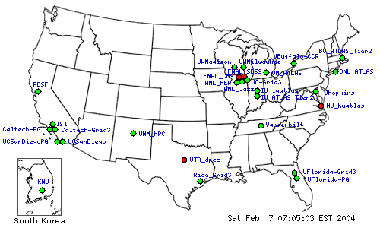

Site Catalog Tool
periodic validation checks & status display
(uses GITS plus other tools)

Slide 13
iVDGL Operations Center (iGOC)
Co-located with Abilene NOC, hosted by Indiana University
Hosts/manages multi-VO services:
  top level Ganglia collectors
  MonALISA web server and archival service
  top level GIIS
  VOMS servers for iVDGL, BTeV, SDSS
  Site Catalog service
  iVDGL Pacman caches
Trouble ticket systems
  phone (24 hr), web and email based collection and reporting system
  Investigation and resolution of grid middleware problems at the level of 16-20 contacts per week
Weekly operations meetings for troubleshooting

Slide 14
Scientific Applications
Rule: install through grid jobs, encourage self-contained environments
11 applications
  LHC (ATLAS, CMS)
  Astrophysics (LIGO/SDSS)
  Biochemical
    Molecular X-ray diffraction
    GADU/Gnare: compares protein sequences
  Computer Science
    Adaptive data placement and scheduling algorithms
    Grid Exerciser
  Over 100 users authorized to run on Grid3

Slide 15
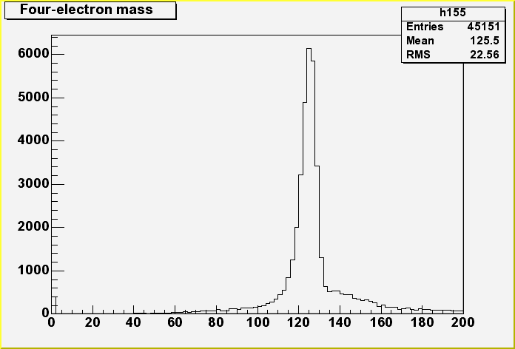
Physics Workflow on Grid3
Higgs → 4 lepton sample
  Simulate and reconstruct
  2000 jobs ( X 6 subjobs); 100~200 events per job
Workflow
  Jobs defined, stored and registered in RLS
  Chimera, Pegasus, and Condor-G to submit to Grid3
  Data pushed to SE at Brookhaven, registered RLS
  Datasets assembled, passed to physicist for analysis
Grid3 resources used
  16 sites, ~1500 CPUs exercised; peak ~800 jobs over three week period
11/18/03
~50% sample
~800 jobs
H → 4e

Slide 16
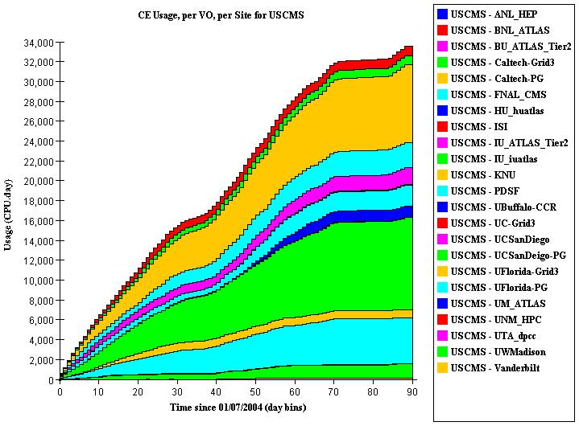
Large Scale Grid3 Operations
USCMS DC04
First three months of 2004
~40% of non-CMS resources

Slide 17
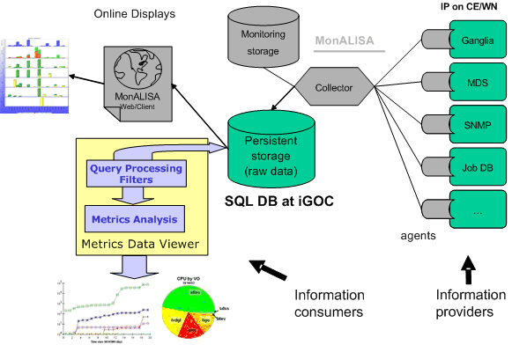
Grid3 Metrics (1)
Goal: associate activity with VOs and sites

Slide 18
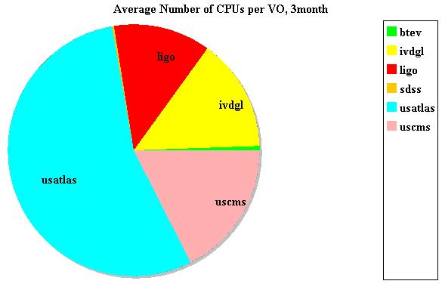
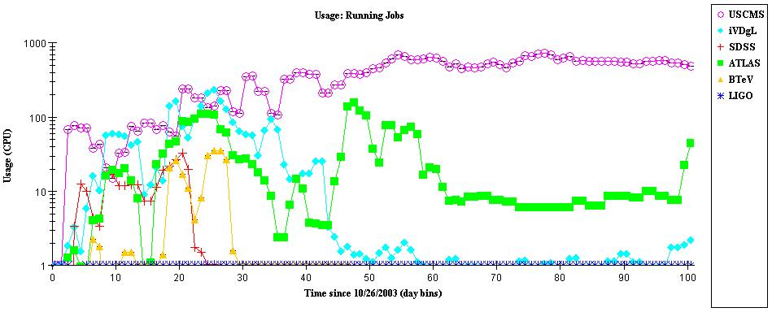
Grid3 Metrics (2)
Hardware resources
  Total of 2762 CPUs
    Maximum CPU count
    Off project > 60%
  Total of 27 sites
    27 administrative domains
    US and Korea
Running jobs
  Peak number of jobs 1100
  During SC2003 various applications were running simultaneously across various Grid3 sites

Slide 19
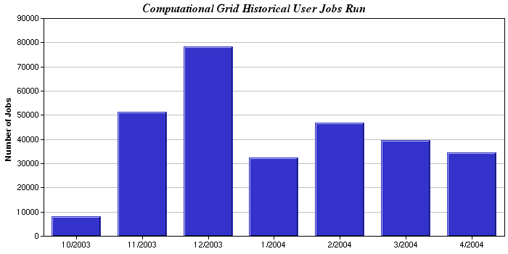
Grid3 Metrics (3)
Jobs from October ‘03 to April ‘04

Slide 20
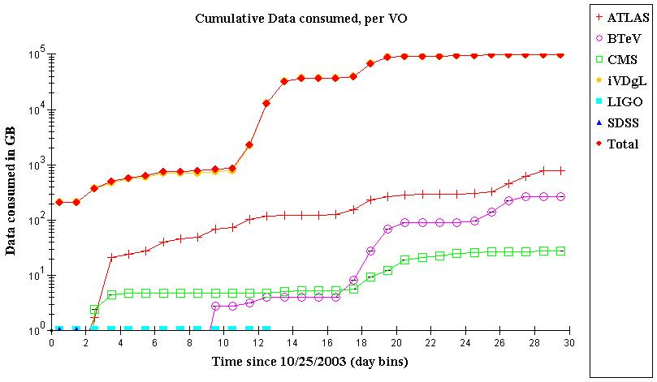
Grid3 Metrics (4)
Data Consumed in Grid3 by VOs
Exercised
100 TB last
November

Slide 21

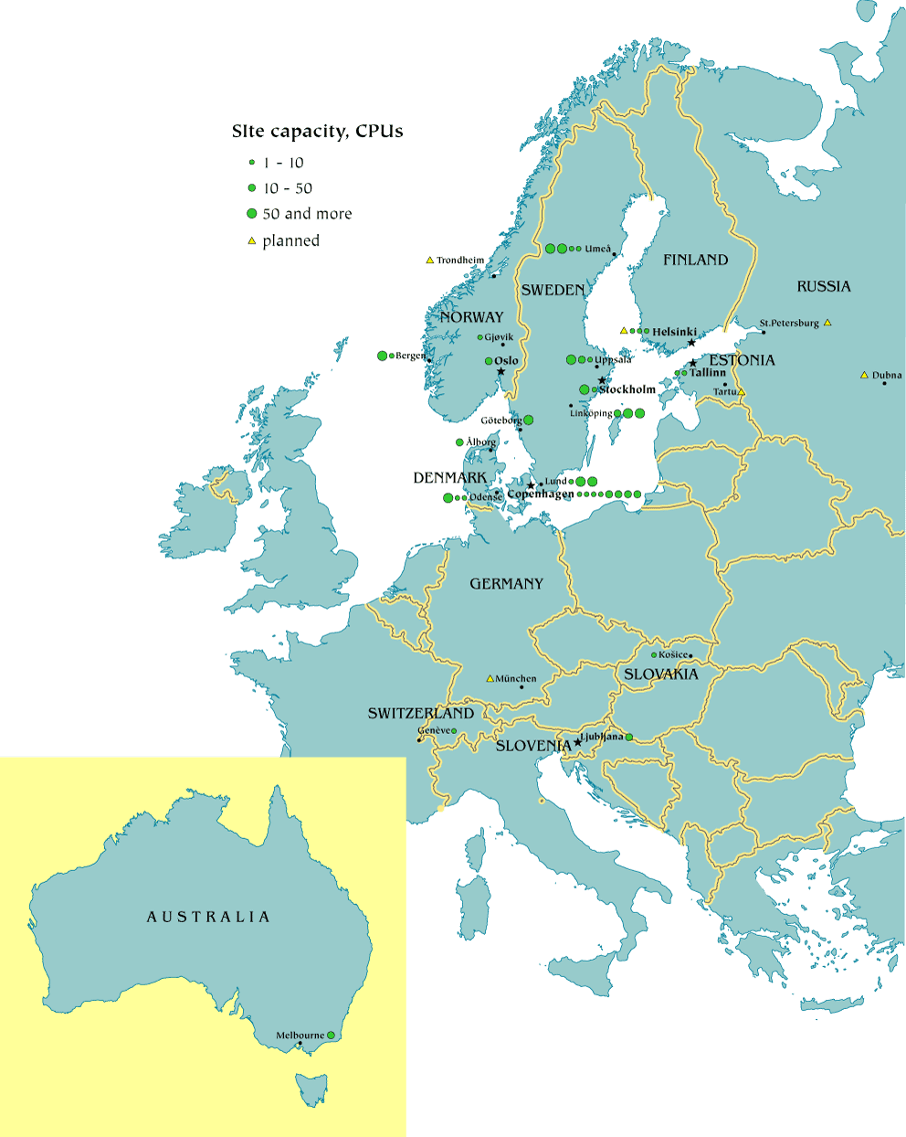

Federation of Grids

Slide 22
Few thoughts on Federation
First and foremost, scientists belong to VOs which span Grids…
  …an LHC scientist may wish (and be authorized to) access resources from the LHC Computing Grid (LCG), UK Grid, NorduGrid, APGrid, participating US Grids like Grid3 and its successors (i.e. Open Science Grid)
  US LHC physicists may wish to gain opportunistic access to other resources like TeraGrid, campus-based Grids, etc
What is the best way to enable this? Many issues.
  authorization, accounting, catalogs, (workflow)

Slide 23
Workflow between Grids
Workflow exercise Grid3 and LCG
  Grid3 produced output staged on disk at Brookhaven lab in NY
  Use VDT client to submit to an LCG server (bypass RB)
  Jobs executing on LCG:
    Input files registered at BNL-RLI
    Stage data from BNL to local scratch area on LCG grid
    Run Athena-reconstruction on LCG
    Write data to local storage element on LCG
    Copy back to disk cache at NY, RLS register
    3rd-party transfer between LCG SE and BNL gridftp servers
  Post job: Dataset catalog and analysis
Many lessons learned about site architectural differences, service configurations; Concrete steps towards combined use of LCG and US Grid3

Slide 24
ATLAS Production System for DC2
AMI
prodDB
dms
Don Quixote
CERN
super
super
super
super
super
jabber
jabber
soap
soap
jabber
LCG
exe
LCG
exe
NG
exe
Grid3
exe
LSF
exe
Capone
Dulcinea
Lexor
RLS
RLS
RLS
LCG
NG
Grid3
LSF
system implemented, production starting this week

Slide 25
Conclusions
Grid2003 project created a persistent, production scale grid infrastructure, Grid3
Continuous use since 10/03
Grid3 will undergo adiabatic upgrades, and continue operations for 2004 (Grid3+)
Outlook:
  Follow-on project will involve more sites and VOs
  Larger “consortia” forming, Open Science Grid (OSG)
  New projects will be defined in this larger framework

Slide 26
Acknowledgements
the entire Grid2003 team which did all the work!
  site administrators
  application developers
  iGOC team
  coordinators and project teams
Slides I’ve taken from presentations by:
  Leigh Grundhoefer (Indiana, iVDGL)
  Ian Fisk (Fermilab, USCMS)
  Ruth Pordes (Fermilab, PPDG)
  Jorge Rodriguez (Florida, USCMS/iVDGL)

