Slide 1





The End-User and Middleware APIs for GridRPC
Keith Seymour, UTK
Craig Lee, Aerospace Corp.
Frédéric Desprez, INRIA/ENS Lyon
Hidemoto Nakada, AIST
Yoshio Tanaka, AIST

Slide 2
Introduction
Provide standardized, portable, and simple programming interface for Remote Procedure Call
Motivation: Significant users for network-enabled server model
  NetSolve, Ninf-G, and DIET
Unify client access to existing grid computing systems
  Easy way for adoption of grid computing
Working towards standardization through GGF WG
Year | NetSolve Downloads
2000 | 627
2001 | 831
2002 | 1106

Slide 3
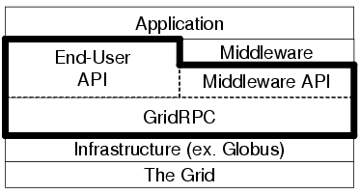
Status of the Working Group
Originally planned API naturally partitioned into
End-User API
  Simple, straight-forward
Middleware API
  More complicated issues: variable args, service discovery, introspection, persistent data, workflow

Slide 4
The End-User GridRPC API – Data Types
Function Handles – grpc_function_handle_t
  Represents a mapping from a function name to an instance of that function on a particular server
  Once created, calls using a function handle always go to that server
Session IDs – grpc_sessionid_t
  Identifier representing a previously issued non-blocking call
  Allows checking status, canceling, waiting for, or getting the error code of a non-blocking call
Error Codes – grpc_error_t

Slide 5
The End-User API Calls (from 10k meters)
Initialization & Finalization
  grpc_initialize, grpc_finalize
Function Handle Management
  create, initialize, destroy, get
Call Functions
  blocking, non-blocking
Async Control/Wait Functions
  probe, cancel, wait, wait_and, wait_or, wait_or, wait_any
Error Reporting
  strings, etc.

Slide 6
Example Program Segment (1/3)
#include "grpc.h"
#define NUM_HOSTS 8
char * hosts[] = {"host00", "host01", "host02", "host03",
"host04", "host05", "host06", "host07"};
grpc_function_handle_t handles[NUM_HOSTS];
int port = 4000;
main(int argc, char ** argv){
double pi;
long times, count[NUM_HOSTS], sum;
char * config_file;
int i, ids[NUM_HOSTS];
if (argc < 3){
fprintf(stderr, "USAGE: %s CONFIG_FILE TIMES \n", argv[0]);
exit(2);
}
config_file = argv[1];
times = atol(argv[2]) / NUM_HOSTS;

Slide 7
Example Program Segment (2/2)
if (grpc_initialize(config_file) != GRPC_OK) {
grpc_perror("grpc_initialize");
exit(2);
}
for (i = 0; i < NUM_HOSTS; i++)
grpc_function_handle_init(&handles[i], hosts[i], port,
"pi/pi_trial");
for (i = 0; i < NUM_HOSTS; i++)
if ( gprc_call_async(&handles[i], &ids[i], i, times,
&count[i]) == GRPC_ERROR ) {
grpc_perror("pi_trial");
exit(2);
}

Slide 8
Example Program Segment (3/3)
if (grpc_wait_all() == GRPC_ERROR){
grpc_perror("wait_all");
exit(2);
}
for (i = 0, sum = 0; i < NUM_HOSTS; i++)
sum += count[i];
pi = 4.0 * ( sum / ((double) times * NUM_HOSTS));
printf("PI = %f\n", pi);
grpc_finalize();
}

Slide 9
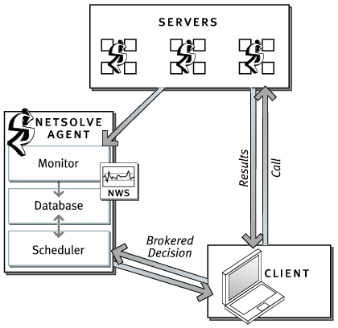
Implementation Overview: NetSolve

Slide 10
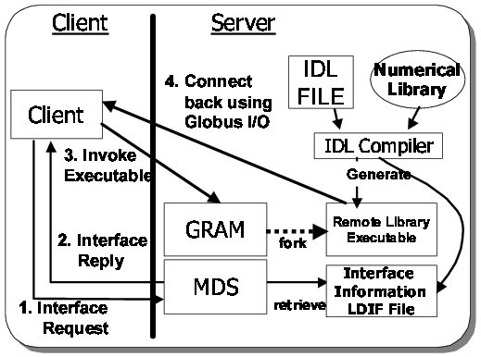
Implementation Overview: Ninf-G

Slide 11
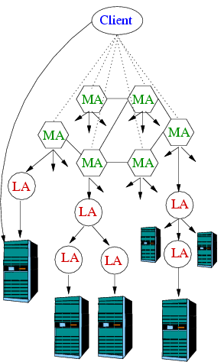
Implementation Overview: DIET

Slide 12
Middleware and Advanced Issues
GridRPC Arguments in Middleware
Service Discovery
Introspection
Persistent Data and Workflow

Slide 13
GridRPC Arguments in Middleware
A specific instance of a GridRPC call in a middleware library may have to accommodate variable number of arguments
Definition of a specific data structure to be used for GridRPC arguments in middleware
  Stack, Vector, etc.
Definition of a "grpc_arg" data type, if necessary
  To be used in conjunction with the argument data structure
Definition of the argument data structure semantics
  Creation, destruction, lifetime and copy semantics

Slide 14
Service Discovery
Service Names
  GridRPC (End-user and Middleware) will not define a Naming Service for service discovery
  But has requirements for its use
Service Name Collisions
  Different systems may have different calling sequences for the same function
  So, in some sense a GridRPC program may be bound to a particular implementation
Function handle binding
  Function handle represents a persistent function-to-server mapping
  Binding a function handle a long time before the actual calls may result in less satisfactory resource selection because of changing server workloads and network conditions

Slide 15
Service Introspection
Rather than require clients to know specific servers, allow clients to dynamically inspect services
Definition of possible introspection capabilities
  Call arguments and attributes
How much a priori knowledge exists prior to run-time, e.g., compile-time?

Slide 16
Persistent Data and Workflow
How can we leave input or output data on a server?
Data Handles
  A data handle is a reference to data that may reside anywhere
Data and data handles may be created separately
Binding is the fundamental operation on DHs
  DHs could be bound to existing data
  DHs could be bound to where you want the data to be
Enables virtualization of data
  Data could be local, hosted on remote machine, managed by service, e.g., SRB or MCS, that know how to retrieve or produce desired data
Typical storage management issues reoccur
  Dangling pointers, etc.
Additional semantics are possible
  Lazy copy semantics, data leases, time-outs
  Single-assignment, etc.

Slide 17
Operations on Data Handles
(General, operational semantics without using exact function signatures)
create(data_handle_t *dh)
  Create a new, unbound data handle.
bind()
  Bind a DH to a specific data item or a machine. This allows the possibility of binding a DH to a third-party machine. (see next slide)
data_t read(data_handle_t dh)
  Read (copy) the data referenced by the DH from whatever machine is maintaining the data. Reading on an unbound DH is an error.
write(data_t data, data_handle_t dh)
  Write data to the machine, referenced by the DH, that is maintaining storage for it. Writing on an unbound DH could have the default semantics of binding to the local host. This storage does not necessarily have to be pre-allocated nor does the length have to be known in advance.
data_desc_t inspect(data_handle_t dh)
  Allow the user to determine if the DH is bound, what machine is referenced, the length of the data, and possibly its structure. Could be returned as XML.
Bool free_data(data_handle_t dh)
  Free the data (storage) referenced by the DH.
Bool free_handle(data_handle_t dh)
  Free just the DH.
May also need:
Copy operation
Bind argument
Transfer mode

Slide 18
Simple RPC – without persistency
Client
Svc A
Svc B
create input data
create input_DH
bind input_DH to input data
create output_DH
bind output_DH to client
not in solution 2
call( input_DH, output_DH )
read input_DH
data sent
execute service
write output data
on output_DH
(output and input data are not subsequently
available on this server)
delete input data
delete input_DH
delete output data
delete output_DH

Slide 19
Simple RPC w/ Unbound Data Handle
Client
Svc A
Svc B
create input data
create input_DH
bind input_DH to input data
create output_DH
call( input_DH, output_DH )
Note: output_DH is unbound
read input_DH
data sent
execute service
create output data
bind output data to output_DH, server
return bound output_DH
(output data still available
on this server)
read output_DH
data sent
free data referenced
by output_DH
free output_DH
(output data no longer
available on this server)

Slide 20
Two Successive RPCs on the Same Server
Client
Svc A
Svc B
create input data
create input_DH
bind input_DH to input data
create output_DH
call( input_DH, output_DH )
Note: output_DH is unbound
read input_DH
data sent
execute service
create output data
bind output data to output_DH
return bound output_DH
create output2_DH
(output data still available
on this server)
bind output2_DH to client
call( output_DH, output2_DH)
execute service
write data on
output2_DH

Slide 21
Two Successive RPCs on Different Servers
Client
Svc A
Svc B
create input data
create input_DH
bind input_DH to input data
create output_DH
call( input_DH, output_DH )
Note: output_DH is unbound
read input_DH
data sent
execute service
create output data
bind output data to output_DH
return bound output_DH
create output2_DH
(output data still available
on this server)
bind output2_DH to client
call( output_DH, output2_DH)
read output_DH
data sent
execute service
write data on
output2_DH

Slide 22
Conclusions
Attempting to provide:
  Simple API upon which higher-level services could be built
  Lower burden when porting code to the Grid
  Medium to coarse-grained calls
  Asynchronous task-parallel programming
Manage IDLs on server side only
  Dynamic resource discovery and scheduling
Introspection
  Lots of work to be done
Persistent Data
  We are not doing Generalized Workflow
  Piggy-back on other work (lots of it!)
Evaluate the compatibility with other systems, e.g., WSRF
  WS-Address and Resource ID are a lot like function and data handles
Desireable Properties
  Implementability, Security, Fault Tolerance
  Thread Safety (at least not “thread hostility”)
Interoperability between implementations done in separate effort

