Slide 1
Grid Content Management
Jim Myers
PNNL

Slide 2
GFS-WG
Aims to
  “describe and manage the namespace of federated data sets, access control mechanisms, and meta-data”
  “(a) virtualized hierarchical namespaces for files or data sets, (b) efficient and transparent file sharing, and (c) access control with flexible capabilities management, and (d) ability to manage other metadata.”
  “(e.g. data in file systems, FTP server, WWW sites, streams, etc.,) or semi-structured data (XML repositories). “

Slide 3
Why a GFS?
Familiar metaphor supporting user control of
  data organization,
  access control,
  file metadata
Value added beyond a UUID/address

Slide 4
Content Management
What other aspects of data management should/could be virtualized?
  User metadata
  Granularity
  Versioning
  Searching
  Locking
  Observation
  Content Typing
  (Semantic) Linking
  Packaging
  Transactions

Slide 5
Questions for GFS-WG
Are these useful services to think about?
Are they logically dependent on/connected to a virtual namespace?
Do they require significant additional capabilities to implement?

Slide 6
Are they useful?
I’ve been influenced by JSR 170 and WebDAV…
Yes!

Slide 7
JSR-170 Expert Group
Major CM, DM & Repository Vendors
Content Application Vendors
Application Server Vendors
Integration Experts
Open Source Community Representatives

Slide 8
JSR-170 Expert Group
Apache Software Foundation
Art Technology Group Inc.(ATG)
BEA Systems
Broadvision Inc.
Day
Divine
Documentum, Inc.
Filenet Corporation
Fujitsu Limited
Griffin, Sean
Hewlett-Packard
IBM
Intalio, Inc.
Interwoven
Kandzior, Alexander
Macromedia, Inc.
Mark, Scott
Mediasurface Ltd.
Myers, James D.
Novell, Inc.
Oracle
Rational Software
SAP AG
SAS Institute Inc.
Shin, Simon Y.S.
Software AG
Stellent, Inc.
Sun Microsystems, Inc.
Thodla, Dorai
Venetica Corporation
Vignette

Slide 9
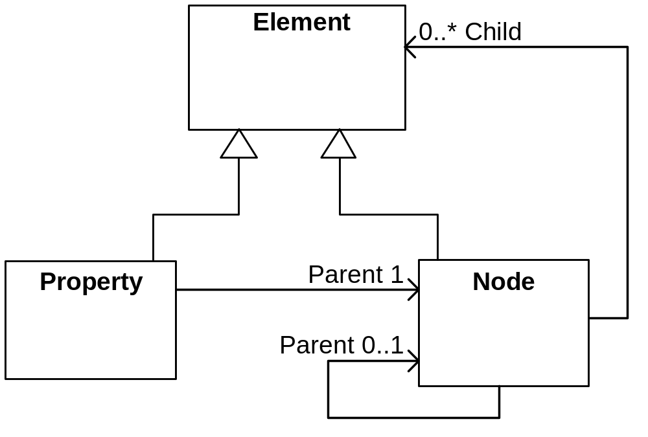
Simplified Content Model

Slide 10
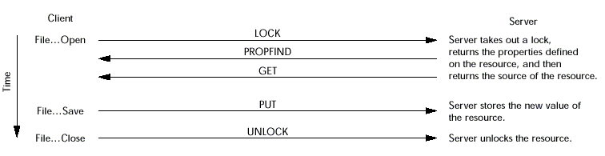
Web Distributed Authoring and Versioning (WebDAV)
An early web service (XML Payloads over HTTP)
Put/Get data with arbitrary properties (dynamic)
Properties can be discovered and accessed independently
DASL, Versioning, Transactions, …

Slide 11
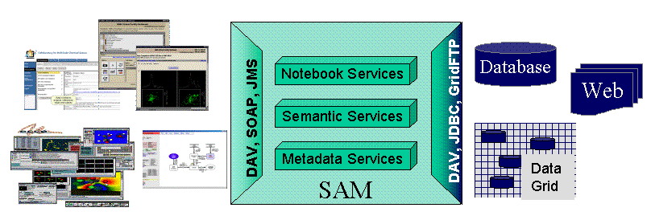
Scientific Annotation Middleware

Slide 12
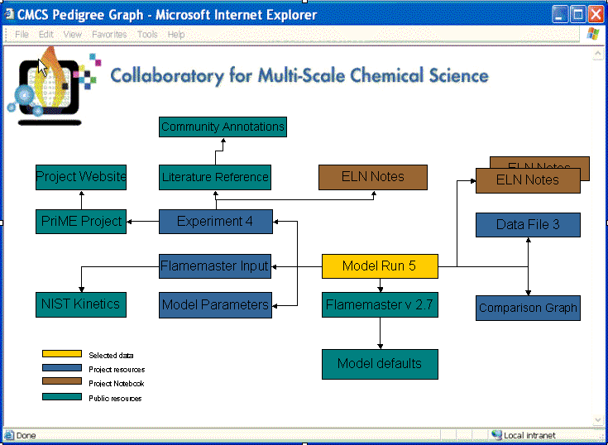
Supporting A Wide range of Applications
File View
  Implemented by DAVfs, MS WebFolders
Content View
  DAVExplorer views properties, versioning
Provenance View
  SAM/CMCS generates provenance graphs, etc.
‘Local
Disk’
Fortran
Application
DAV Store
Resource +
Key/value
metatadata
DAV+
JMS

Slide 13
What is required?
“Arbitrary” metadata associated with a logical name
  Not much more than is requires to support a file system view
Interpreting metadata to implement specific capabilities could be separable (level1,2 compliance)

Slide 14
Questions for GFS-WG
Are these useful services to think about?
Are they logically dependent on/connected to a virtual namespace?
Do they require significant additional capabilities to implement?
  Should they be considered in this WG?
  Use a level 1, level 2 compliance scheme?

Slide 16
If “yes”
Do we need a document describing “content management” in more detail?
  Concept
  Benefits (higher level services such as provenance, …)
  Mapping(s) to virtual file directory service?
  Grid-related practice?

Slide 18
Hierarchy Support
Sample API
getNode(String path)
addNode(String path)
removeNode(String path)
getNodes()
moveTo(String absPath)
copyTo(String absPath)

Slide 19
Make the case for other services,
Argue why they apply to a virtual namespace
Note that they may rely on lower level services tied to the UUID
Argue that most can be implemented using properties to store state
Argue that GFS should be GCM – level 1 ala JSR 170.

Slide 20
XML Serialization
Example DTD:
<!ELEMENT node (property|node)*>
<!ATTLIST node
name CDATA #REQUIRED>
<!ELEMENT property (#PCDATA)>
<!ATTLIST property
name CDATA #REQUIRED
type (String|Date|SoftLink|Binary|Double|Long|Boolean)
"String"
onVersion (copy|noCopy) "copy"
pattern CDATA ".*"
defaultValue CDATA "">

Slide 21
Scope of Level 2 Spec
What does an “extended” Content Repository do?
  Versioning
  Searching
  Locking
  Observation
  Content Typing
  Linking
  Packaging
  Transactions
  Access Control

