Slide 1

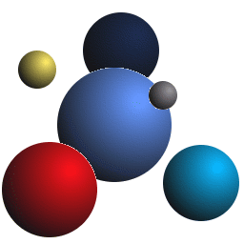
Open Grid Forum, GridVirt Session
May 7-11 2007, Manchester UK
Management of Virtual Machines in Grids Infrastructures
Rubén S. Montero
http://asds.dacya.ucm.es
Distributed Systems Architecture Group
Universidad Complutense de Madrid
Notes:
Good afternoon

Slide 2
Contents
Grids & Virtual Machines
Case of Study: XMM-Newton SAS
Management of Virtual Machines with GridWay
Experience & Results
The GridHypervisor Project

Slide 3
Grids & Virtual Machines
Grid Infrastructures
International research projects (EGEE, OSG, TeraGrid)
  Unprecedented levels of resource sharing
  Increase the computational and storage resources
High degree of heterogeneity (software & hardware)
  Increases the cost and length of application development cycle
  Limits the effective number of resources available to the user
  Increases the operational cost of the infrastructure
Isolate and partition amount of resources contributed to the Grid.
Even worse when using different Grids!

Slide 4
Grids & Virtual Machines
Current Approaches
Software-environment configuration systems
  For the Users, define what applications they want to use
  For the Sysadmins, make a applications available to the user
  Example: SoftEnv
  Does not completely solved none of the problems
Deployment of software overlays
  Custom software configurations (user-space)
  Managed by a general-purpose LRM
  Issues shifted from the applications to the overlaid infrastructure
  Examples: Condor Glide-in, GridWay-BOINC

Slide 5
Grids & Virtual Machines
Virtual Machines
Renewed interest on virtualization technologies (performance and VM support)
Add a new abstraction layer to the Grid:
  Natural way to deal with the heterogeneity of the infrastructure
  Allow partitioning and isolating of physical resources (access to your HW not to your system)
  Execution of legacy applications or scientific codes.
Provide highly distributed environments with a powerful tool to overlay custom infrastructures on top of physical resources

Slide 6

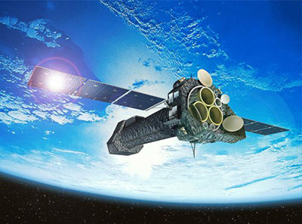
Case of Study: XMM-Newton SAS
SAS Science Analysis Software
Analysis of the data provided by XMM-Newton
Frequently released
Support for several platforms (OS, hardware)
Must be deployed in all the Grid resources
Impose a significant effort
  Sysadmin staff
  Developers
  Users which may need specific versions
The XMM Newton satellite

Slide 7
Case of Study: XMM-Newton SAS
Goal
Leverage actual Grid infrastructure with virtual the use of machines:
  Straight-forward deployment using existing middleware
  Based on well-tested and standard services (production-ready)
  Not tied to a given virtualization technology
  Co-exist within other Grid infrastructures

Slide 8
Management of Virtual Machines with GridWay
Idea
Encapsulate a virtual machine in a grid job.
  Incorporate the functionality of a general purpose meta-scheduler
  Do not need new middleware
  The underlying LRMS is not aware of the nature of the job
  Only suitable to medium/coarse grained HTC applications.

Slide 9

Management of Virtual Machines with GridWay
DRMAA
Results
$>
Advanced scheduling
Different application profiles
Fault detection & recovery
Job execution management
  Prolog (stage-in)
  Wrapper (execution)
  Epilog (stage-out)
Application-Infrastructure decoupling
CLI
Applications
.C, .java
.C, .java
Grid Meta-
Scheduler
GridWay
Globus
Grid Middleware
PBS
SGE
Infrastructure

Slide 10
Management of Virtual Machines with GridWay
XMM-Newton Science Archive (XSA)
VM Image Repository
SAS
GridFTP
GridFTP
Front-end
GridFTP
Virtual WN
GridWay
GRAM
LRMS
Wrapper
1
Prolog (Satge-in)
2
Wrapper (Execution)
Client Machine
3
Epilog (stage-out)
2.1 Stage-in to virtual WN
2.2 Execution in the virtual WN
Worker Nodes
2.3 Stage-ou to cluster FS

Slide 11
Experience & Results
Some Implementation Details
Xen capable resources (Worker-nodes)
Virtual Images available at remote resources.
Virtual OS has been hardened
Disk Image layout
Mount Point | Size | Contents
/ | 500MB | FC4 base system
/usr | 650MB | System apps.
/opt | 600MB | SAS 6.5.0
/scratch | 2GB | SAS tmp
Shared save storage and ease the deployment
Local for I/O performance

Slide 12
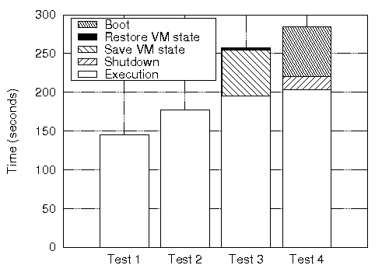
Experience & Results
Overhead Analysis
Without VMs
Persistent
VMs
Save
Restore
Start
Stop

Slide 13
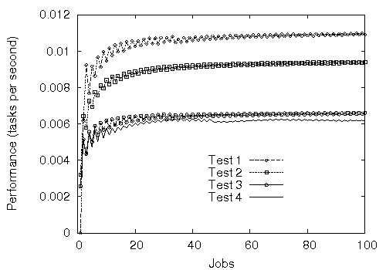
Experience & Results
Application Performance
Cost of Virtualization 13%
Boot/save overhead 35%
Without VMs
Persistent VMs
Save/Restore
Start/Stop

Slide 14
Experience & Results
Experience
Straightforward deployment of VMs on Grids.
  Ready to work on existing infrastructures
  Limited overhead for some deployments
  Significant increase of the quality of life in the Grid
However:
  Does not fully exploit virtualization
  Limited to medium to coarse grained batch applications
Provide persistent virtual overlay management system

Slide 15
The GridHypervisor Project
Goal of the Project
The GridHypervisor will manage Virtual Infrastructures (VI) in the same way a Hypervisor manage Virtual Machines (VM)
Enable large-scale, reliable and dynamic deployment and reallocation of VMs between different administration domains
Functionality
Based on existing middleware, Globus Workspace Service:
  WSRF interface
  Start, monitor and control a Worksapce
VI requests are handled by the GridHypervisor:
  Physical resource Discovery and Selection
  Remote System Preparation
  VM Start/Migration
  VM Monitoring
  Termination

Slide 16
The GridHypervisor Project
Service process
Service-ready VM Images
Re-configured on each site
Examples: a SGE cluster, a virtual classroom…
Service Interaction
Users
Service Overlay
Applications
VM
Request
Virtual
Infrastructure
Grid
Hypervisor
Virtual Machine Control & Monitor
GridFTP
Workspace
Service
Globus
Services
Middleware
Virtualizer
Virtualizer
Physical
Infrastructure
Grid Site

Slide 17
Management of Virtual Machines in Grid Infrastructures
Thank you for
your attention!
More Information at…
  www.gridhypervisor.org
  www.gridway.org

