Slide 1

OGF NSI: the Network as a Manageable Resource for Clouds and Grids
Science Agency Uses of Clouds and Grids
NSI Co-chairs: Guy Roberts, Tomohiro Kudoh, Inder Monga
18th July 2011

Slide 2
Networks in Clouds & Grids
Networks are often been taken for granted by Clouds and Grids
Networks performance sensitive to distance and congestion
Longer distances may require using more than one provider
Goals is to have networks as a manageable resource

Slide 3

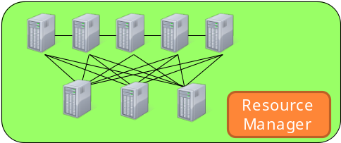


Inter-DC connectivity challenge
(1) Ｒｅｑｕｅｓｔ
(3) Use
Inter-DC
network
NRM
(2) Provide

Slide 4
Managing complex networks in Clouds
Requirements:
A simple API to support connectivity management
Network should be just another resource – easy integration with scheduling of computing resources
Dynamic assignment of bandwidth, VLAN ids etc.
Compatibility with monitoring systems for virtual infrastructures while keeping isolation
Global reach: multi-provider enabled solution

Slide 5
Dynamic circuits – service rollout
Research and education networks are rolling out dynamic service networks, but use a range of different technologies:
  OSCARS (Esnet, Internet2, LHCnet, NORDUnet, several RONs)
  AutoBAHN (GÉANT and several NRENs)
  G-lambda (AIST, KDDI, NTT)
  openDRAC (SURFnet)
These systems are currently not interoperable
Network services Interface (NSI) protocol will allow these systems to interoperate.

Slide 6
Network Service Interface
NSI is designed to allow Grid, Cloud and other applications to mange network connectivity.
NSI also supports provider-to-provider circuit request
NSI can also allows existing BoD systems to interoperate
Oriented to creating and managing L1/L2 connection-oriented circuits: bandwidth guarantees.

Slide 7
NSI is a framework
NSI provides a framework for multiple services:
  Connection service
  Topology exchange service
  Negotiating monitoring
The NSI Framework is available here:
http://forge.gridforum.org/sf/go/doc16014?nav=1
© 2006 Open Grid Forum

Slide 8
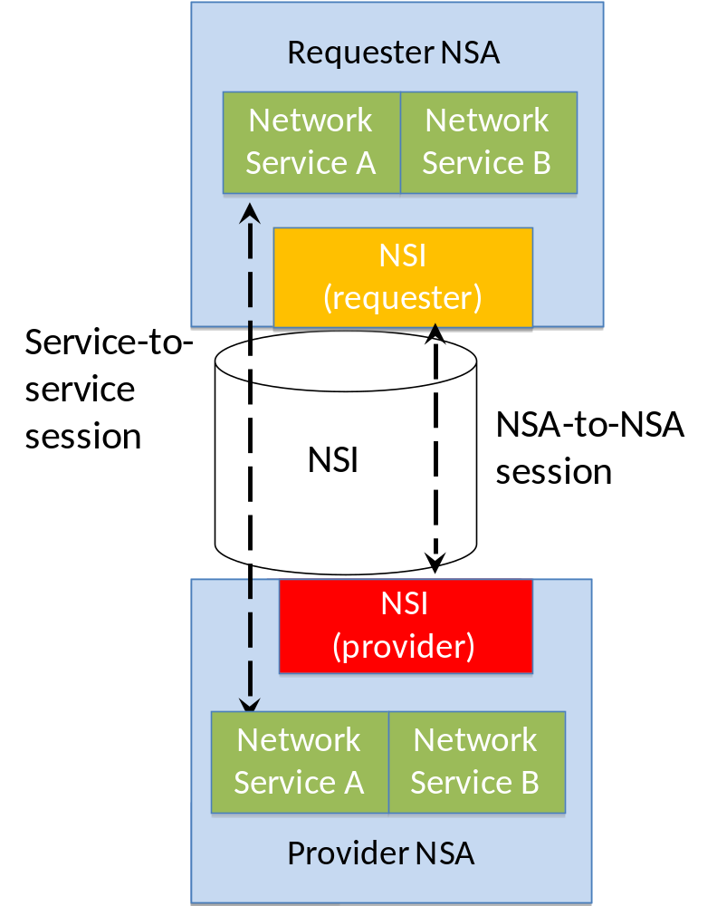
Network Service Framework (NSF)
Platform for many services
Services sessions established between service instances
NSI Requester-Provider session established between NSAs
Message transport not mandated, however, reference Web Service WSDL has been issued.

Slide 9
Connections in NSI
Connections have:
  Source and Destination (point to point)
  Performance characteristics (capacity, framing, etc)
  Authorization policy (defined by domain)
  Book-ahead schedule (“now” for on demand)
Two part connection establishment :
  Reservation- includes PathFinding and Resource allocation
  Provisioning- includes re-configuration of the network elements along a pre-computed path
© 2006 Open Grid Forum

Slide 10
Connection lifecycle
Requester
Provider
rsv.rq
rsv.cf
messages (primitives) manage connection lifecycle
  Request a connection (creates a reservation)
  Terminate the connection (removes the reservation)
  Provision the connection (enable on transport plane)
  Release the connection (releases connection)
Start time
prov.rq
prov.cf
In service
rel.rq
rel.cf
Reserved
prov.rq
prov.cf
term.rq
In service
term.cf

Slide 11
Delivering Network Services
Network
Services
Interface (NSI)
Network Service A
Network Service B
Network Service A
Network Service B
NSI
Provider
NSI Requester
NSI Provider
NSA
NSA
NRM
Service plane
NSA = Network Services Agent
NRM = Network Resource Manager
Transport plane
NSI used to communication requests between Agents
Provider Agent delivers circuit via Network Resource Manager
Notes:
1. Connection Service, a service used to request and manage transport connections. Another example is the Topology Service; this is used to exchange network topologies.

Slide 12
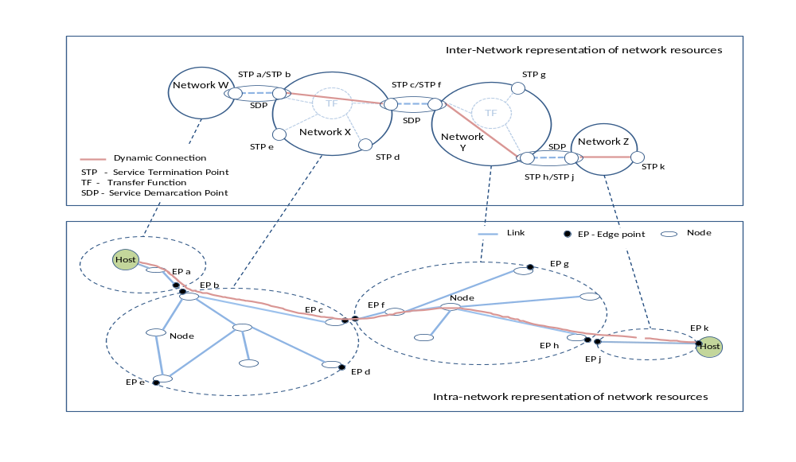
NSF: Network topology
NSF describes method for aggregating topology into ‘Networks’

Slide 13
NSI documents
GFD.173 Network Services Framework
The NSF is a framework to support Network Services
Supports many services – initial service is Connection Service
Possible future services, e.g.: Network Topology Exchange Service
Status – NSF v1.0 has been published
GFD.XXX Connection Service Protocol
Allows an application or network provider to request and automatically reserve and provision circuits from other network providers
Designed to support circuits that transit multiple service providers
Status – protocol freeze this week to support NSI plugfest Sept 2011

Slide 14
NSI implementation timeline
  ION service (Esnet and Internet2), AutoBAHN (GÉANT), G-lambda (AIST, KDDI, NTT), openDRAC (SURFnet), openNSA (NORDUnet) are all developing NSI compliant interfaces.
  NSI plugfest will take place at GLIF meeting in Rio September this year
  Aiming to demonstrate first protocol implementations at SuperComputing in November 2011

Slide 15
Summary
  Inter data center connectivity not trivial
  NSI is an open interface request connectivity
  R&E networks around world rolling out dynamic services
  Commitment by these providers to become NSI compliant

Slide 16
Full Copyright Notice
Copyright (C) Open Grid Forum (2008-2011). All Rights Reserved.
This document and translations of it may be copied and furnished to others, and derivative works that comment on or otherwise explain it or assist in its implementation may be prepared, copied, published and distributed, in whole or in part, without restriction of any kind, provided that the above copyright notice and this paragraph are included on all such copies and derivative works.
The limited permissions granted above are perpetual and will not be revoked by the OGF or its successors or assignees.
Notes:
OGF Full Copyright Notice if necessary

