Slide 1
INFOD Working Group – A Use Case In Detail
GGF16 in Athens
February 13-16, 2006

Slide 2
GGF Intellectual Property Policy
All statements related to the activities of the GGF and addressed to the GGF are subject to all provisions of Appendix B of GFD-C.1, which grants to the GGF and its participants certain licenses and rights in such statements. Such statements include verbal statements in GGF meetings, as well as written and electronic communications made at any time or place, which are addressed to any GGF working group or portion thereof,
Where the GFSG knows of rights, or claimed rights, the GGF secretariat shall attempt to obtain from the claimant of such rights, a written assurance that upon approval by the GFSG of the relevant GGF document(s), any party will be able to obtain the right to implement, use and distribute the technology or works when implementing, using or distributing technology based upon the specific specification(s) under openly specified, reasonable, non-discriminatory terms. The working group or research group proposing the use of the technology with respect to which the proprietary rights are claimed may assist the GGF secretariat in this effort. The results of this procedure shall not affect advancement of document, except that the GFSG may defer approval where a delay may facilitate the obtaining of such assurances. The results will, however, be recorded by the GGF Secretariat, and made available. The GFSG may also direct that a summary of the results be included in any GFD published containing the specification.

Slide 3
Early Discussion
Open phone bridge (if necessary)
Well note GGF IPR statement
Assign note taker(s)
Review agenda

Slide 4
NextGRID Graphical Animations Use Case
In these scenarios the designer submits jobs (i.e. animated scenes to be rendered) to the rendering service (compute cluster).
  Parameters such as time limit, number of frames in the scene, type of rendering software to use, can be specified.
  How the job is submitted to the rendering service and the animation data transport are outside the scope of this document.
Key players:
  A Rendering Service – Publisher
  Project Boss – Subscriber
  Animations Designer – Consumer
  Animations Reviewer – Consumer
Main INFOD steps:
  Create Data & Property Vocabularies – define community
  Create Entities – add members of the community (publishers, subscribers, consumers)
  Publish – create subscriptions, associate vocabularies, send data.

Slide 5
Scenario steps
Boss (or Organisation Admin) registers the vocabularies with the INFOD Registry.
Rendering Service is added as a Publisher and instance of the publisher properties are created.
Boss adds himself into the INFOD Registry as a Subscriber and instance of the employee properties are created.
Boss adds their Designers and Reviewers as Consumers, plus instances of the employees properties are created.
Boss adds the relevant Subscriptions to the INFOD Registry.
Boss creates Associations between the Publisher and Subscription entities and the Data Vocabularies.
The Rendering Service gets details of any new animation job subscriptions and consumers.
Rendering Service sends data to relevant consumer when animation jobs are completed.

Slide 6
Animation Data Vocabulary – Rendering Jobs
Animation Vocabulary Components | Comment | Example Values
Designer_Name | Name of the designer that submitted the animation for rendering. | Fred Designer
Rendering_Job_Name | Name for the submitted rendering job. | AnimationJobID12345
Project_Name | Name of the project (e.g. film or commercial perhaps). | Toy Story 3
Number_of_Scenes | Number of scenes to be rendered (i.e. some measure of the complexity of the animation). | 14
Rendering_Software | Rendering software used, e.g. 3D Studio Max or Maya etc. | 3D Studio Max
Job_Time_Limit | Maximum completion time for the rendering job. | 02:30:00.0
Job_Start | Actual start time for the rendering job. | 14-02-06 11:22:33.4
Job_End | Actual end time for the rendering job. | 14-02-06 11:55:22.4
Job_Status | Accepted, Rejected, Submitted, Started, Completed, Reviewed, Passed, Failed, Exceeded Time Limit. | Completed
Animation_EPR | Location (EPR) of the resulting stored animation. | www.nextgrid.org/ AnimationJobID12345_results

Slide 7
Register Data Vocabulary - message
<wsinfod:RegisterDataVocabulary>
<wsinfod:VocabularyName>NextGridAnimationVocab</wsinfod:VocabularyName>
<wsinfod:VocabularyDescription>
Publication is created if constraint condition changes from false to
true/become valid (constraints are used to identify state changes) </wsinfo:VocabularyDescription>
<wsinfod:VocabularyLanguage>
XML Schema (Namespace/URI of Data Format)
</wsinfod:VocabularyLanguage>
<wsinfod:VocabularyBody>
    <?xml version="1.0"?>
    <xsd:schema xmlns:xsd="http://www.w3.org/2001/XMLSchema" xmlns:ident="http://www.w3.org/INFOD/Entity" targetNamespace="http://www.w3.org/INFOD/Entity">
    <xsd:element name = “Designer_Name” type = “xs:string”/>
    <xsd:element name = “Rendering_Job_Name” type = “xs:string”/>
    <xsd:element name = “Job_Start” type = “xs:time”/>
    <xsd:element name = “Job_Status” type = “xs:string”/>
    …
  </wsinfod:VocabularyBody>
</wsinfod:RegisterDataVocabulary>

Slide 8
Register Data Vocabulary - response message
<wsinfod:RegisterDataVocabularyResponse> <wsinfod:INFODVocabularyIdentifier>
<wsa:Address> http://www.nextgrid.org/NGInfoDRegistry/NextGridAnimationVocabEPR
</wsa:Address>
</wsinfod:INFODVocabularyIdentifier> <wsinfod:VocabularlyVersion>1.0_alpha</wsinfod:Version>
</wsinfod:RegisterDataVocabularyResponse>

Slide 9
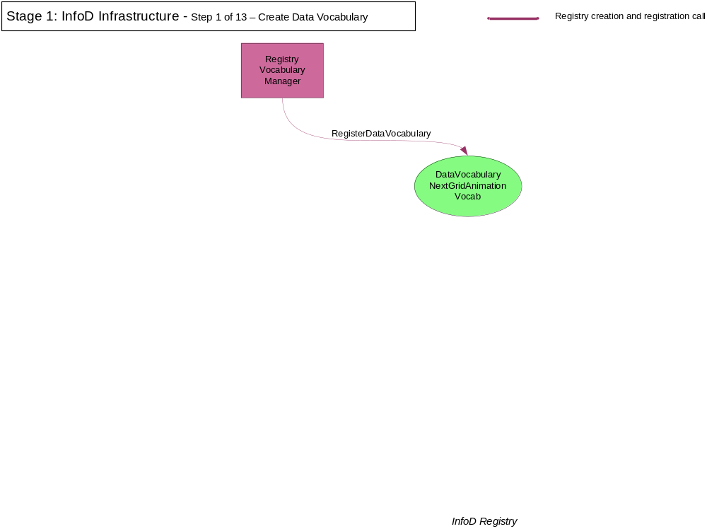

Slide 10
Rendering Service Property Vocabulary – Publishers
Rendering Service Vocabulary Components | Comment | Example Values
Service_Name | Name of rendering service. | NextGridRenderingService1
Service_Address | URL. | http://www.nextgrid.org/RenderingService1
Organisation_Name | Name of the organisation hosting the rendering service. | Super Animations Inc.
Organisation_Location | Address of the organisation hosting the rendering service. | Edinburgh, UK
Business_rating | A number between 1 and 5. | 5
Rendering_Software | List of rendering software products available. | 3D Studio Max, Maya

Slide 11
Register Property Vocabulary - message
<wsinfod:RegisterPropertyVocabulary>
<wsinfod:VocabularyName>NextGridRenderingServiceVocab</wsinfod:VocabularyName>
<wsinfod:VocabularyBody> - Will always be XML
<?xml version="1.0"?>
<xsd:schema
xmlns:xsd=http://www.w3.org/2001/XMLSchema
xmlns:ident="http://www.w3.org/INFOD/Entity" targetNamespace="http://www.w3.org/INFOD/Entity"> <xsd:element name = “Service_Name” type = “xs:string”/> <xsd:element name = “Service_Address” type = “xs:uri”/> <xsd:element name = “Service_Organization” type = “xs:string”/>
<xsd:element name = “Rendering_Software” type = “xs:complexType”/>
…
</wsinfod:VocabularyBody>
</wsinfod:RegisterPropertyVocabulary>
Response from the INFOD Registry is again an EPR of this entry in the registry.

Slide 12
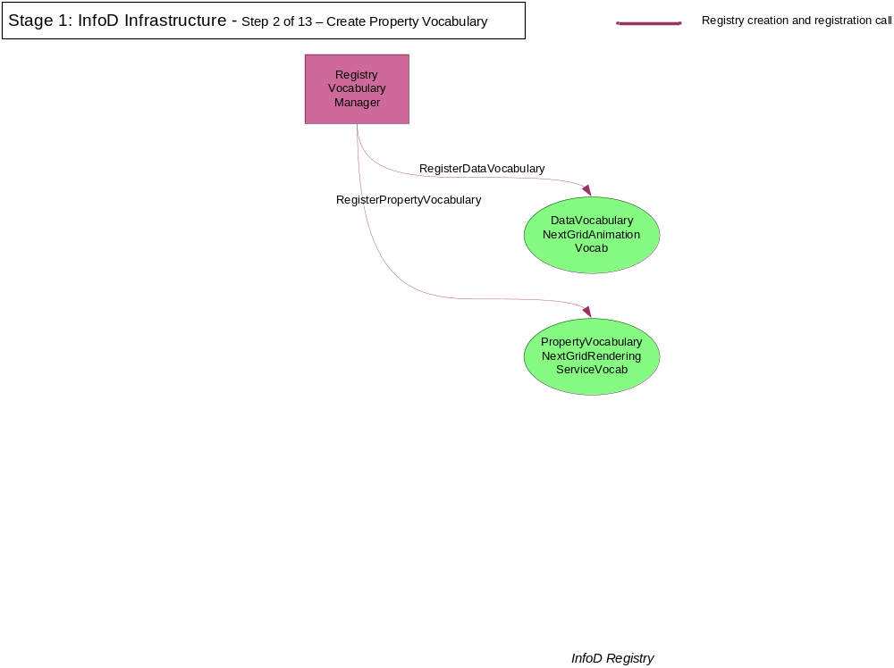

Slide 13
Register Employee Property Vocabulary – Designers, Reviewers
Designer Vocabulary Components | Comment | Example Values
Employee_Name | Name of the animator/designer, reviewer or boss. | John Boss, Fred Designer, Peter Reviewer
Employee_Email | E-mail address. | johnB@nextgrid.org
Employee_Type | Designer, Reviewer or Boss. | Boss, Designer, Reviewer
Employer_Name | Name of the employer. | Super Animations Inc.
Employee_Location | Address of the employee. | Edinburgh, UK
Hourly_Rate | Hourly rate, for example for designing animations. | $123.45
Availability | Dates and times when the employee is available. | Monday-Friday

Slide 14
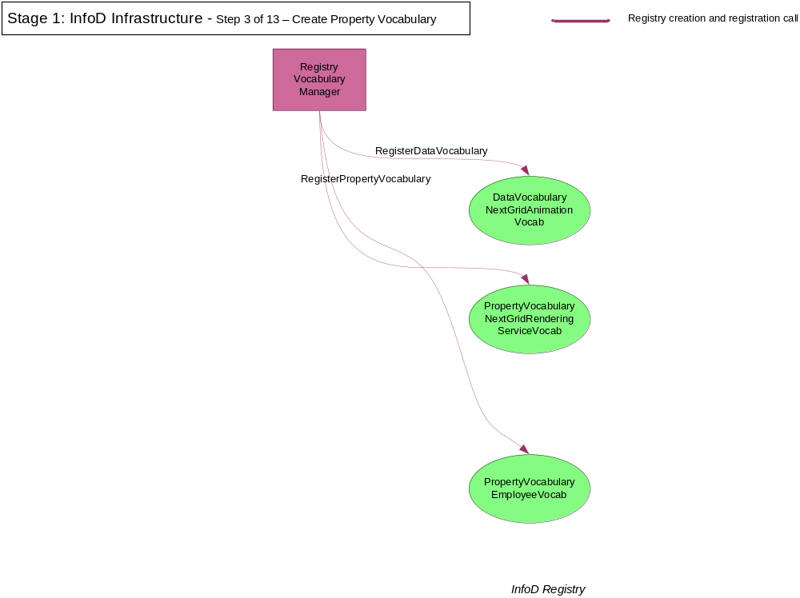

Slide 15
Add Publisher to INFOD Registry
<wsinfod:CreatePublisher>
<wsinfod:PublisherName>
NextGridRenderingService1
</wsinfod:PublisherName>
</wsinfod:CreatePublisher>
Response:
<wsinfod:CreatePublisherResponse>
…
http://www.nextgrid.org/NGInfoDRegistry/ NextGridRenderingService1EPR
…
<wsinfod:CreatePublisherResponse>

Slide 16
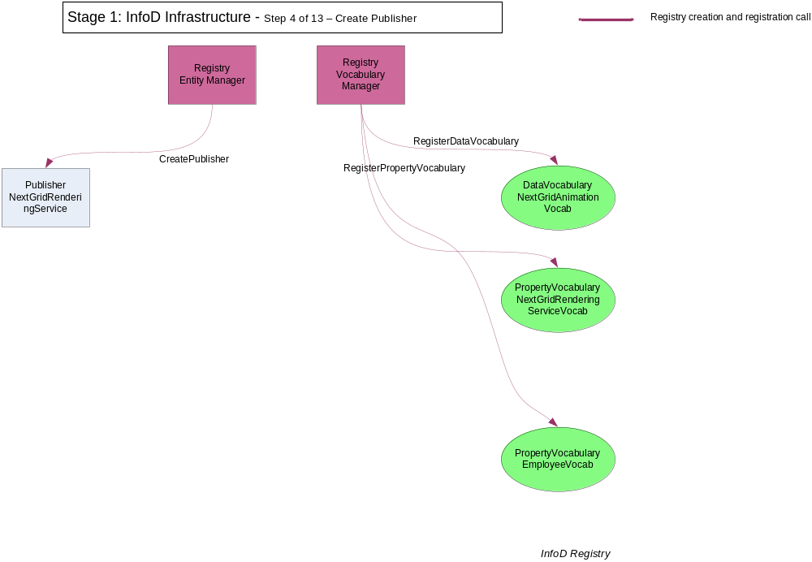

Slide 17
Create instance of publisher properties
<wsinfod:CreatePropertyVocabularyInstance>
<wsinfod:VocabularyInstanceEntityReference> NextGridRenderingServiceEPR1 </wsinfod:VocabularyInstanceEntityReference> <wsinfod:VocabularyInstanceVocabularyReference> RenderingServiceVocabEPR </wsinfod:VocabularyInstanceVocabularyReference> <wsinfod:VocabularyInstanceVocabularyBody>
<?xml version="1.0"?>
<xsd:schema xmlns:xsd="http://www.w3.org/2001/XMLSchema" xmlns:ident="http://www.w3.org/INFOD/Entity" targetNamespace="http://www.w3.org/INFOD/Entity">
<Service_Name> NextGridRenderingService1 </Service_Name>
<Service_Organisation> Super Animations Inc. </Service_Organization>
<Service_Address> http://superinc.com </Service_Address>
<Rendering_Software> 3D Studio Max </Rendering_Software>
</wsinfod:VocabularyInstanceVocabularyBody>
</wsinfod:CreateVocabularyInstance>

Slide 18
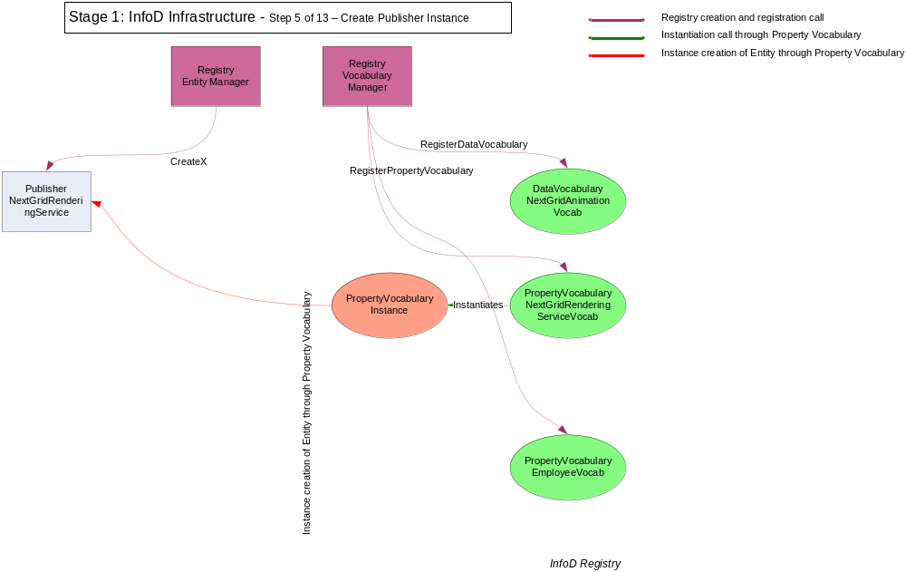

Slide 19
Add Subscriber to INFOD Registry
<wsinfod:CreateSubscriber>
<wsinfod:SubscriberName>
John Boss
</wsinfod:SubscriberName>
</wsinfod:CreateSubscriber>
Response:
<wsinfod:CreateSubscriberResponse>
…
http://www.nextgrid.org/NGInfoDRegistry/JohnBossEPR
…
<wsinfod:CreateSubscriberResponse>

Slide 20
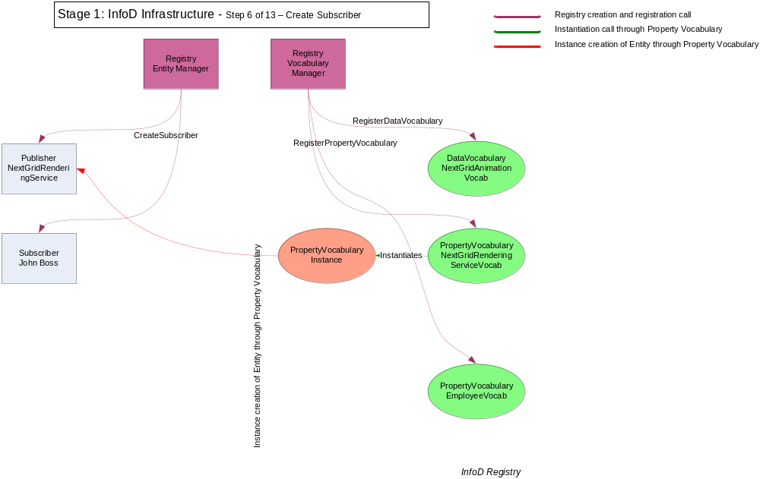

Slide 21
Create instance of subscriber properties
<wsinfod:CreatePropertyVocabularyInstance>
<wsinfod:VocabularyInstanceEntityReference> JohnBossEPR
</wsinfod:VocabularyInstanceEntityReference> <wsinfod:VocabularyInstanceVocabularyReference>
EmployeeVocabEPR </wsinfod:VocabularyInstanceVocabularyReference> <wsinfod:VocabularyInstanceVocabularyBody>
<?xml version="1.0"?>
<xsd:schema
xmlns:xsd="http://www.w3.org/2001/XMLSchema" xmlns:ident="http://www.w3.org/INFOD/Entity" targetNamespace="http://www.w3.org/INFOD/Entity">
<Employee_Name> John Boss </Employee_Name>
<Employee_Organisation> Super Animations Inc. </Employee_Organisation>
</wsinfod:VocabularyInstanceVocabularyBody>
</wsinfod:CreateVocabularyInstance>

Slide 22
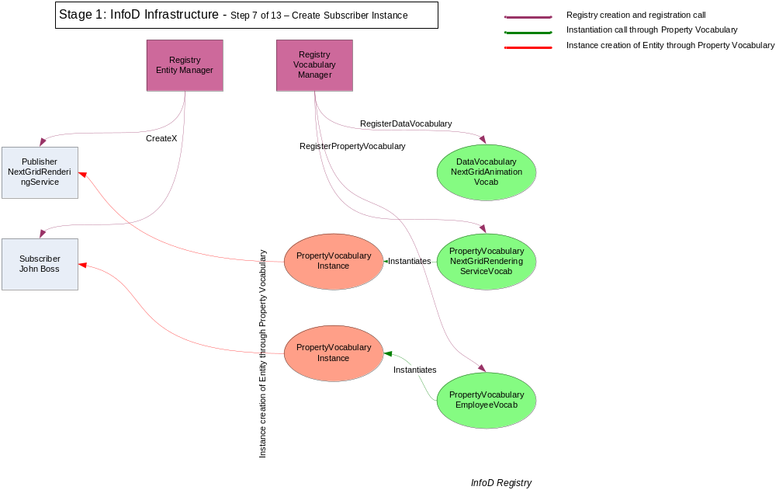

Slide 23
Add Consumer to INFOD Registry
<wsinfod:CreateConsumer>
<wsinfod:ConsumerName>
Peter Reviewer
</wsinfod:ConsumerName >
</wsinfod:CreateConsumer >
Response:
<wsinfod:CreateConsumerResponse>
…
http://www.nextgrid.org/NGInfoDRegistry/ PeterReviewerEPR
…
<wsinfod:CreateConsumerResponse>

Slide 24
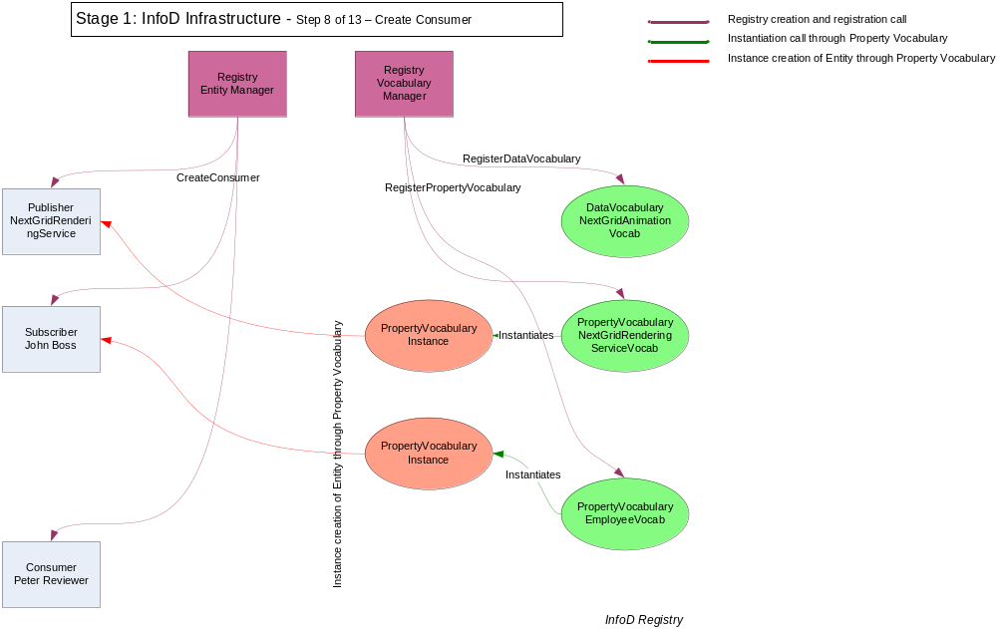

Slide 25
Create instance of consumer properties
<wsinfod:CreatePropertyVocabularyInstance>
<wsinfod:VocabularyInstanceEntityReference> PeterReviewerEPR
</wsinfod:VocabularyInstanceEntityReference> <wsinfod:VocabularyInstanceVocabularyReference>
EmployeeVocabEPR </wsinfod:VocabularyInstanceVocabularyReference> <wsinfod:VocabularyInstanceVocabularyBody>
<?xml version="1.0"?>
<xsd:schema
xmlns:xsd="http://www.w3.org/2001/XMLSchema" xmlns:ident="http://www.w3.org/INFOD/Entity" targetNamespace="http://www.w3.org/INFOD/Entity">
<Employee_Name> Peter Reviewer </Employee_Name>
<Employee_Organisation> Super Animations Inc. </Employee_Organisation>
</wsinfod:VocabularyInstanceVocabularyBody>
</wsinfod:CreateVocabularyInstance>

Slide 26
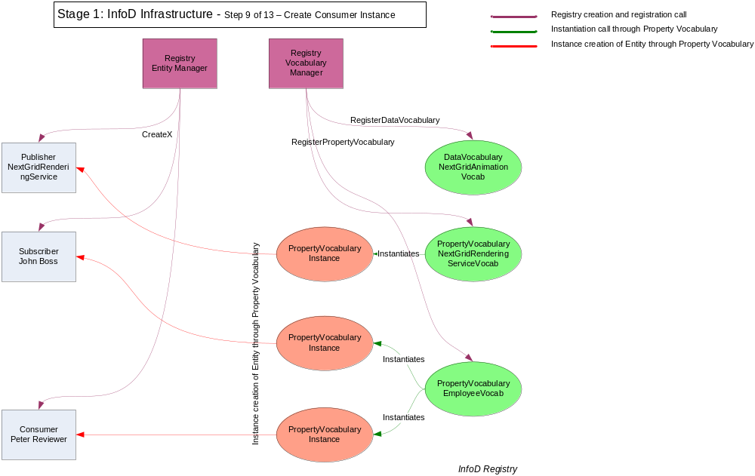

Slide 27
Create Subscription
Subscription Entity INFOD Component | Values
wsinfod:Type | Subscription
wsinfod:Name | Reviewer Monitoring Jobs Subscription.
wsinfod:Description | Reviewer monitoring for animation jobs being completed
wsinfod:Data_Constraint | Rendering_Jobs_Inventory: SHOW (Rendering_Job_Name, Designer_Name, Animation_EPR) FOR Project_Name = Toy Story 3, Job_Status = Completed
wsinfod:Property_Constraints | wsinfod:EntityEPR = PeterReviewerEPR
wsinfod:Schedule | None
wsinfod:Policies | None
wsinfod:Processing | None

Slide 28
Create Subscription - message
<wsinfod:CreateSubscription>
  <wsinfod:SubscriptionName> Reviewer Monitoring Jobs Subscription
  </wsinfod:SubscriptionName>
  <wsinfod:SubscriptionDescription> Reviewer monitoring for animation jobs being completed
  </wsinfod:SubscriptionDescription>
  <wsinfod:SubscriptionSubscriberIdentifier> JohnBossEPR </wsinfod:SubscriptionSubscriberIdentifier>
  <wsinfod:SubscriptionDataConstraints> AnimationDataVocabEPR.Job_Status = “Completed”, AnimationDataVocabEPR.Project_Name = “Toy Story 3”
  </wsinfod:SubscriptionDataConstraints>
  <wsinfod:SubscriptionPropertyConstraints>
  wsinfod:EntityEPR = PeterReviewerEPR
  </wsinfod:SubscriptionPropertyConstraints>
</wsinfod:CreateSubscription>

Slide 29
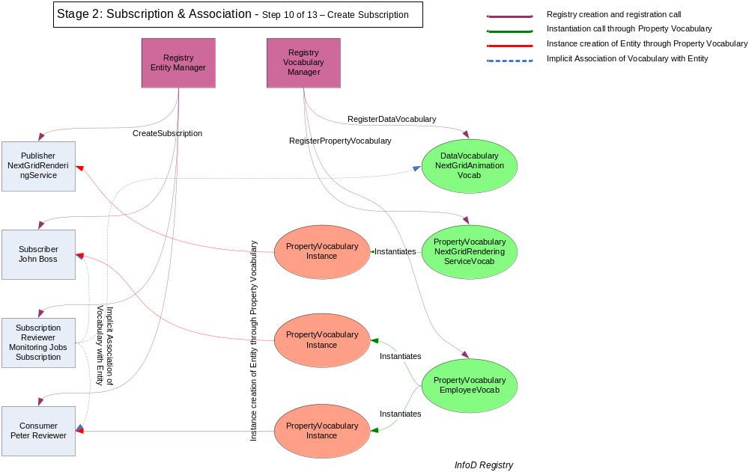

Slide 30
Create Associations with Data Vocabulary
Boss creates association
<wsinfod:AssociateVocabulary>
<wsinfod:AssociateVocabularyName> PublisherAndDataVocabAssoc </wsinfod:AssociateVocabularyName>
<wsinfod:AssociateVocabularyEntityIdentifier> NextGridRenderingServiceEPR1 </wsinfod:AssociateVocabularyEntityIdentifier> <wsinfod:AssociateVocabularyVocabularyIdentifier> NextGridAnimationDataVocabEPR </wsinfod:AssociateVocabularyVocabularyIdentifier>
</wsinfod:AssociateVocabulary>

Slide 31
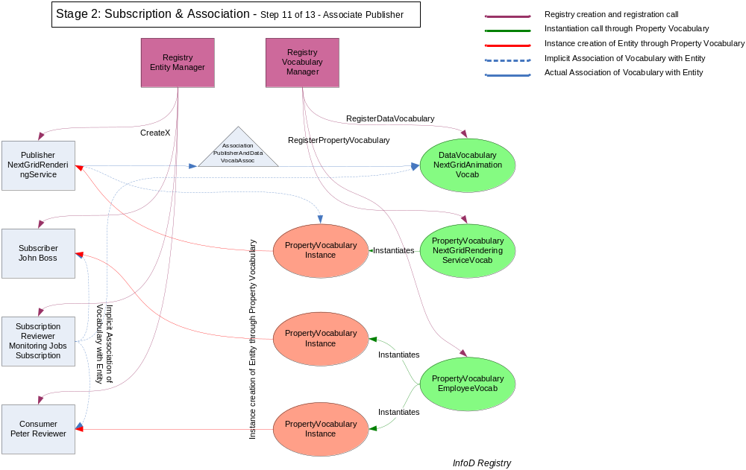

Slide 32
Get details of subscriptions and consumers
The Rendering Service gets details of any new animation job subscriptions and consumers from the INFOD Registry.
listSubscriptions (NextGridRenderingService1, …)
returns: ReviewerMonitoringSubscriptionEPR
(Note: This subscription contains a reference to PeterReviewerEPR).
listConsumers (PeterReviewerEPR, …)
returns: Peter Reviewer’s actual address/EPR

Slide 33
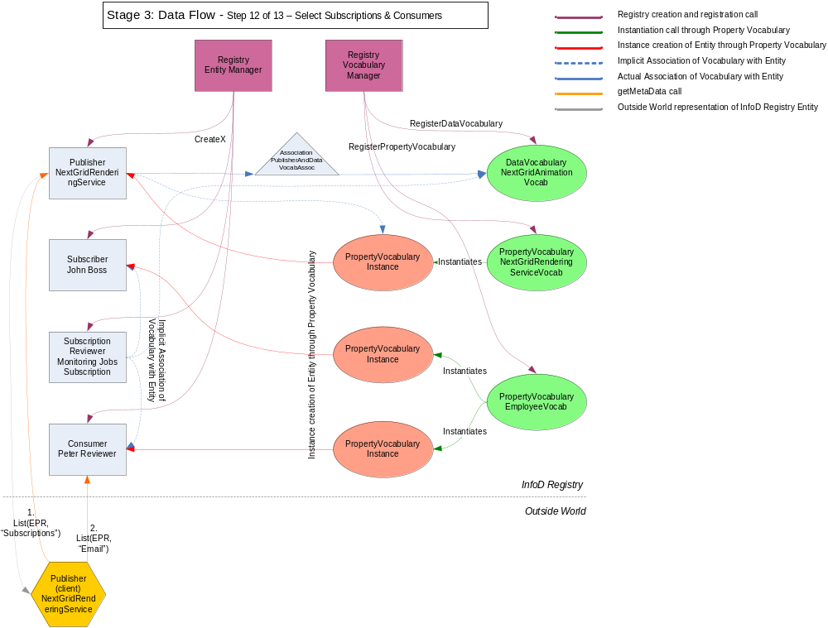

Slide 34
Publisher sends data to consumers
Rendering Service sends data to relevant consumer when animation jobs are completed.
  XML Schema for Message Body to Consumer
<element name=”Body” type=”infoDMsg:BodyType”/>
<complexType name=”infoDMsg:BodyType”>
<sequence>
<element name=”Type” type=”string”/>
<element name=”Length” type=”integer”/>
<element name=”Data” type=”extensionType”/>
E.g. “JobName=AnimationJobID12345
DesignerName=Fred Designer
Status=Completed”
<element name=”Flag” type=”integer”/>
<element name=”Transform” type=”string”/>
</sequence>
</complexType>

Slide 35
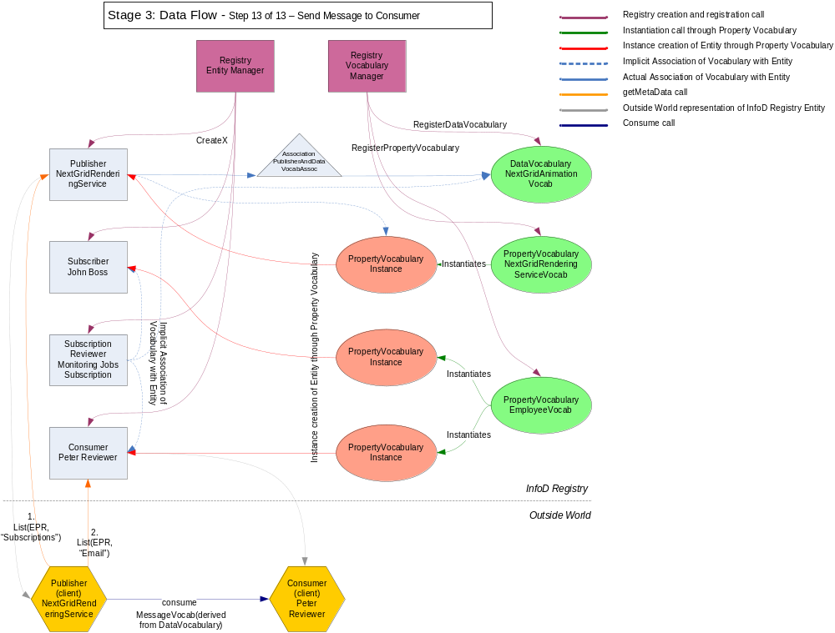

Slide 36
Questions?

Slide 37
Additional Subscription
Subscription for a Designer who wants to be informed when any of their jobs are completed. I.e. Consumers (employee) name matches job designers name.
Subscription Entity INFOD Component | Values
wsinfod:Type | Subscription
wsinfod:Name | Designer Monitoring Jobs Subscription.
wsinfod:Description | Designer monitoring for animation jobs being completed
wsinfod:Data_Constraint | Rendering_Jobs_Inventory: SHOW (Rendering_Job_Name, Animation_EPR) FOR Project_Name = Toy Story 3, Job_Status = Completed
wsinfod:Property_Constraints | EmployeeVocabEPR.Employee_Name=AnimationDataVocabEPR.Designer_Name

Slide 38


