Slide 1
INFOD Pattern and Use Cases
Dieter Gawlick, Oracle
03-06 October, 2005 (GGF15 in Boston)

Slide 2
GGF Intellectual Property Policy
All statements related to the activities of the GGF and addressed to the GGF are subject to all provisions of Appendix B of GFD-C.1, which grants to the GGF and its participants certain licenses and rights in such statements. Such statements include verbal statements in GGF meetings, as well as written and electronic communications made at any time or place, which are addressed to any GGF working group or portion thereof,
Where the GFSG knows of rights, or claimed rights, the GGF secretariat shall attempt to obtain from the claimant of such rights, a written assurance that upon approval by the GFSG of the relevant GGF document(s), any party will be able to obtain the right to implement, use and distribute the technology or works when implementing, using or distributing technology based upon the specific specification(s) under openly specified, reasonable, non-discriminatory terms. The working group or research group proposing the use of the technology with respect to which the proprietary rights are claimed may assist the GGF secretariat in this effort. The results of this procedure shall not affect advancement of document, except that the GFSG may defer approval where a delay may facilitate the obtaining of such assurances. The results will, however, be recorded by the GGF Secretariat, and made available. The GFSG may also direct that a summary of the results be included in any GFD published containing the specification.

Slide 3
Agenda
Patterns
  Base Pattern
  POBoxes
  Single Disseminator
  Multiple Disseminator
Use Case
  Car dealer/buyer community
  Registry entries
  Subscriptions
  Matching dealers and buyers
  More cases to come

Slide 4
The Start
Publisher
Consumer
Publication
WS message delivery is the start

Slide 5
INFO Base Pattern
Registry
Consumer
Consumer
Filtering
Publisher
Consumer
Publication
* Registry allows identification of relevant consumers
* Consumers can be described with community vocabulary

Slide 6
INFO Base Pattern
Registry
Publishers
Publisher
Filtering
Publisher
Consumer
Publication
* Registry allows verification of relevant publishers
* Publishers can be described with community vocabulary

Slide 7
INFO Base Pattern
Registry
Data Vocabulary
Data
Vocabularies
Data
Vocabularies
Publisher
Consumer
Publication
* Registry ensures use of shared vocabularies

Slide 8
INFO Base Pattern
Registry
Vocabularies
Publisher
Consumer
Subscriptions
Vocabulary Associations
Subscription
Operation
Subscriptions
Publisher
Consumer
Publications
* Subscription managed by registry
Subscription based publication
Requires sophisticated publishers consumers

Slide 9
POBoxes
Registry
Vocabularies
Publishers
Consumers
Subscriptions
Associations
Subscription
Operation
Subscriptions
Constraint
Verification
Subscriptions
Publisher
Publication
POBox
GetData
Consumer
* Significant part of the logic is outsourced
* From publishers and consumer to POBoxes

Slide 10
POBoxes
Registry
Vocabularies
Publishers
Consumers
Subscriptions
Associations
Constraint
Verification
Publisher
POBox
Consumer
Publication
GetData
* There are no Subscription
* This is classical Messaging

Slide 11
Single Disseminator
Registry
Vocabularies
Publishers
Consumers
Subscriptions
Associations
Subscription
Operation
Subscriptions
Constraint
Verification
Subscriptions
Publisher
Disseminator
Consumer
Publication
Publication
* Significant part of the logic is outsourced
* From publishers and consumer to Disseminators

Slide 12
Multiple Disseminators
Registry
Vocabularies
Publishers
Consumers
Subscriptions
Associations
Subscription
Operation
Subscriptions
Constraint
Verification
Subscriptions
Publisher
Disseminator
Publication
* A publishers/consumers can work
(and trust) their local disseminators.
* Significant parts of the dissemination
are handled by the disseminators
Propagation
Disseminator
Publication
Consumer

Slide 13
Agenda
Patterns
  Base Pattern
  POBoxes
  Single Disseminator
  Multiple Disseminator
Use Case
  Car dealer/buyer community
  Registry entries
  Subscriptions
  Matching dealers and buyers
  Additional use cases

Slide 14
Car Use Case
Keep up-to-date with the inventory of cars, which are of interest to me and are from dealers who are
  Not too far away
  Have been in business for some time
  Have a good BBB rating
  Have a good service rating
Keep in mind
  The buyer should determine what information is of interest
  An initial state as well as changes should be available
  Explicitly knowledge of the names of the dealers who qualify at any point in time should not be required
  Not only the inventory is changing
    Dealers may come and go
    The properties of dealers may change

Slide 15
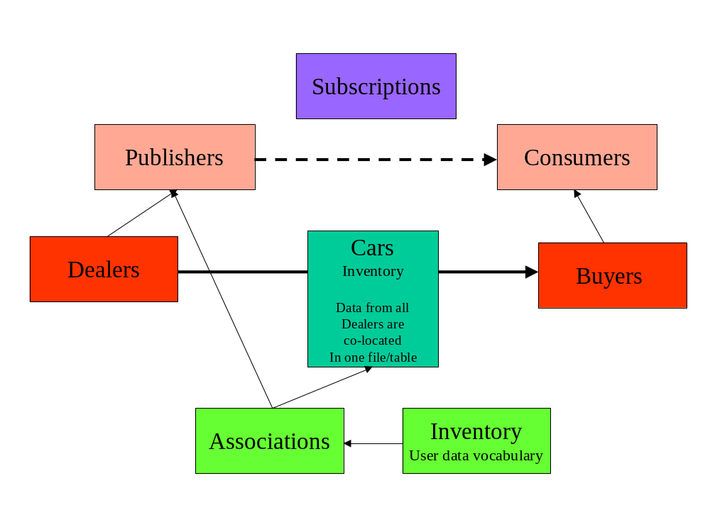
Car Use Case

Slide 16
Publisher - Car Dealer
Column Name | Values
INFOD_Identifier | CA_FF
INFOD_Name | Frontier Ford
INFOD_Description | Oldest Ford Dealer in SFO Bay Area
INFOD_UserPropVocab | CarDealer
INFOD_UserProps | <CarDealer BBBRating=“5” YOS=“15” Location=“37,74” />
INFOD_PropConstraint_S | 1 = 1
INFOD_PropConstraint_C | INFOD_UserPropVocab = ‘CarBuyer’ and EXTRACT (INFOD_UserProps, ‘/CarBuyer[CreditRating > 4 and infod:SpatialWID(Location, Point(37,74),30) = 1]’) is not null
.. | ..

Slide 17
Car Dealer
Column Name | Values
Reference | EPR of publisher, this binds an dealer property entry to a publisher entry
Name | Name
Location | Address
Phone | Phone number
E-mail | E-mail address
Web-site | URL
Open_for | Years in business
BBB_rating | A number between 1 and 5
Service_Rating | A number between 1 and 12
This is the description of a dealer using the dealer vocabulary,
which is previously registered

Slide 18
Consumer - Car Buyer
Column Name | Values
INFOD_Identifier | SMC
INFOD_Name | Susan Maria Callas
INFOD_Description | Car Buyer
INFOD_UserPropVocab | CarBuyer
INFOD_UserProps | <CarBuyer CreditRating=“5” Location=“36.99,73.85”/>
INFOD_PropConstraint_S | 1 = 1
INFOD_PropConstraint_P | INFOD_UserPropVocab = ‘CarDealer’ and EXTRACT(INFOD_UserProp, ‘/CarBuyer[YOS > 10 and BBBRating > 3]’) is not null
..

Slide 19
Car Buyer
Column Name | Values
Reference | EPR of consumer, this binds a buyer property entry to a consumer entry
Name | Name
Location | Address
Phone | Phone number
E-mail | An e-mail address
Credit_Rating | A number between 1 and 5
Interest | Optional expression describing interest of the buyer; could be used instead of subscriptions
This is the description of a buyer using the buyer vocabulary,
which is previously registered

Slide 20
Subscriptions – From Buyer
Column Name | Values
INFOD_Identifier | CarFinder
INFOD_Name | Find a Car
INFOD_Description | Watch for Car Offers
INFOD_UserPropVocab | CarSubsciption
INFOD_UserProps | <CarSubscription/>
INFOD_Data_Vocab | Car
INFOD_Data_Constraint | EXTRACT (Message, ‘//[Make = “FORD” and Type = “SUV” and Price < 20000]’) is not null
INFOD_PropConstraint_P | INFOD_UserPropVocab = ‘CarDealer’ and EXTRACT(INFOD_UserProp, ‘/CarDealer[infod:SpatialWID(Location, Point(36.99,73.85),5) = 1]’) is not null
INFOD_PropConstraint_C | INFOD_Identifier = ‘SMC’
.. | ..

Slide 21
The Car Data
Column Name | Values
INFOD_Type
INFOD_Name
INFOD_Description
INFOD_Entity | Technically the EPR of the publisher Frontier Ford
INFOD_Associate | Technically the EPR of the Inventory vocabulary
INFOD_Property_Constraint
INFOD_Policies
INFOD_Data_Source | A view of the cars table shared by all dealers
.. | ..
Properties could be used to restrict information
To a group of consumers

Slide 22
Additional Use Cases
Editing of digital audio/video
Network monitoring
SensorNet
DAIS 3rd party delivery

