Slide 1

INFOD for Wide-Area Sensor Networks
OGF21, Seattle, WA, USA
shankarm@ornl.gov

Slide 2

Overview
Wide-area sensor networks context
Typical paradigms of communication
Mapping a use-case to INFOD
  Processing alerts (and events) with INFOD
Potential gaps/mismatches to address in implementation and evaluation

Slide 3
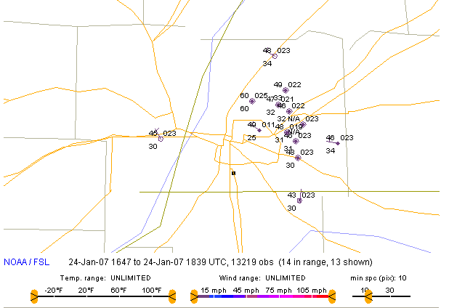
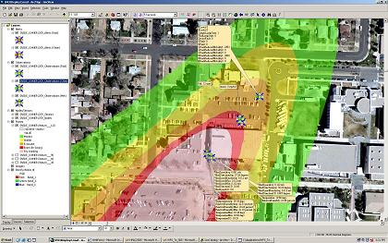
Application Scenario: County Fusion Centers
HPAC with Live Weather Feeds
Plotting of Data, Display Video Feeds
GIS Situational Awareness
(ArcView or Google Earth, Browsers, …)
1
County Sheriff SensorNet Mobile System
3
NOAA Live Regional Weather
4
HTTPS: XML-RPC, SOAP
INFO-D
8 chem/5 rad/5 video /1 weather sensors
WFS, OLS,…
Filter Agents
Publisher
Access control
Replicated storage, image, video server
Distributed Wide-Area Middleware
  Prototype and Analysis
  Distributed querying and top-down programming
  Policy-based data-sharing
  Asynchronous messaging
Subscriber
Fusion Center Portal and Viewer (Web Server; Database; GIS (Google); HPAC plume modeling)
UT
ORNL
Industry
2
Fielded Sensors
Application info
Emergency updates
Responder data
5 chem/ 1 weather sensors
Publisher

Slide 4
Paradigms of Communication
Known Destinations (or Endpoints)
  Point-to-Point (e.g., email)
  Point-to-Multipoint (e.g., lists)
  Subscribe for information and notify on availability (e.g., Priceline; OASIS WSN)
“Sharing” – crucial for local, regional, federal; unknown recipients
  Web-page; Bulletin Board
  Chat-rooms (e.g., AOL/Yahoo/Google Chat); Topic based (e.g., Battelle DMIS)
  Subscription from data provider (not known a priori) - INFOD

Slide 5

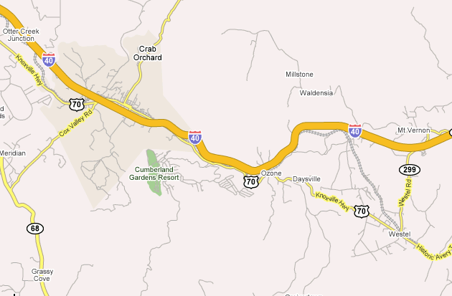










Alerting Scenario Components
Publisher of Alerts
Consumer
Consumer
Consumer
Consumer
ABC Chemicals
Consumer
Weather Sensor
Police/ First Responders
Subscriber, defines subscription based on client necessities.
Weather (Poll/Pub)
Consumer
Service Providers
Hospital
Consumer
Consumer
County Office/E911/ Models
Consumer
Fire Station
Consumer of alerts and weather information. Also, Publisher. Identifies modes for consumers to be alerted based on different levels of toxicity
Fire Station
Notes:
County office may have multiple offices in there..
multiple organizations
e911 is separate, county civil support teams are different.. want a way to create communities of interest

Slide 6
SensorNet Data Dissemination
SensorNet Prototypes and Projects
  Data-flow from edge to hierarchical datacenters – accessed by application queries (SensorNet Node/ WFS/ ArcGIS/ Browsers/ Google Earth)
  Alerting based on publish-subscribe using SAS/XMPP
Deployment Scenario Examples:
    Weigh Station Monitors; Port of Entry Monitors
    Area Situational Awareness and Threat detection

Slide 7
Sample Use Case: Actors and the Message Flows
Publisher
Publisher
APD 2000
Chemical Sensors
Coordination/Meta-Data:
A Registry
Weather Station
Consumer
First Responder 1
Alerting System
Consumer
Plume Analysis
First Responder 2
Subscriber/Consumer/Publisher
Consumer
First Responder 3
E911 Center
Subscriber
Message Exchange
Information Exchange

Slide 8
Abstracting the Components in an Alerting Scenario
Registration and Notification of Consumer Presence
Data-Center
Node
INFO-D Registry
Node or Local Data-Hub
Applications
Node
Other entities may similarly subscribe and publish
Sensors produce data and consume data from Node
Subscription
Applications
Applications
Applications
Publish-Subscribe Example Context: Flow of Data
…
Registry matches sensor data publishers and application subscribers (and consumers)

Slide 9
Event Results to be Communicated from Sources to Sinks
Publish-Subscribe paradigm works well here.
Subscriptions can equate to “first class objects” capturing state-changes
  Independent engine can inject subscriptions (i.e., independent entity can make decisions for the system dynamically)
  Meta-data (properties, subscriptions, etc.) stated in extensible vocabularies enable formation of communities of interest
Publish from source based on a subscription
  Typically infer and create plumbing for the main connections
  Create dynamic filtering mechanism for the actual data
  Filtering and event correlations are often on trees that are one-level deep. More complex trees/graphs could be broken down into constituents.
..
Notes:
need to generically match interested parties with providers of information.
Could use WSN and such a content based subscription, but discovering the information is a big challenge.
Put a subscription in the mill and create pipelines from origins to end-points.

Slide 10
Traditional System Behavior
Centralized Model
Query to Data Center
Consumer + Subscriber
Data Center
Distributed/Federated Queries
Publisher/Node/ Computation/ Processing
Event Stream: X
Event Stream: Y
Event Stream: Z
Software/ Hardware Source
Temporary or Local Archival Storage
Typical Request: if ((X and Y) or (X and !Z)) => InterestingEvent
Notes:
Can do above in the following two ways:
Centralize data at Data Center
Or by compiling above query into a “Distributed Query”, and reassembling returned results, and doing joins and logical operations, before returning a result

Slide 11
INFOD Entities Behavior
Distributed Model
Originator and Sink
Interest: Query or Lookup
Publisher/Node/ Computation/ Processing
Compile + Mapping
Event Stream: X
Event Stream: Y
Event Stream: Z
Temporary or Local Archival Storage
Software/ Hardware Source

Slide 12
INFOD Features Desirable for Wide-Area Sensor Networks
Publishers and Subscribers can be unaware of each other but instead meet as a generalized vocabulary-based community of interest
Both subscription and publication information is explicitly described
  Generic Vocabulary Implementation
  Extensible structure
Matching performed with “expressions”
Data-constraints allow filtering of publisher’s content

Slide 13
Evaluation Dimensions: Applicability of INFOD
Expressive power of subscriptions
Flexibility for dynamic behaviors
Vocabulary management
Security
Performance
…others?

Slide 14
Gap Analysis: Questions to Address
Many producers submit data to one publisher
  Support for internal and external EPR
  Data-sources match well with producers (not necessarily?)
  Extended specification addresses this?
Vocabulary management concern
  What if two groups have similar but different vocabularies
What is the performance of the matching step? What are the scaling limitations?
  If matches are limited to vocabulary sets, this may be easily parallelizable
Use-case exposes subscription requirements
  Query flexibility (on data and on properties that are dynamic) – example solutions have been proposed so far
…bring discussion examples to OGF…

Slide 15
Summary

