Slide 1
ACS-WG
Installable Unit Deployment Descriptor
GGF13 , March 14, 2005
Thomas Studwell
studwell@us.ibm.com
IBM Autonomic Computing
http://forge.gridforum.org/projects/acs-wg/

Slide 2
Intellectual Property Policy
I acknowledge that participation in GGF13 is subject to the GGF Intellectual Property Policy.
Intellectual Property Notices Note Well: All statements related to the activities of the GGF and addressed to the GGF are subject to all provisions of Section 17 of GFD-C.1 (.pdf), which grants to the GGF and its participants certain licenses and rights in such statements. Such statements include verbal statements in GGF meetings, as well as written and electronic communications made at any time or place, which are addressed to: the GGF plenary session,
any GGF working group or portion thereof,
the GFSG, or any member thereof on behalf of the GFSG,
the GFAC, or any member thereof on behalf of the GFAC,
any GGF mailing list, including any working group or research group list, or any other list functioning under GGF auspices,
the GFD Editor or the GWD process
Statements made outside of a GGF meeting, mailing list or other function, that are clearly not intended to be input to an GGF activity, group or function, are not subject to these provisions.
Excerpt from Section 17 of GFD-C.1 Where the GFSG knows of rights, or claimed rights, the GGF secretariat shall attempt to obtain from the claimant of such rights, a written assurance that upon approval by the GFSG of the relevant GGF document(s), any party will be able to obtain the right to implement, use and distribute the technology or works when implementing, using or distributing technology based upon the specific specification(s) under openly specified, reasonable, non-discriminatory terms. The working group or research group proposing the use of the technology with respect to which the proprietary rights are claimed may assist the GGF secretariat in this effort. The results of this procedure shall not affect advancement of document, except that the GFSG may defer approval where a delay may facilitate the obtaining of such assurances. The results will, however, be recorded by the GGF Secretariat, and made available. The GFSG may also direct that a summary of the results be included in any GFD published containing the specification.
GGF Intellectual Property Policies are adapted from the IETF Intellectual Property Policies that support the Internet Standards Process.

Slide 3
Overview
The Problem Space
Principles
The Installable Unit Deployment Descriptor Relationship to ACS
IUDD, what it is and what it isn’t…
IUDD concepts, structure and capabilities
Questions
Summary
Notes:
(CLICK) If we take a closer look at the structure of OGSA itself we discover that it is really made up of two different types of components. The lower box called OGSI is really an set of fundamental extensions to web services designed to meet some specific requirements of Grid and OnDemand computing. The upper layer called OGSA Architected Services, are implementations of specific services designed to manage grid components, deliver common functions that support all other grid services and provide environments for managing data and program execution in the grid.
Given that resources are the foundation of Grid computing and that they are comprised of diverse and heterogeneous entities, an important design goal of OGSA was to provide a consistent and uniform way for Grid protocols and services to interact with Grid resources. OGSI, the Open Grid Services Infrastructure, specifies a standard interface for all Grid resources whether they are physical or logical and it is built on top of standard Web services technologies such as WSDL, WSIL, and XML. Web services, in a sense, serve as a substrate for OGSI and OGSA in general. Web services, together with OGSI comprise the second main layer of the OGSA architecture view in Figure 1.
Web services and OGSI together provide a base infrastructure for higher level Grid services to be created. As Grid services continue to be specified and implemented, they will likely include a broad range of functionality (example). These services are referred to as OGSA architected services in Figure 1 and refer to any Grid service built on an OGSI foundation. They comprise the third main layer of the OGSA architecture and the specification of these services is a focal area for the GGF working groups. As OGSA architected services begin to appear, OGSA will become a more useful service oriented architecture (SOA).
Now that we have begun to see implementations of OGSI, Grid service providers can begin to construct Grid architected services. For instance, Platform Computing recently introduced the Community Scheduling Framework (CSF) specification at GGF 8 in Seattle. Over time, as a rich set of Grid architected services continue to be developed, new Grid applications which utilize one or more Grid architected services will appear. These applications comprise the fourth main layer of the OGSA architecture.

Slide 4
Problem Space
Installation and configuration complexities must not become an impediment to adoption of grid technologies
Installation and configuration needs are fundamental – little is unique to grid
Grid, by definition, requires automation
  Static configurations, tolerated in data center, can not be tolerated in grid
  Standardized deployment descriptors increase reliability
What standards can provide a foundation?
Notes:
(CLICK) If we take a closer look at the structure of OGSA itself we discover that it is really made up of two different types of components. The lower box called OGSI is really an set of fundamental extensions to web services designed to meet some specific requirements of Grid and OnDemand computing. The upper layer called OGSA Architected Services, are implementations of specific services designed to manage grid components, deliver common functions that support all other grid services and provide environments for managing data and program execution in the grid.
Given that resources are the foundation of Grid computing and that they are comprised of diverse and heterogeneous entities, an important design goal of OGSA was to provide a consistent and uniform way for Grid protocols and services to interact with Grid resources. OGSI, the Open Grid Services Infrastructure, specifies a standard interface for all Grid resources whether they are physical or logical and it is built on top of standard Web services technologies such as WSDL, WSIL, and XML. Web services, in a sense, serve as a substrate for OGSI and OGSA in general. Web services, together with OGSI comprise the second main layer of the OGSA architecture view in Figure 1.
Web services and OGSI together provide a base infrastructure for higher level Grid services to be created. As Grid services continue to be specified and implemented, they will likely include a broad range of functionality (example). These services are referred to as OGSA architected services in Figure 1 and refer to any Grid service built on an OGSI foundation. They comprise the third main layer of the OGSA architecture and the specification of these services is a focal area for the GGF working groups. As OGSA architected services begin to appear, OGSA will become a more useful service oriented architecture (SOA).
Now that we have begun to see implementations of OGSI, Grid service providers can begin to construct Grid architected services. For instance, Platform Computing recently introduced the Community Scheduling Framework (CSF) specification at GGF 8 in Seattle. Over time, as a rich set of Grid architected services continue to be developed, new Grid applications which utilize one or more Grid architected services will appear. These applications comprise the fourth main layer of the OGSA architecture.

Slide 5
Principles
For more complete autonomic functionality, the installation of OS and grid container must be automated and born from the network.
Generic enough to apply to any computing container solution. Grid or otherwise.
Must be able to deal with heterogeneous pools of hardware.
An increasing percentage of software is aggregated as a component within a larger, integrated “solution”. Grid applications are, by definition, an aggregated solution
Customers outages are often caused by their inability to rollout changes to applications because of the complex interdependencies with other application components and products
In order to enable autonomic deployment and configuration management , standardized formats are needed for declaring the structure of a solution and dependencies among its software components
  Grid depends on the ability to dynamically deploy and configure solutions

Slide 6
Installable Unit Deployment Descriptor Relationship to ACS
Application Contents Service defines a repository interface (ARI) and format for contents of the respository (AAF)
While the requirements for a grid application archive are unique to grid, the description of the contents are not
The description must define the application artifacts, dependencies, and deployment mechanisms
Add software life cycle management to the mix and you have the requirements for Installable Unit Deployment Descriptor (IUDD)
Only requirements difference between AAF and IUDD are any wrappers needed for storage within ACS repository.

Slide 7
IUDD – What it is…
IBM, InstallShield (Macrovision), Zero G, and Novell collaborated on a set of specifications to
  “define the schema of an XML document describing the characteristics of an installable unit (IU) of software that are relevant for its deployment, configuration and maintenance. ”
  Published by W3C on July 15, 2004
    http://www.w3.org/Submission/2004/04/
    Announcement: http://xml.coverpages.org/ni2004-07-19-a.html
    Made available to Industry under RF terms
  Publication coincident with announcements calling for formation of a standards workgroup to formalize an Industry standard for IUDD Schema.

Slide 8
IUDD – What it is… (cont.)
Scope
  Atomic installable units as small as mobile devices
  to…
  Enterprise scale applications that include services distributed over a Grid.
    Designed for distributed heterogeneous environments
    See Application Contents Service BoF
Standardization goal
  Have a single Industry standard to describe all aspects of a software solution needed to provide complete lifecycle maintenance.
    IUDD specifications will be IBM’s submission to a formal workgroup.

Slide 9
IUDD – What it isn’t…
Does NOT define the
  Hosting platform information models
    DMTF is responsible for these
      (with input from other orgs like GGF)
  Hosting platform management interfaces
    OASIS WS-Distributed Management defining for WS
      GGF CMM-WG provides Grid specific extensions
  Deployment and Lifecycle Management engines
    Typically proprietary or value-added
      For example, see InstallShield and Zero G announcements
    Open platforms, e.g. GGF, are defined by respective orgs

Slide 10
Installable Unit Deployment Descriptor - Concepts
A solution may encompass inter-dependent Installable Units (IU) deployed across multiple hosting domains
Target hosting domains (Op Systems, J2EE servers, Databases) and other external resources are each represented by a node in the solution topology.
The simplest solution has a single IU targeted at the only topology node.
Example: AcrobatReader targeted to a Windows OS
A topology node needs to be mapped to one or more instances of a resource (e.g. OS).
The mapping is constrained by type and possibly additional selection requirements.
Installable Units declare dependencies (topology targets may also declare dependencies)
Requirements from all IU’s aimed to a given topology target include:
  hosting-environment dependencies (capacity, consumption, properties, relationships, etc)
  software dependencies (pre- co- and ex-requisites)
A solution may define bundled requisites that can be deployed on-demand to satisfy a software dependency
Basic text slide

Slide 11
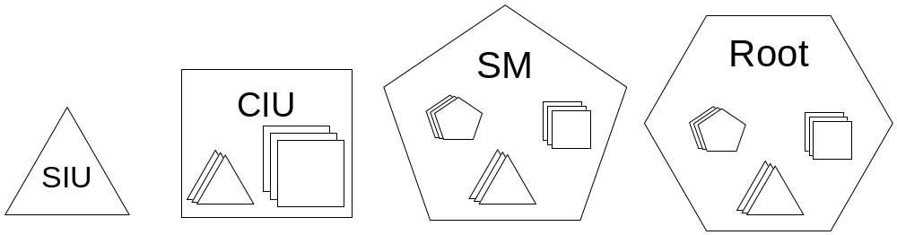
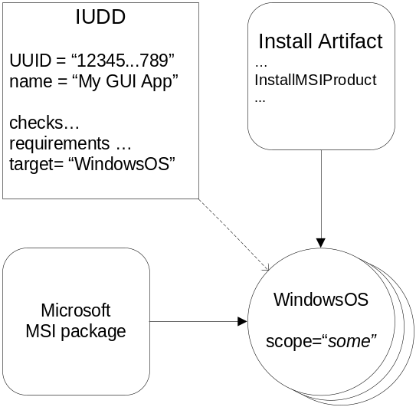
Installable Units
SIU – Smallest Installable Unit
  Leaf node in the aggregation hierarchy
  “Points” to bundled artifacts
CIU – Container Installable Unit
  Aggregate aimed at a single logical target (target may resolve to multiple instances)
SM – Solution Module
  Aggregated IUs may span multiple logical targets
Root
  Root of the hierarchy
  Unit of packaging

Slide 12
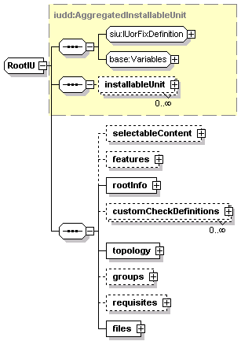
IUDD – Root IU
Root IU is the Unit of packaging
  It is an Installable Unit
    Base, Update or Fix
  May include any other IU aggregate
Base and selectable content
Topology
  Target definitions
Info
  Build #
  Manufacturer
  Size
Features and Groups
  Features select optional content
  Groups are pre-defined sets of features
Bundled requisites
Files (included in the package)
  Files referenced from within the IUDD
    Artifacts
    Other bundled root IU packages (IUDD)
  Files referenced from within artifacts

Slide 13
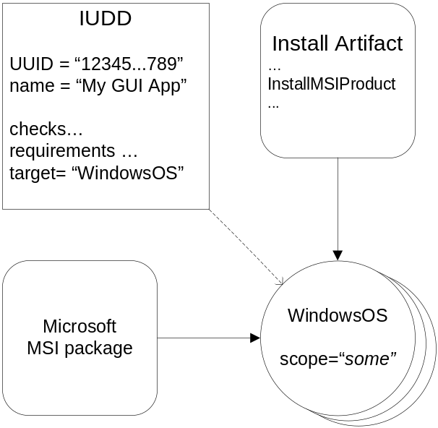
Targeting, artifacts, bundled files
SIU (Smallest installable Unit)
  Leaf node in the hierarchy
  Targeted to a hosting environment target (WindowsOS)
  Identity, and dependencies
  Deployable content (artifacts)
  An aggregate IU (CIU,SM, root) does not have deployable content of its own.
Install Artifact
  Defines actions to be executed on the HE (InstallMSIProduct)
  Referenced in the SIU definition as an external file
  Artifact schema is HE specific
  Actions in an artifact may reference bundled files (the MSI package in the example)

Slide 14
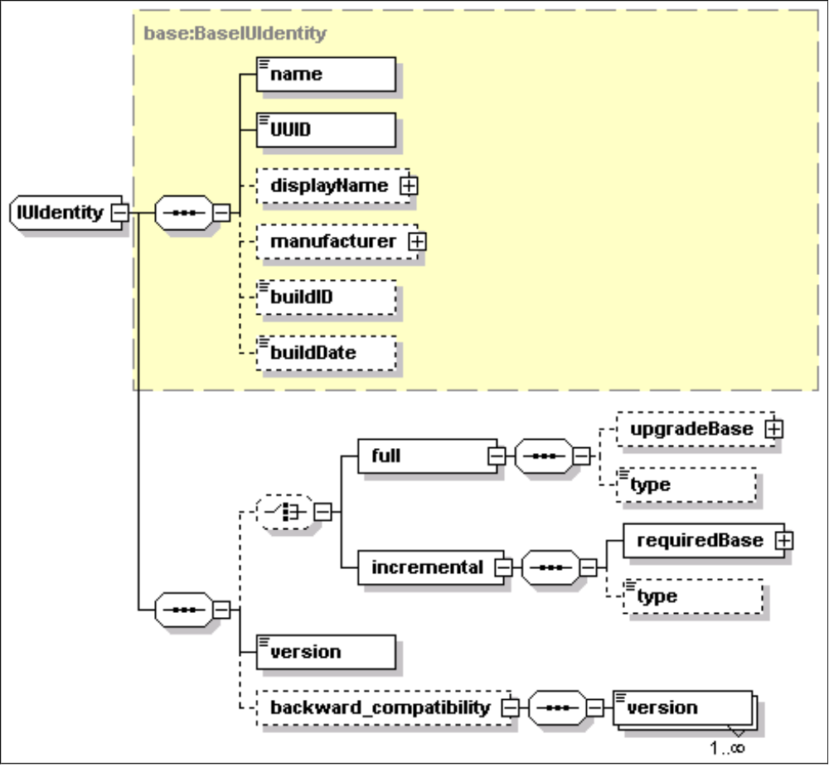
IU Identity
IU Identity
  name
  Universally Unique Identifier (UUID)
  Company/Manufacturer information
  Build information
Base or Update
  Full vs incremental update
Version
  backward_compatibility
IU type identity elements
  UUID
  Version
Multiple instances allowed

Slide 15
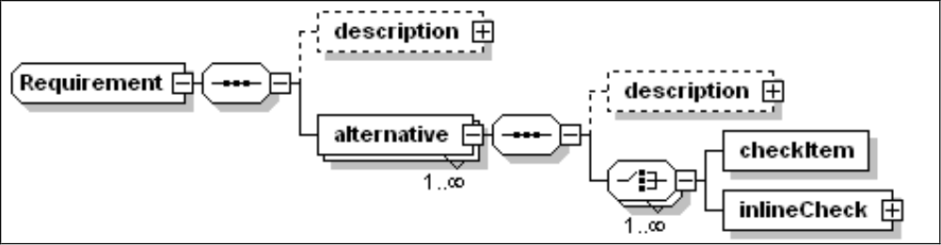
Requirements (expression of a dependency)
A requirement is declared to be met by one or more alternatives (logical “OR”)
  At least one alternative must be satisfied
  Multiple non-exclusive alternatives should indicate a priority
  Example: a requirement could be to have either DB2 or MSSQL installed
  Requirements can be declared in single-target IUs (SIU/CIU) and topology targets
An alternative combines one or more elementary checks (logical “AND”)
  check definition may be elsewhere (normally in the checks section of the IU) or inline
  The boolean result of an alternative is the boolean .AND. of all the referenced or inline checks
  A check can be computed in the alternative with the .NOT. (testValue=“false”)

Slide 16
Checks (testing an environment condition)
Capacity of the hosting environment. This specifies a property of the hosting environment, such as processor speed, and some minimum or maximum value.
Consumption of resources allocated on the hosting environment. This specifies resource, such as diskspace, that will be consumed by the installation. Consumption requirements are cumulative across installable units.
Property check. This compares the value of a named property exposed by the hosting environment against a specified value or pattern.
Version of a target resource. This is used to check the value of a version property against a specified interval.
Software check. This specifies the check of a software resource, identified by name and version range. The resource may not have an associated IU definition.
IU (Istallable Unit) check. This is used to determine if a given IU is installed.
Relationship check. It specifies a relationship that must exist between two topology targets.
Custom checks. These specify the execution of a user defined command.

Slide 17
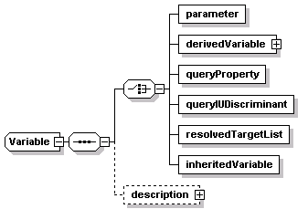
IU Variables
Variables can be defined at any IU level
Variable types
  parameter
    May have default
    Overridable (e.g. via a response file)
  derivedVariable
    Conditioned variable expressions
  queryProperty
    Value from topology target
  queryIUDiscriminant
    IU instance identifier (i.e. install-location)
  resolvedTarget list
    List of target instances for a logical target
  inheritedVariable
    To get the persisted value of a variable from an existing instance being updated

Slide 18
Variable expressions and conditions
Variable Expression
  Symbolic reference to one or more variables
  Example: “$(rootDirectory)/MyProductDirectory”
Boolean variable expressions are used to condition the following
  Installable units within the IUDD
    If “false”, the IU is ignored
    (selection based on environmental condition vs user selection)
  Sets of artifacts associated to a SIU
    E.g. to select the artifact set suitable for a given target instance
  Initialization of a derived variable (multiple conditioned expressions)

Slide 19
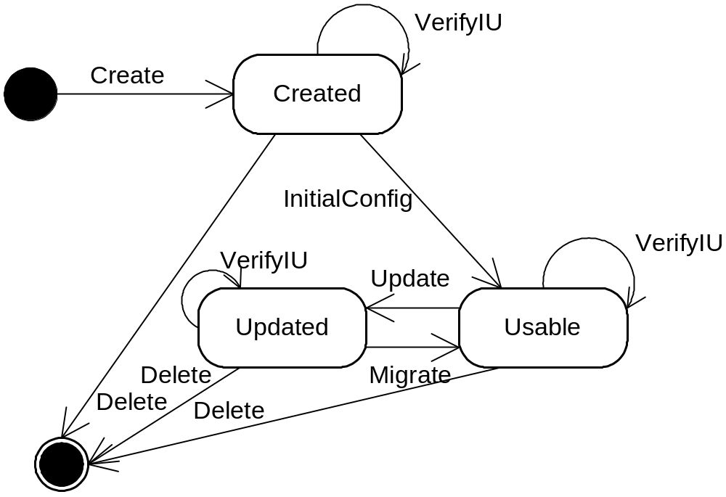
IU life cycle – CM operations and artifacts
Change Management Operations
  Create
  InitialConfig
  Update
  Migrate
  Delete
  VerifyIU
  Undo
IU Artifacts
  Most operations have an asssociated artifact
    Install artifact [for Create & Update]
    InitConfig/Migrate artifacts
    Delete artifact

Slide 20
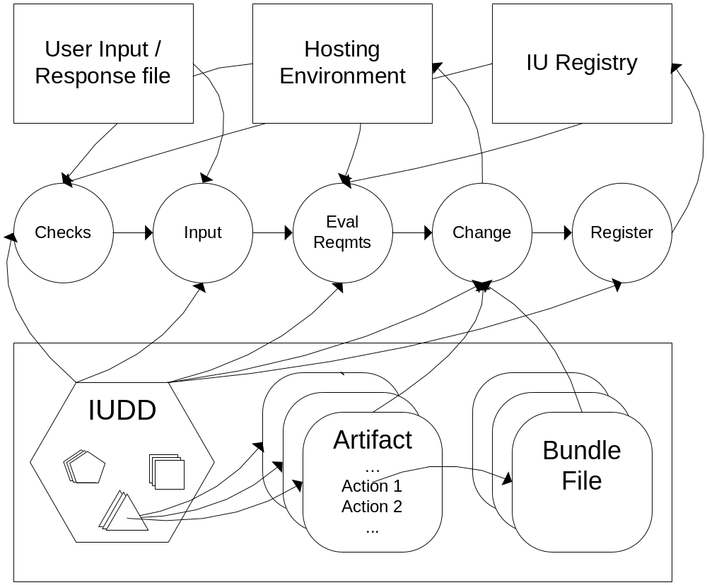
Logical view of the change management process
One or more hosting environments are the targets of the software being installed.
The user provides input, in this process, either interactively or via a response file.
That input drives the activity of a software installer program that interacts with the hosting environments and the IU registry.

Slide 21
Questions
Installable Unit Deployment Descriptor
- ACS-WG -
(acs-wg@ggf.org)

Slide 22
Summary
Requirements for IUDD and AAF are very similar
Leverage a broader standard like IUDD so configuration problem is addressed at many levels of granularity with same data
Candidate standards such IUDD and provisioning implementation efforts such as NaReGI and others provide foundation.
Encourage vendors of install products to participate in ACS-WG.
Notes:
(CLICK) If we take a closer look at the structure of OGSA itself we discover that it is really made up of two different types of components. The lower box called OGSI is really an set of fundamental extensions to web services designed to meet some specific requirements of Grid and OnDemand computing. The upper layer called OGSA Architected Services, are implementations of specific services designed to manage grid components, deliver common functions that support all other grid services and provide environments for managing data and program execution in the grid.
Given that resources are the foundation of Grid computing and that they are comprised of diverse and heterogeneous entities, an important design goal of OGSA was to provide a consistent and uniform way for Grid protocols and services to interact with Grid resources. OGSI, the Open Grid Services Infrastructure, specifies a standard interface for all Grid resources whether they are physical or logical and it is built on top of standard Web services technologies such as WSDL, WSIL, and XML. Web services, in a sense, serve as a substrate for OGSI and OGSA in general. Web services, together with OGSI comprise the second main layer of the OGSA architecture view in Figure 1.
Web services and OGSI together provide a base infrastructure for higher level Grid services to be created. As Grid services continue to be specified and implemented, they will likely include a broad range of functionality (example). These services are referred to as OGSA architected services in Figure 1 and refer to any Grid service built on an OGSI foundation. They comprise the third main layer of the OGSA architecture and the specification of these services is a focal area for the GGF working groups. As OGSA architected services begin to appear, OGSA will become a more useful service oriented architecture (SOA).
Now that we have begun to see implementations of OGSI, Grid service providers can begin to construct Grid architected services. For instance, Platform Computing recently introduced the Community Scheduling Framework (CSF) specification at GGF 8 in Seattle. Over time, as a rich set of Grid architected services continue to be developed, new Grid applications which utilize one or more Grid architected services will appear. These applications comprise the fourth main layer of the OGSA architecture.

